Slide 1


&
by HERBER

Slide 2

SEASONS OF THE YEAR
SPRING

Slide 3



SEASONS OF THE YEAR
SUMMER

Slide 4
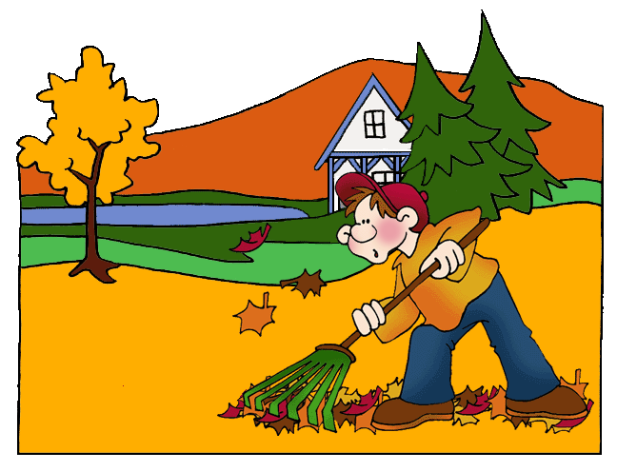
SEASONS OF THE YEAR
AUTUMN

Slide 5
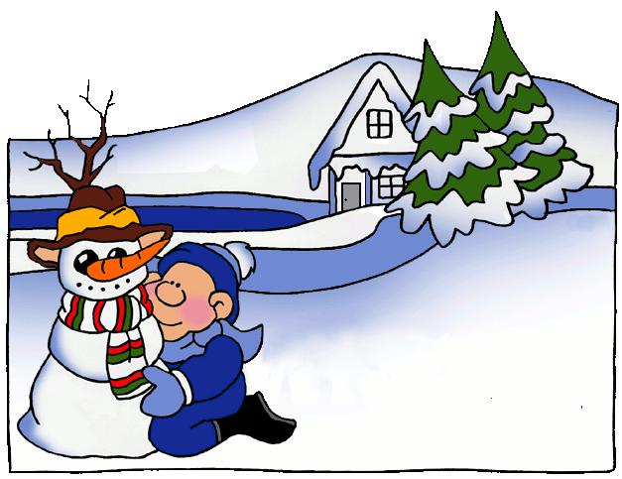
SEASONS OF THE YEAR
WINTER

Slide 6
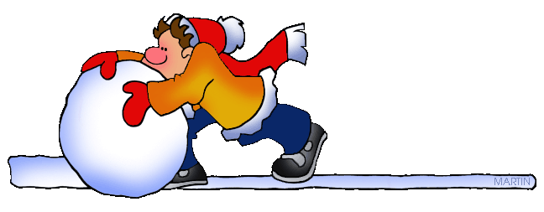
MONTHS OF THE YEAR
1
JANUARY

Slide 7
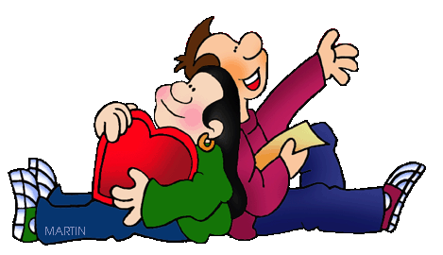
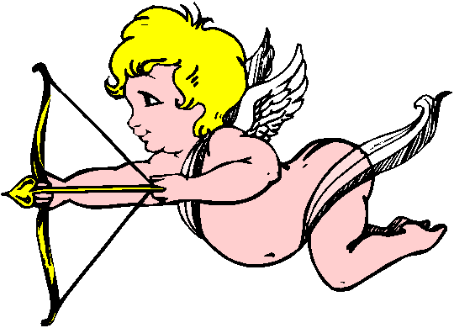
MONTHS OF THE YEAR
2
FEBRUARY

Slide 8
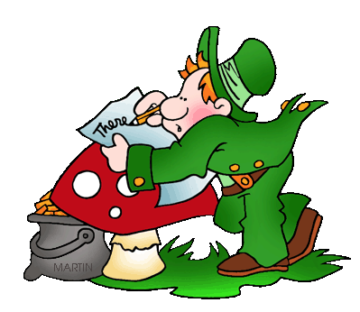
MONTHS OF THE YEAR
3
MARCH

Slide 9

MONTHS OF THE YEAR
4
APRIL

Slide 10
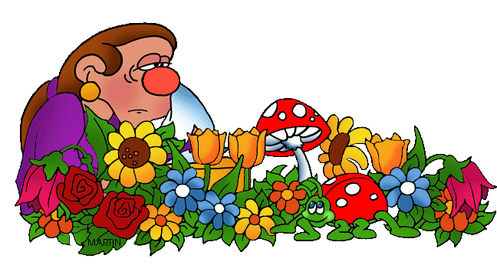
MONTHS OF THE YEAR
5
MAY

Slide 11
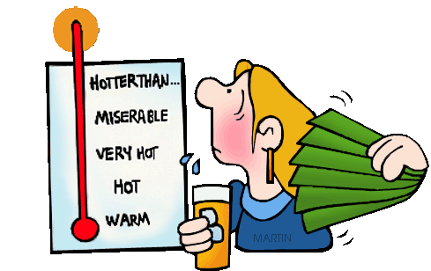
MONTHS OF THE YEAR
6
JUNE

Slide 12

MONTHS OF THE YEAR
7
JULY

Slide 13
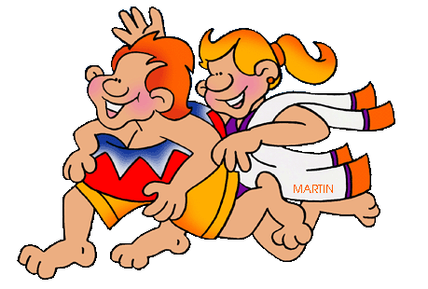
MONTHS OF THE YEAR
8
AUGUST

Slide 14


MONTHS OF THE YEAR
9
SEPTEMBER

Slide 15
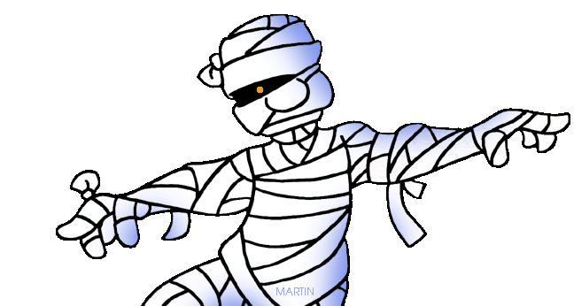
MONTHS OF THE YEAR
10
OCTOBER

Slide 16
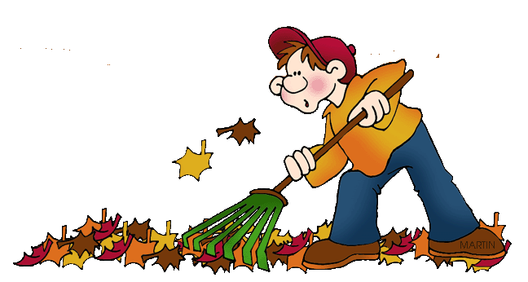
MONTHS OF THE YEAR
11
NOVEMBER

Slide 17

MONTHS OF THE YEAR
12
DECEMBER

Slide 18

RHYME
Thirty days have September,
April, June, and November;
February has twenty-eight alone,
All the rest have thirty-one,
Excepting leap-year, that's the time
When February's days are twenty-nine.

Slide 19
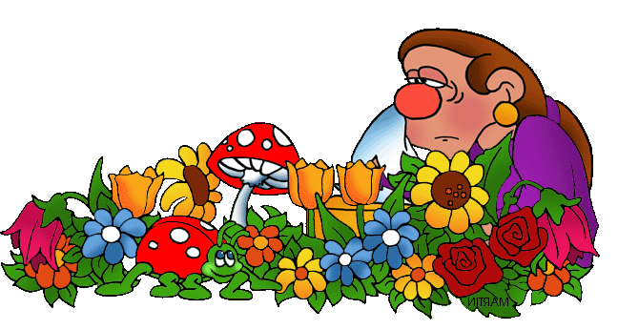
RHYME
March winds and April showers
Bring for May a lot of flowers.

Slide 21
HOROSCOPE
1
22 DECEMBER – 20 JANUARY

Slide 22
HOROSCOPE
2
21 JANUARY – 19 FEBRUARY

Slide 23
HOROSCOPE
3
20 FEBRUARY – 20 MARCH

Slide 24
HOROSCOPE
4
21 MARCH – 20 APRIL

Slide 25
HOROSCOPE
5
21 ABRIL – 21 MAY

Slide 26
HOROSCOPE
6
22 MAY – 21 JUNE

Slide 27
HOROSCOPE
7
22 JUNE – 22 JULY

Slide 28
HOROSCOPE
8
23 JULY – 23 AUGUST

Slide 29
HOROSCOPE
9
24 AUGUST – 23 SEPTEMBER

Slide 30
HOROSCOPE
10
24 SEPTEMBER – 23 OCTOBER

Slide 31
HOROSCOPE
11
24 OCTOBER – 22 NOVEMBER

Slide 32

HOROSCOPE
12
23 NOVEMBER – 21 DECEMBER

