Slide 1
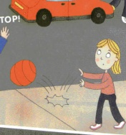
Don’t play next to the traffic.

Slide 2
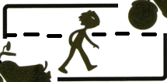
Don’t walk on the road.

Slide 3
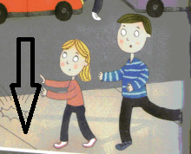
Walk on the pavement.

Slide 4
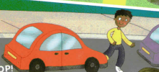
Don’t cross the road
next to the car.

Slide 5
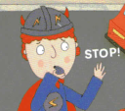
Be safe.

Slide 6
Don’t play next to the traffic.
2. Don’t walk on the road.
3. Walk on the pavement.
4. Don’t cross the road next
to the cars.
5. Be safe.

Slide 7
play / Don’t / traffic/ next to/ the

Slide 8
the / road / walk / Don’t / on

Slide 9
on / pavement / Walk / the

Slide 10
cross / Don’t / road /the / the /cars / next to

Slide 11
safe / Be

Slide 12
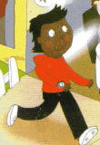
Wear clothes in bright colours.

Slide 13
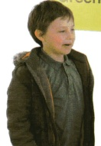
Don’t wear black or brown.

Slide 14
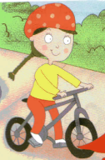
Wear a helmet.

Slide 15
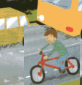
Don’t cycle on busy roads.

Slide 16

Look left and right for traffic.

Slide 17
6. Wear clothes in bright colours.
7. Don’t wear black or brown.
8. Wear a helmet.
9. Don’t cycle on busy roads.
10. Look left and right for traffic.

Slide 18
colours/bright/ Wear/in/clothes

Slide 19
black or brown/wear/ Don’t

Slide 20
helmet / Wear / a

Slide 21
cycle/busy/on/roads/Don’t

Slide 22
for/left and right/traffic/Look.

Slide 23
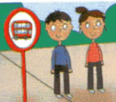
Wait in a safe place.

Slide 24
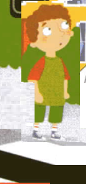
Don’t stand near the road.

Slide 25
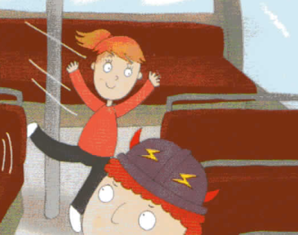
Don’t run on the bus.

Slide 26
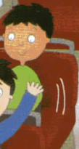
Sit down.

Slide 27
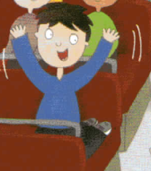
Don’t shout.

Slide 28

11. Wait in a safe place.
12. Don’t stand near the road.
13. Don’t run on the bus.
14. Sit down.
15. Don’t shout.

Slide 29
Wait/ a safe / in /place.

Slide 30
stand /Don’t /the road./ near

Slide 31
on /Don’t/ the bus./ run

Slide 32
down./ Sit

Slide 33
shout./ Don’t

Slide 34
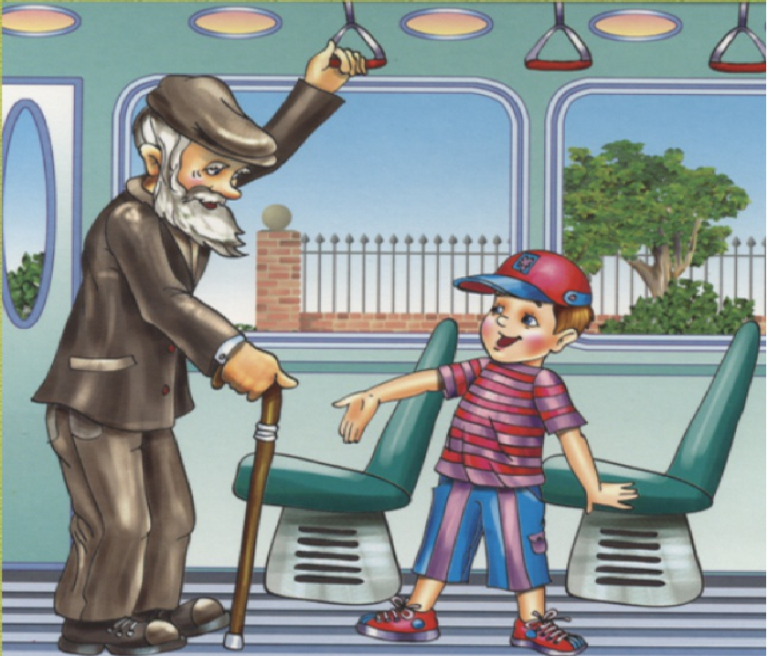
Be polite to the driver and to other people.

Slide 35
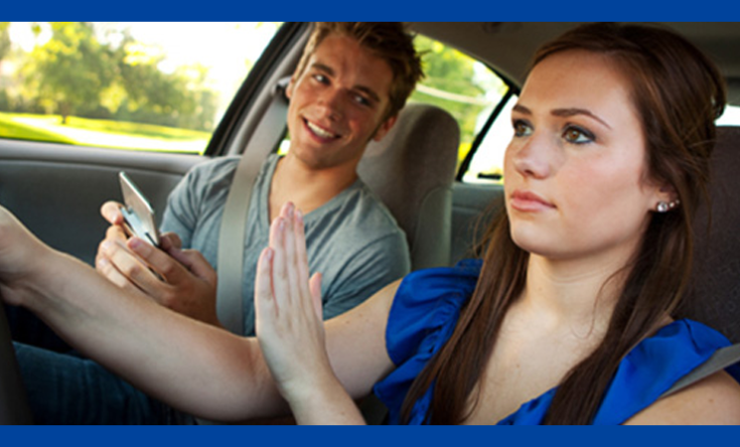
Don’t talk to the driver when he or she is driving.

Slide 36
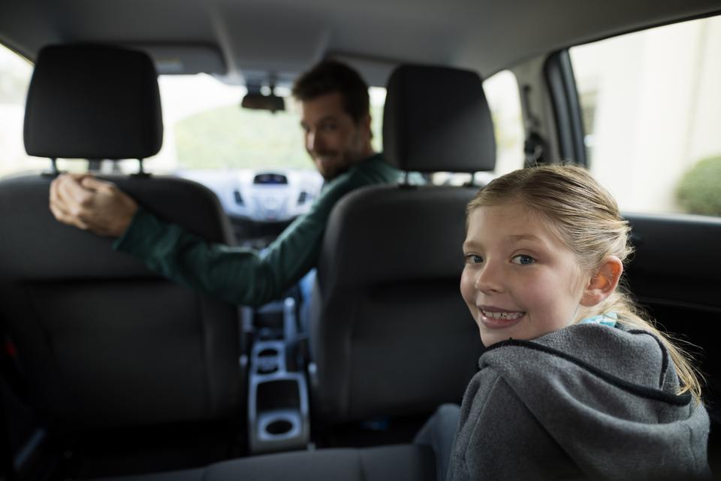
Sit in the back seat

Slide 37
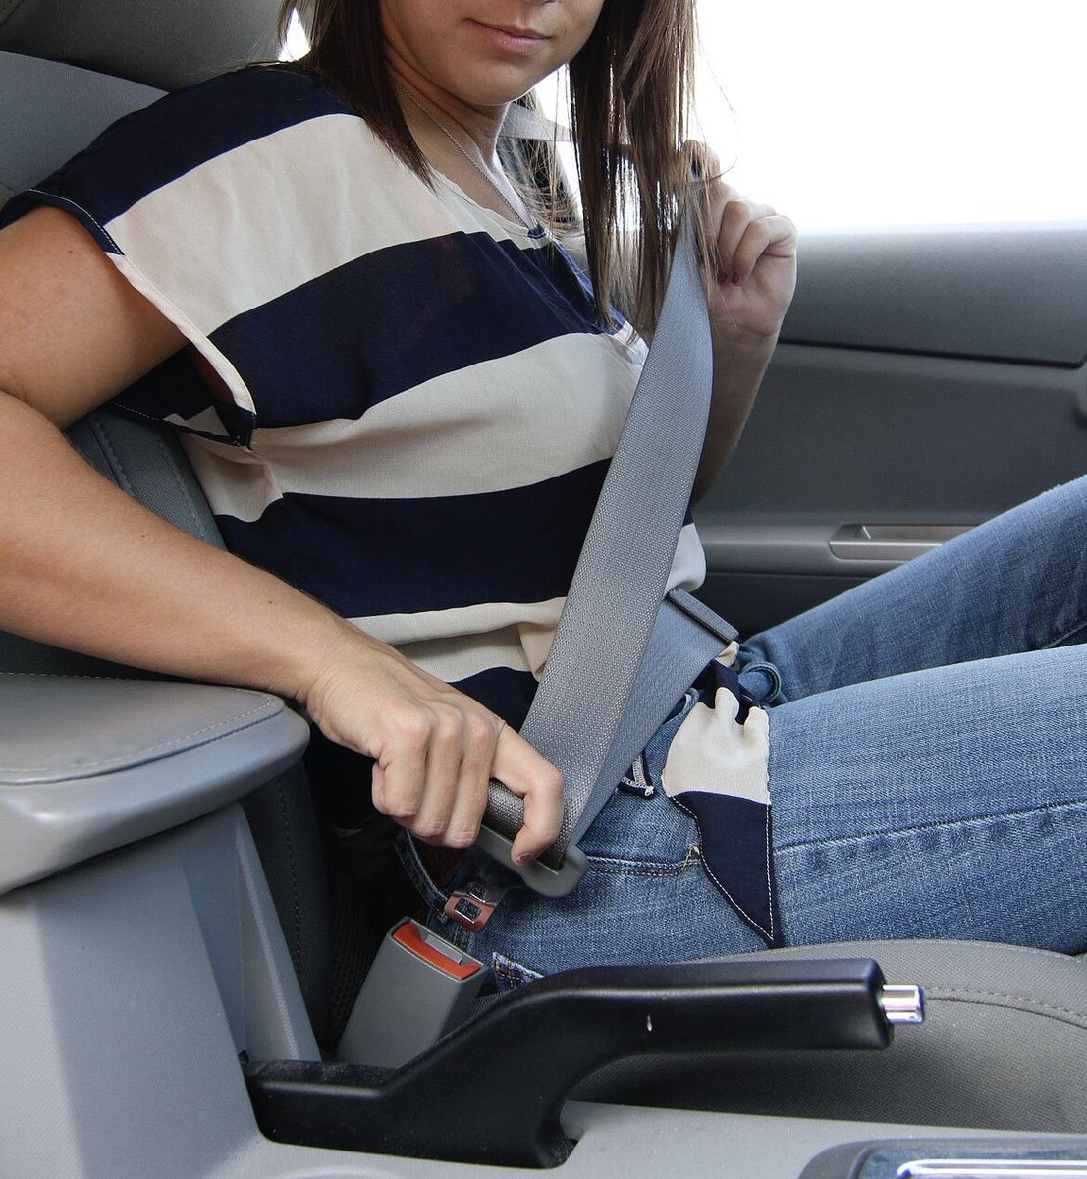
Wear your seat belt

Slide 38
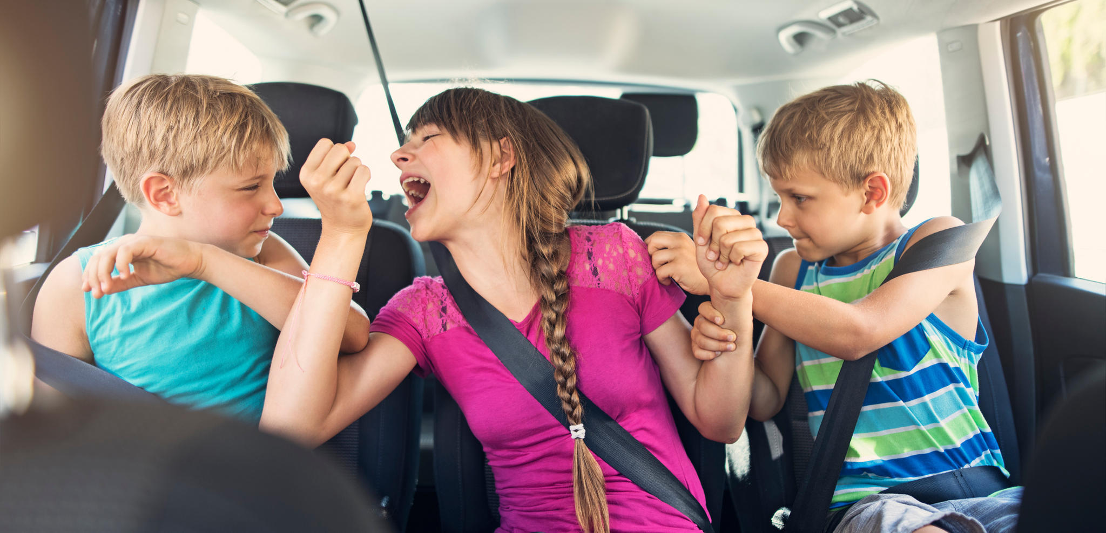
Don’t play in the car.

Slide 39




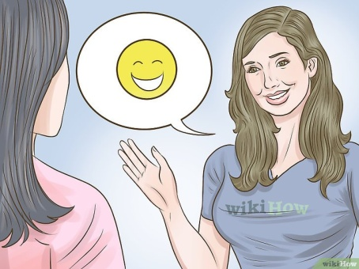
16. Be polite to the driver
and to other people.
17. Don’t talk to the driver
when he or she is driving.
18. Sit in the back seat.
19. Wear your seat belt.
20. Don’t play in the car.

Slide 40
the driver /polite to / Be /and /to other people.

Slide 41
the driver /Don’t talk to/ when / is driving. /he or she

Slide 42
Sit /back seat./ in the

Slide 43
seat belt ./ Wear / your

Slide 44
Don’t /in the car./ play

