Slide 2
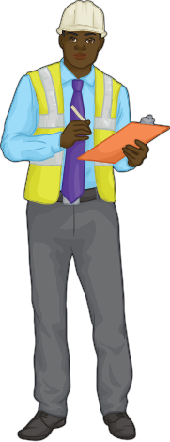
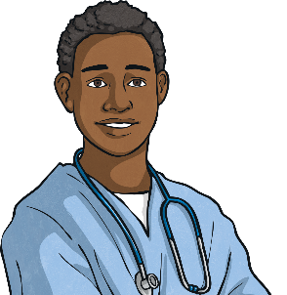
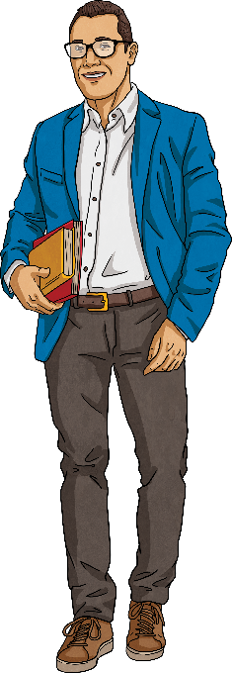
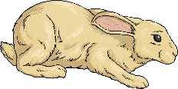
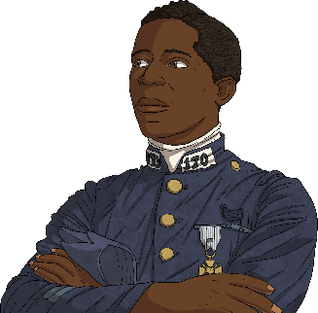
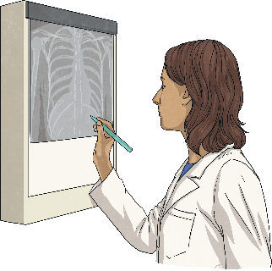
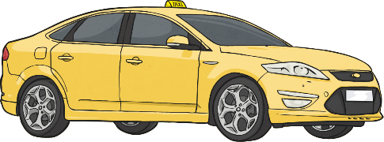
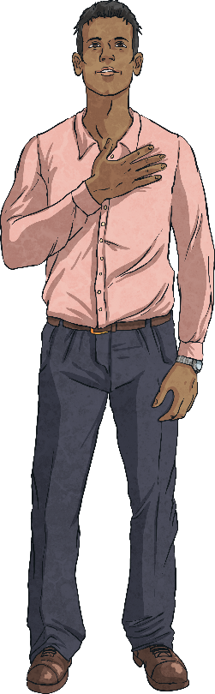
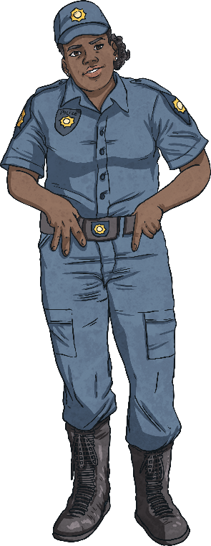
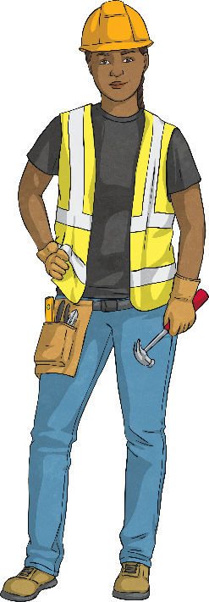
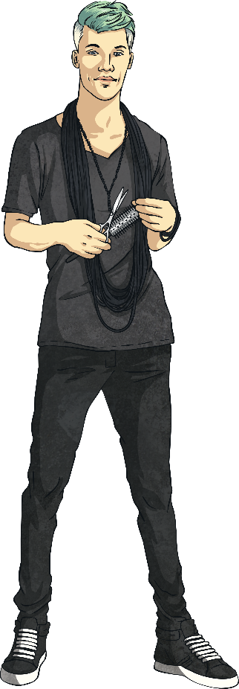
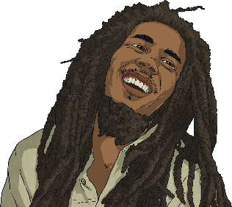
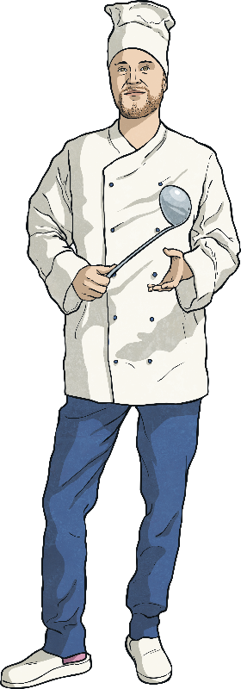
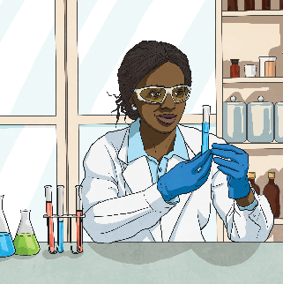
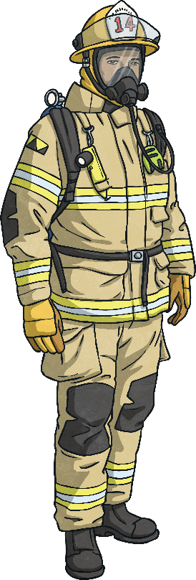
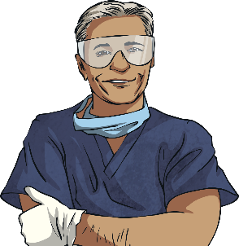
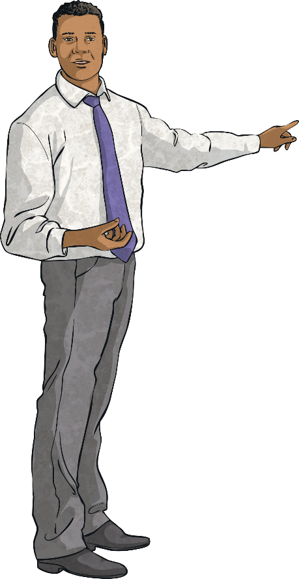
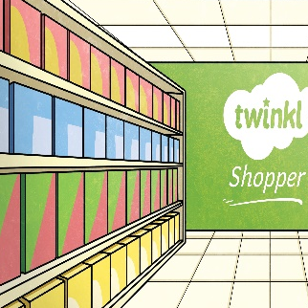
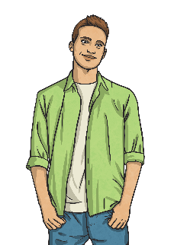
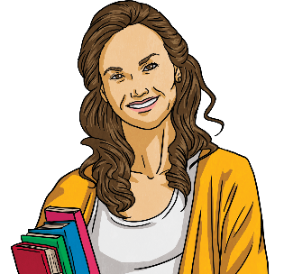
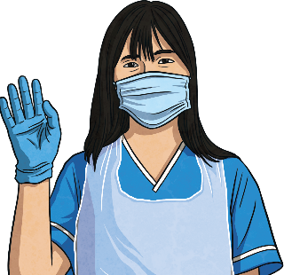
Revision: Click on the picture to see the word
Engineer
Vet
Teacher
Pilot
Taxi driver
Doctor
Police officer
Builder
Hairdresser
Singer
Chef
Scientist
Firefighter
Dentist
Accountant
Sales assistant
Manager
Nurse

Slide 3
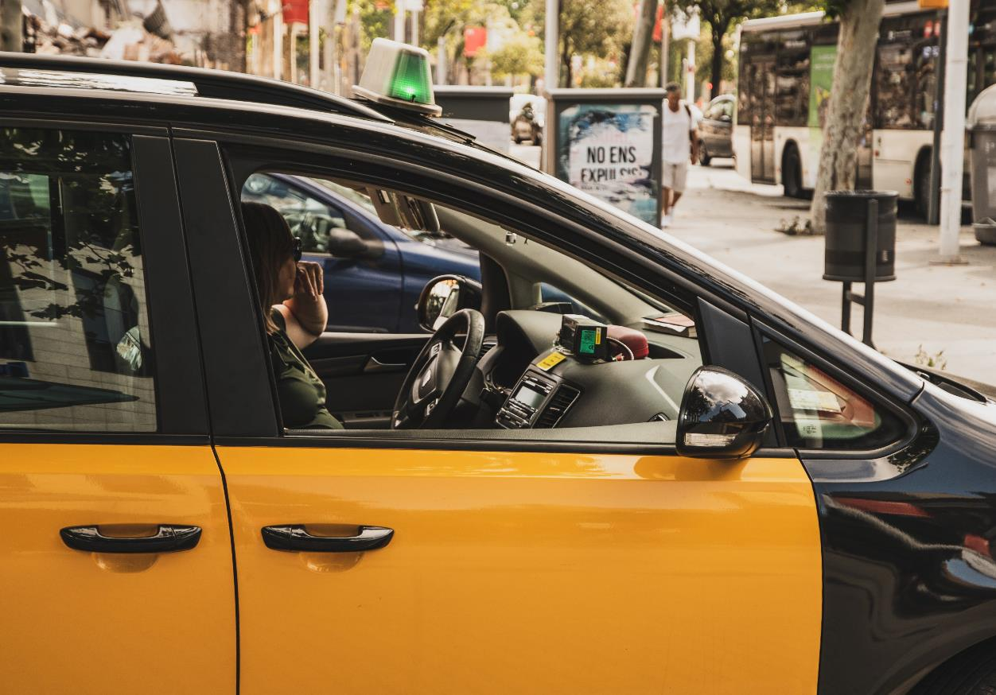
Who Is It?
1
6
11
2
18
10
17
5
14
7
4
15
8
3
12
16
9
13
19
20
She’s a taxi driver.
Answer

Slide 4
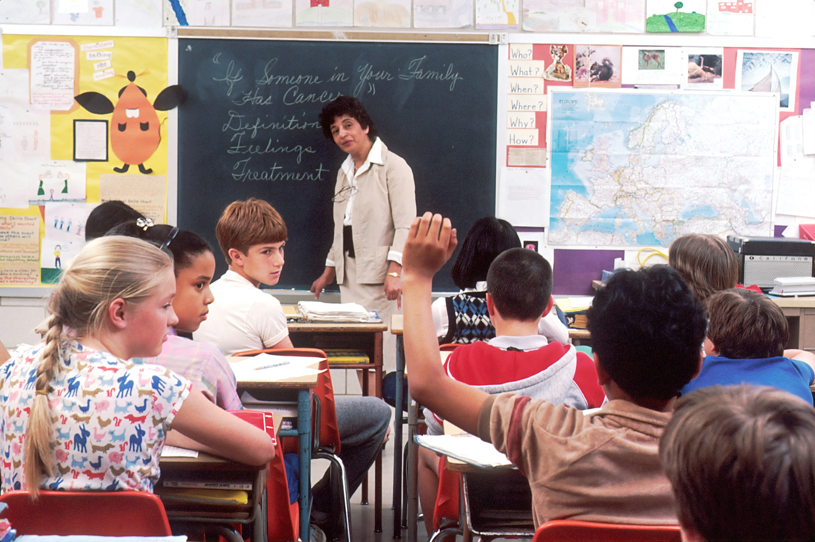
Who Is It?
8
5
3
2
7
17
4
6
12
18
10
13
1
11
14
9
16
15
20
19
She’s a teacher.
Answer

Slide 5
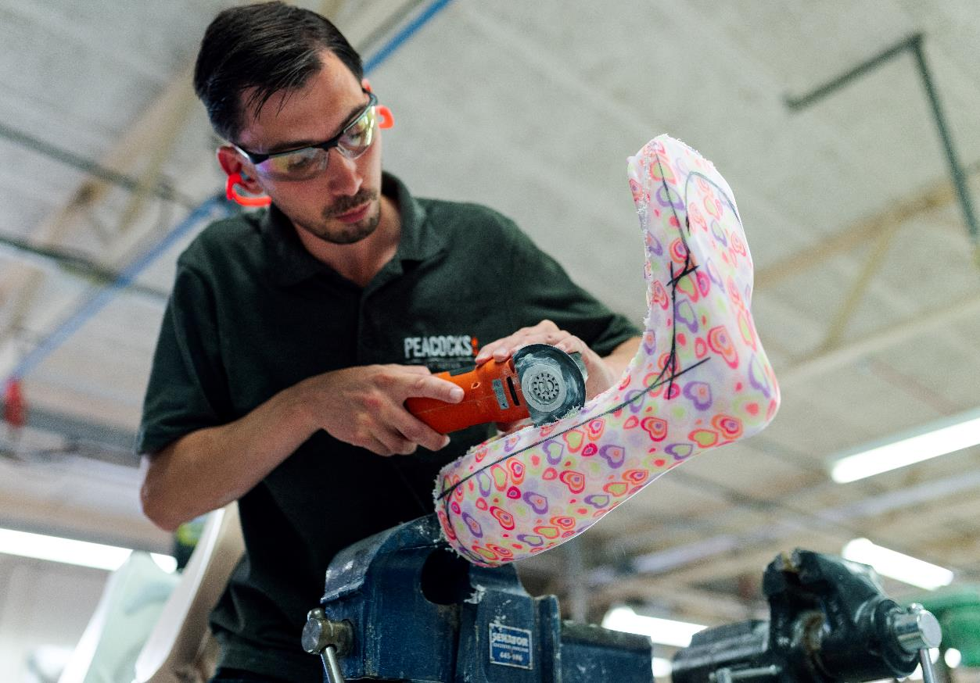
Who Is It?
8
5
3
2
7
17
4
6
12
18
10
13
1
11
14
9
16
15
20
19
He’s an engineer.
Answer

Slide 6
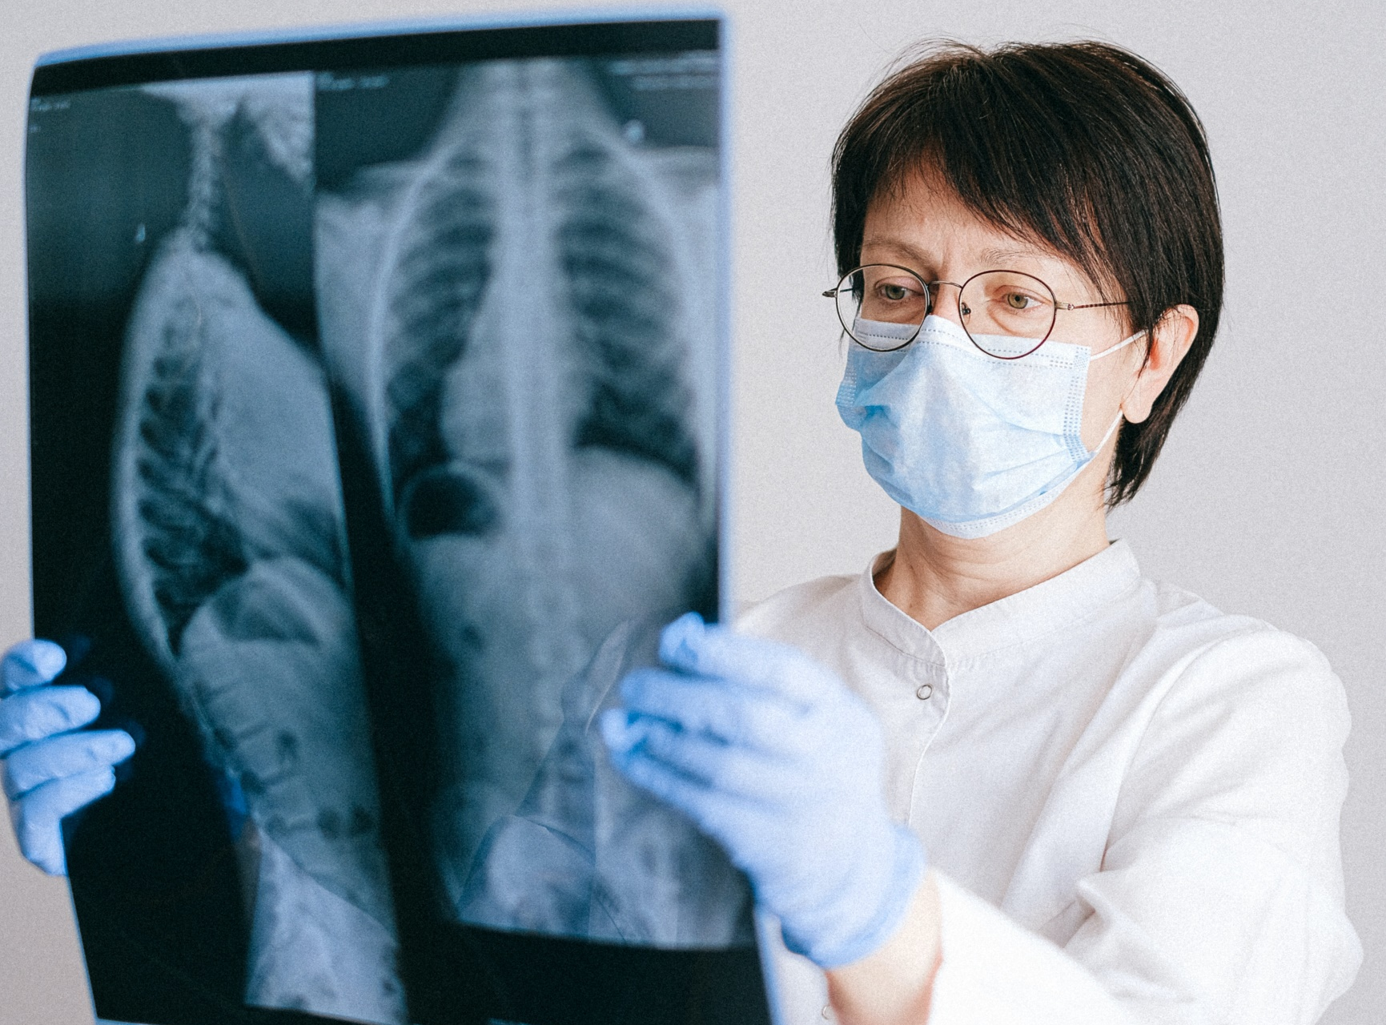
Who Is It?
8
5
3
2
7
17
4
6
12
18
10
13
1
11
14
9
16
15
20
19
She’s a doctor.
Answer

Slide 7
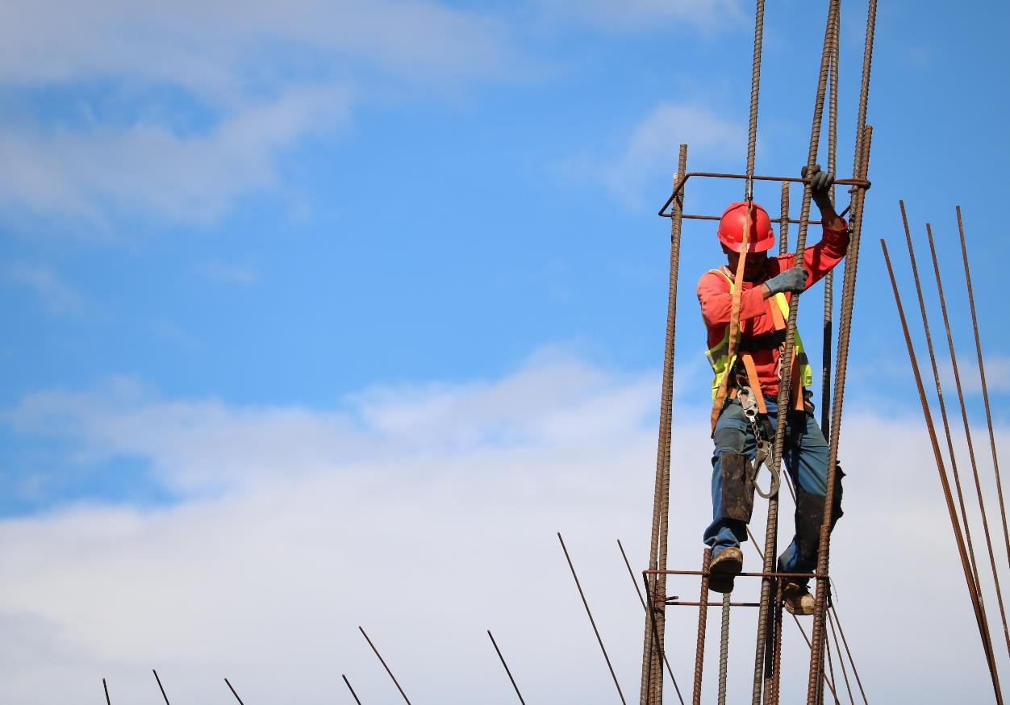
Who Is It?
19
3
5
12
2
4
17
7
6
18
10
16
11
1
14
9
13
15
8
20
He’s a builder.
Answer

Slide 8
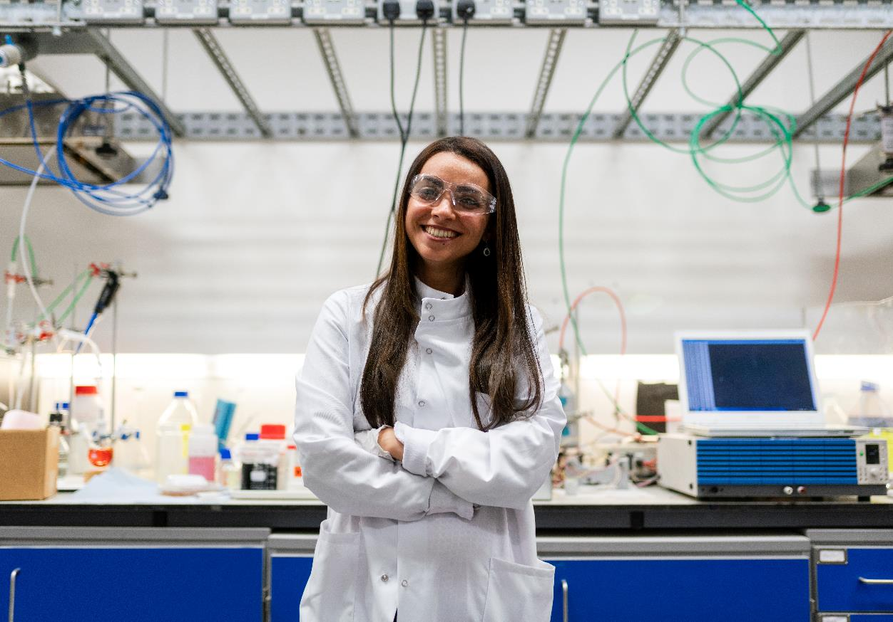
Who Is It?
1
6
11
2
18
10
17
5
14
7
4
15
8
3
12
16
9
13
19
20
She’s a scientist.
Answer

Slide 9
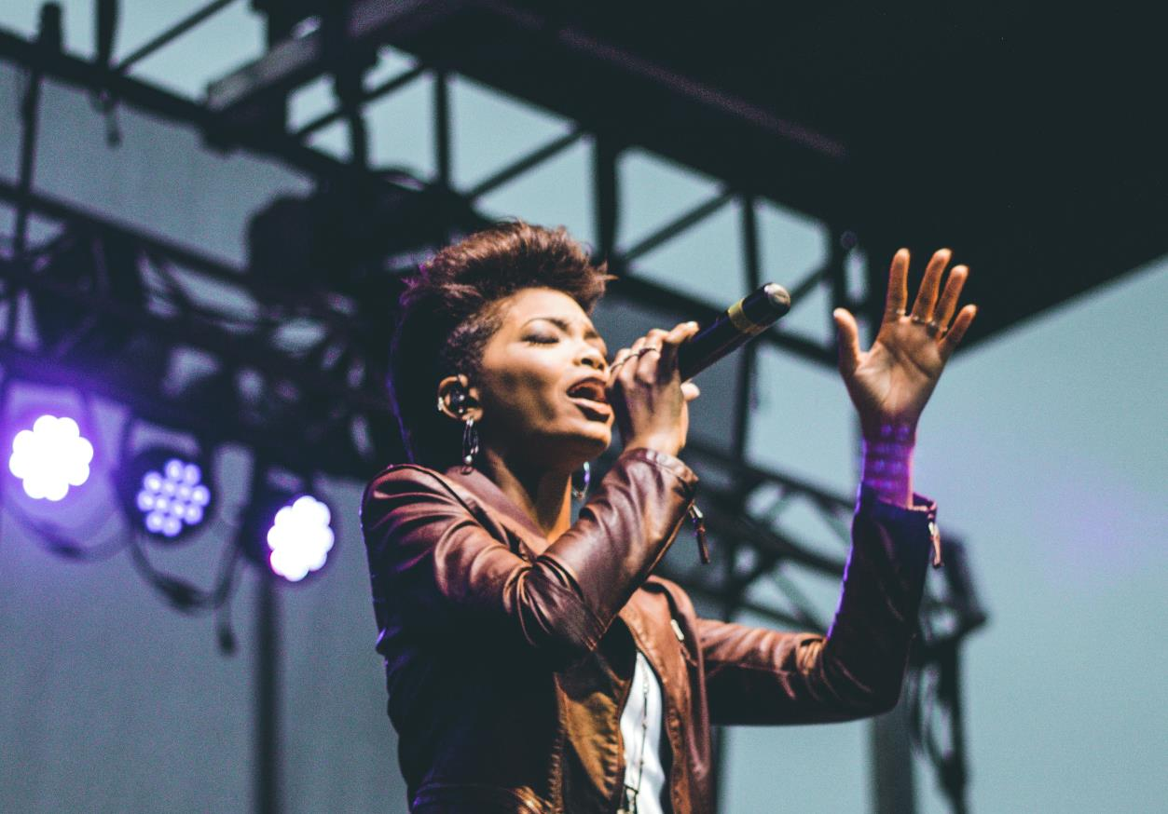
Who Is It?
18
19
12
2
1
10
17
5
14
3
4
15
8
7
11
16
9
13
6
20
She’s a singer.
Answer

Slide 10
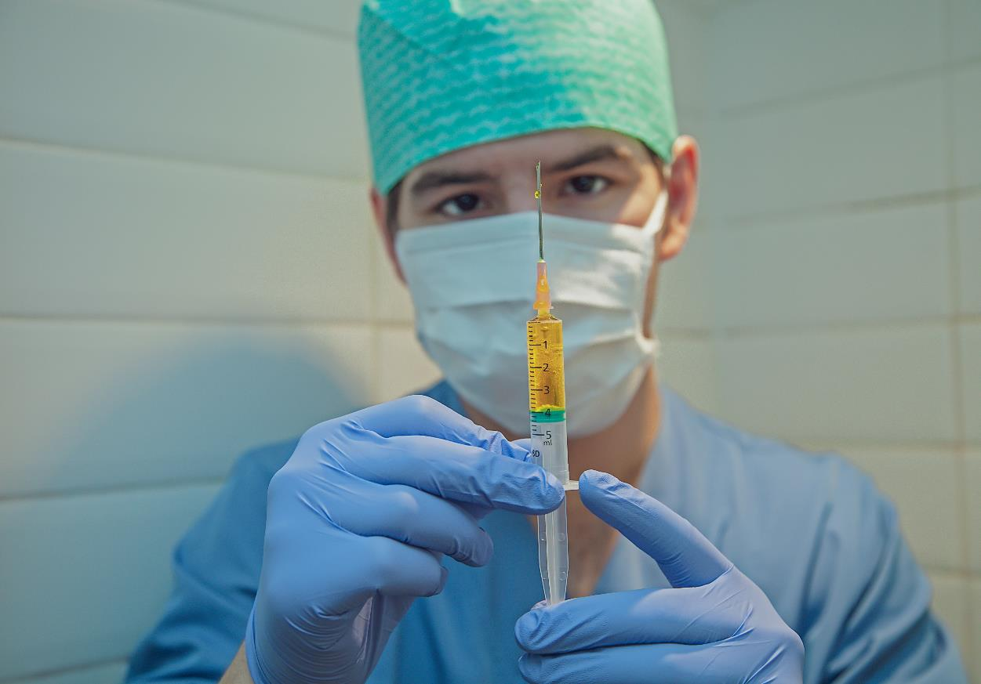
Who Is It?
8
5
3
2
7
17
4
6
12
18
10
13
1
11
14
9
16
15
20
19
He’s a nurse.
Answer

Slide 11
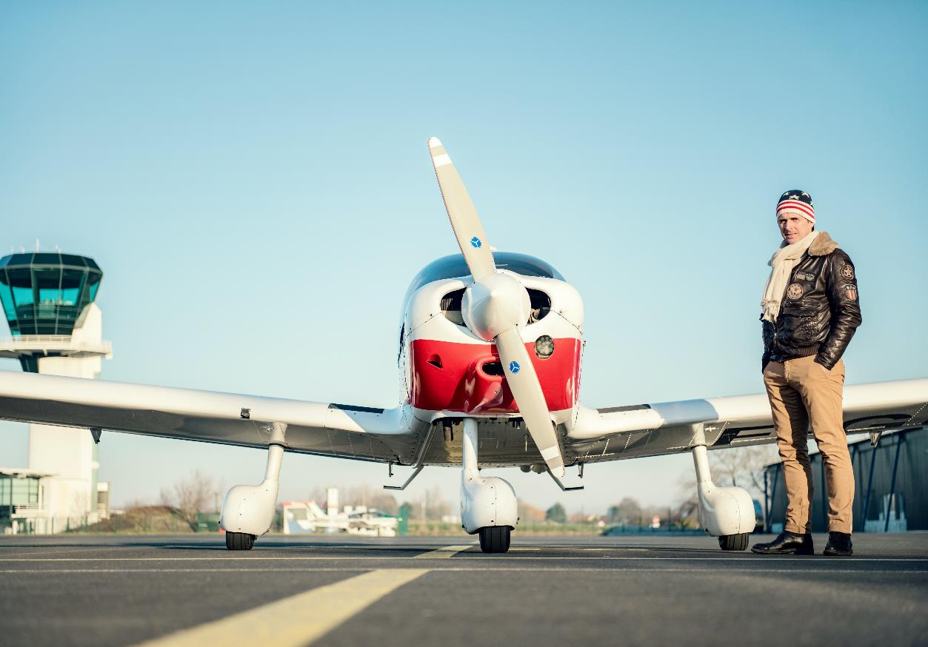
Who Is It?
8
5
3
2
7
17
4
6
12
18
10
13
1
11
14
9
16
15
20
19
He’s a pilot.
Answer

Slide 12
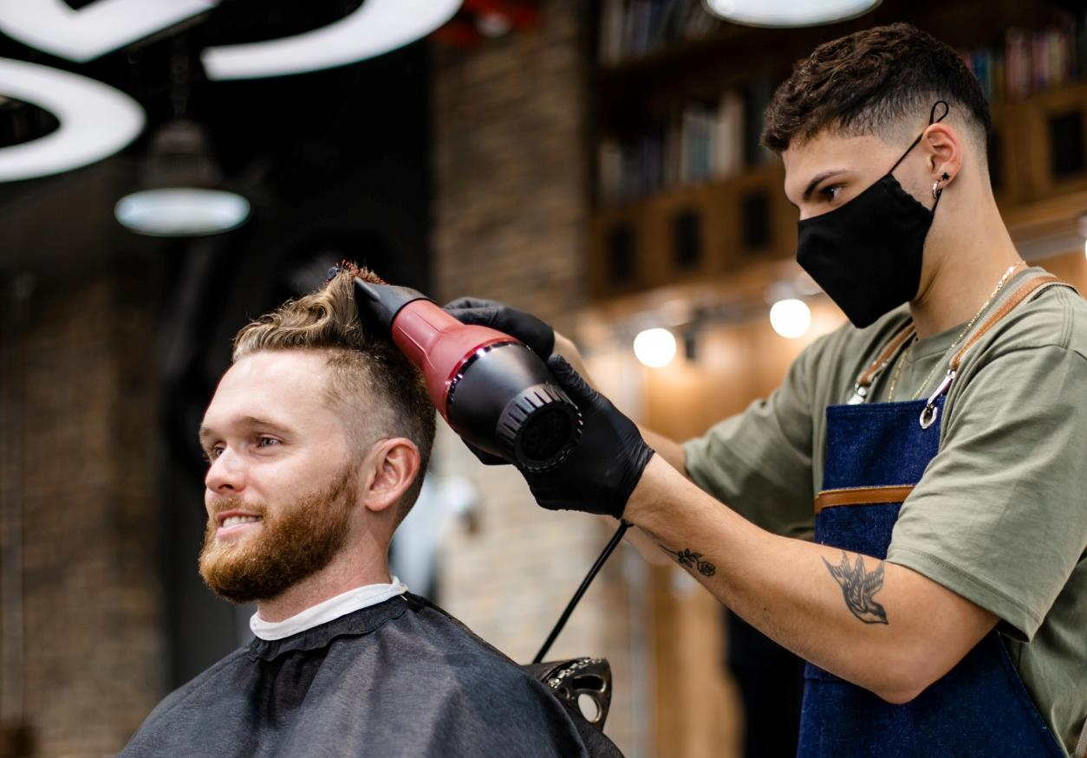
Who Is It?
19
3
5
12
2
4
17
7
6
18
10
16
11
1
14
9
13
15
8
20
He’s a hairdresser.
Answer

Slide 13
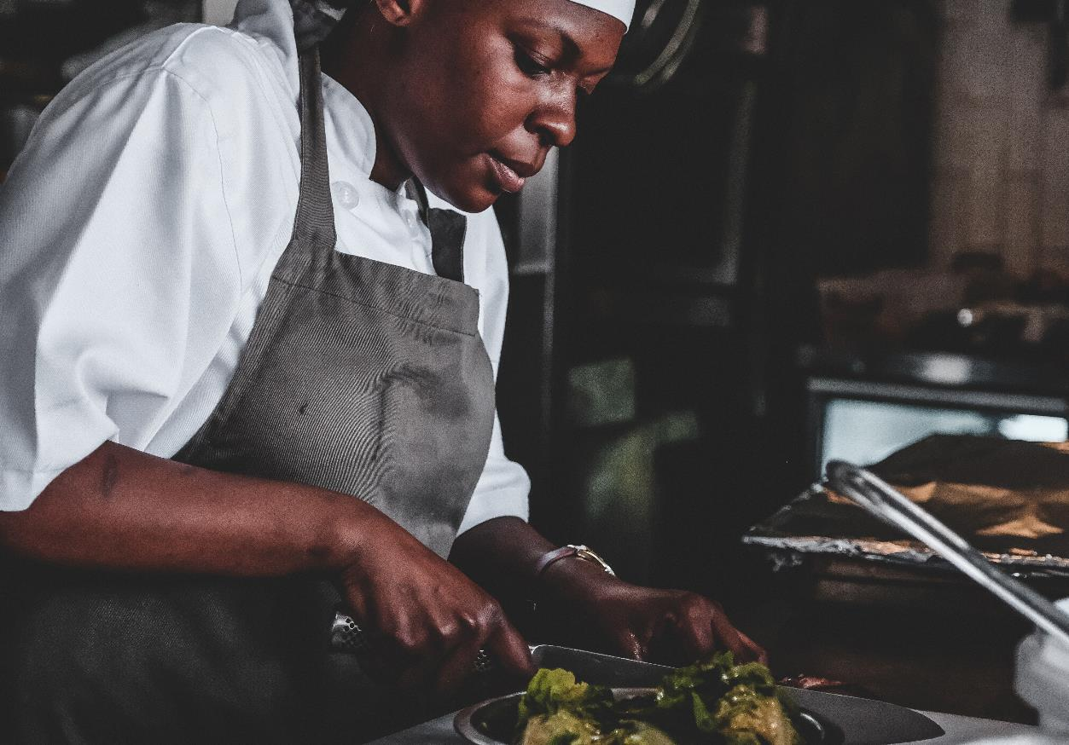
Who Is It?
1
6
11
2
18
10
17
5
14
7
4
15
8
3
12
16
9
13
19
20
She’s a chef.
Answer

Slide 14
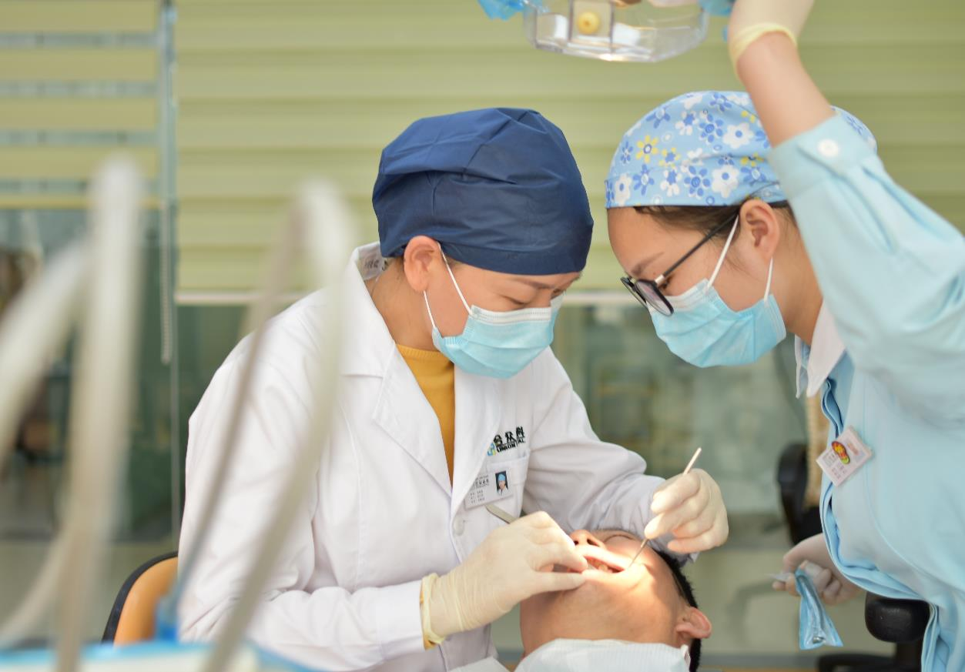
Who Is It?
8
5
3
2
7
17
4
6
12
18
10
13
1
11
14
9
16
15
20
19
She’s a dentist.
Answer

Slide 15
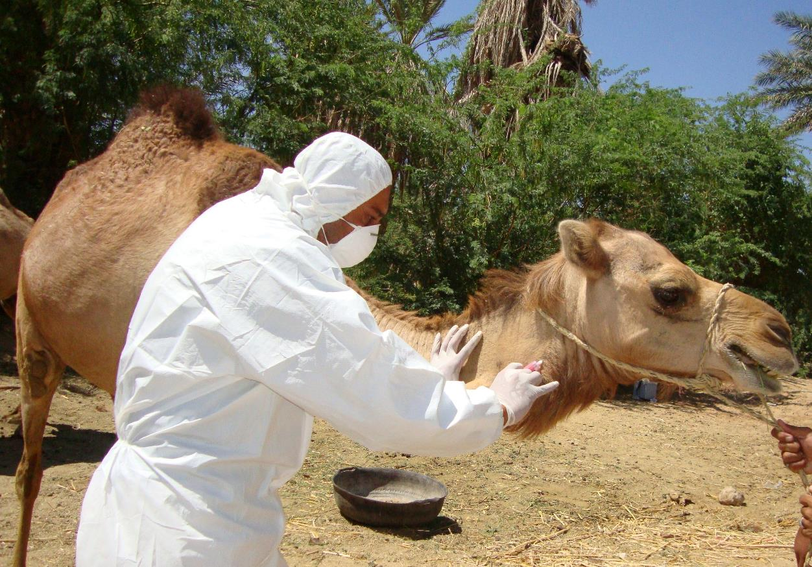
Who Is It?
19
3
5
12
2
4
17
7
6
18
10
16
11
1
14
9
13
15
8
20
He’s a vet.
Answer

Slide 16
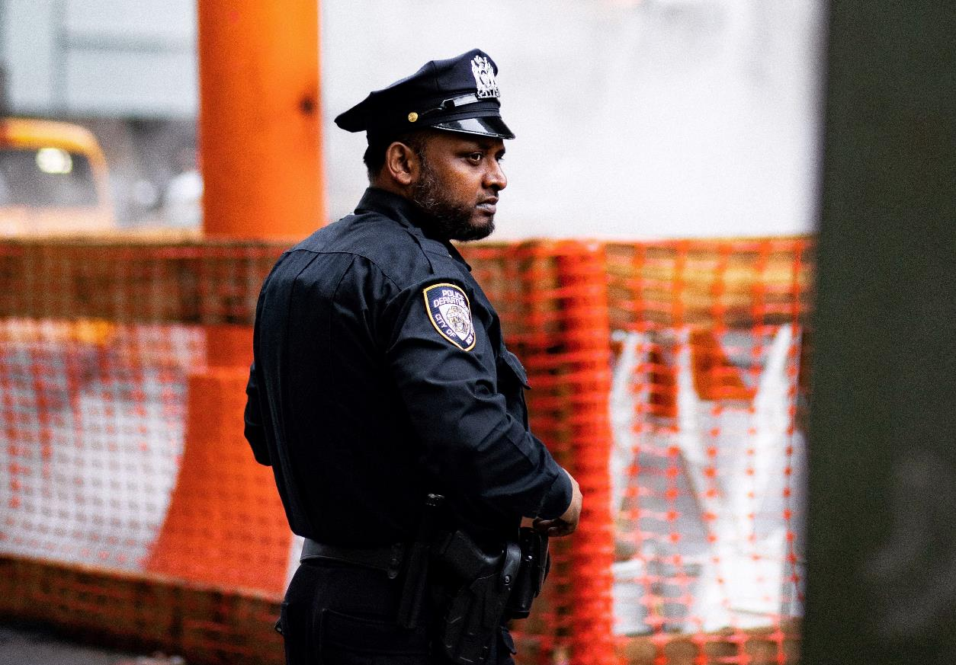
Who Is It?
8
5
3
2
7
17
4
6
12
18
10
13
1
11
14
9
16
15
20
19
He’s a police officer.
Answer

Slide 17
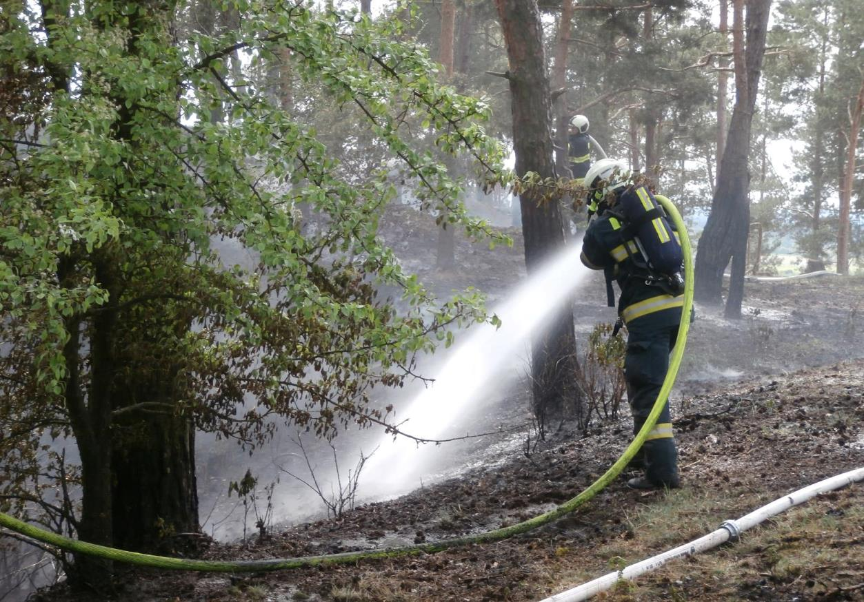
Who Is It?
19
3
5
12
2
4
17
7
6
18
10
16
11
1
14
9
13
15
8
20
She’s a firefighter.
Answer

Slide 18
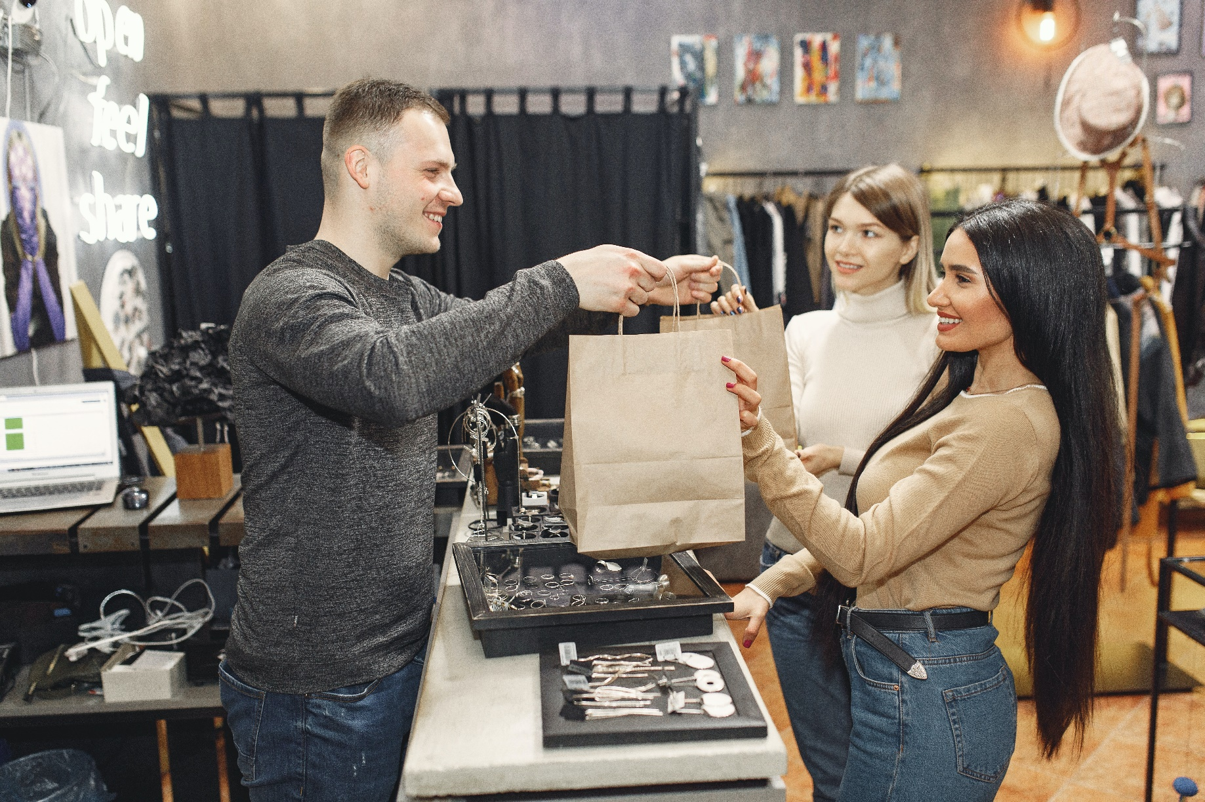
Who Is It?
8
5
3
2
7
17
4
6
12
18
10
13
1
11
14
9
16
15
20
19
He’s a sales assistant.
Answer

Slide 19

Who Is It?
1
6
11
2
18
10
17
5
14
7
4
15
8
3
12
16
9
13
19
20
Answer
She’s a manager.

Slide 20

Who Is It?
8
5
3
2
7
17
4
6
12
18
10
13
1
11
14
9
16
15
20
19
Answer
He’s an accountant.

Slide 21
Extra question prompts
What job would you like to do?
What jobs would you not like to do?
What do the adults you know do?
What would be fun if you were a (firefighter/doctor/sales assistant)?
What would be difficult if you were a (teacher/pilot/singer)?
Is it more important to love your job or earn lots of money?
What would be good and bad about being famous?

