Slide 1
Present Simple (singular)

Slide 2
+s
get up – gets up
listen – listens
hang up – hangs up
ch/sh/ss +es
watch – watches
dress – dresses
wash - washes
y i+es y +s
tidy – tidies
play - plays
have – has
go – goes
do - does

Slide 3
get up
gets up
I
We
You
They
He
She
It
go
goes
have
has
play
plays
listen
listens
watch
watches
walk
walks

Slide 4
+s/es
I
get up
at 6 am.
He
gets up
at 7 am.
I
go
to school.
She
goes
to school.
They
have
5 lessons.
She
has
6 lessons.
We
play
games.
It
plays
with a ball.

Slide 5
I
get up
at 6 am.
He
gets up
at 7 am.
I
go
to school.
She
goes
to school.
They
have
5 lessons.
She
has
6 lessons.
We
play
games.
It
plays
with a ball.

Slide 6
I
get up
at 6 am.
He
gets up
at 7 am.
I
go
to school.
She
goes
to school.
They
have
5 lessons.
She
has
6 lessons.
We
play
games.
It
plays
with a ball.

Slide 7
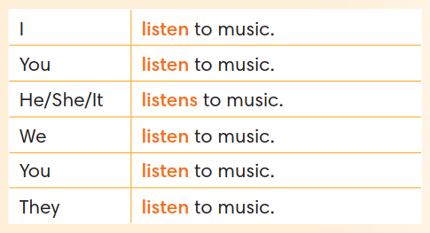
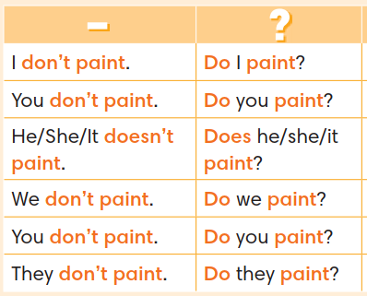
Negative sentences
He paints
She plays
They read
We play
She watches
Tom has
I have
Amy reads
He does
They do
He doesn’t paint
+
She doesn’t play
They don’t read
We don’t play
She doesn’t watch
Tom doesn’t have
I don’t have
Amy doesn’t read
He doesn’t do
They don’t do

Slide 8
Negative sentences
He doesn’t paint
He paints
+
She doesn’t play
She plays
They don’t read
They read
We don’t play
We play
She doesn’t watch
She watches
Tom doesn’t have
Tom has
I don’t have
I have
Amy doesn’t read
Amy reads
He doesn’t do
He does
They don’t do
They do

Slide 9
Positive sentences
Let’s change the sentences!

Slide 10
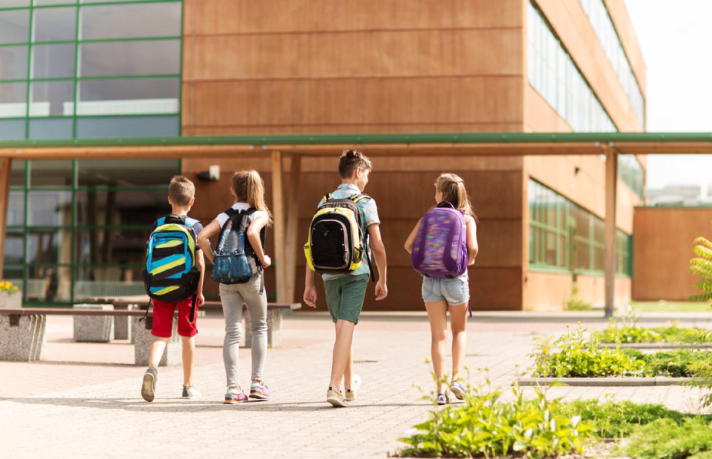
They go to school.
She
goes
to school.

Slide 11
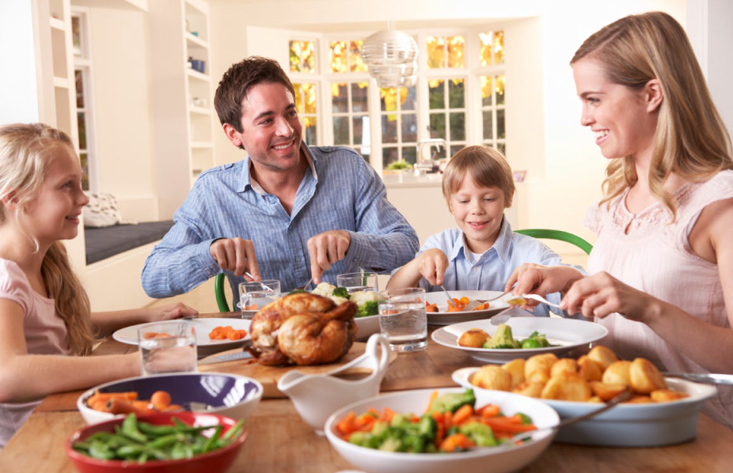
They have dinner at home.
He
has
dinner at home.

Slide 12
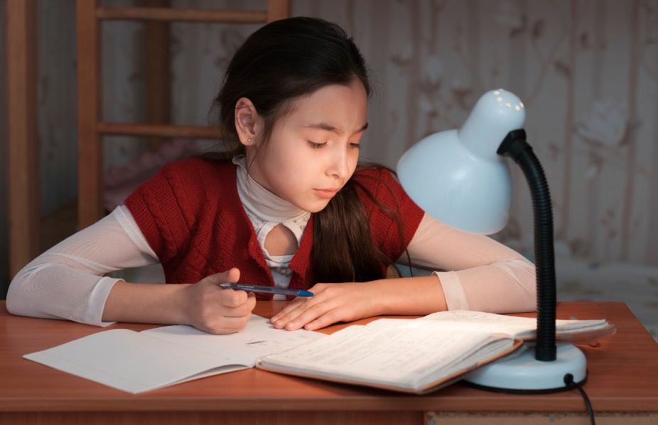
I do my homework every day.
She
does
her homework every day.

Slide 13
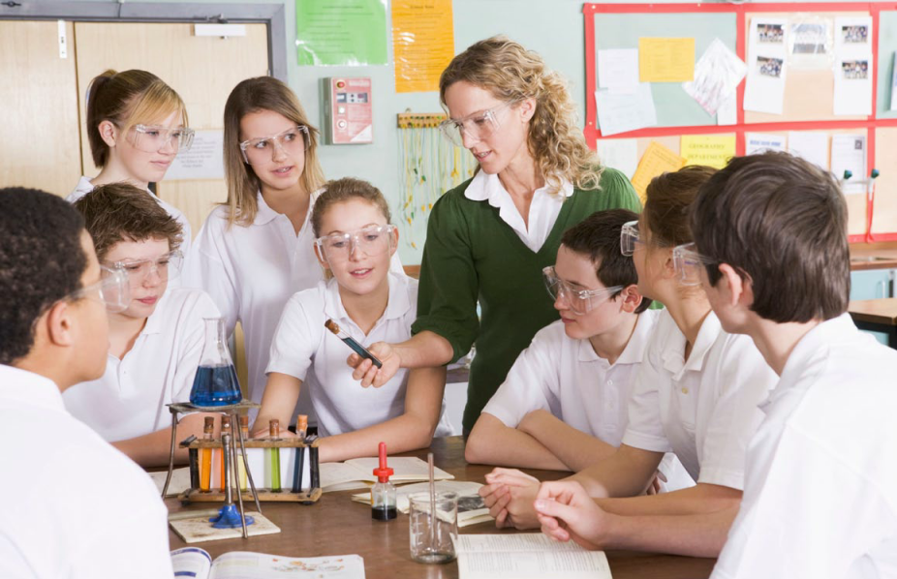
They have lessons on Saturdays.
She
has
lessons on Saturdays.

Slide 14
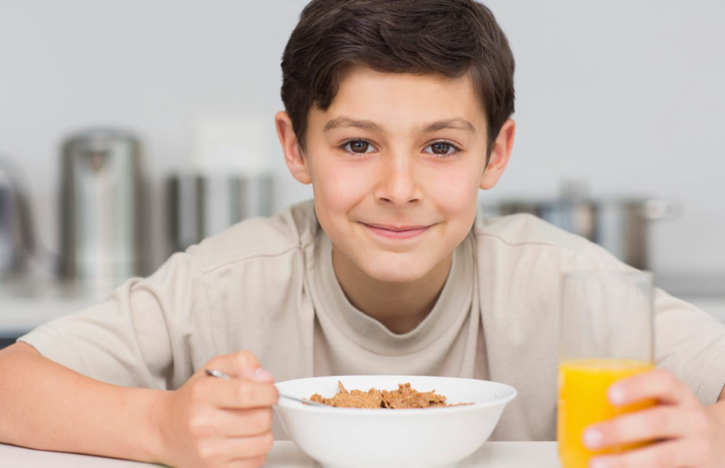
I have breakfast in the morning.
He
has
breakfast in the morning.

Slide 15
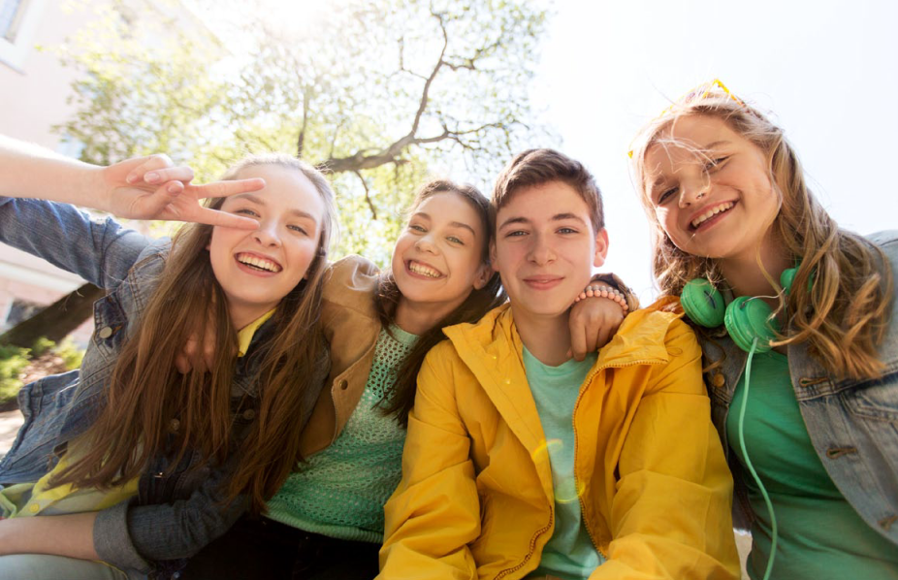
They hang out with friends.
She
hangs out
with friends.

Slide 16
Negative Sentences
Let’s correct the mistakes!

Slide 17
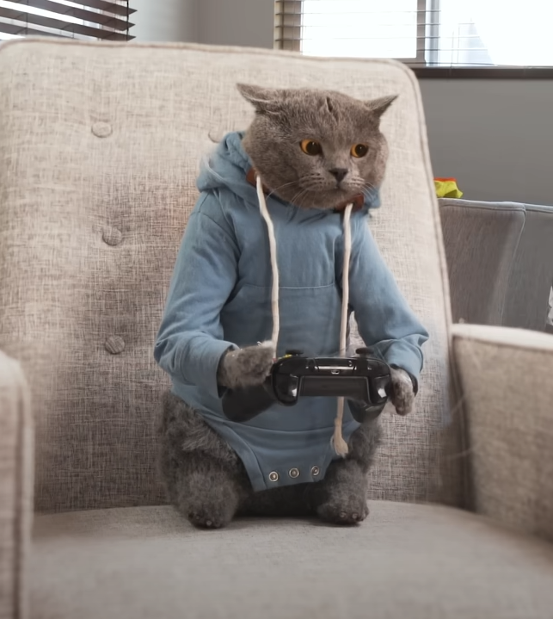
Michael usually plays football in the morning.
Make the sentences negative
Michael doesn’t play football.
He plays computer games in the morning.

Slide 18
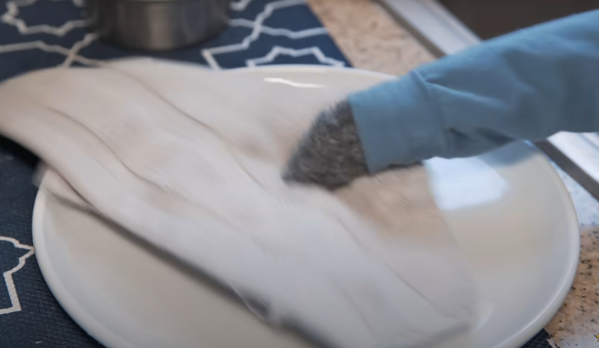
Michael dusts after dinner.
Make the sentences negative
Michael doesn’t dust after dinner.
He washes up after dinner.

Slide 19
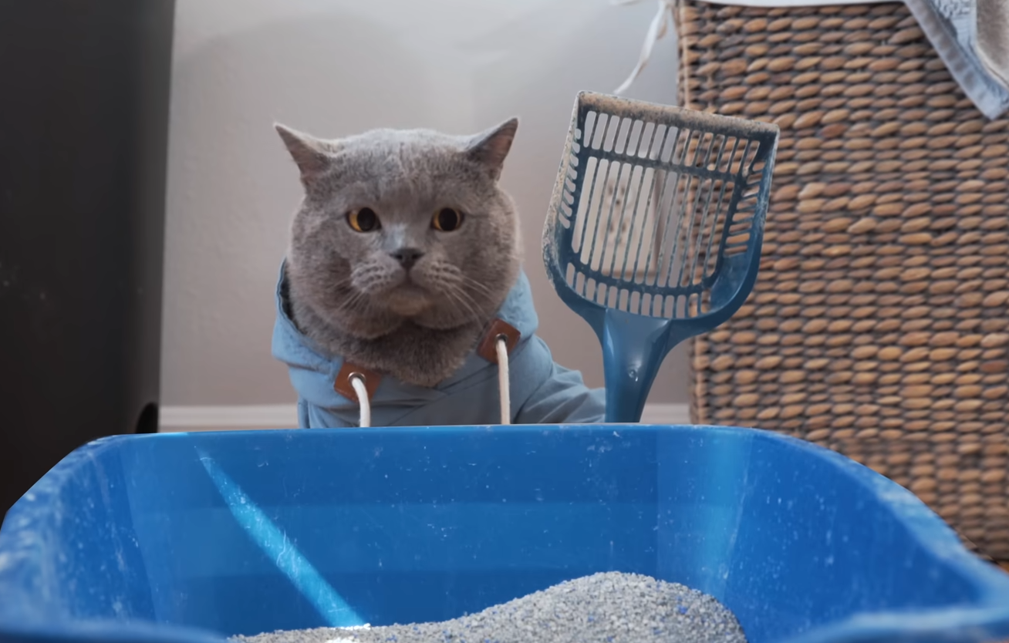
Michael always cleans his cat house.
Make the sentences negative
Michael doesn’t clean his cat house.
He always cleans his cat litter.

Slide 20
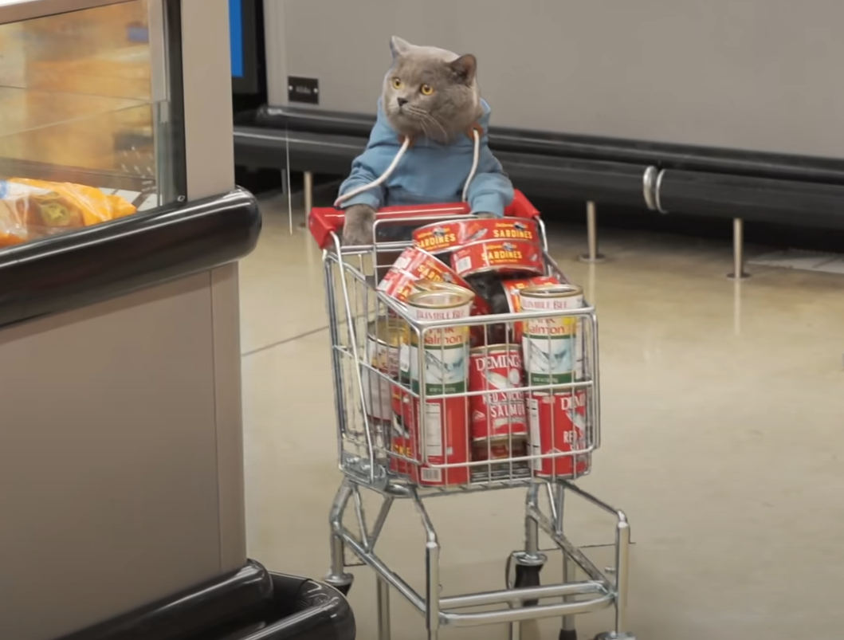
Michael goes to the park on Sundays.
Make the sentences negative
Michael doesn’t go to the park.
He goes shopping on Sundays.

Slide 21
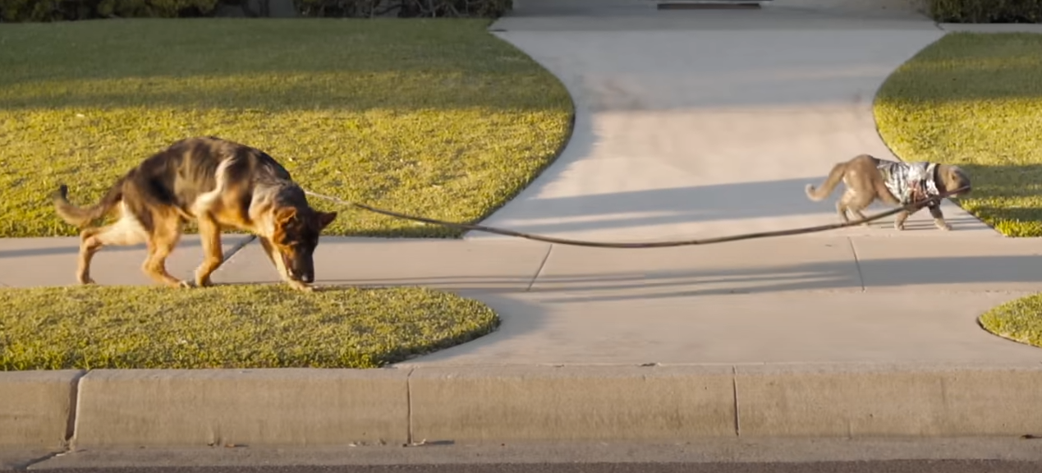
Michael walks a hamster twice a day.
Make the sentences negative
Michael doesn’t walk a hamster.
He walks a dog twice a day.

Slide 22
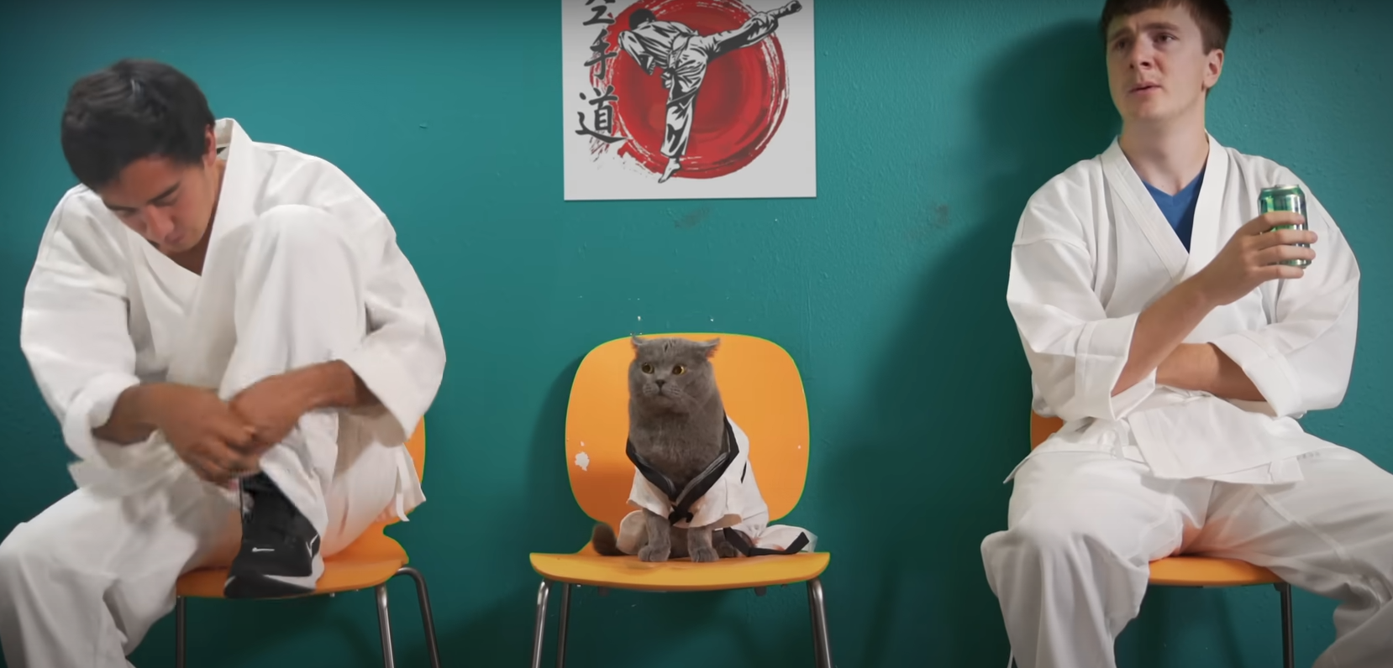
Michael plays chess on Fridays.
Make the sentences negative
Michael doesn’t play chess.
He does karate on Fridays.

Slide 23
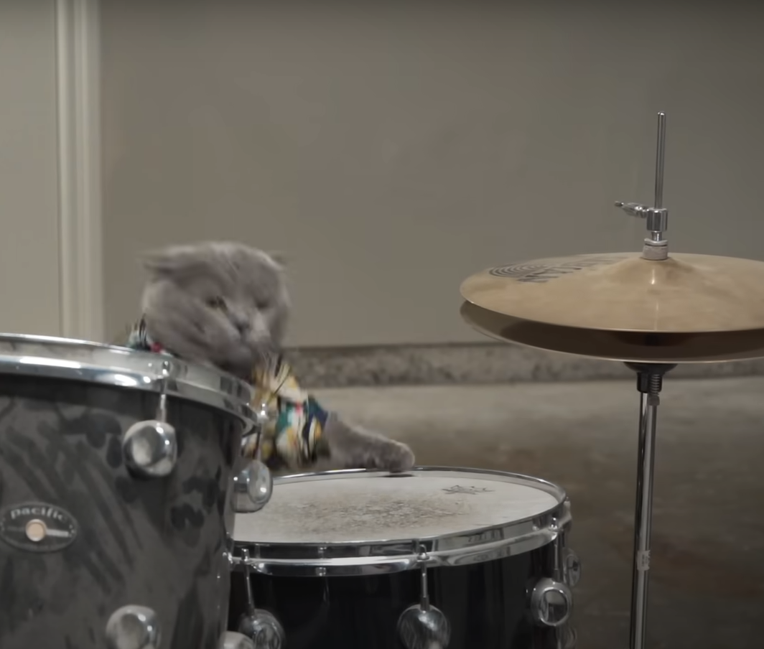
Michael plays the guitar in a band.
Make the sentences negative
Michael doesn’t play the guitar.
He plays the drums in a band.

Slide 24
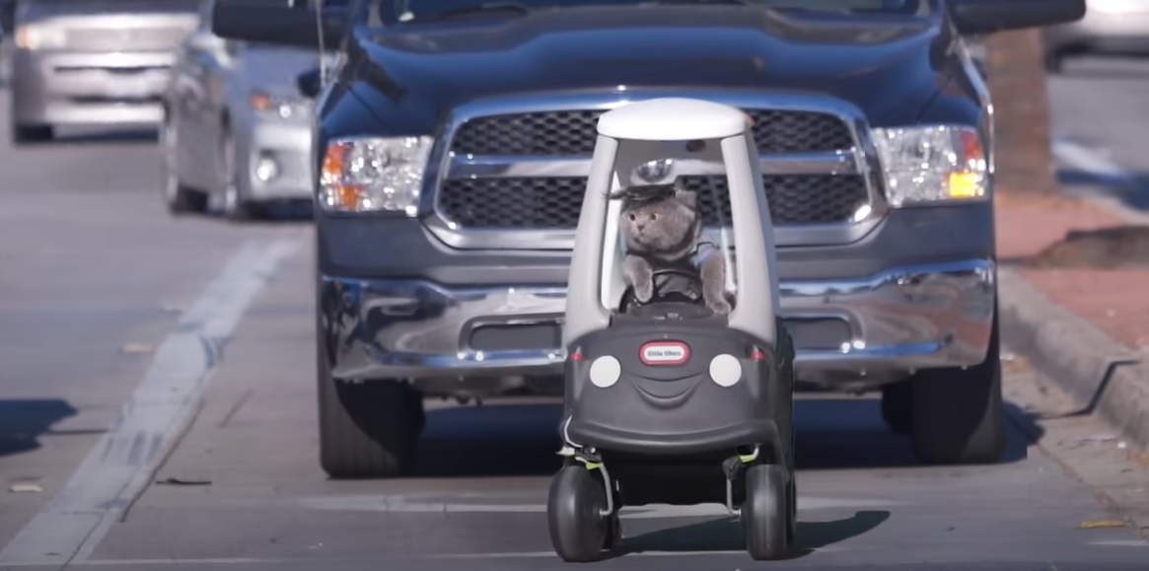
Michael rides a bike to work every day.
Make the sentences negative
Michael doesn’t ride a bike.
He drives to work every day.

Slide 25
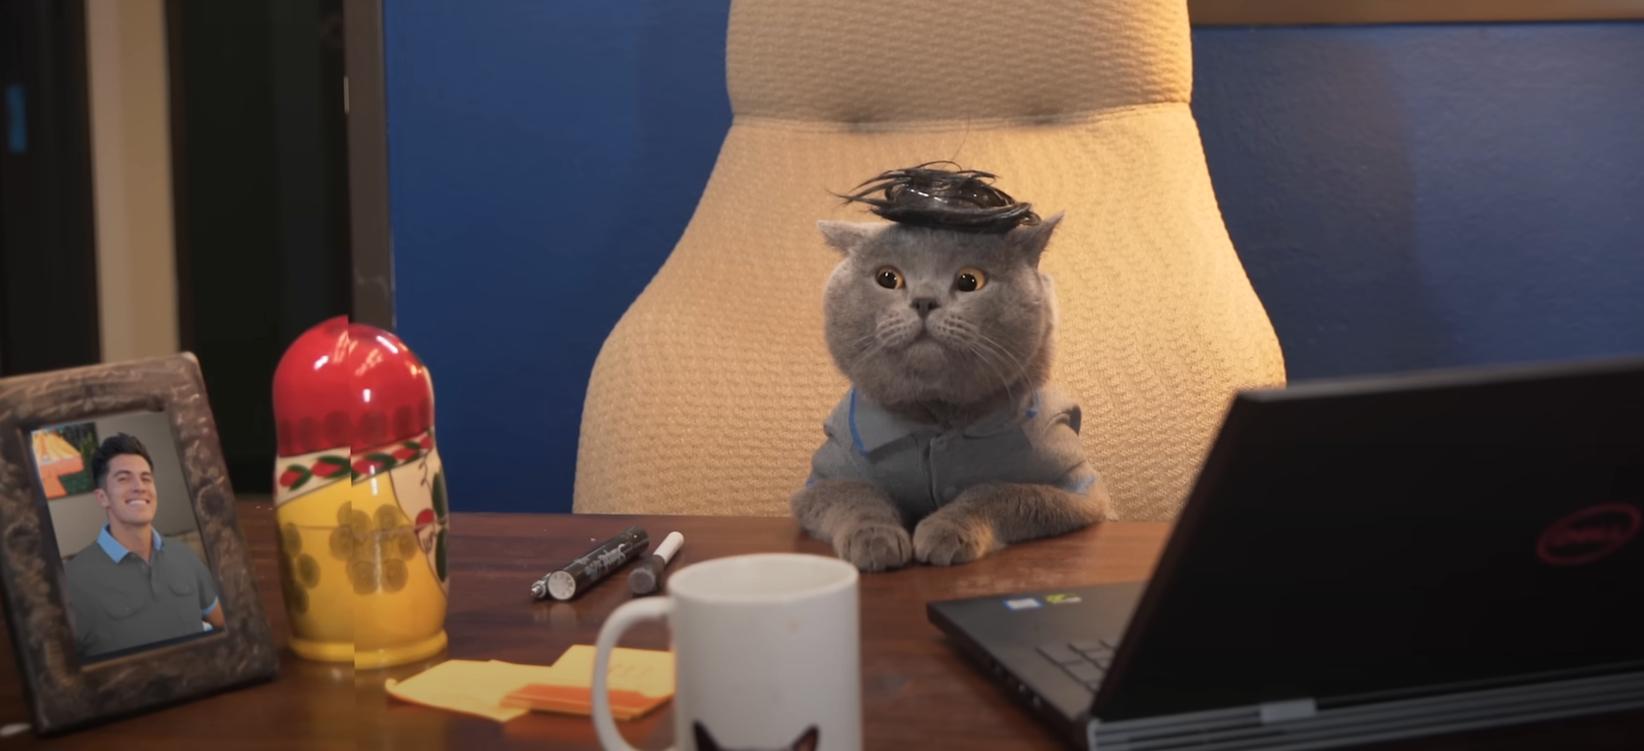
He works in a cafe.
Make the sentences negative
He doesn’t work in a cafe.
He works in an office.

Slide 26
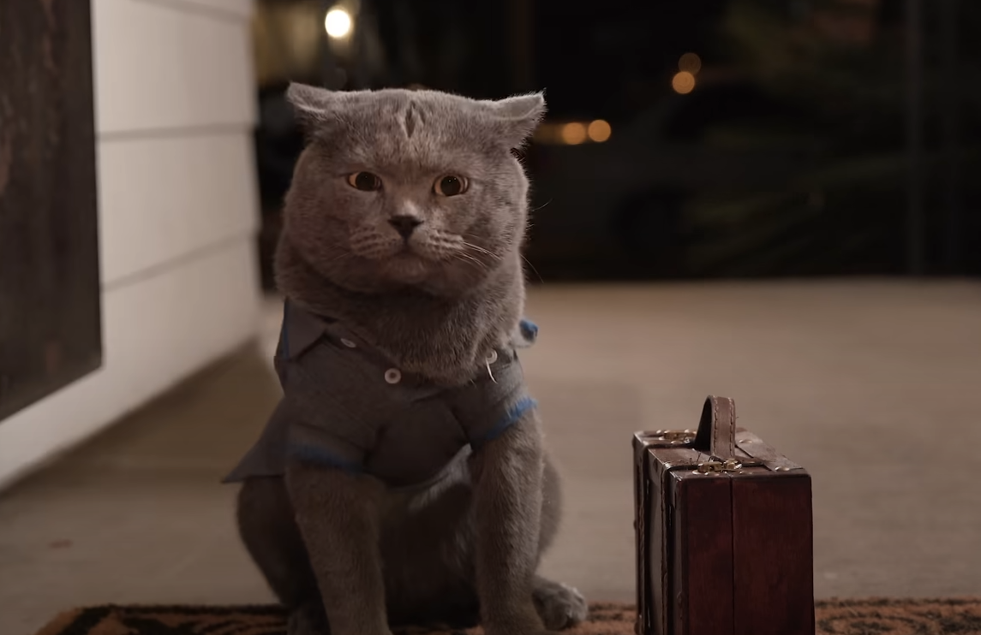
Michael comes back home at 7 p.m.
Make the sentences negative
He doesn’t come back home at 7 p.m.
9 p.m.
He comes back home at 9 p.m.

Slide 27
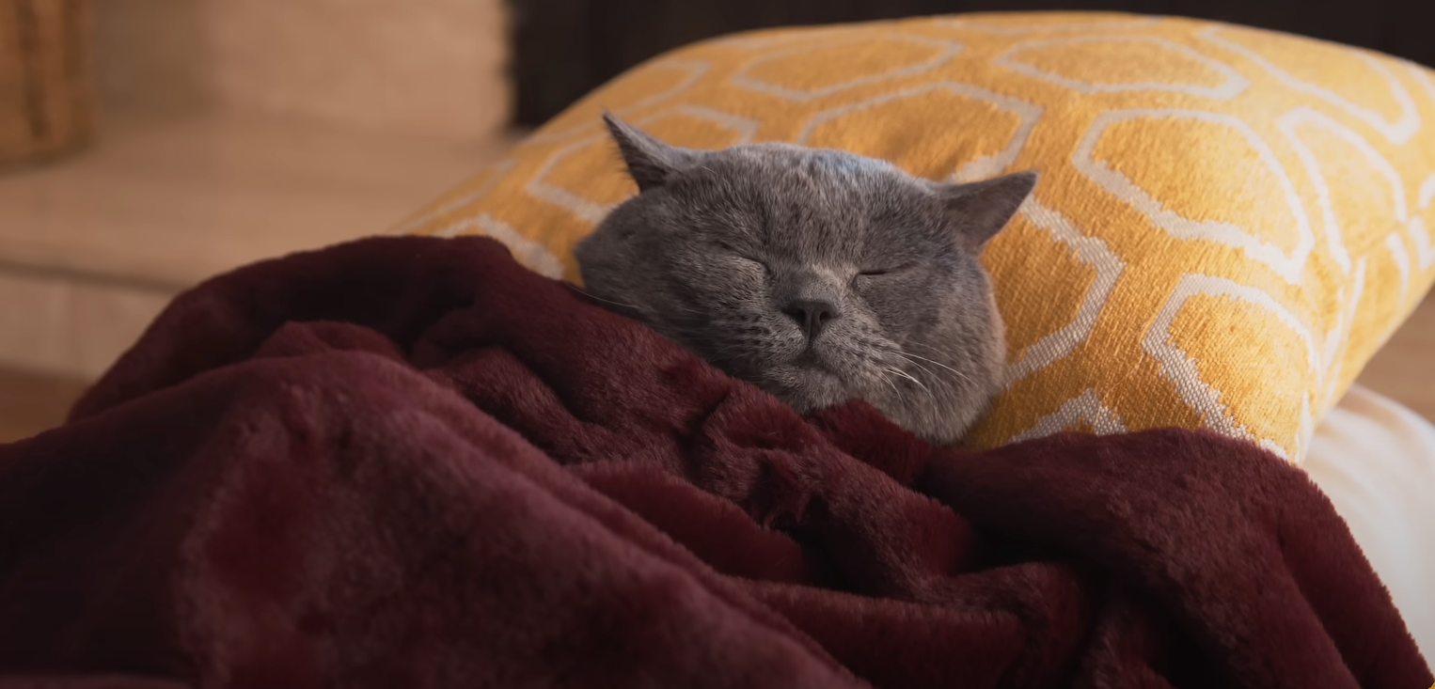
Michael goes to bed at 8 p.m.
Make the sentences negative
He doesn’t go to bed at 8 p.m.
11 p.m.
He goes to bed at 11 p.m.

