Slide 1
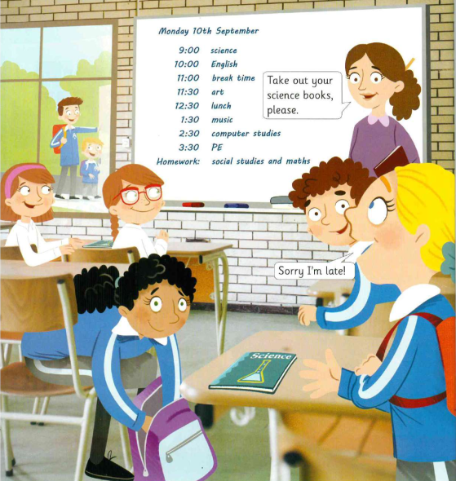
Where are the children? They’re
Notes:
Students answer the question: They’re in the classroom/ at school.

Slide 2
Are the children arriving?
Yes, they are. No, they aren’t.

Slide 3
Are the children leaving?
Yes, they are. No, they aren’t.

Slide 4
Are the children leaving?
Yes, they are. No, they aren’t.

Slide 5
Are the children saying Hello?
Yes, they are. No, they aren’t.

Slide 6
Are the children saying goodbye?
Yes, they are. No, they aren’t.

Slide 7
Are the children starting the lesson?
Yes, they are. No, they aren’t.

Slide 8
Are the children finishing the lesson?
Yes, they are. No, they aren’t.

Slide 9
Can you remember the children’s names?
Notes:
Flo, Ella, Charlie, Luke

Slide 10
What’s on the board?
Notes:
The classes for that day.

