Slide 1

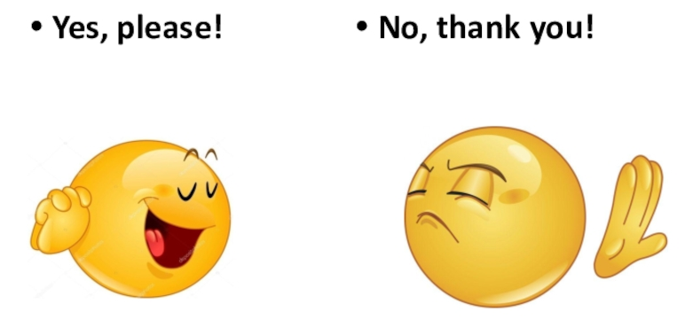
Would you like a / an / some

Slide 2

Would you like a / an / some

Slide 3

Would you like a / an / some

Slide 4

Would you like a / an / some

Slide 5

Would you like a / an / some

Slide 6

Would you like a / an / some

Slide 7
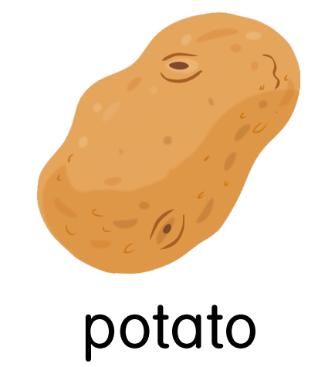
Would you like a / an / some

Slide 8

Would you like a / an / some

Slide 9

Would you like a / an / some

Slide 10
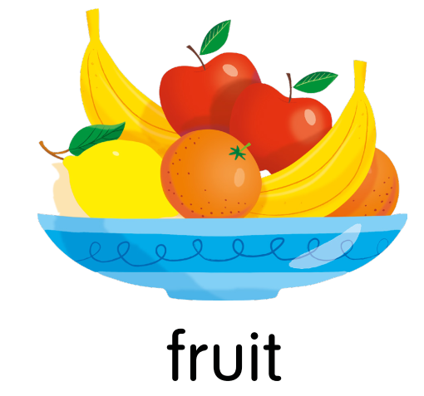
Would you like a / an / some

Slide 11

Would you like a / an / some

Slide 12

Would you like a / an / some

Slide 13
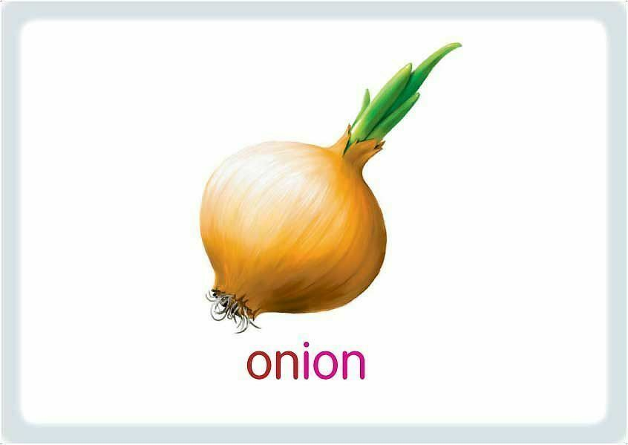
Would you like a / an / some

Slide 14

Would you like a / an / some

