Slide 1
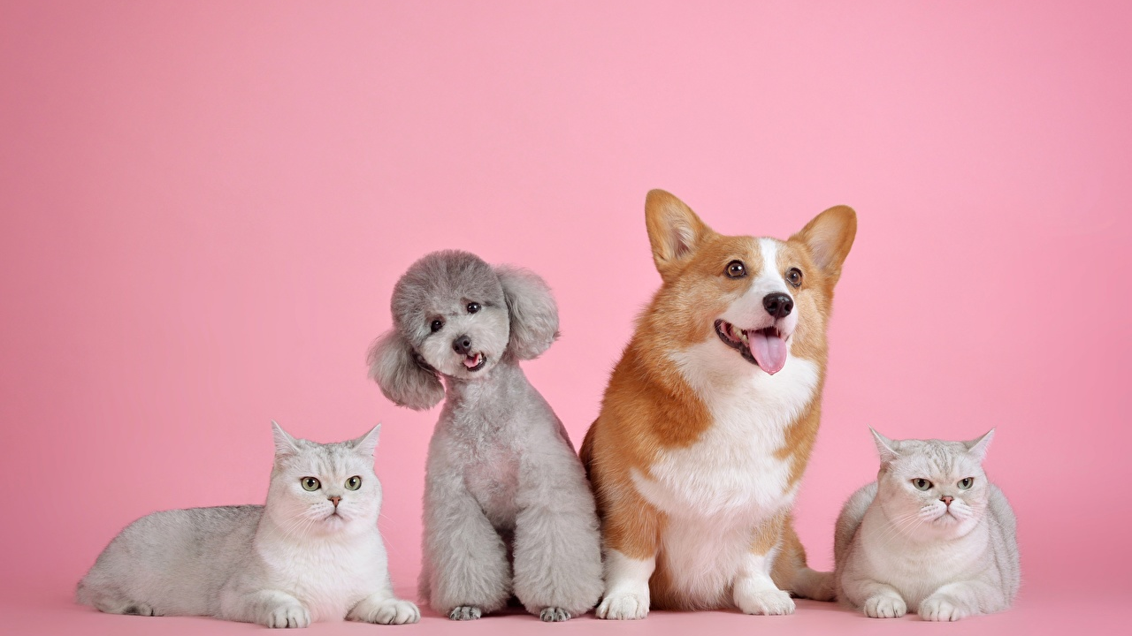




IrinaPapakhinac

Slide 2



1. Have you got a pet?
What is it?
2. What is his / her name?
3. What colour is your pet?
4. What can he / she do?
IrinaPapakhinac

Slide 3
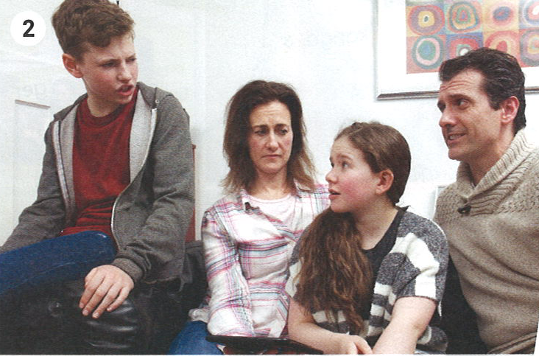

Alex wants to have a pet.
GUESS!
What animal does he want?
Watch the video and check your answers.
IrinaPapakhinac

Slide 4
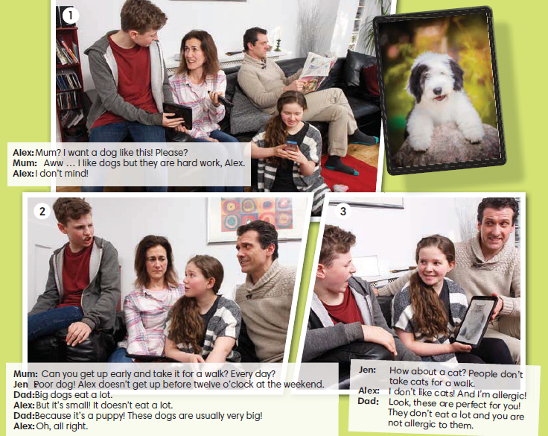
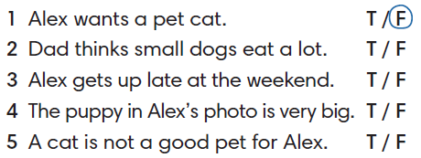
Circle the correct answer.
IrinaPapakhinac

Slide 5



Find these expressions in the story.
What do they mean?
IrinaPapakhinac

Slide 6
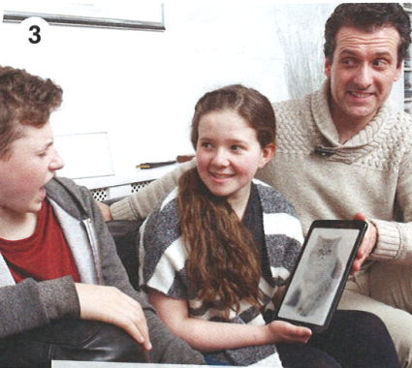

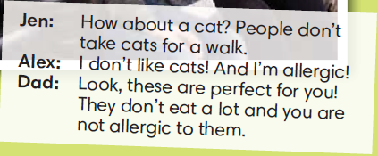
GUESS!
What animals does dad say about?
Watch the video and check your answers.
IrinaPapakhinac

Slide 7
Complete the sentences.
doesn’t
Alex __________ get up before twelve o’clock at the weekend.
It __________ eat a lot.
People __________ take dogs for a walk.
I __________ like cats!
They __________ eat a lot and you are not allergic to them.
doesn’t
don’t
don’t
don’t
IrinaPapakhinac

Slide 8
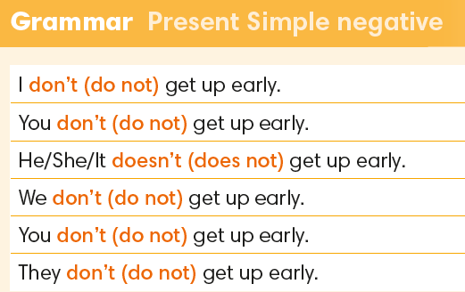
IrinaPapakhinac

Slide 9
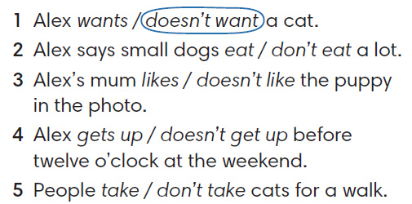
Circle the correct answer.
IrinaPapakhinac

Slide 10
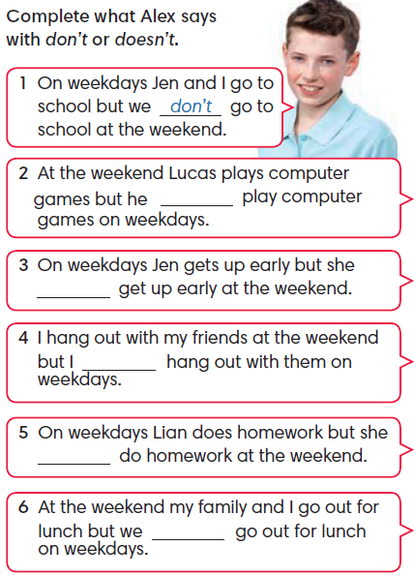
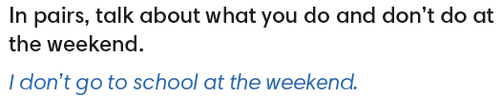
doesn’t
doesn’t
don’t
doesn’t
don’t
IrinaPapakhinac

Slide 11
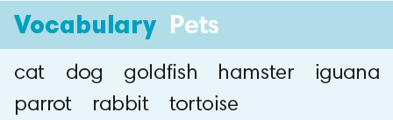

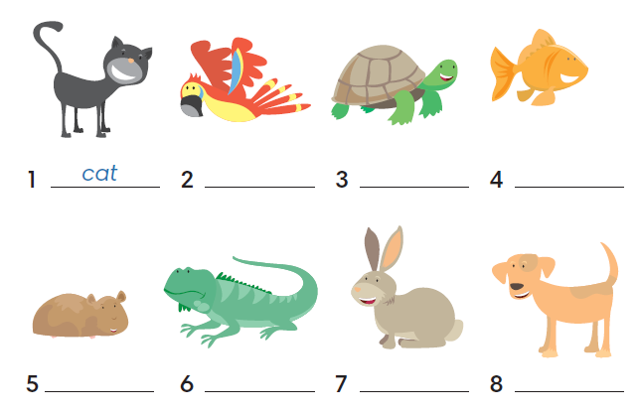
cat
iguana
dog
parrot
goldfish
rabbit
hamster
tortoise
IrinaPapakhinac

Slide 12
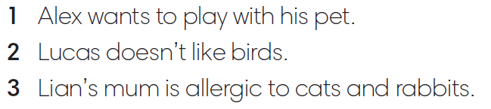
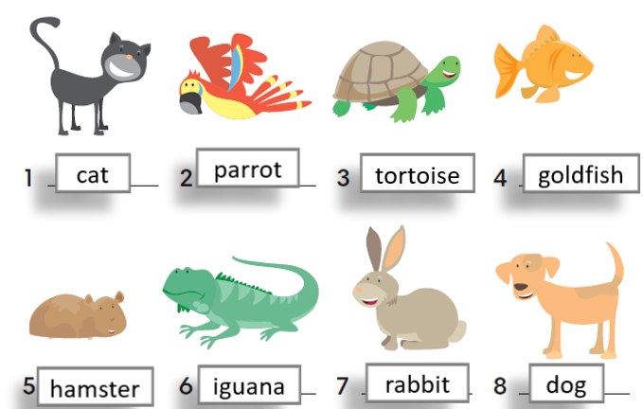
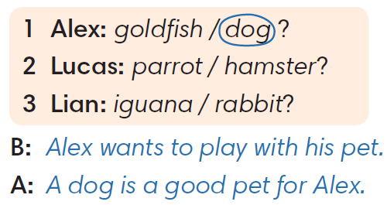
IrinaPapakhinac

Slide 13
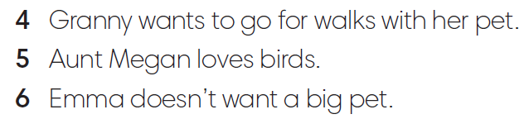
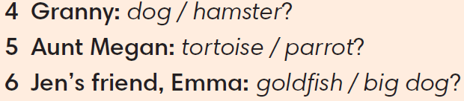
IrinaPapakhinac

Slide 14
What is a good pet for you? Why?
IrinaPapakhinac

Slide 15
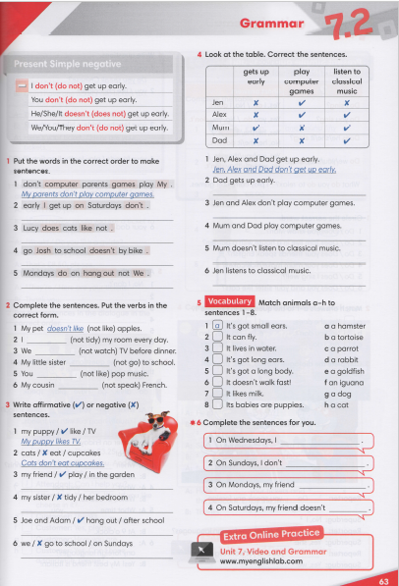


IrinaPapakhinac

Slide 16
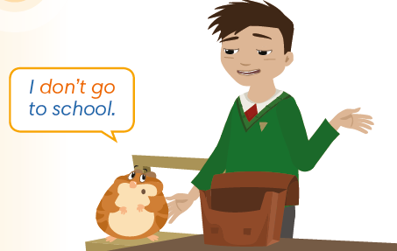

GUESS!
Does Hammy want to go to school?
Watch the video and check your answers.
IrinaPapakhinac

Slide 17
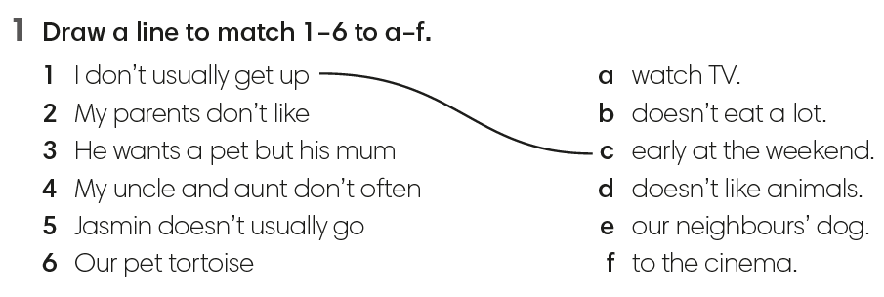
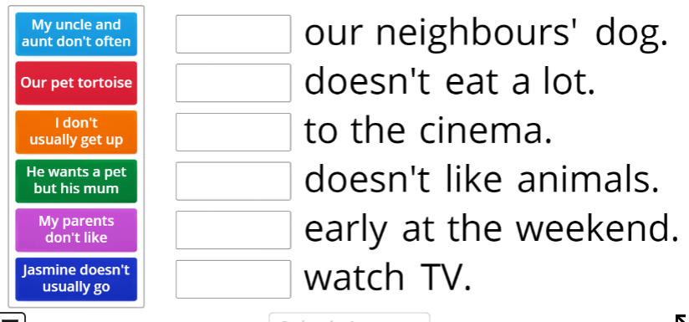
IrinaPapakhinac

Slide 18
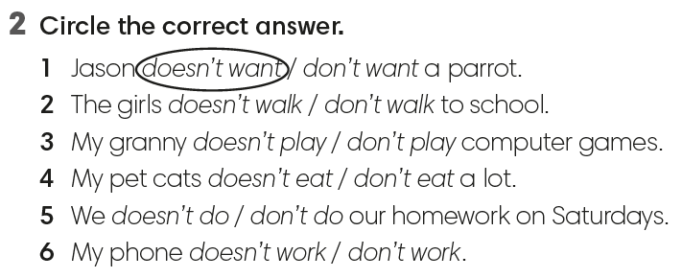
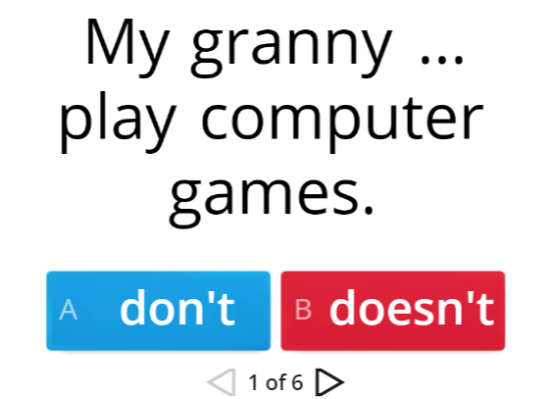
IrinaPapakhinac

Slide 19
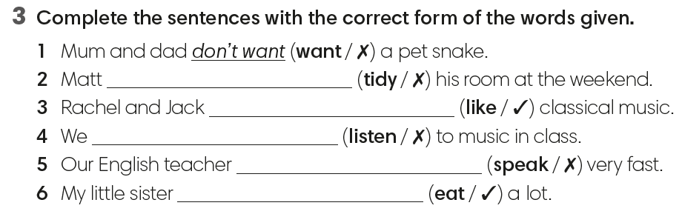
doesn’t tidy
like
don’t listen
doesn’t speak
eats
IrinaPapakhinac

Slide 20
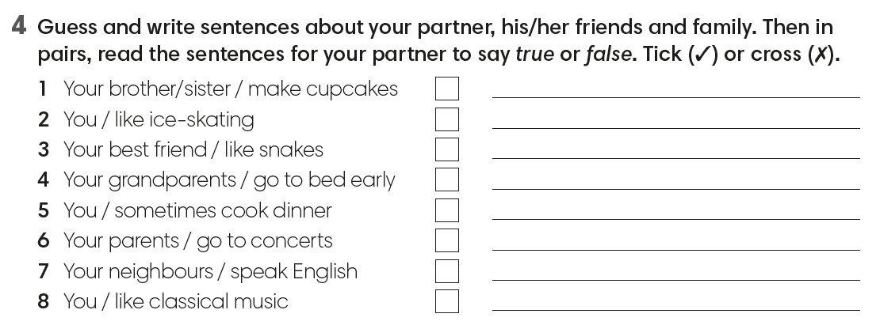
IrinaPapakhinac

