Slide 1




A MESSY ROOM
How good is
your memory?
MEMORY GAME

Slide 2
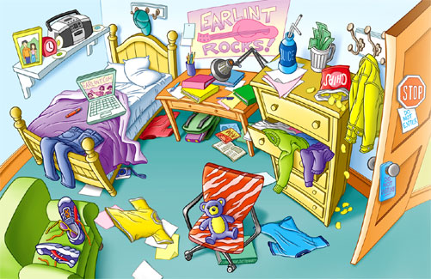


Slide 3
CLICK THE NUMBER OF THE QUESTION
1
2
3
4
5
6
7
8
9
10
11
12

Slide 4





1.Where is the yellow jacket?
It’s Behind the door
It’s Beside the armchair
It’s In the wardrobe

Slide 5
2.Where are the trainers?
They are In a shoe box
They are Under the desk
They are On the armchair

Slide 6
3.Where is the red T-shirt?
It’s On the chair
It’s in the dresser
It’s under the bed

Slide 7
4.Where is the radio?
It’s On the floor
It’s on the shelf
It’s on the desk

Slide 8
5.Where is the green book?
It’s under the rug
It’s under the desk
It’s under the chair

Slide 9
6.Where is the cap?
It’s over the bed
It’s next to the door
It’s on the shelf

Slide 10
7.Where is the chair in the room?
It’s in the middle
It’s on the right
It’s on the left

Slide 11
8.What colour are the pullovers inside the drawer ?
They are green and red
They are green and purple
They are purple and blue

Slide 12
9. The poster is on the wall over …
the desk
the bed
the dresser

Slide 13
10.The alarm clock is between …
The photo and the lamp
The lamp and the radio
The photo and the radio

Slide 14
11.What colour is the T-shirt between the bed and the armchair?
It’s red
It’s yellow
It’s blue

Slide 15
12.The blue T-shirt is on the floor in front of …
The bed
The dresser
The desk

Slide 16

13.Where is the radio?
It’s On the floor
It’s on the shelf
It’s on the desk

