Slide 1
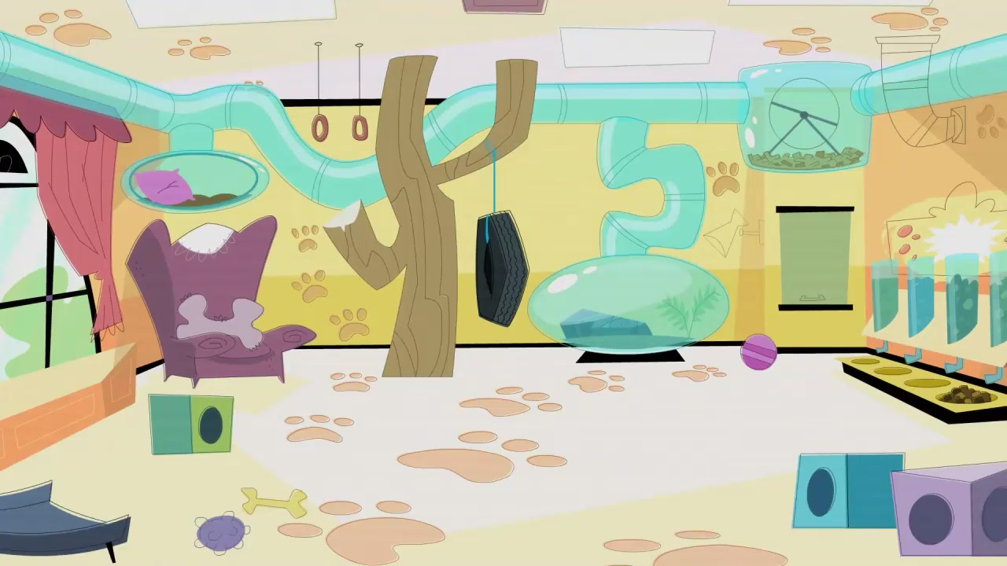



IrinaPapakhinac

Slide 2

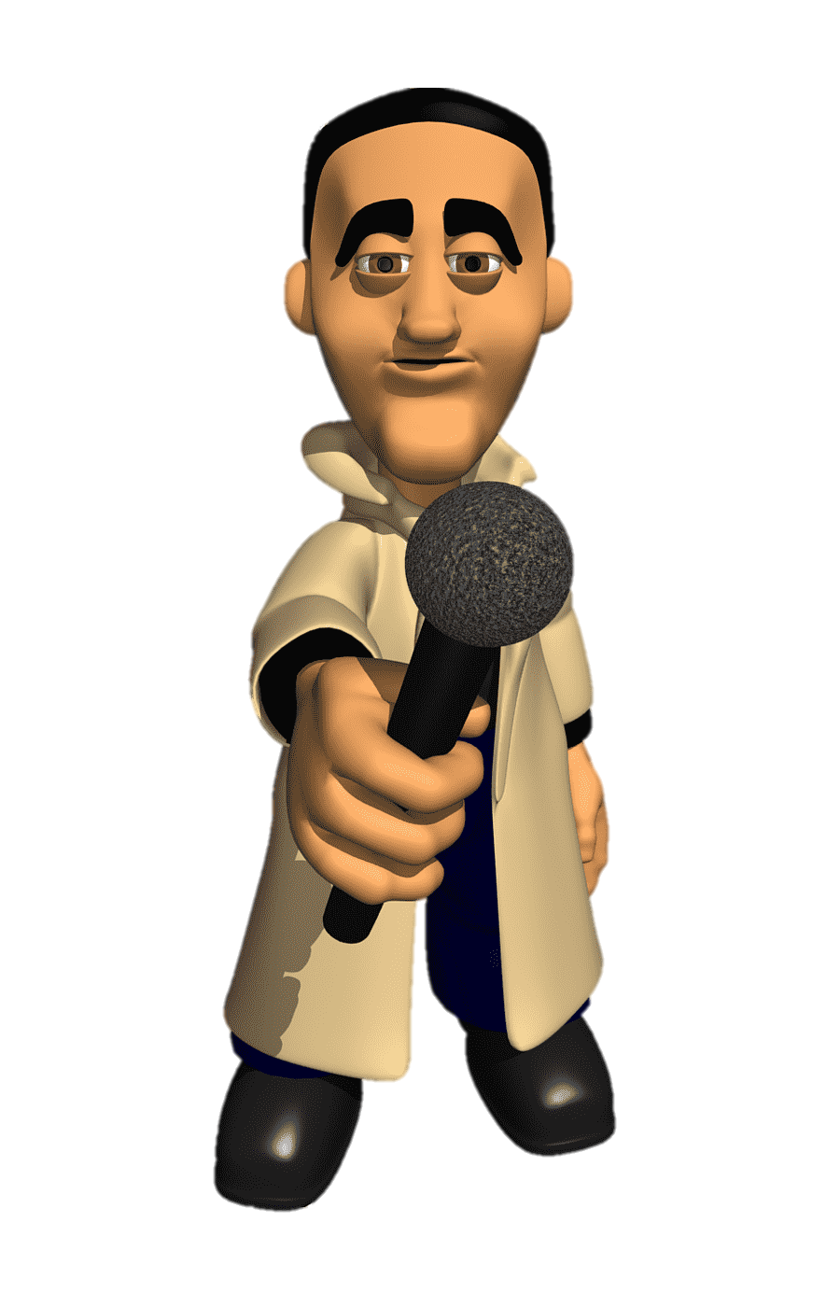
1. Is there a pet shop in your hometown?
2. What animals can you buy in a pet shop?
3. Are these animals easy or difficult to look after?
IrinaPapakhinac

Slide 3













Listen to a radio interview with Jo.
Jo has got a pet shop.
What animals are they talking about?
IrinaPapakhinac

Slide 4
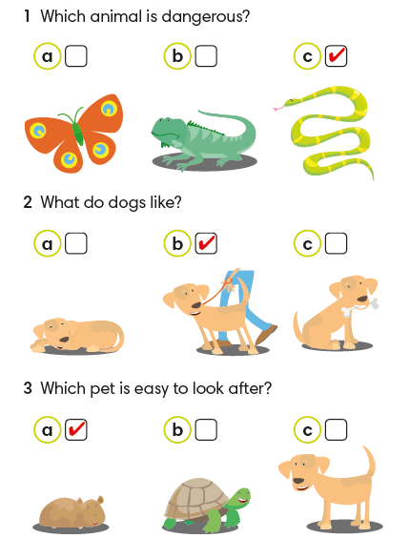

1. Listen again and tick the correct answer a, b, or c.
2. What does Jo say about these animals?
IrinaPapakhinac

Slide 5
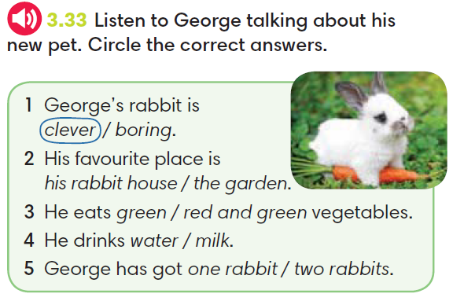
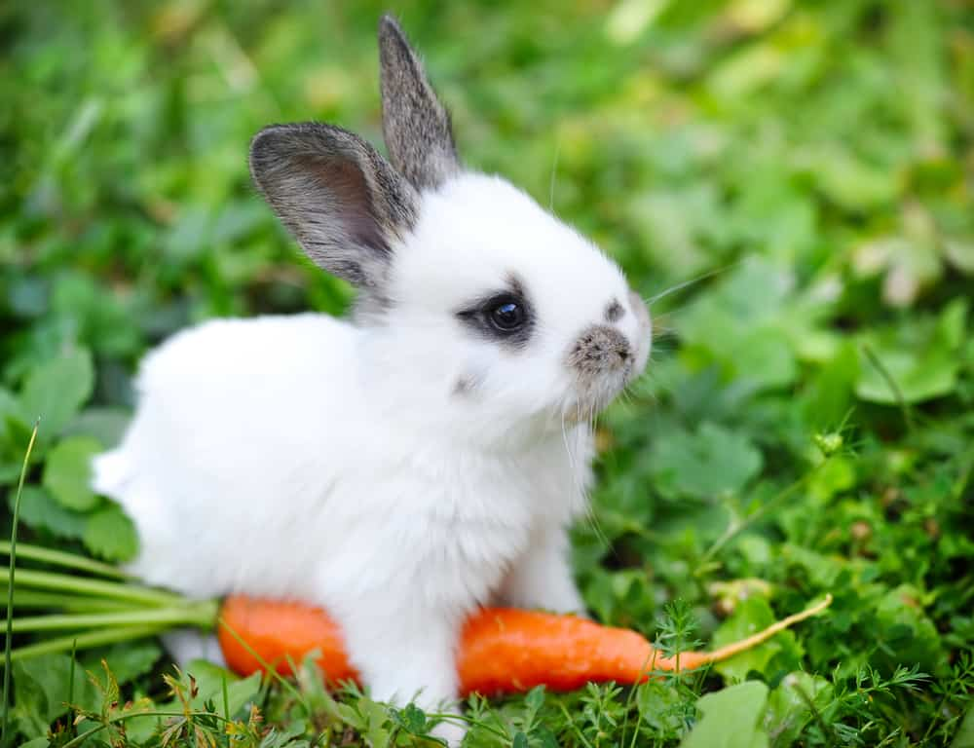
IrinaPapakhinac

Slide 6
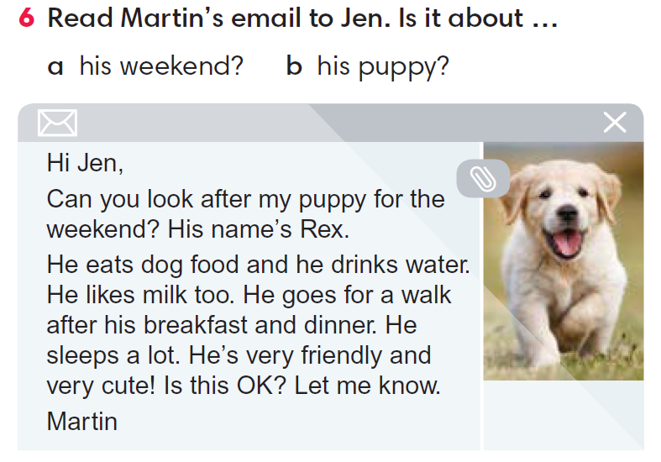
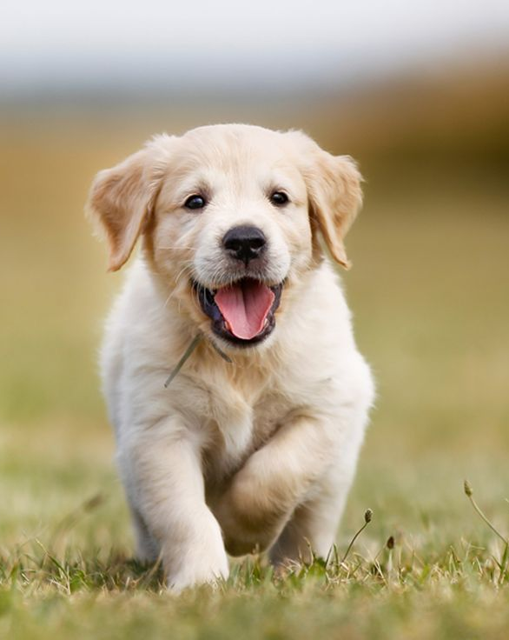
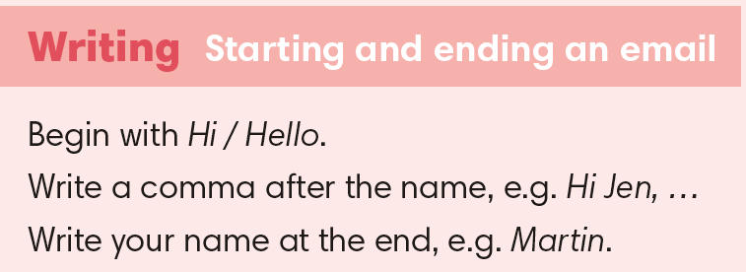
IrinaPapakhinac

Slide 7



IrinaPapakhinac

Slide 8
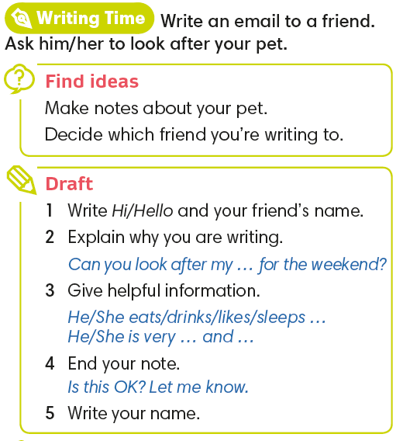
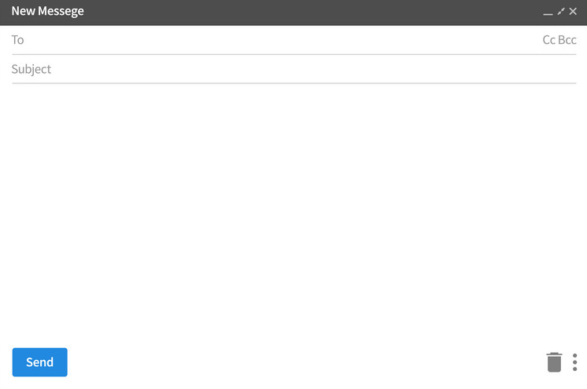
IrinaPapakhinac

Slide 9
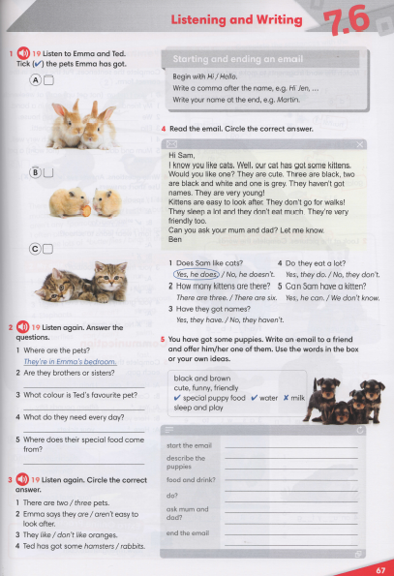


IrinaPapakhinac

Slide 10
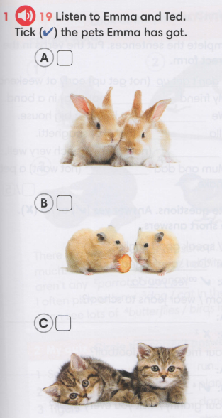
IrinaPapakhinac

Slide 11
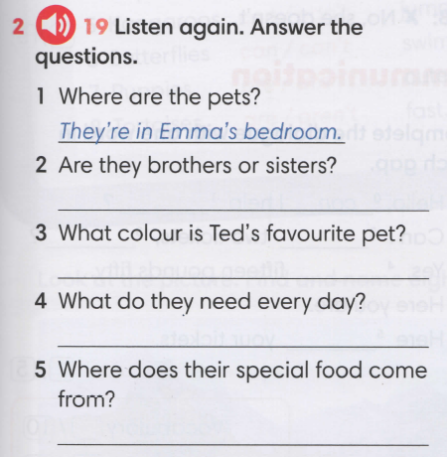
They are sisters.
Brown and white
New food
From the pet shop
IrinaPapakhinac

Slide 12
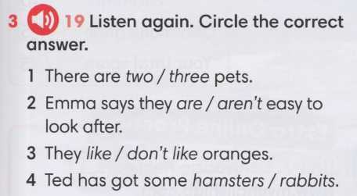
IrinaPapakhinac

