Slide 1
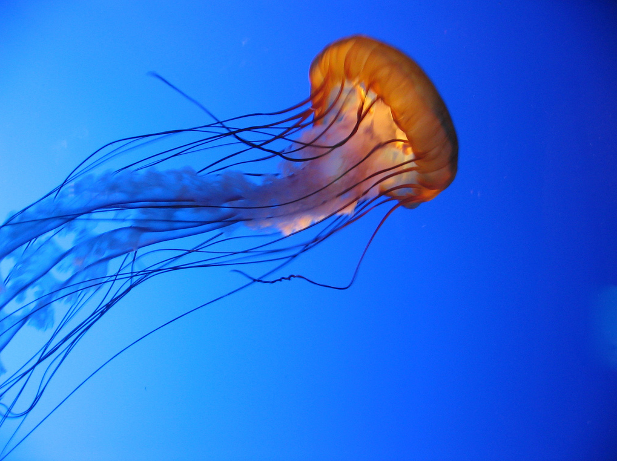
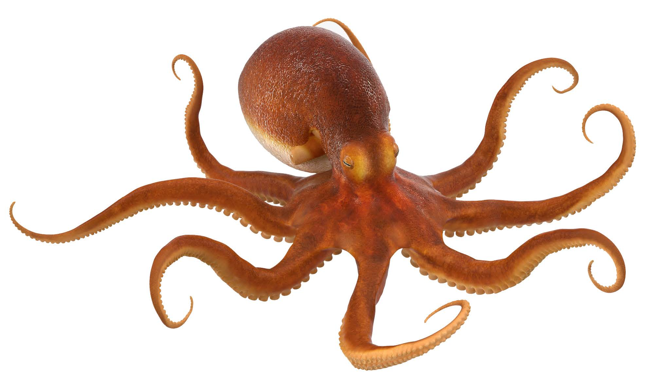
fast

Slide 2
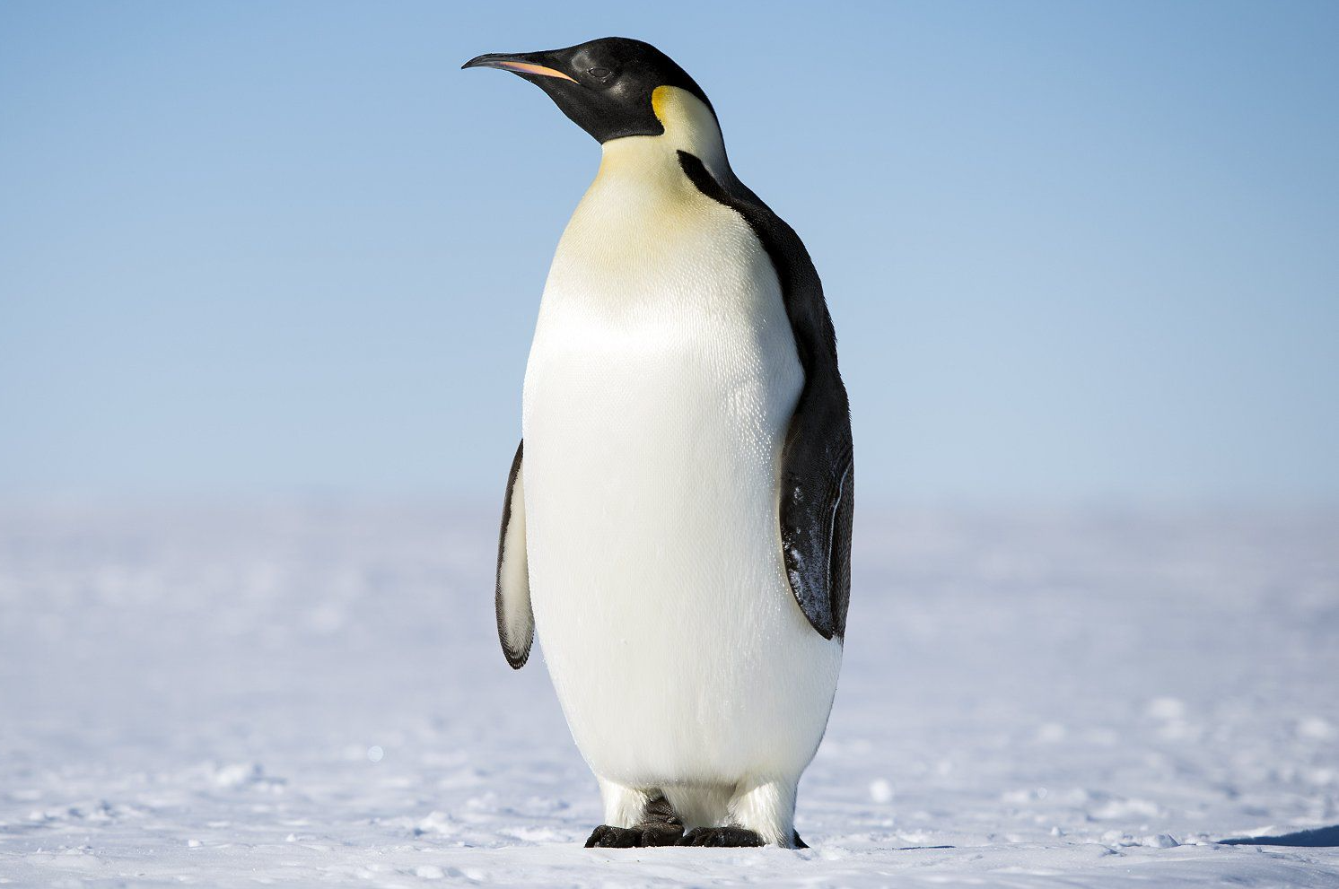

heavy

Slide 3
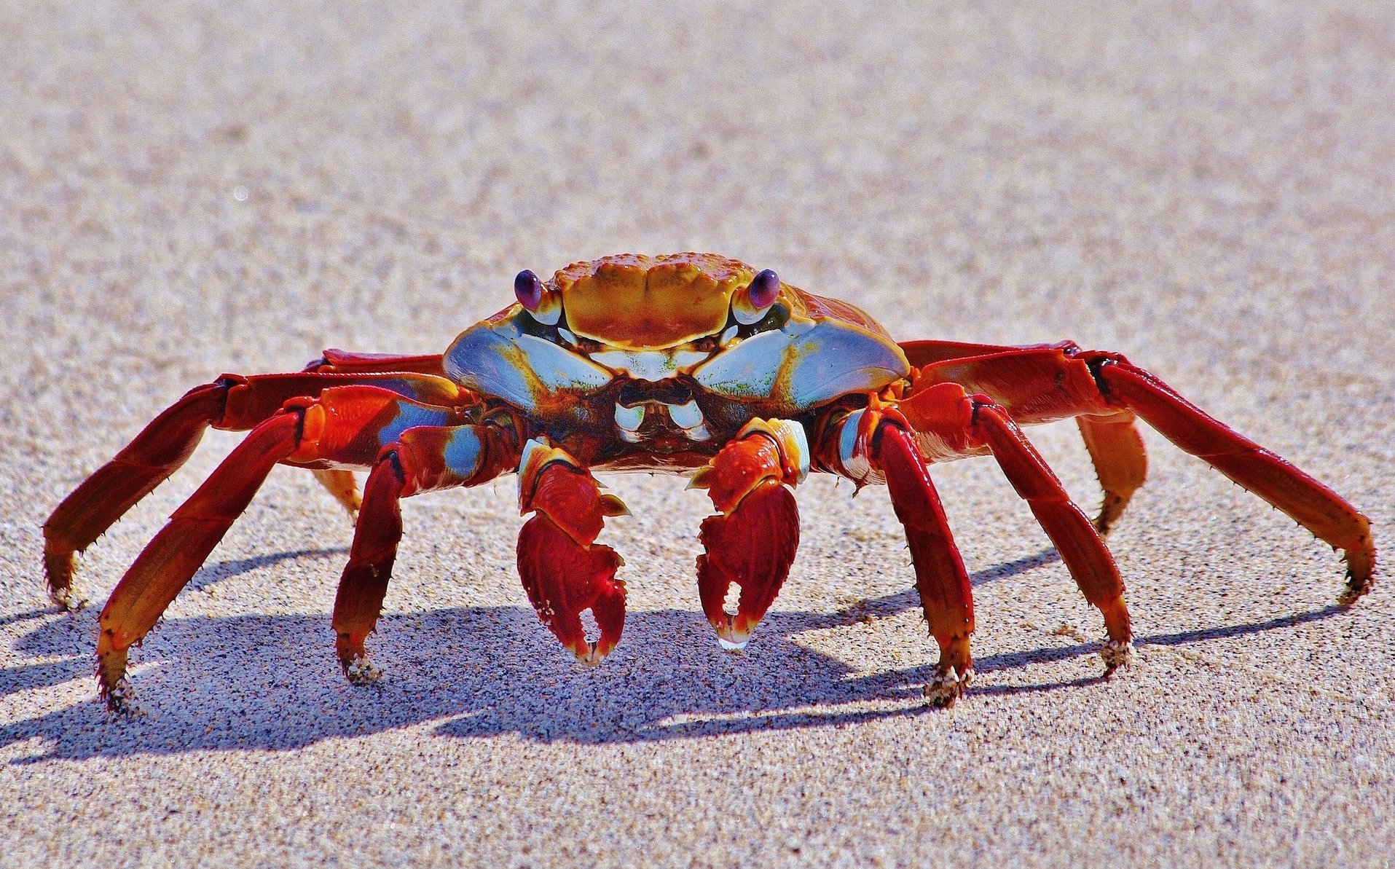
hard

Slide 4
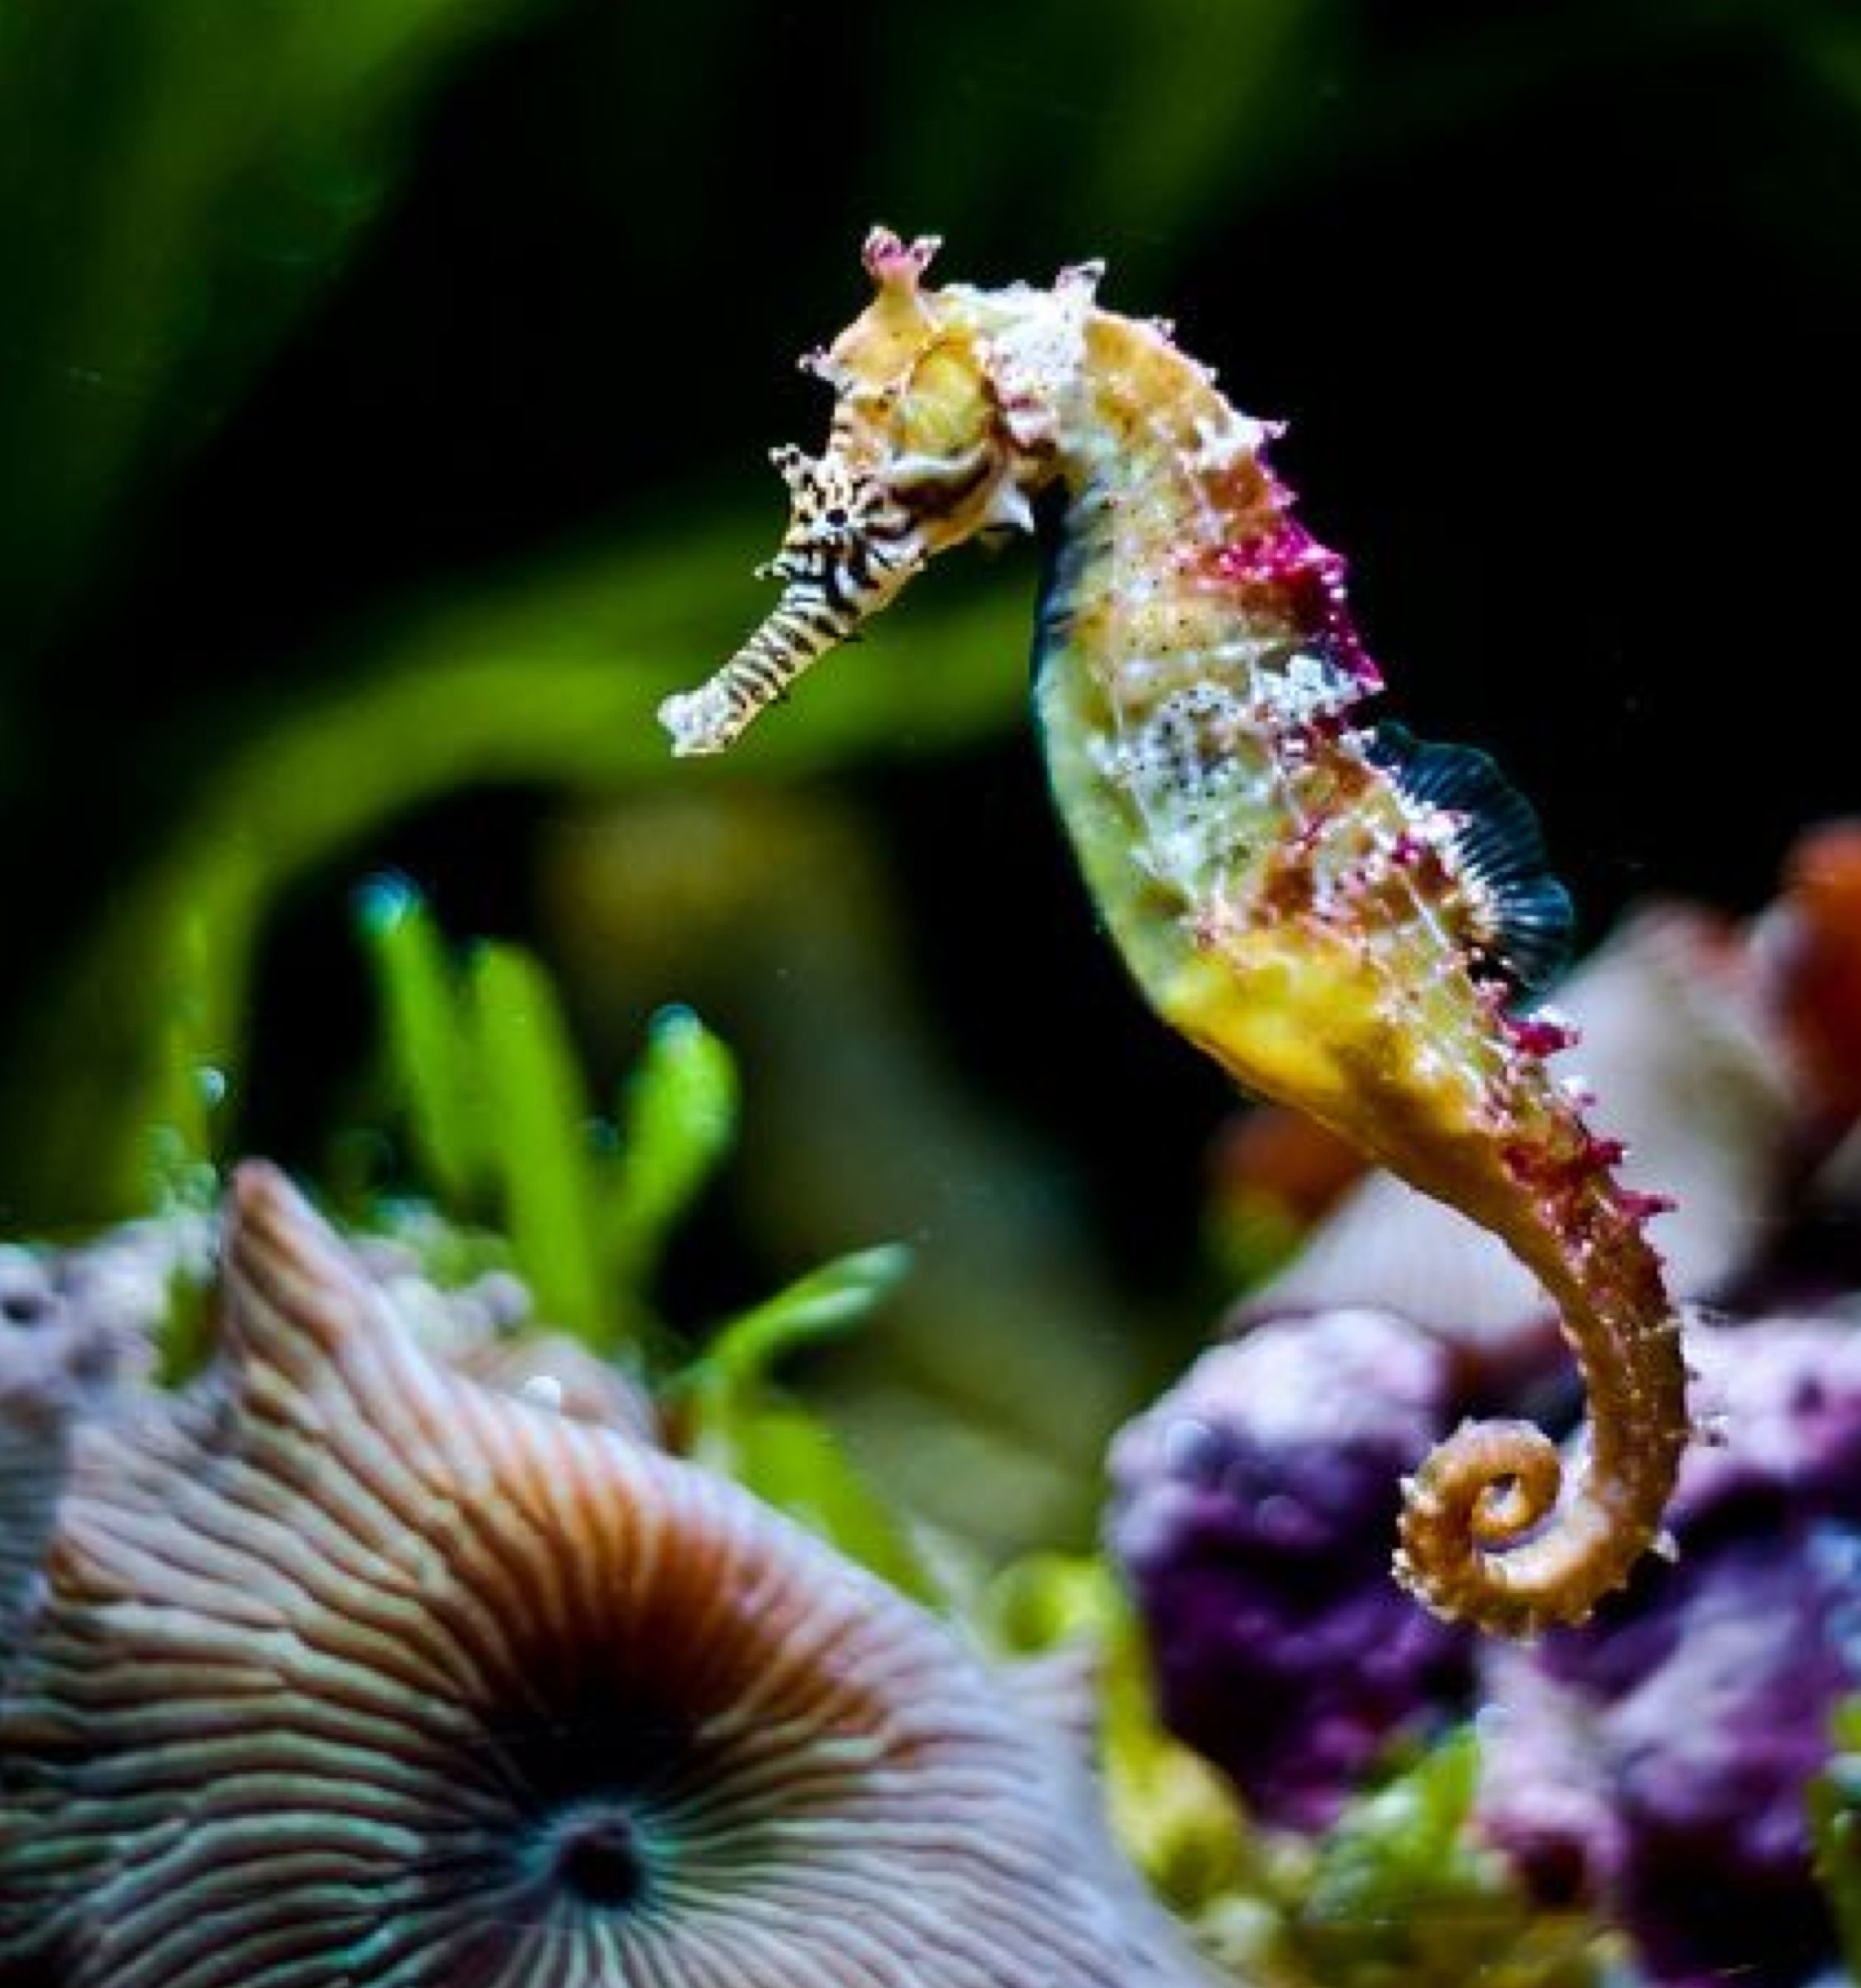
tiny

Slide 5
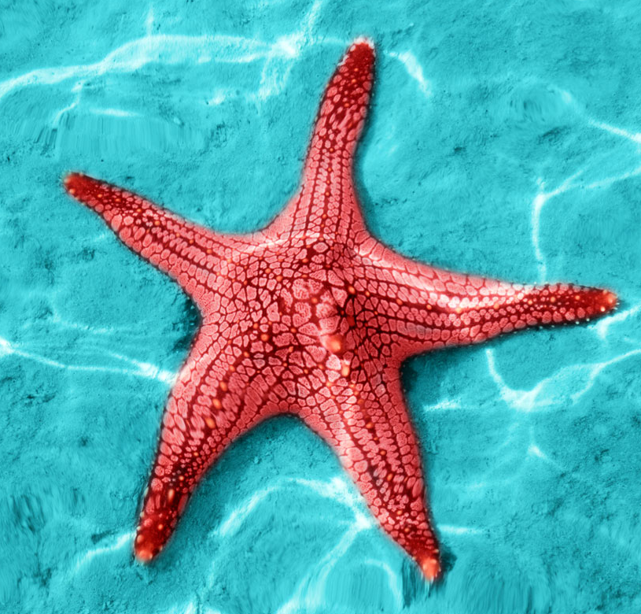
loud

Slide 6
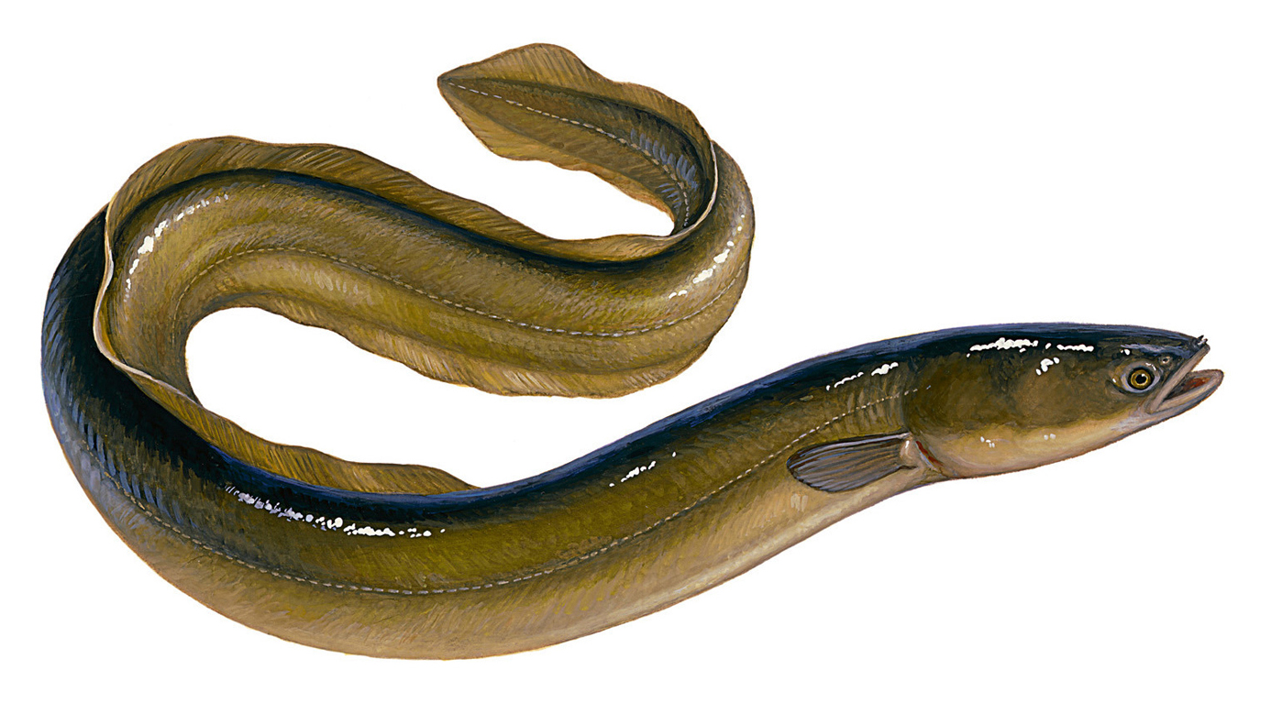
long

Slide 7
thin

Slide 8
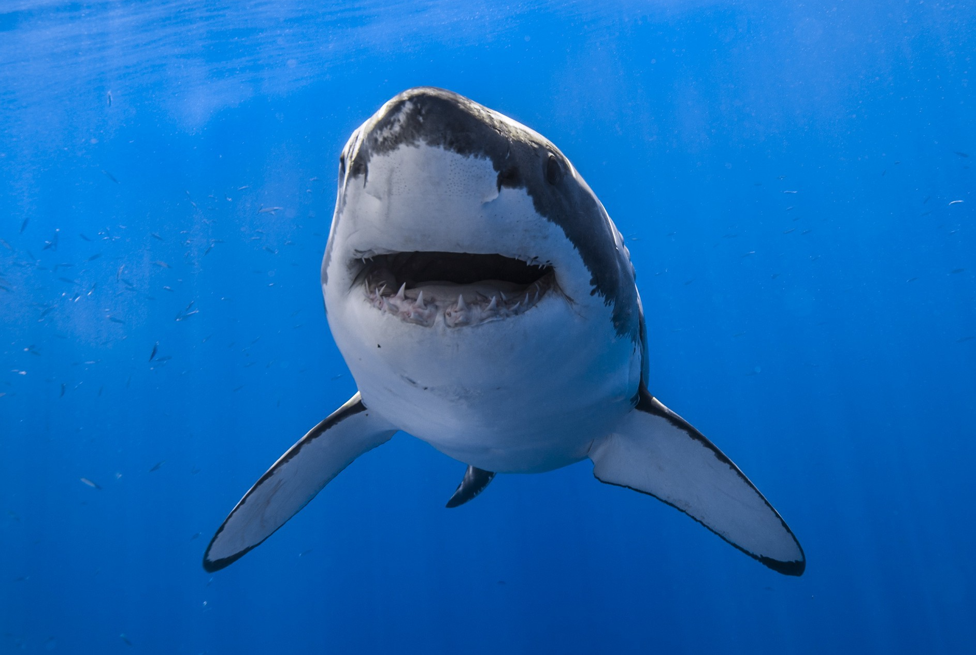
dangerous

Slide 9
beautiful

Slide 10
funny

Slide 11
slow

Slide 12
fat

Slide 13
friendly

Slide 14
scary

