Slide 1
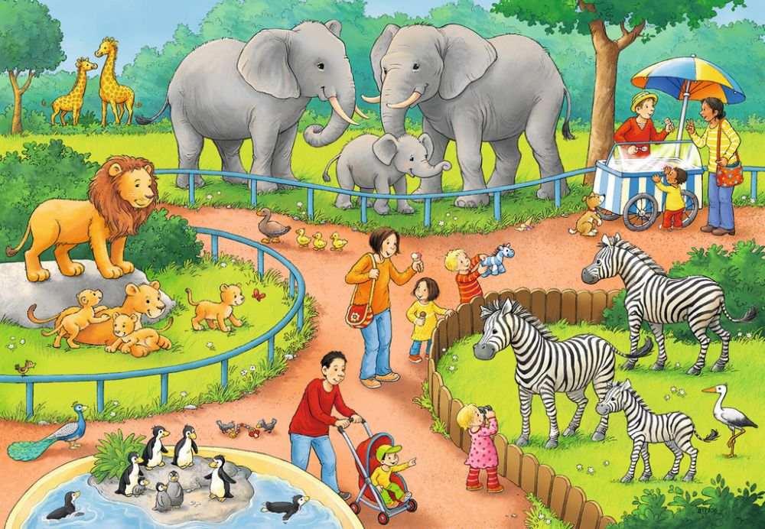
elephants ?

Slide 2
giraffes ?

Slide 3
zebras?

Slide 4
lions?

Slide 5
penguins?

Slide 6
ducklings?

Slide 7
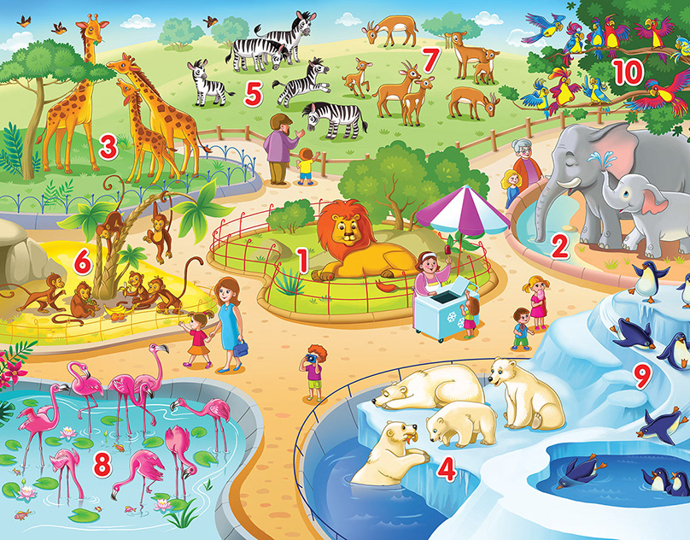
giraffes?

Slide 8
zebras?

Slide 9
deer?

Slide 10
parrots?

Slide 11
elephants?

Slide 12
penguins?

Slide 13
polar bears?

Slide 14
flamingos?

Slide 15
monkeys?

Slide 16
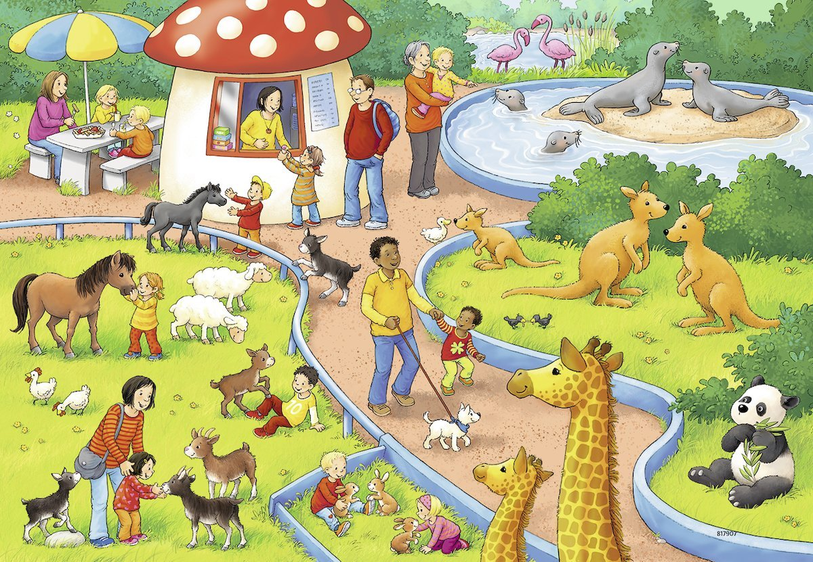
seals?

Slide 17
kangaroos?

Slide 18
sheep?

Slide 19
goats?

Slide 20
hens?

Slide 21
rabbits?

