Slide 1
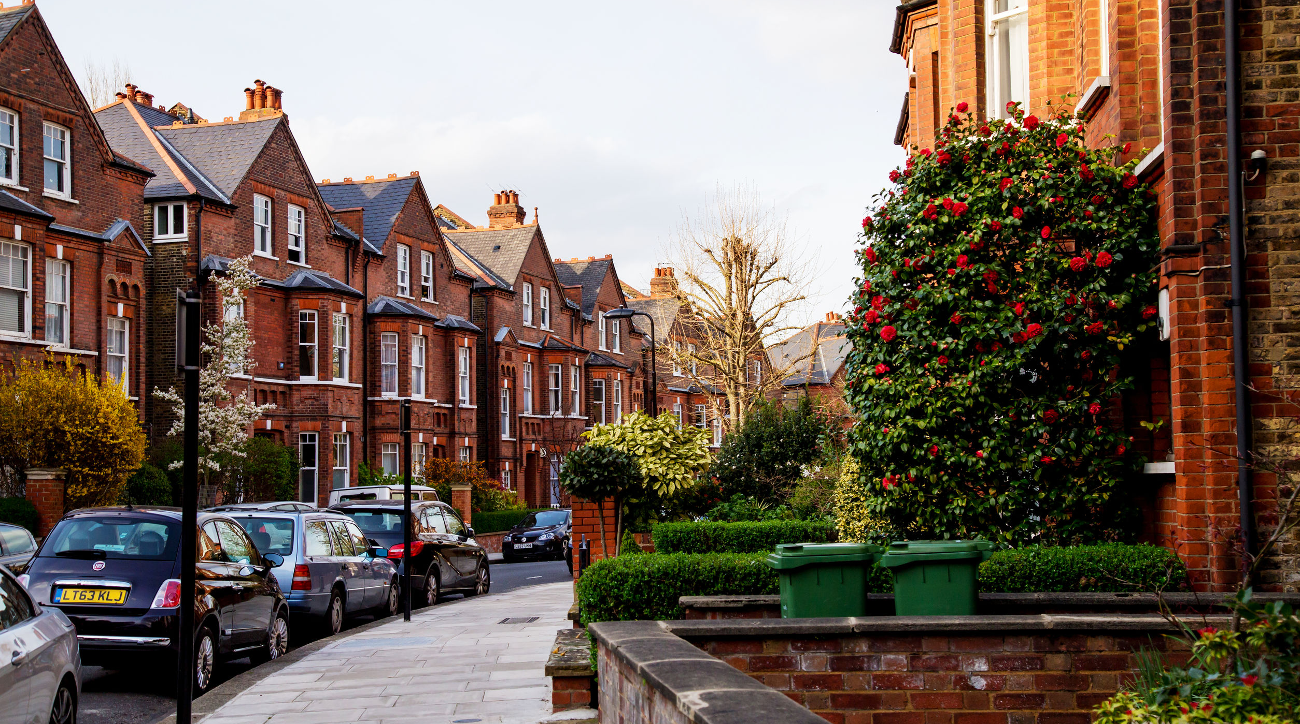


IrinaPapakhina

Slide 2


GUESS THE RIDDLE!
It can be big or small.
It has windows and doors.
It has rooms.
You live in it.
What is it?
ANSWER:
house
IrinaPapakhina

Slide 3
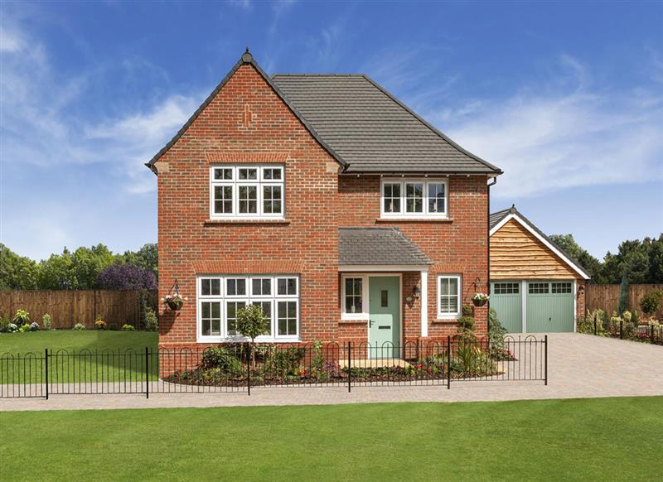

a detached house
IrinaPapakhina

Slide 4
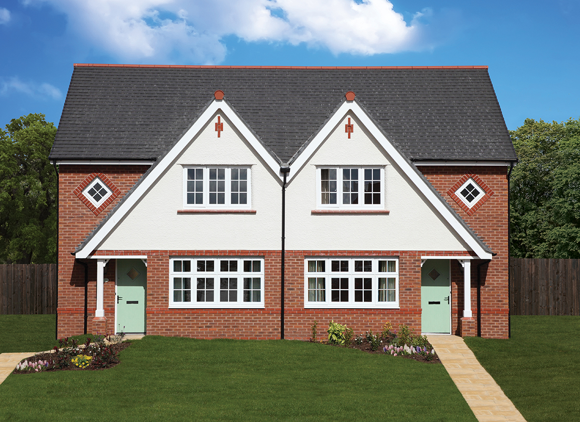
semi-detached houses
IrinaPapakhina

Slide 5
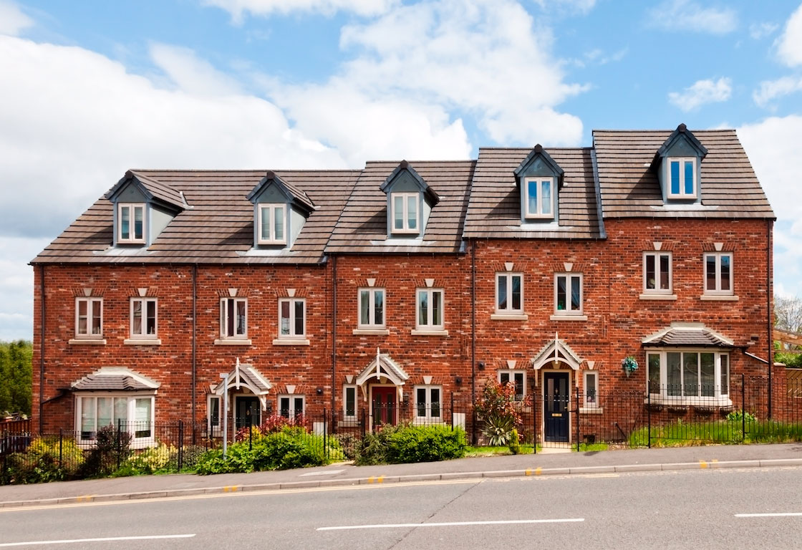
terraced houses
IrinaPapakhina

Slide 6
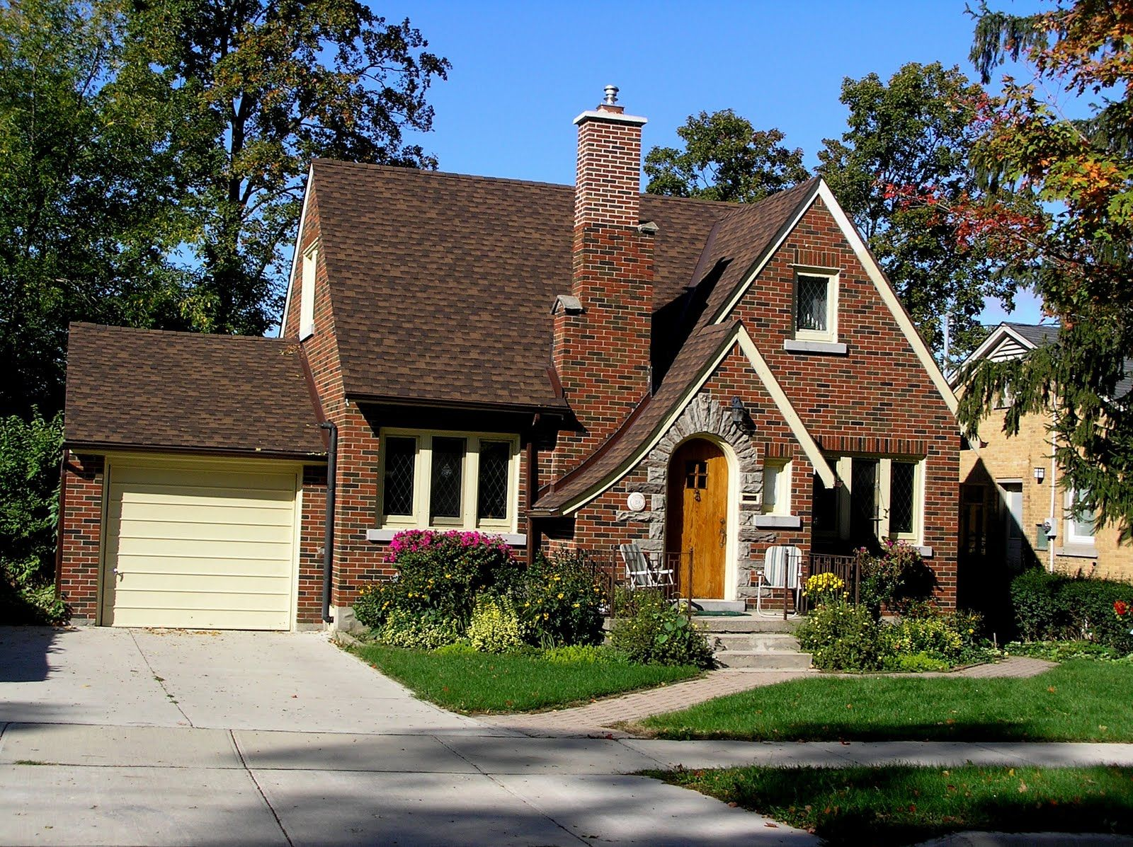
a cottage
IrinaPapakhina

Slide 7
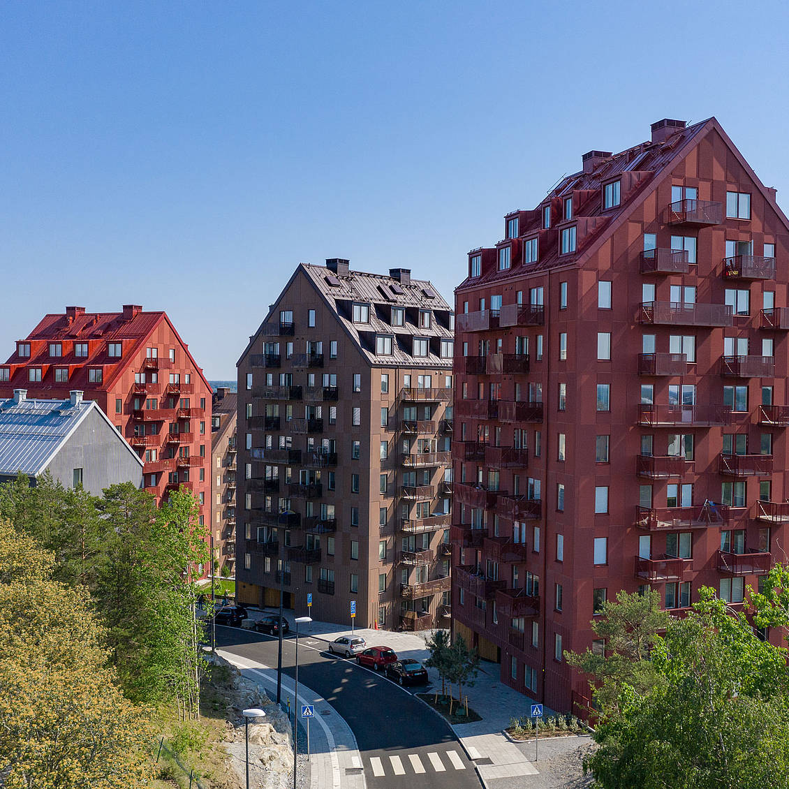
blocks of flats
IrinaPapakhina

Slide 8
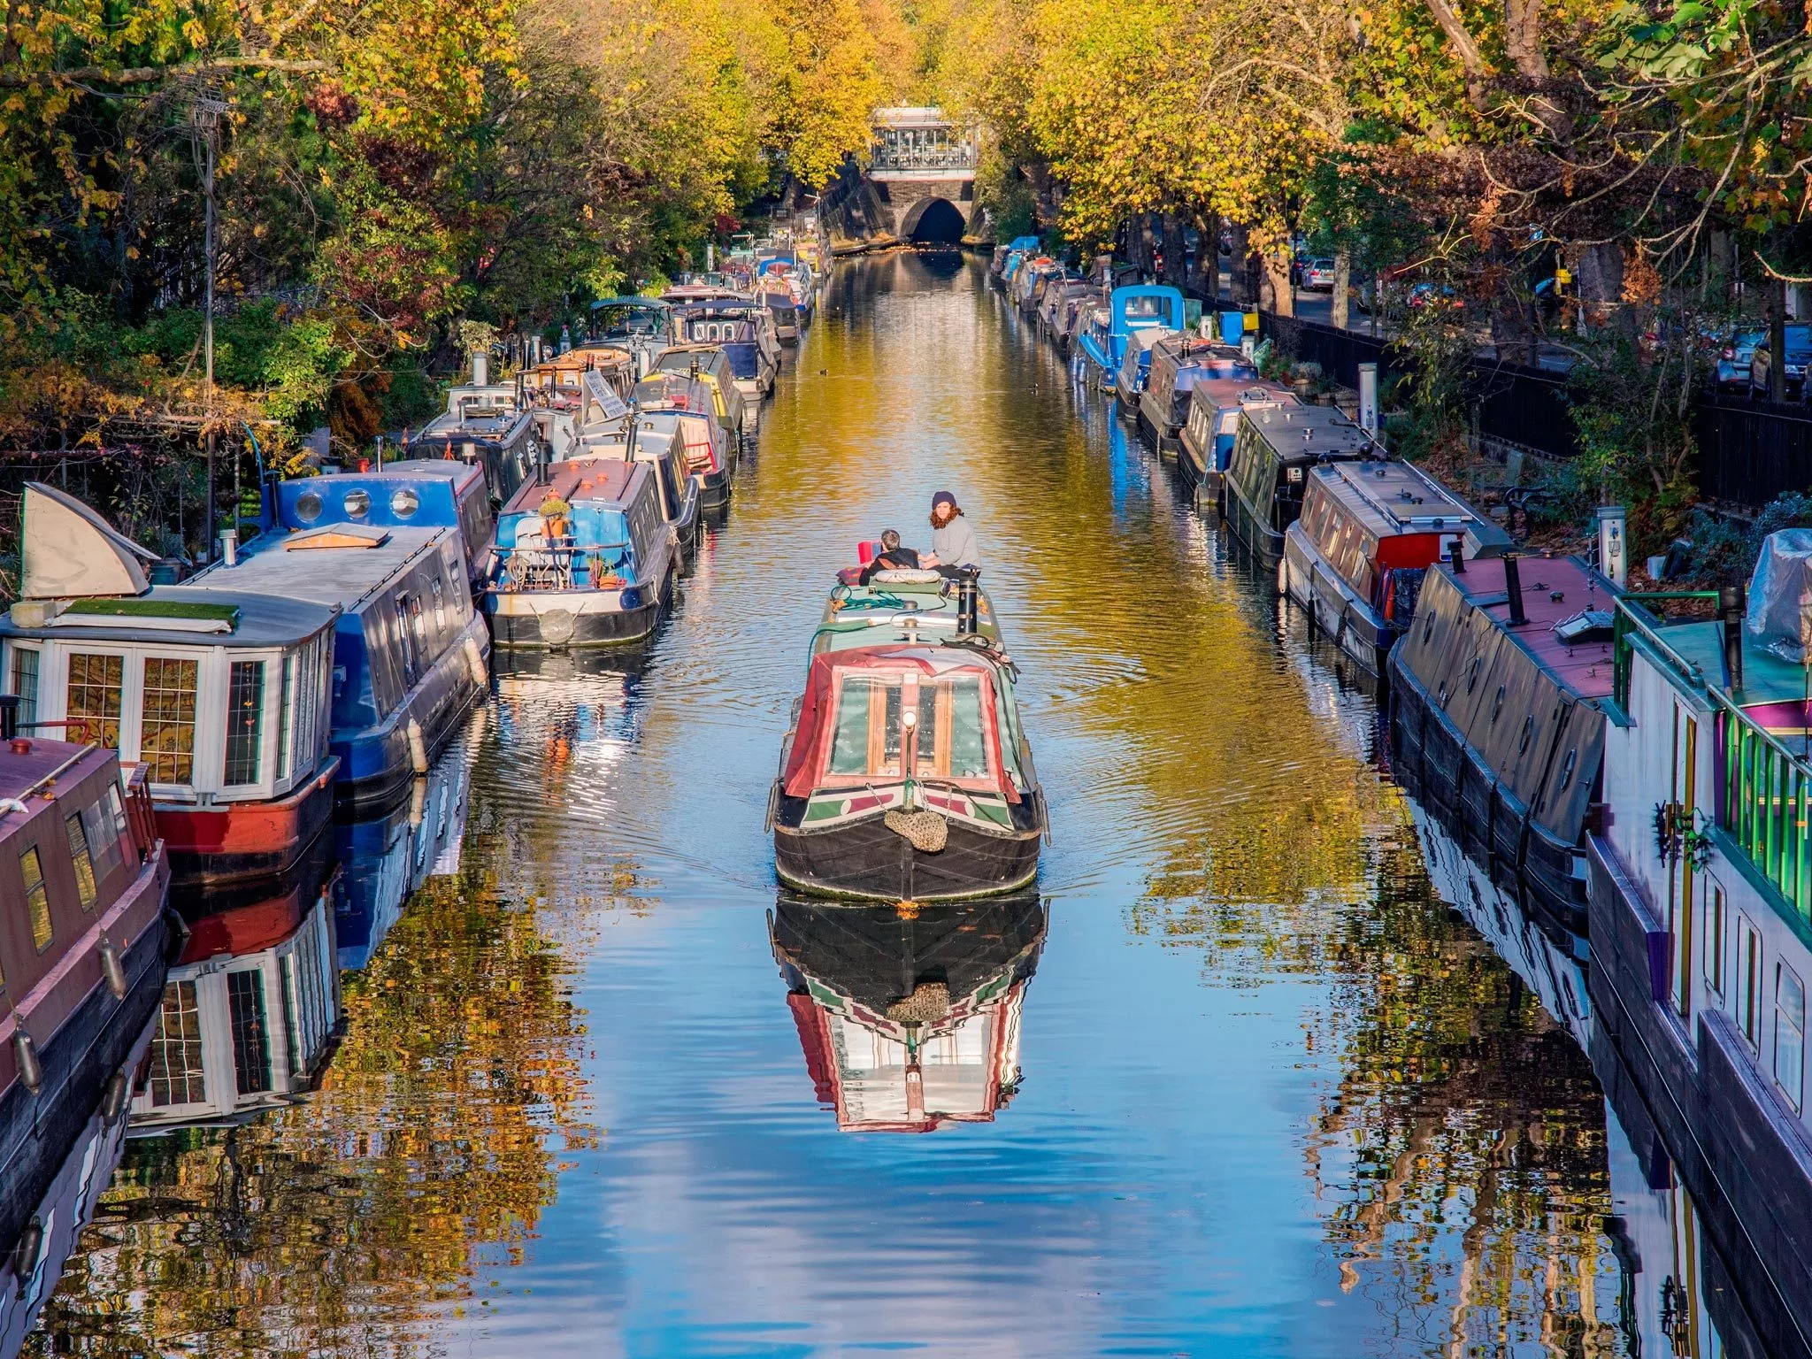
houseboats
IrinaPapakhina

Slide 9
a detached house
semi-detached houses
terraced houses
a cottage
blocks of flats
houseboats
Where can you see these types of houses?
a) in the city b) in the country c) in the city and in the country
IrinaPapakhina

Slide 10
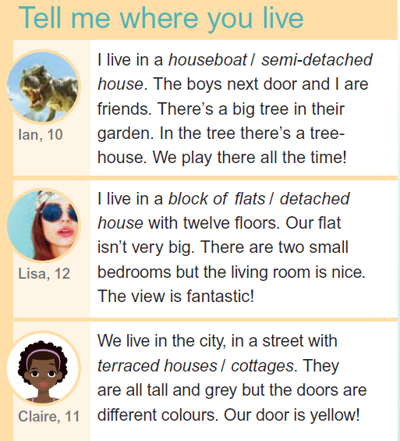
Read the texts and circle the types of the houses the children live in.
Listen and check.
1
4
2
5
3
6
IrinaPapakhina

Slide 11
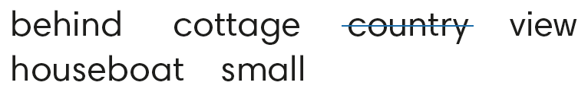
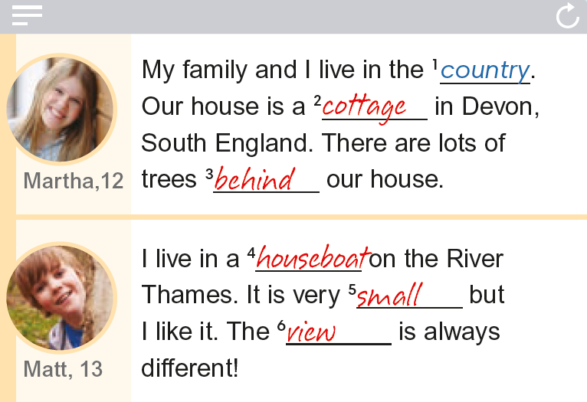


Listen and complete the texts with the words in the box.
1
4
2
5
3
6
IrinaPapakhina

Slide 12
a detached house
terraced houses
blocks of flats
semi-detached houses
a cottage
houseboats
Write a short text about where you live.
Use the texts to help you.
IrinaPapakhina

Slide 13
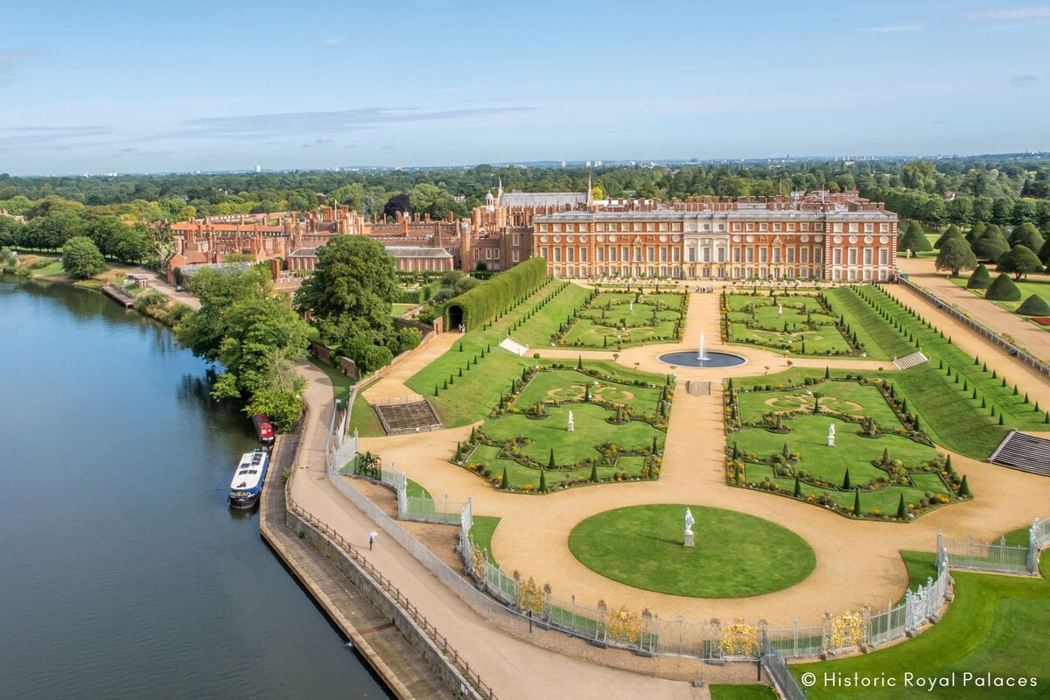
Hampton Court Palace
Who lives in palaces?
IrinaPapakhina

Slide 14

Watch the video and say
who lived in this palace.
King Charles
Queen Elizabeth
King Henry
IrinaPapakhina

Slide 15
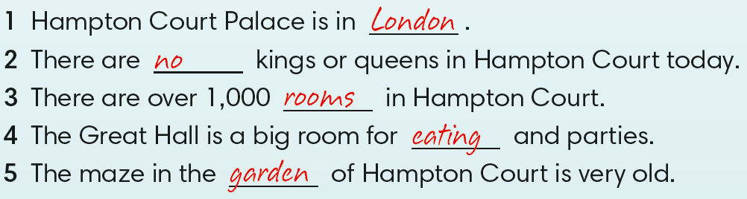
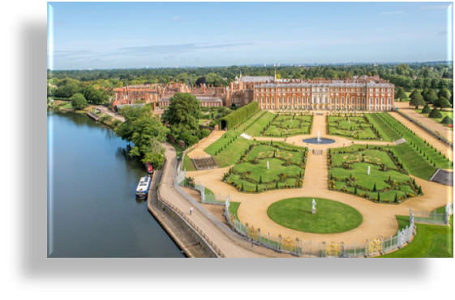
Watch the video and complete the sentences.
Which part of Hampton Court Palace do you like the most? Why?
IrinaPapakhina

Slide 16
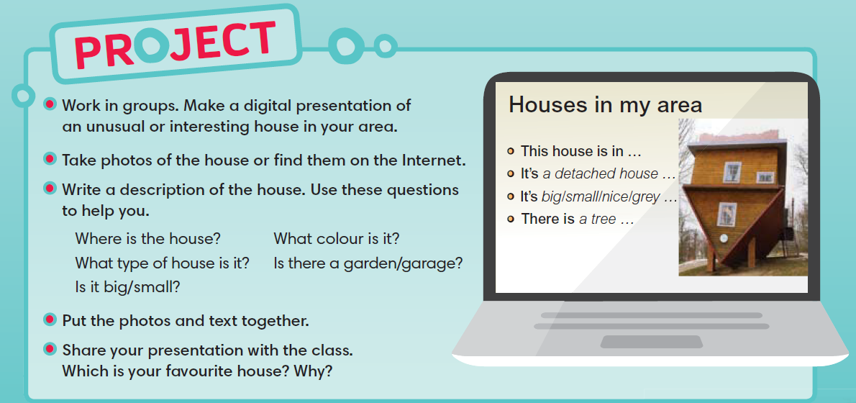
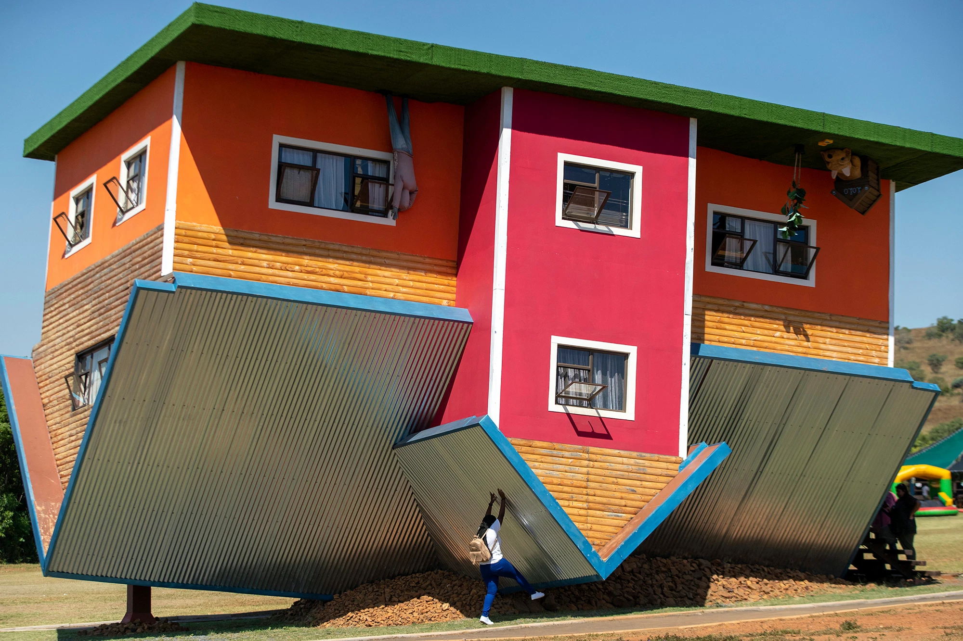
IrinaPapakhina

Slide 17
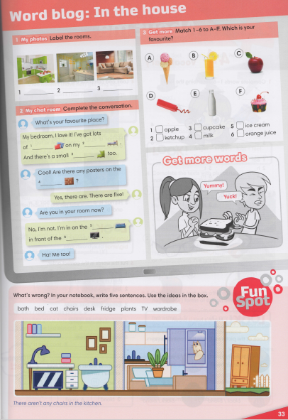


IrinaPapakhina

