Slide 1

DO HOUSEHOLD CHORES

Slide 2
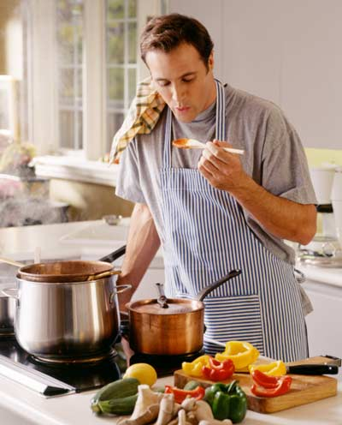
Cook

Slide 3
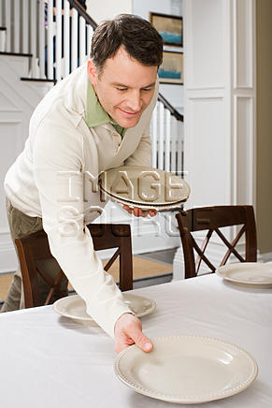
Set the table

Slide 4

Do/wash the dishes

Slide 5
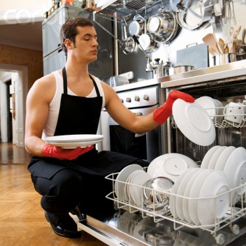
Empty/load the dishwasher

Slide 6
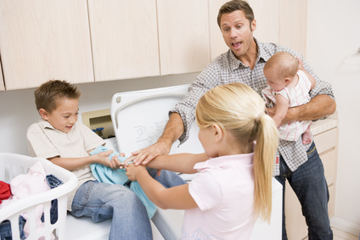
Look after children

Slide 7
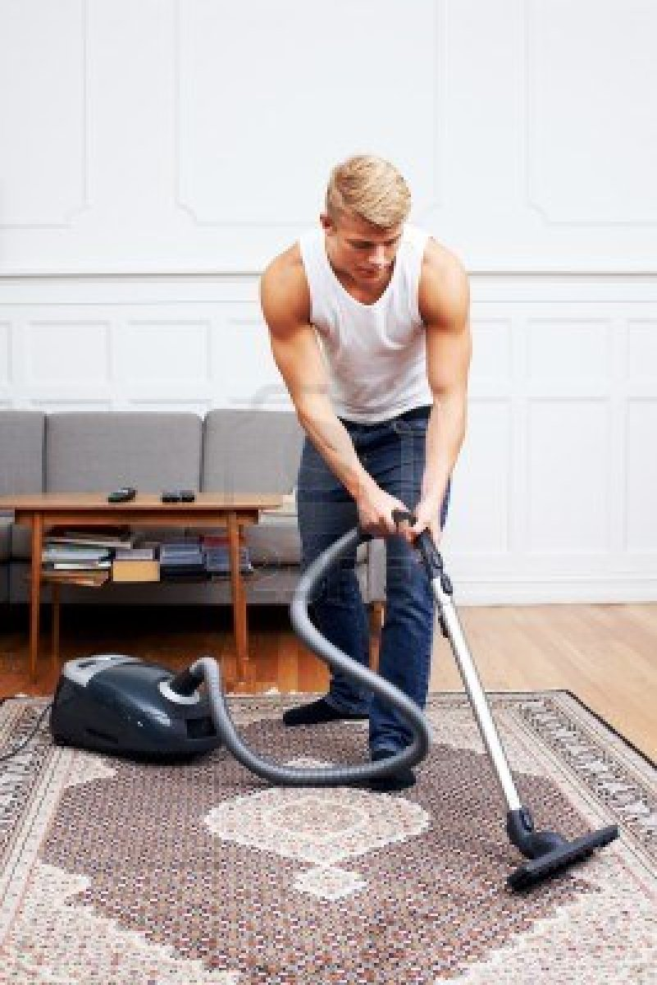
Vacuum the carpet

Slide 8
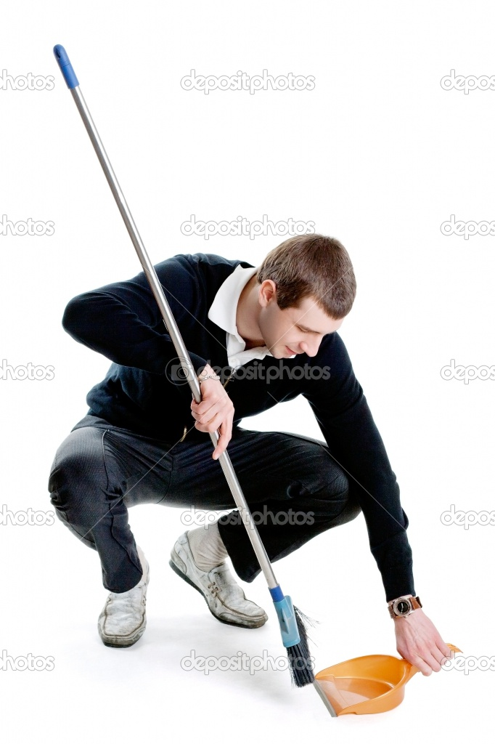
Sweep the floor

Slide 9
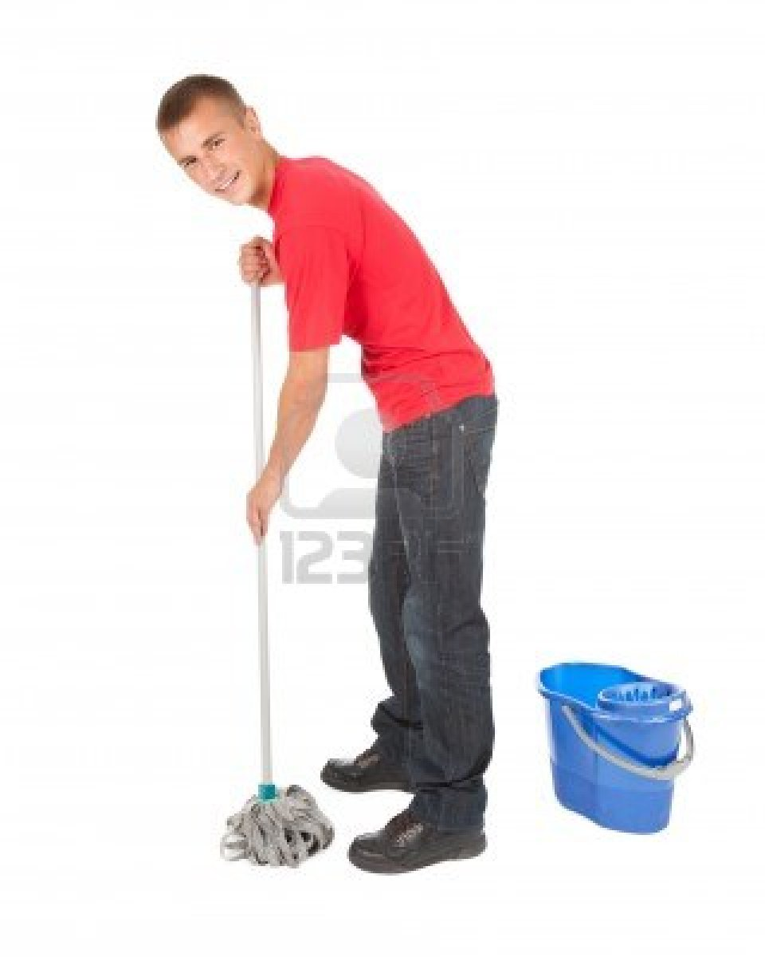
Mop the floor

Slide 10
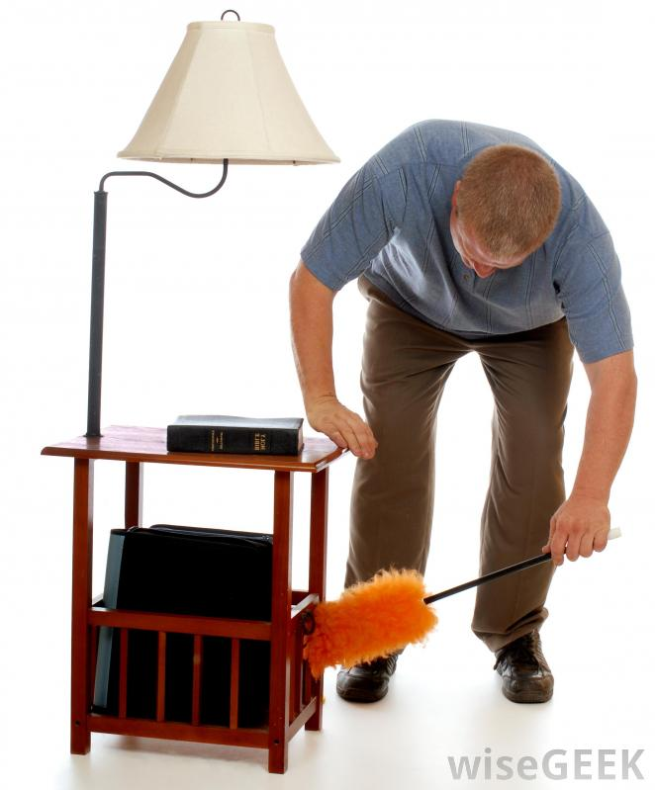
Dust the furniture

Slide 11
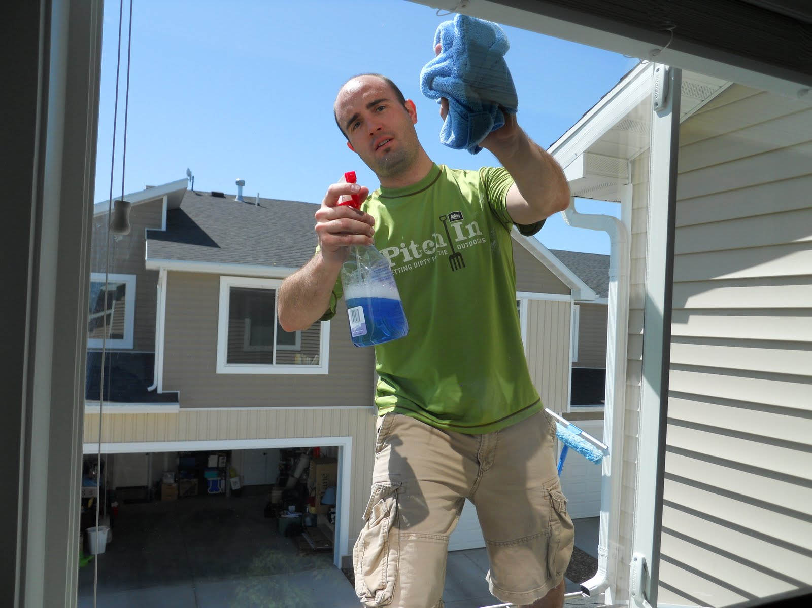
Clean the windows

Slide 12
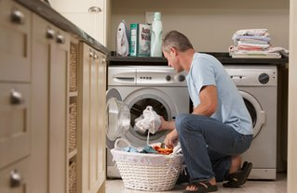
Do the laundry

Slide 13
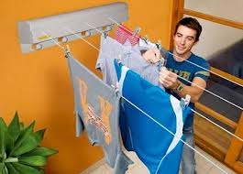
Hang the laundry

Slide 14
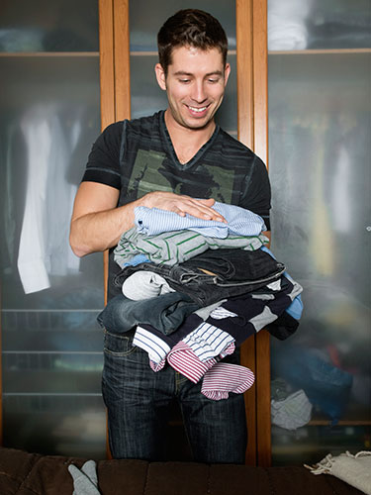
Fold the laundry

Slide 15
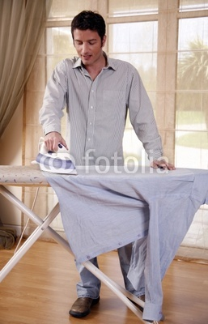
Iron the clothes

Slide 16
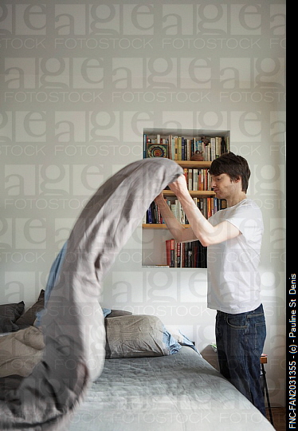
Make the bed

Slide 17
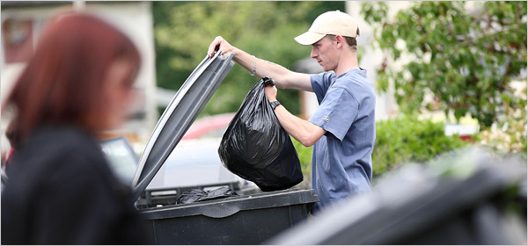
Take the rubbish out

Slide 18
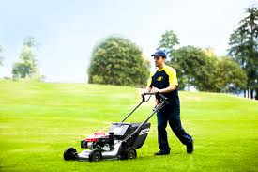
Cut the grass/Mow the lawn

Slide 19
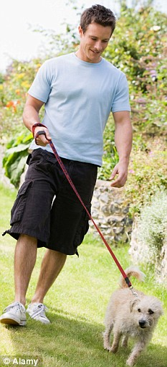
Walk the dog

Slide 20
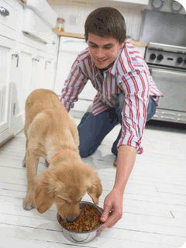
Feed the dog

Slide 21
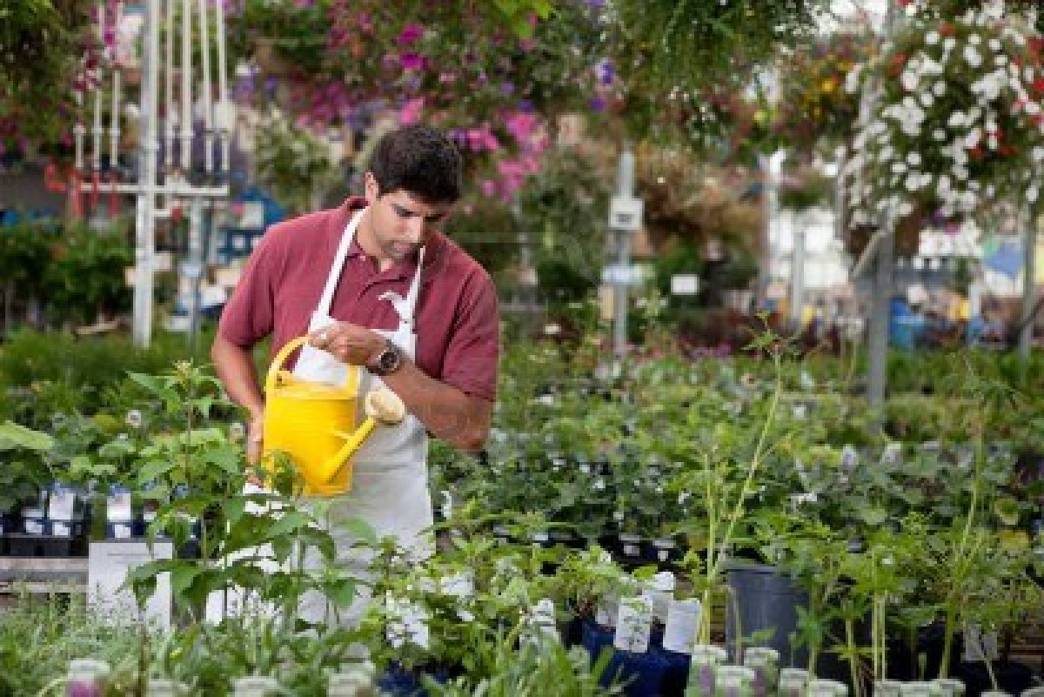
Water the plants

Slide 22
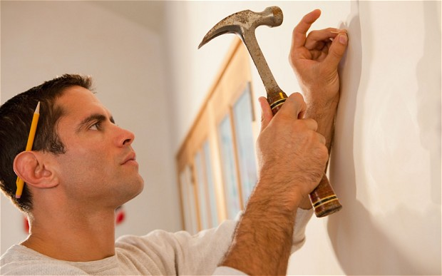
Pound nails

Slide 23
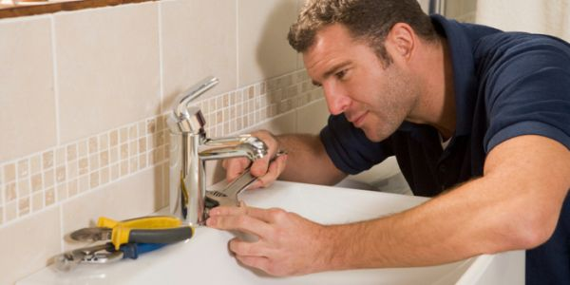
Repair taps / sink

Slide 24
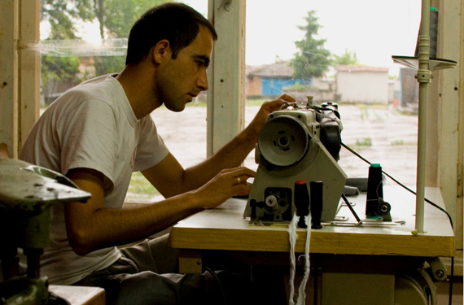
Sew clothes

