Slide 1





IrinaPapakhinac

Slide 2


1. Do you get up early or late?
2. Where do you have breakfast, at home or at school?
3. What do you do after school?
4. What do you do in the evening?

Slide 3

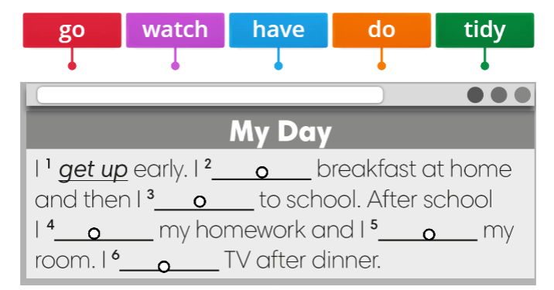
IrinaPapakhinac

Slide 4
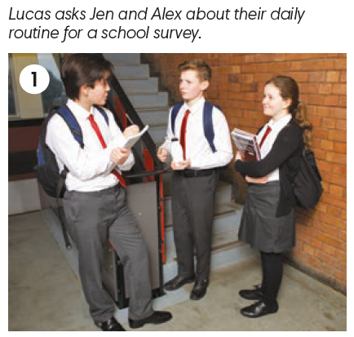
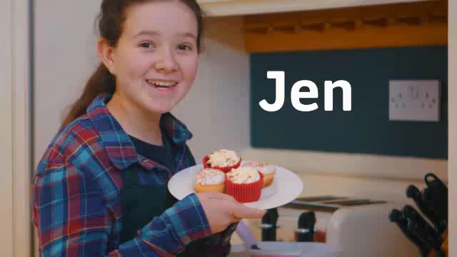
GUESS Jen and Alex’s answers.
Do they get up early or late?
Where do they have breakfast?
What do they do after school?
What do they do in the evening?
Watch the video and check your answers.
IrinaPapakhinac

Slide 5
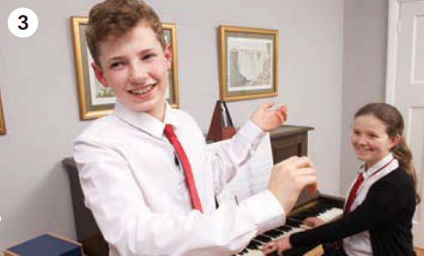
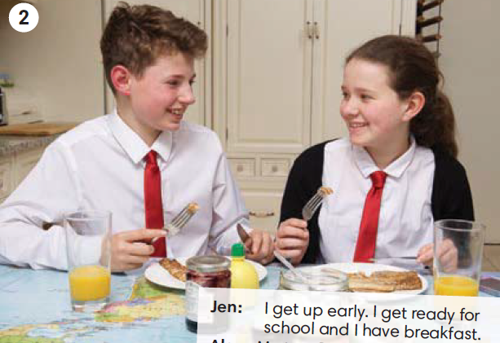
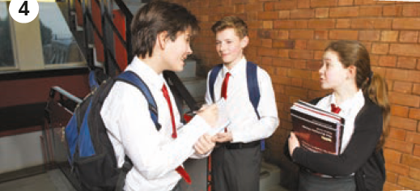
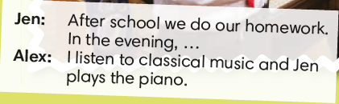
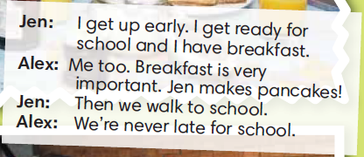
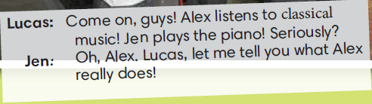
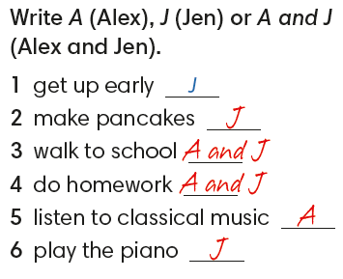
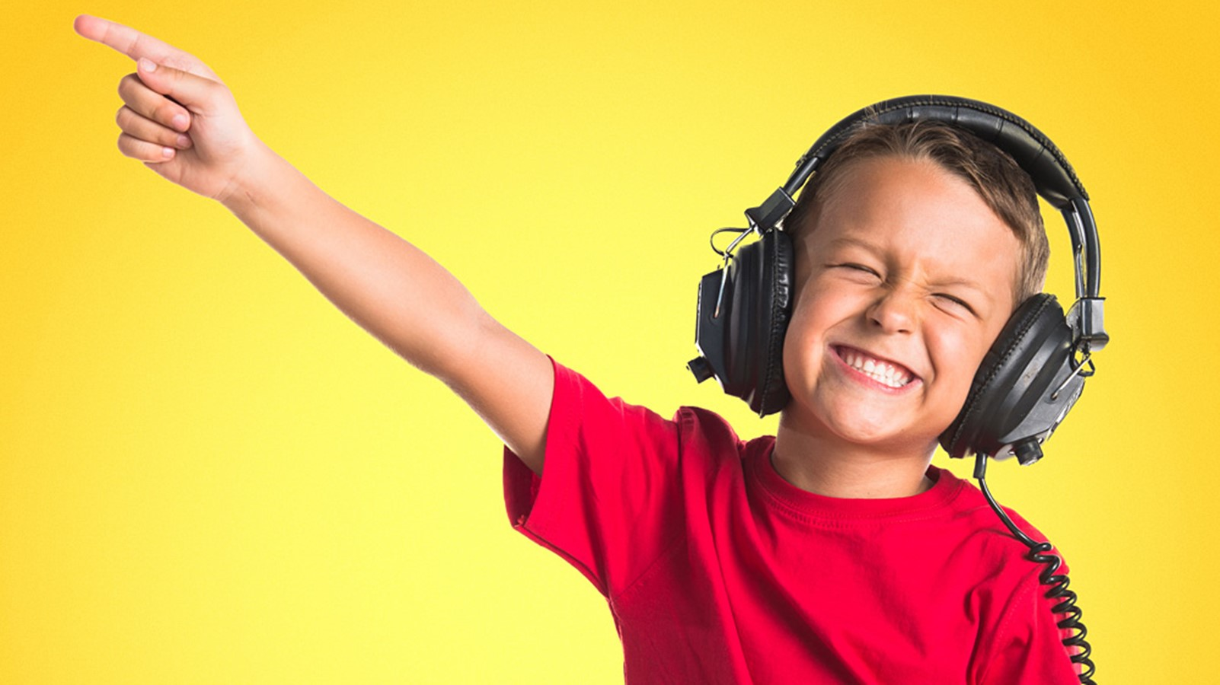
IrinaPapakhinac

Slide 6


Find these expressions in the story.
IrinaPapakhinac

Slide 7
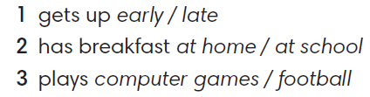

IrinaPapakhinac

Slide 8
Remember the words.
IrinaPapakhinac

Slide 9
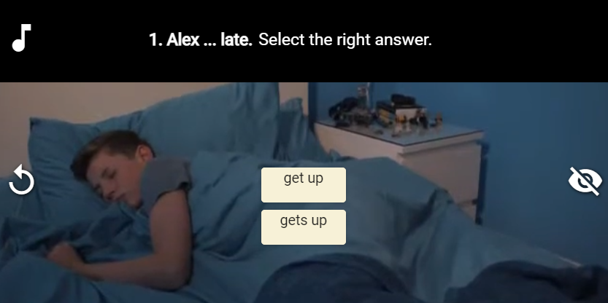
IrinaPapakhinac

Slide 10
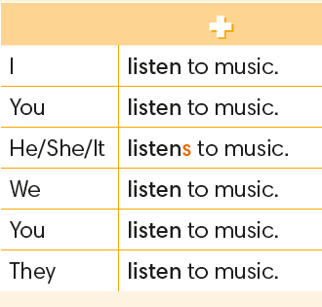
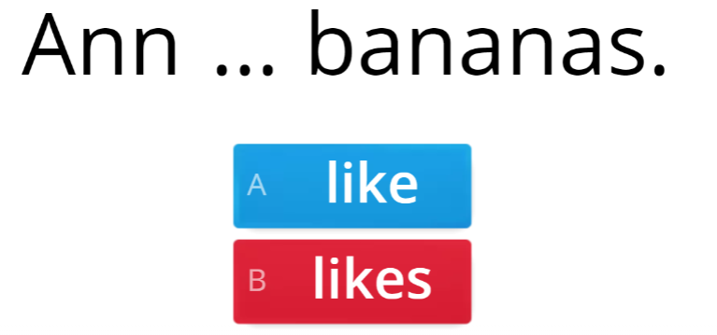
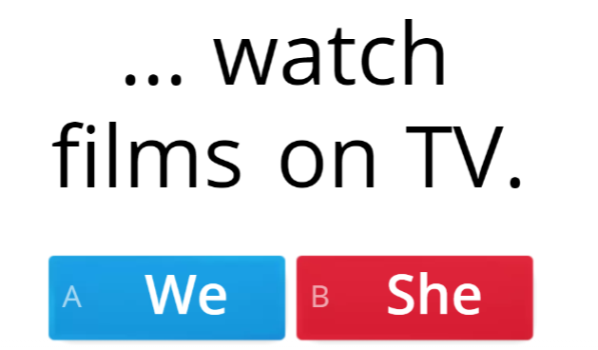
IrinaPapakhinac

Slide 11

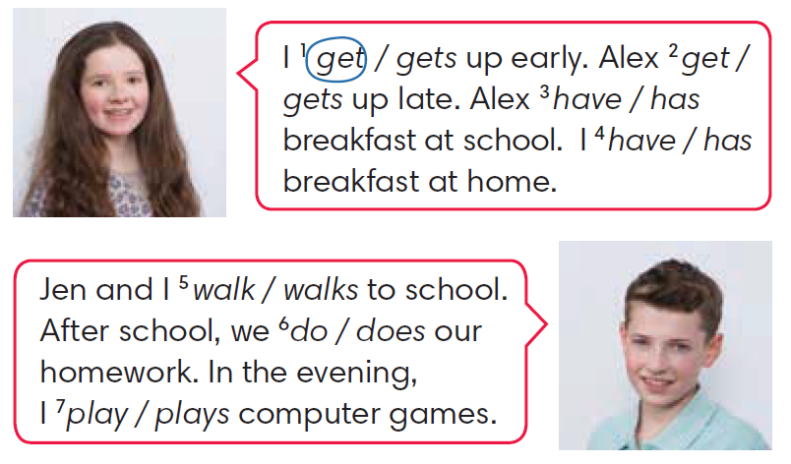

IrinaPapakhinac

Slide 12
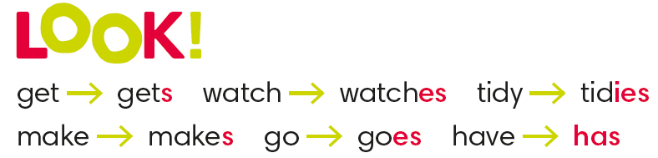
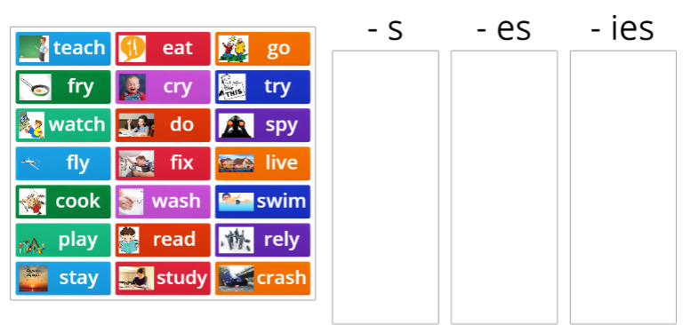
IrinaPapakhinac

Slide 13

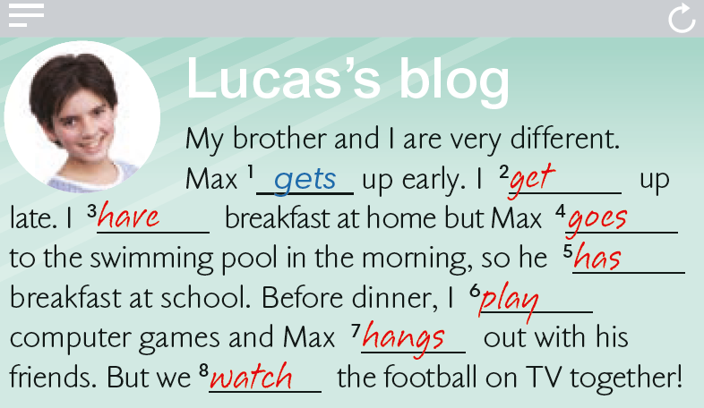
go play
get have
hang have
watch get
IrinaPapakhinac

Slide 14
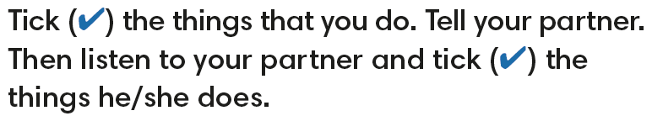
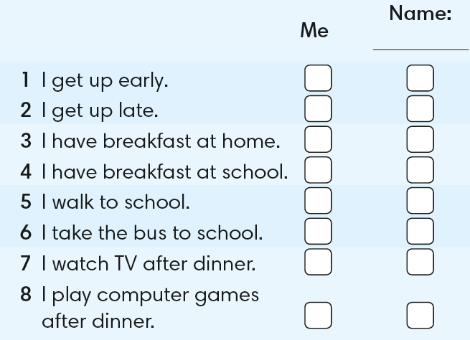
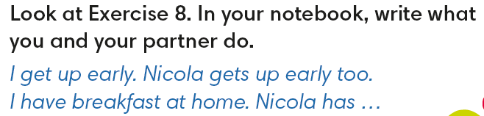
IrinaPapakhinac

Slide 15
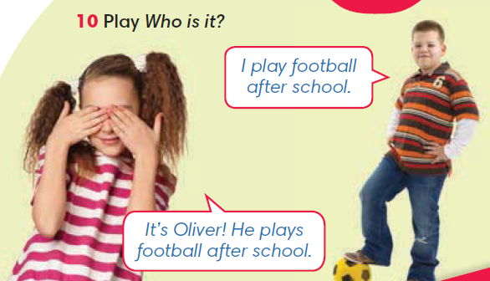
IrinaPapakhinac

Slide 16
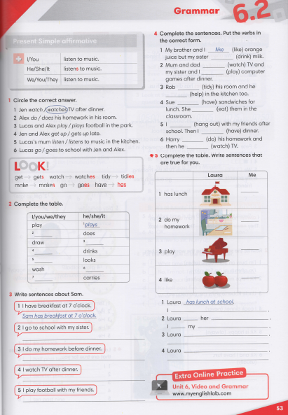


IrinaPapakhinac

Slide 17
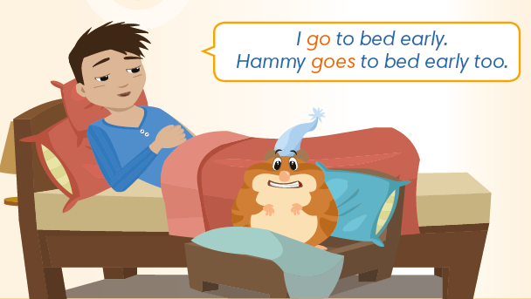

GUESS!
What do Max and Hammy do in the evening?
Watch the video and check your answers.
IrinaPapakhinac

Slide 18
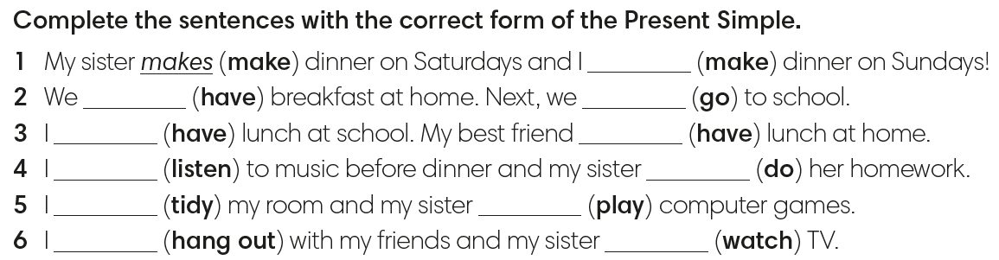
make
have
go
have
has
listen
does
tidy
plays
hang out
watches
IrinaPapakhinac

Slide 19
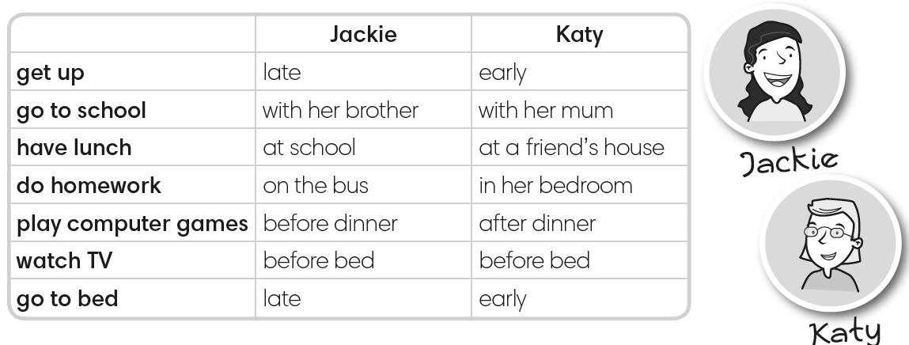
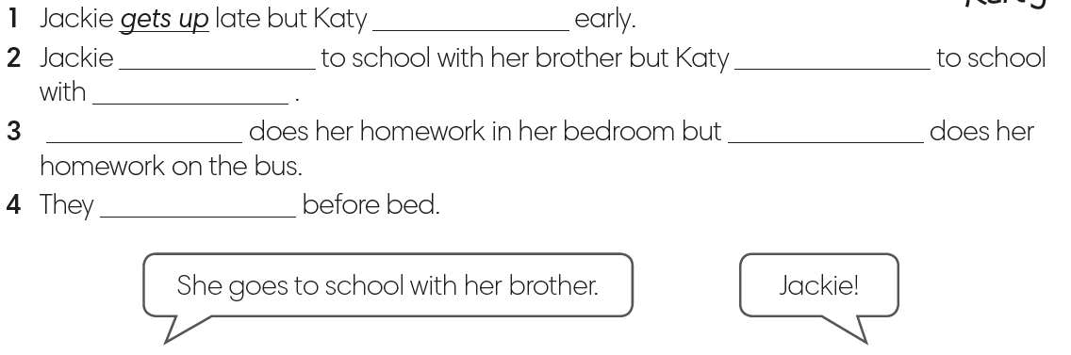
gets up
goes
goes
her mum
Katy
Jackie
watch TV
IrinaPapakhinac

