Slide 1




Slide 2

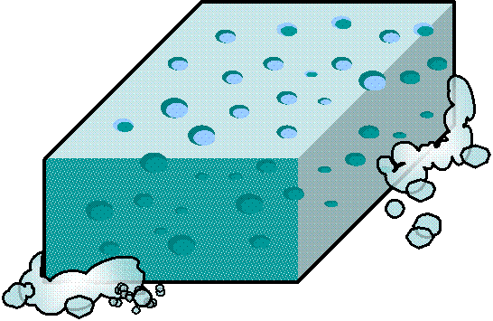

What’s this?
It’s a _______________
Where is it?
It’s in the …
1/20
sponge
bathroom
living room
bedroom

Slide 3

What’s this?
It’s a _______________
Where is it?
It’s in the …
2/20
bed
living room
bedroom
kitchen

Slide 4


What’s this?
It’s an _______________
Where is it?
It’s in the …
3/20
armchair
dining room
kitchen
living room

Slide 5

What’s this?
It’s a _________________
Where is it?
It’s in the …
4/20
watering can
study
kitchen
backyard

Slide 6
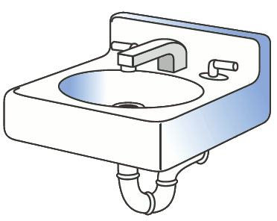
What’s this?
It’s a _______________
Where is it?
It’s in the …
5/20
washbasin
attic
bathroom
study

Slide 7

What’s this?
It’s a _______________
Where is it?
It’s in the …
6/20
coat stand
hallway
kitchen
backyard

Slide 8

What’s this?
It’s a _______________
Where is it?
It’s in the …
7/20
coffee table
attic
living room
kitchen

Slide 9

What’s this?
It’s a _______________
Where is it?
It’s in the …
8/20
toothbrush
hallway
bathroom
kitchen

Slide 10

What’s this?
It’s a _________________
Where is it?
It’s in the …
9/20
desk
bathroom
kitchen
study

Slide 11

What’s this?
It’s a _______________
Where is it?
It’s in the …
10/20
mattress
bedroom
kitchen
dining room

Slide 12

What’s this?
It’s a _________________
Where is it?
It’s in the …
11/20
towel
dining room
living room
bathroom

Slide 13
What’s this?
It’s a _______________
Where is it?
It’s in the …
12/20
dresser
pantry
bedroom
backyard

Slide 14

What’s this?
It’s some _______
Where is it?
It’s in the …
13/20
soap
bathroom
hallway
dining room

Slide 15

What’s this?
It’s a __________
Where is it?
It’s in the …
14/20
sink
dining room
living room
kitchen

Slide 16

What’s this?
It’s a __________
Where is it?
It’s in the …
15/20
mirror
backyard
kitchen
hallway

Slide 17
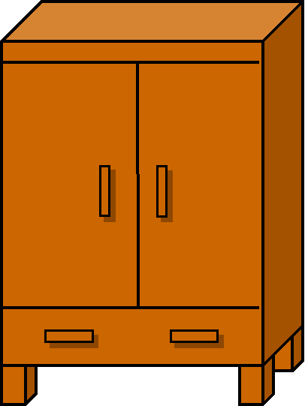
What’s this?
It’s a _______________
Where is it?
It’s in the …
16/20
wardrobe
kitchen
bedroom
backyard

Slide 18
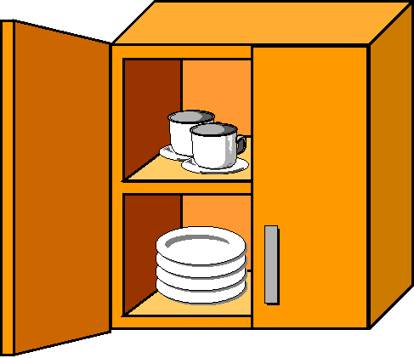
What’s this?
It’s a _______________
Where is it?
It’s in the …
17/20
cupboard
kitchen
living room
study

Slide 19

What’s this?
It’s a _______________
Where is it?
It’s in the …
18/20
cradle
kitchen
bedroom
hallway

Slide 20

What’s this?
It’s a __________________
Where is it?
It’s in the …
19/20
bedside table
pantry
kitchen
bedroom

Slide 21
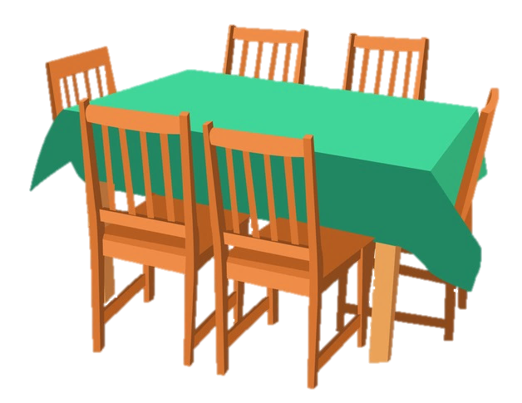
What’s this?
It’s a _____________
Where is it?
It’s in the …
20/20
公众号：zao123jaio
pantry
garage
dining room

