Slide 1
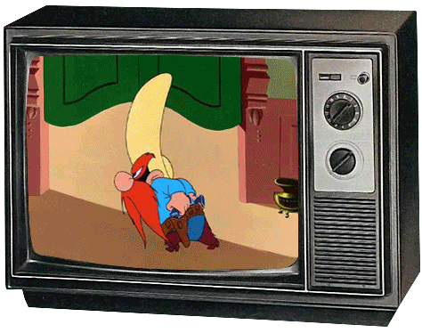
you/ watch cartoons/ last Sunday?
Yes, I did. No, I didn’t.

Slide 2
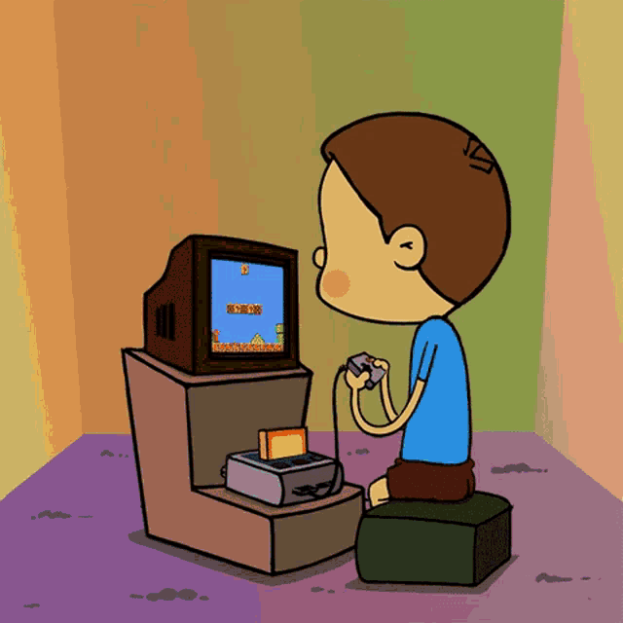
you/ play computer games/ last Friday?
Yes, I did. No, I didn’t.

Slide 3
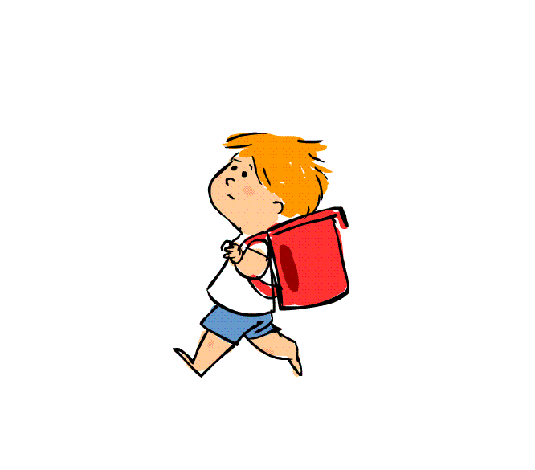
you/ walk to school/ last Thursday?
Yes, I did. No, I didn’t.

Slide 4
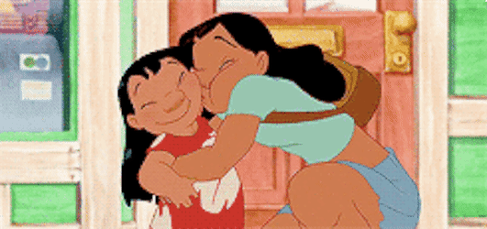
you/ look after your little brother or sister/ last Saturday?
Yes, I did. No, I didn’t.

Slide 5
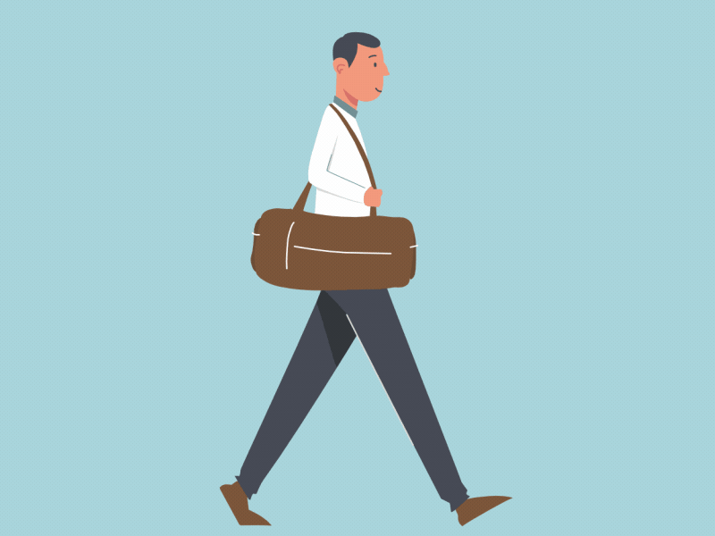
you/ carry your heavy bag/ yesterday?
Yes, I did. No, I didn’t.

Slide 6
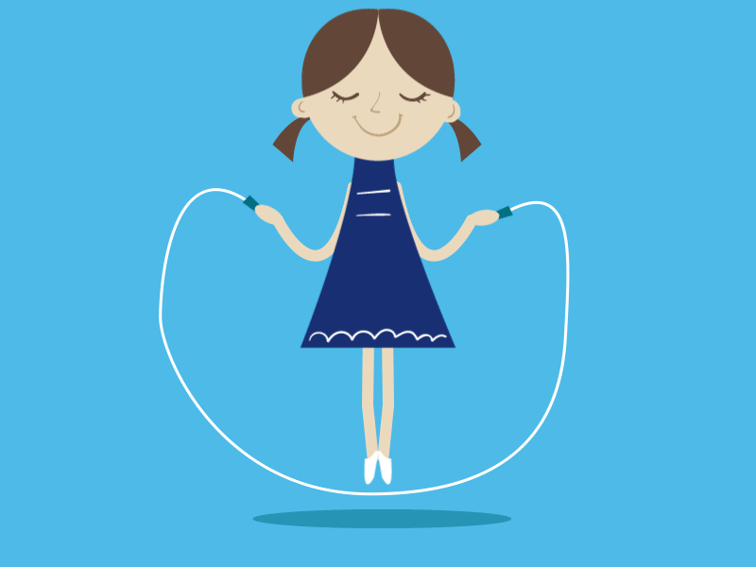
you/ skip in PE class/ last week?
Yes, I did. No, I didn’t.

Slide 7
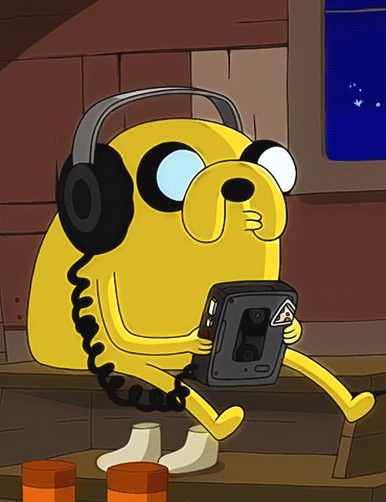
you/ listen to music / last Wednesday?
Yes, I did. No, I didn’t.

Slide 8

you/ travel to school by bus / yesterday morning?
Yes, I did. No, I didn’t.

Slide 9
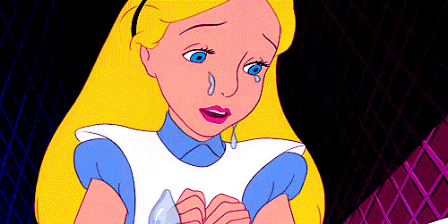
you/ cry at school/ last Tuesday?
Yes, I did. No, I didn’t.

Slide 10
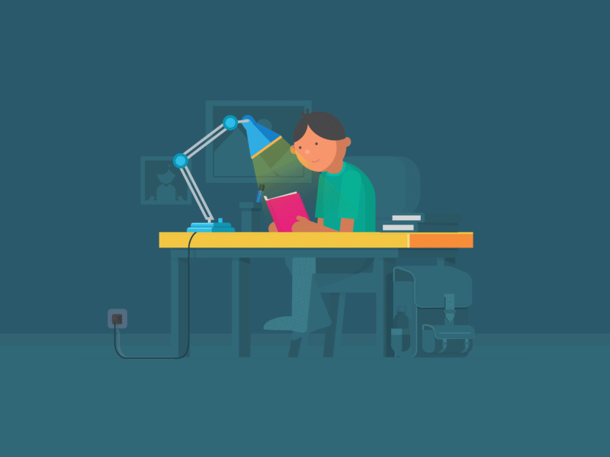
you/ study English/ last Monday?
Yes, I did. No, I didn’t.

