Slide 1

my / your

Slide 2

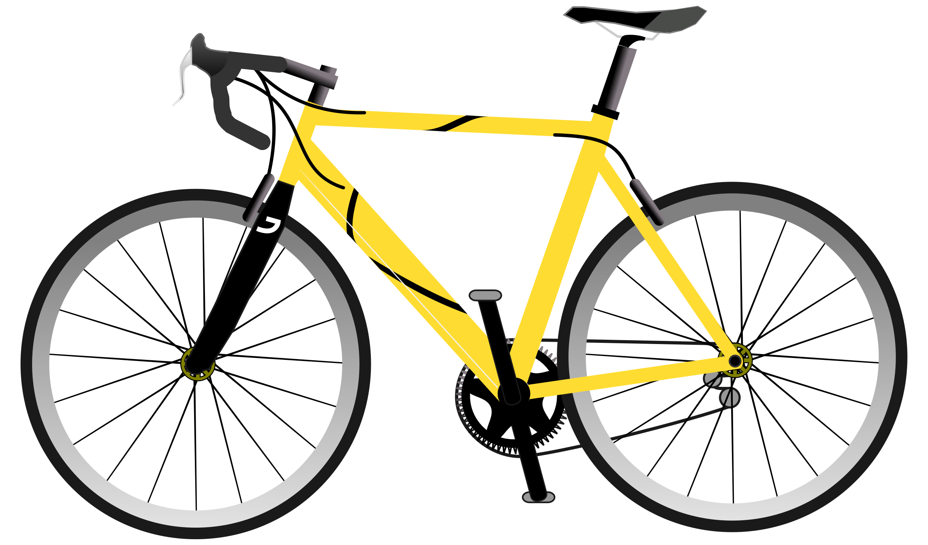
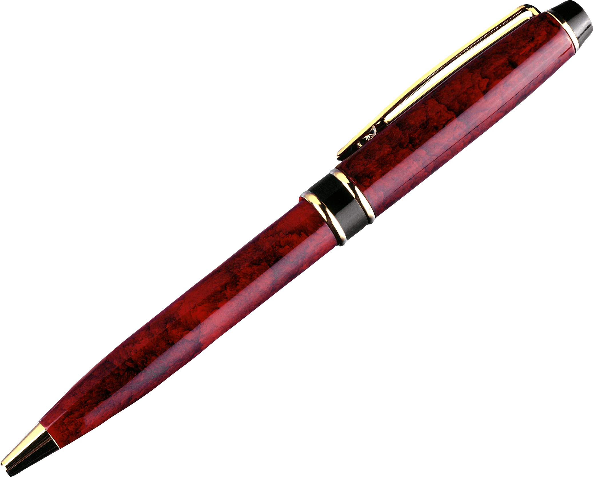







This is my / your …
S1
S2
1
2
3
4
5
6
7
8
9
10

Slide 3
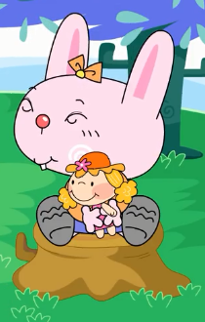
This is her doll.

Slide 4
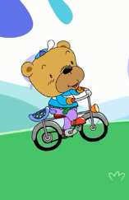
This is his bike.

Slide 5
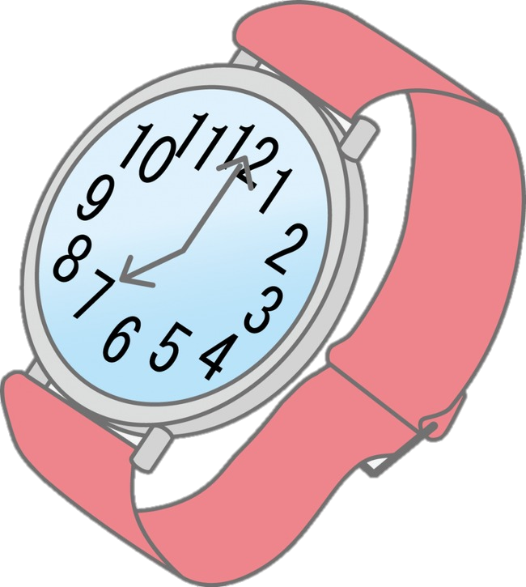

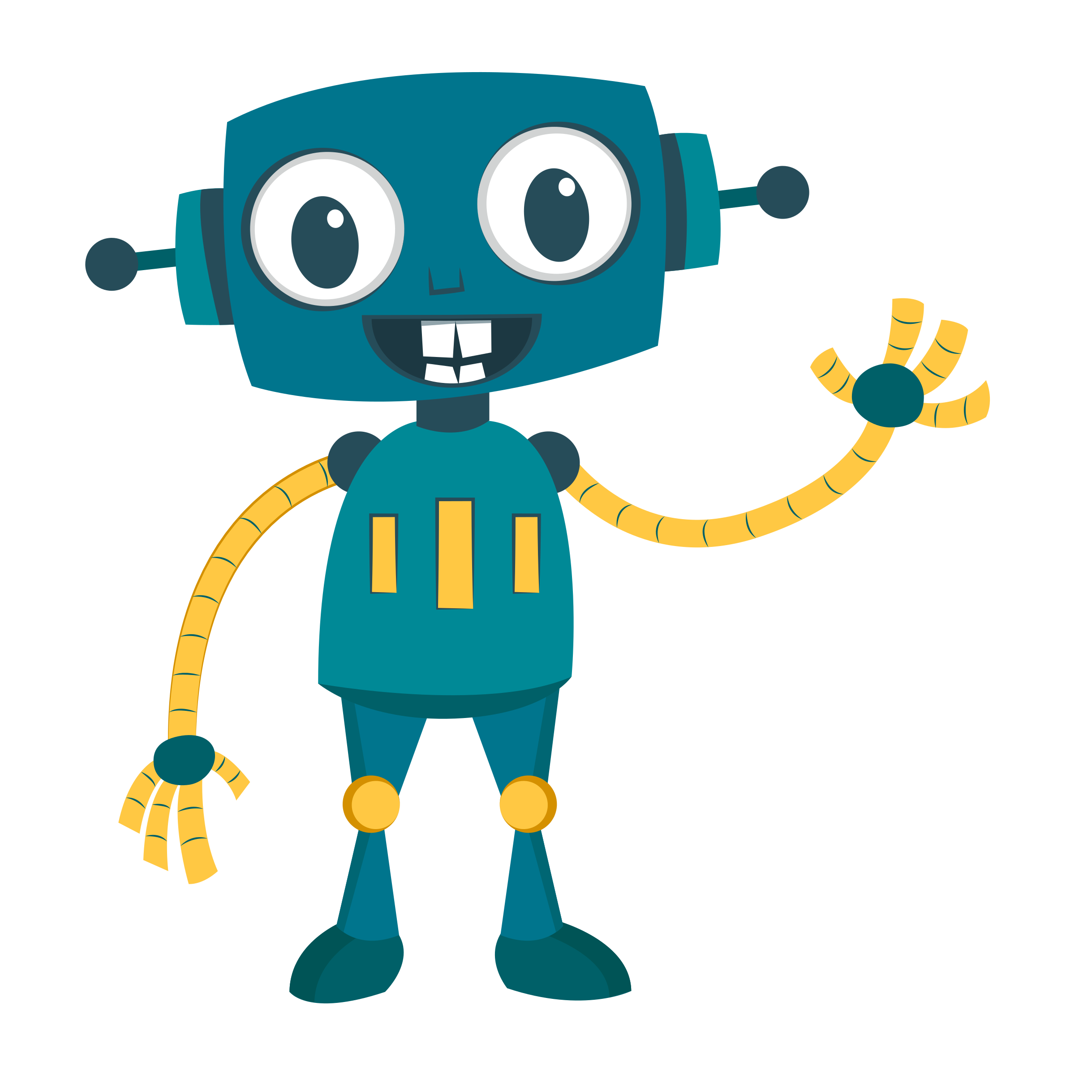





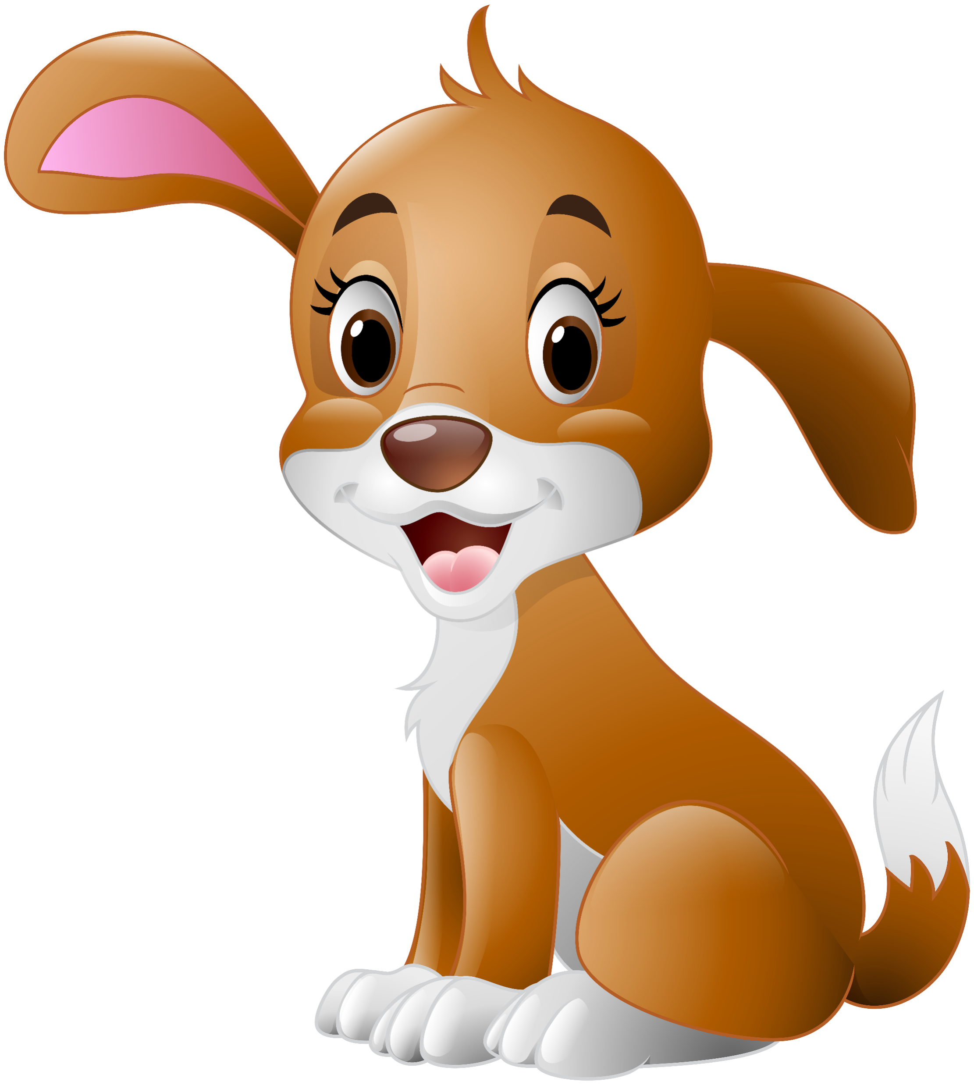
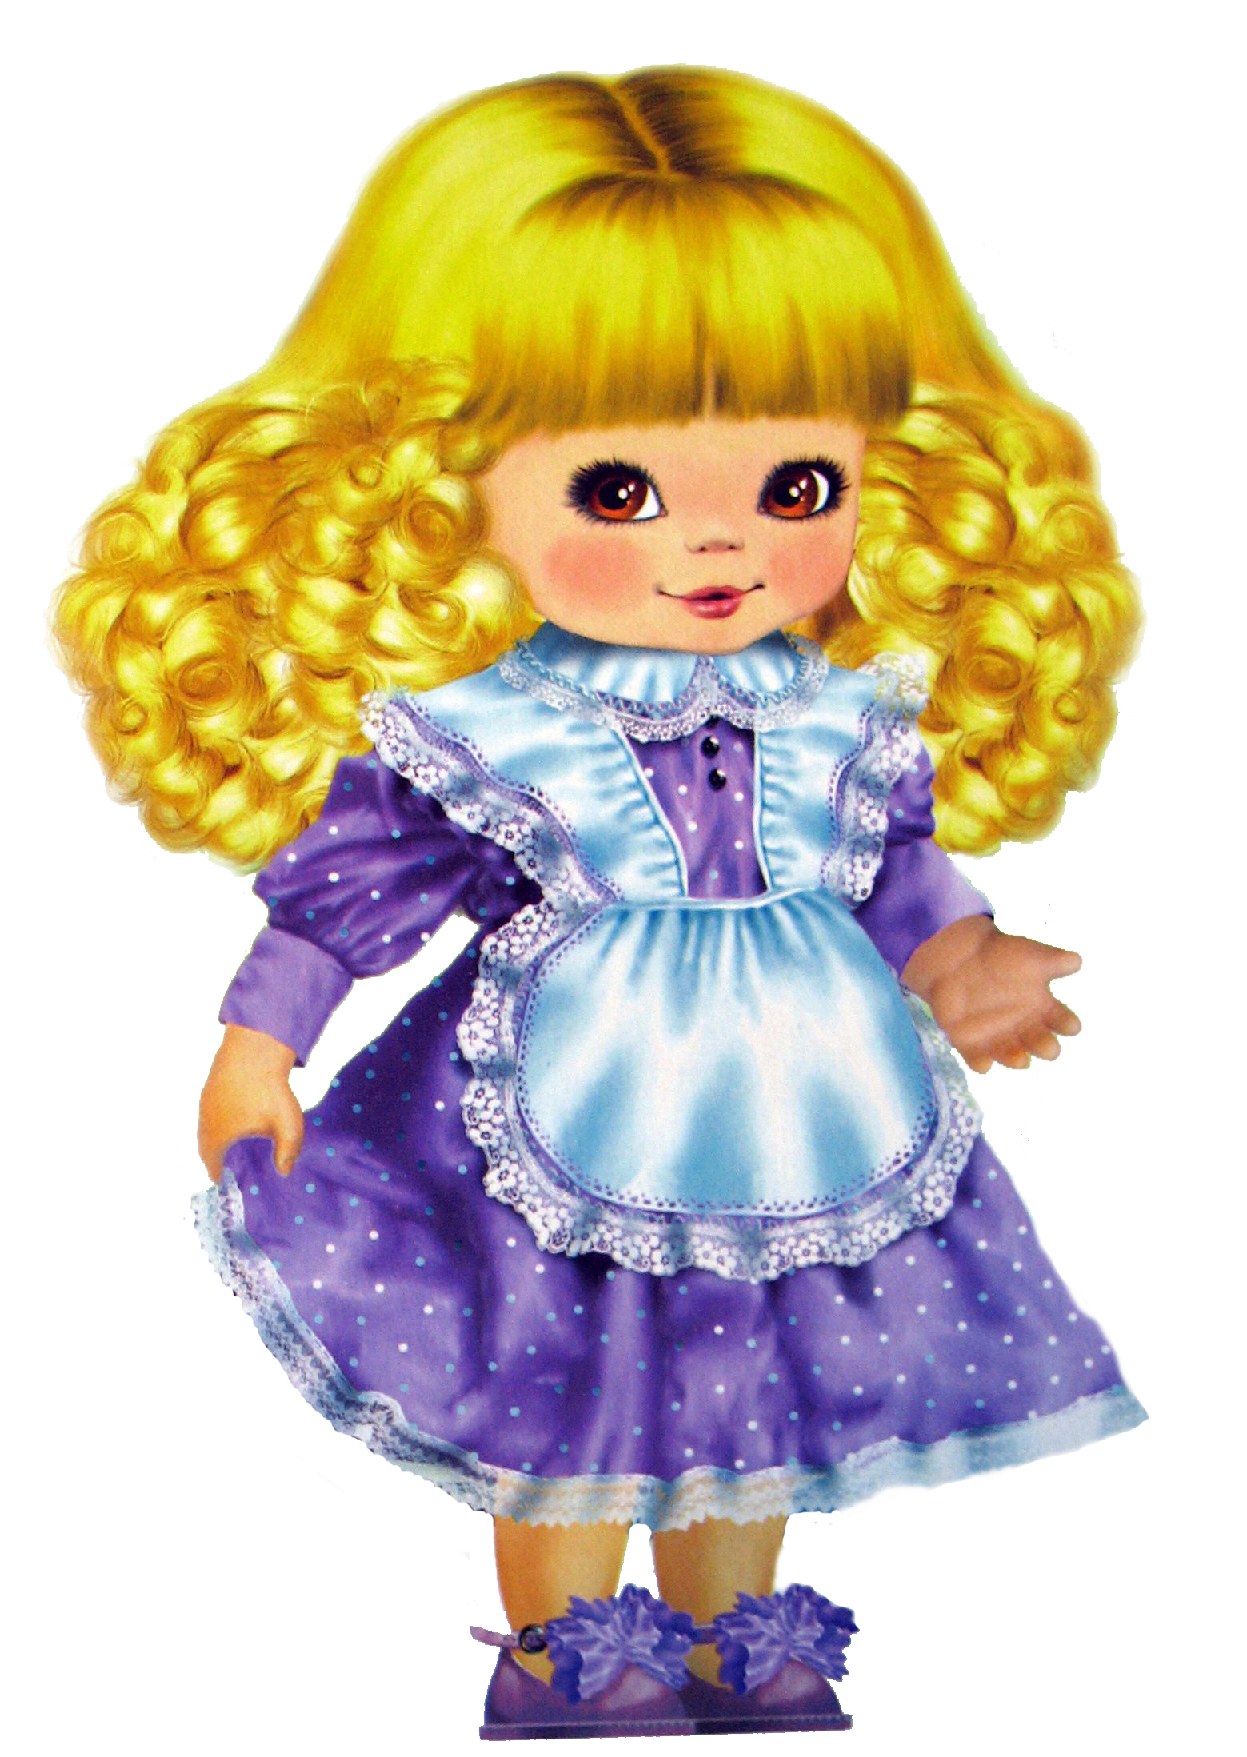
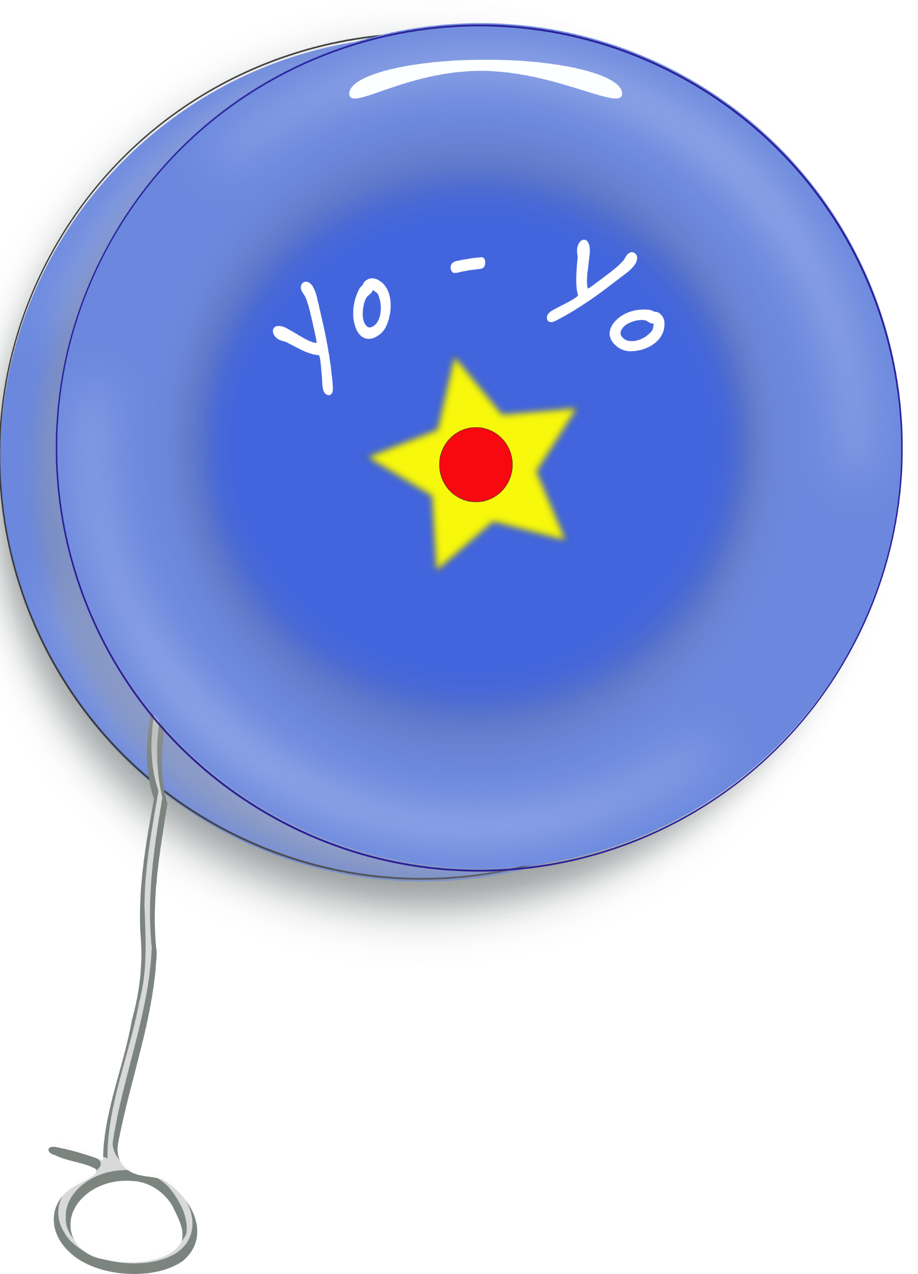

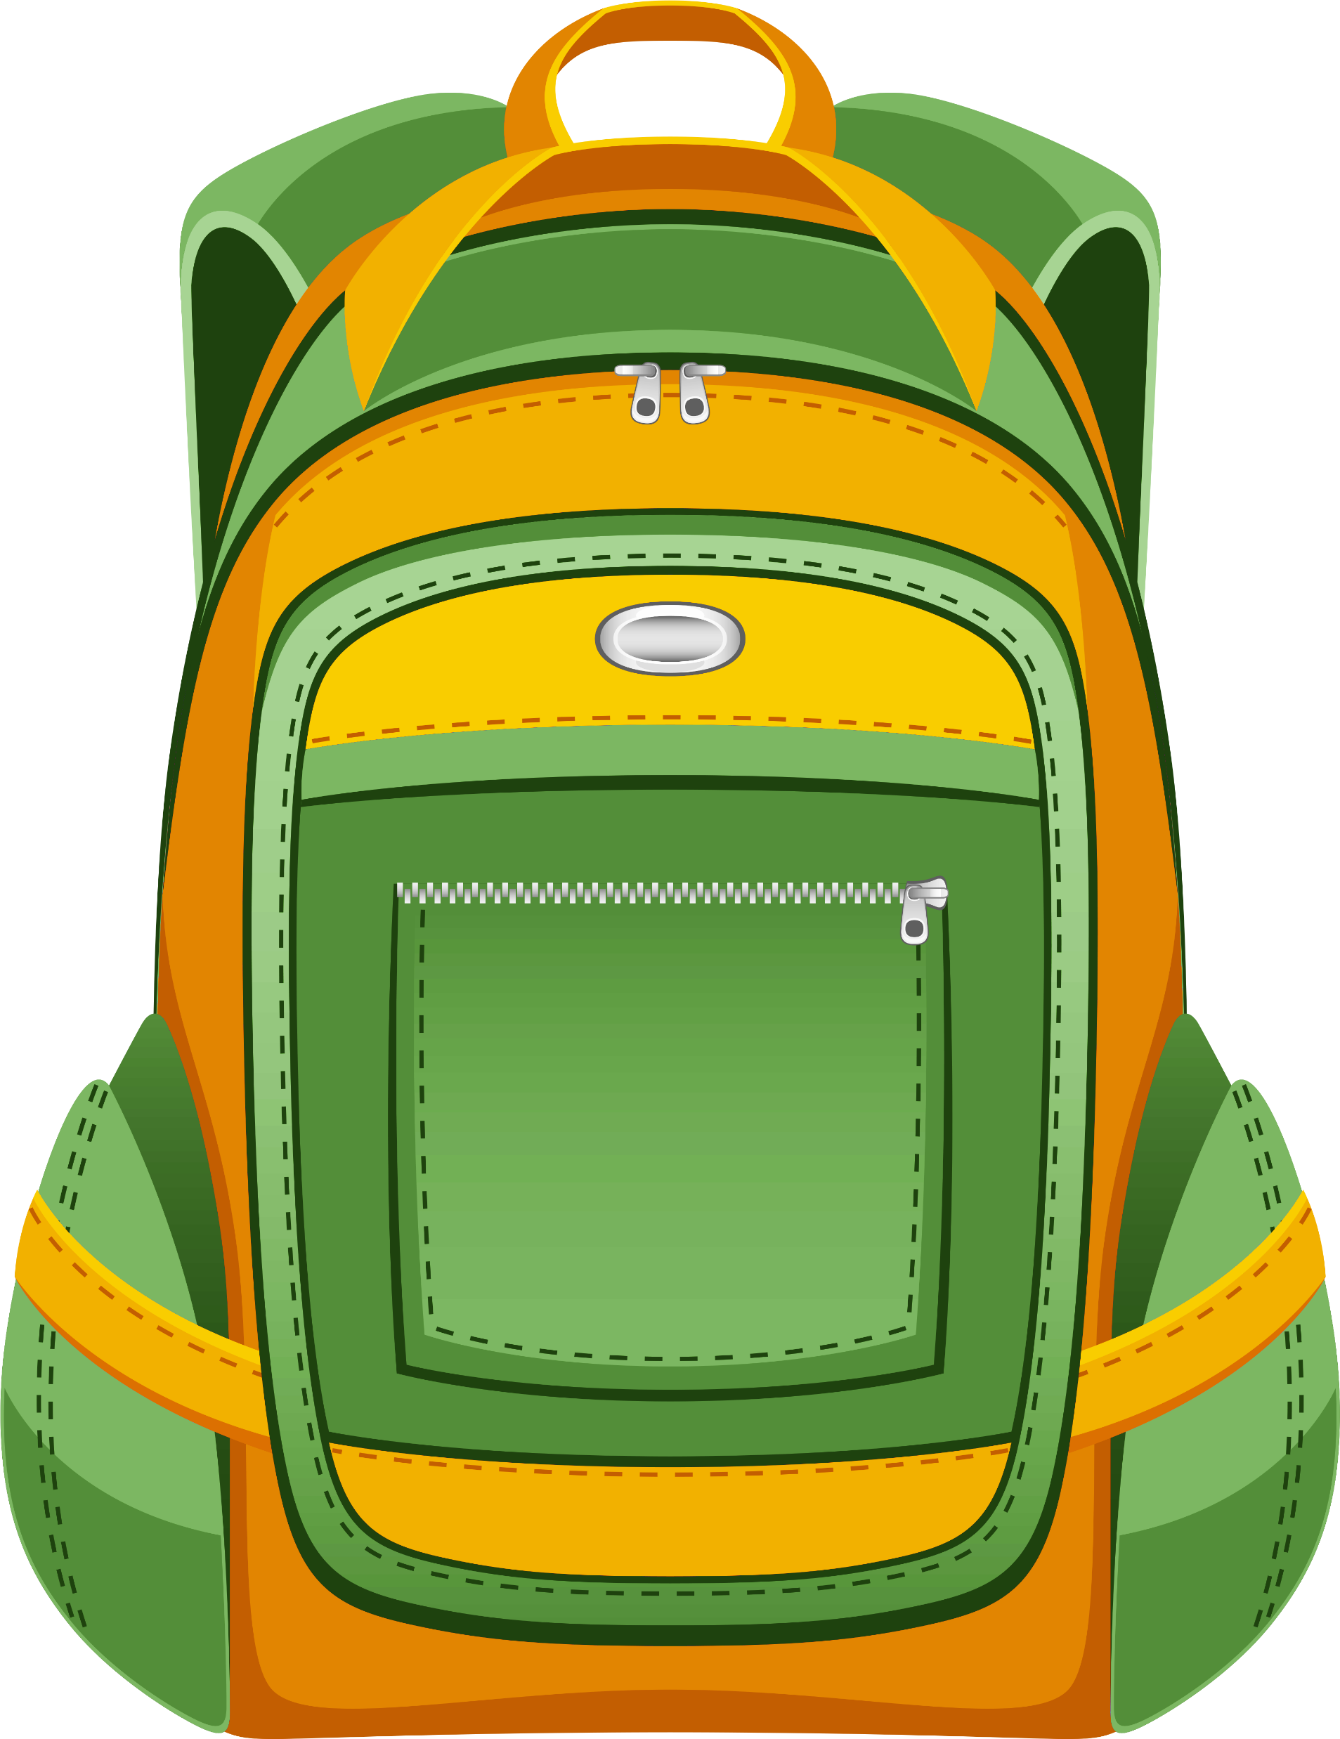
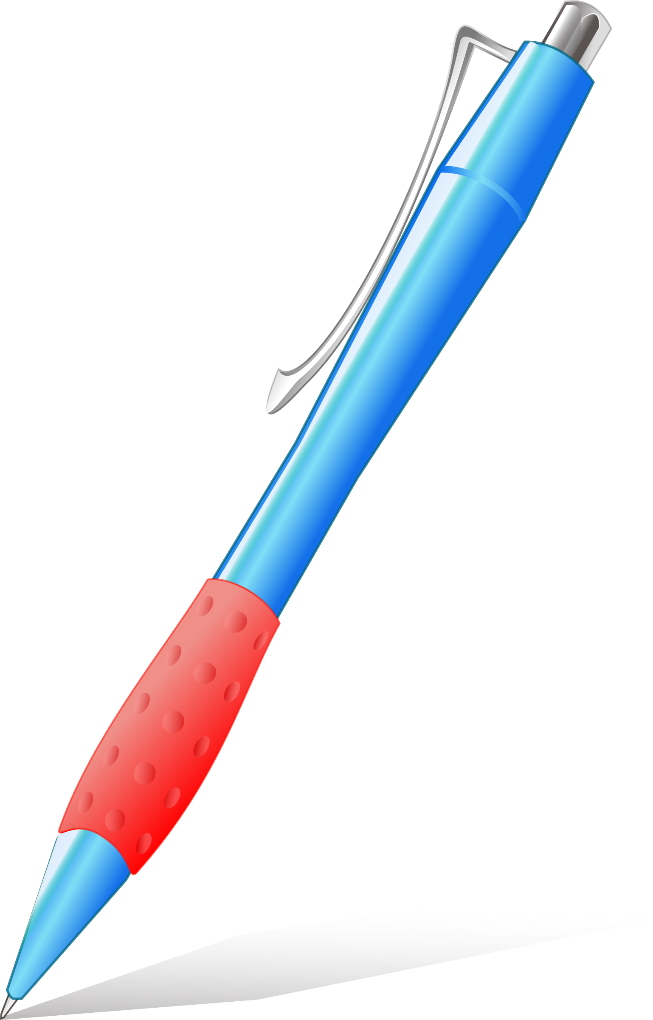

Alice
Max

Slide 6
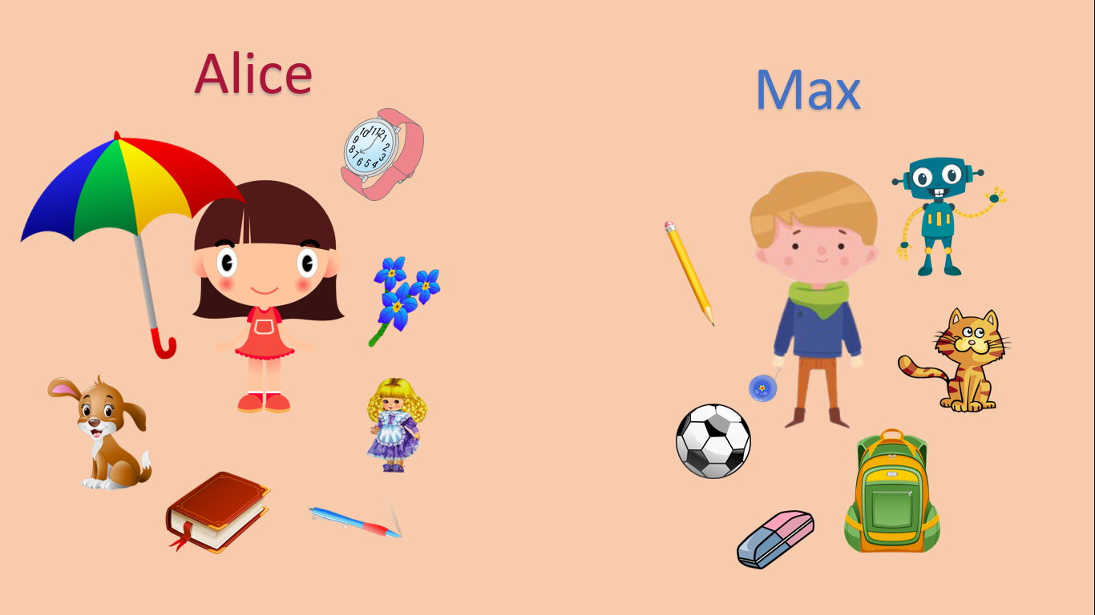
his
This is
doll.
her

Slide 7
his
This is
book.
her

Slide 8

his
This is
yo-yo.
her

Slide 9
his
This is
ball.
her

Slide 10
his
This is
pen.
her

Slide 11
his
This is
pencil.
her

Slide 12
his
This is
umbrella.
her

Slide 13
his
This is
cat.
her

Slide 14
his
This is
flower.
her

Slide 15
his
This is
school bag.
her

Slide 16
his
This is
rubber.
her

Slide 17
his
This is
robot.
her

Slide 18

his
This is
puppy.
her

Slide 19
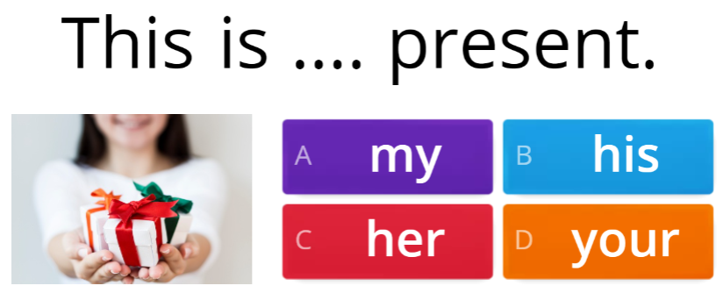

Slide 20

