Slide 1

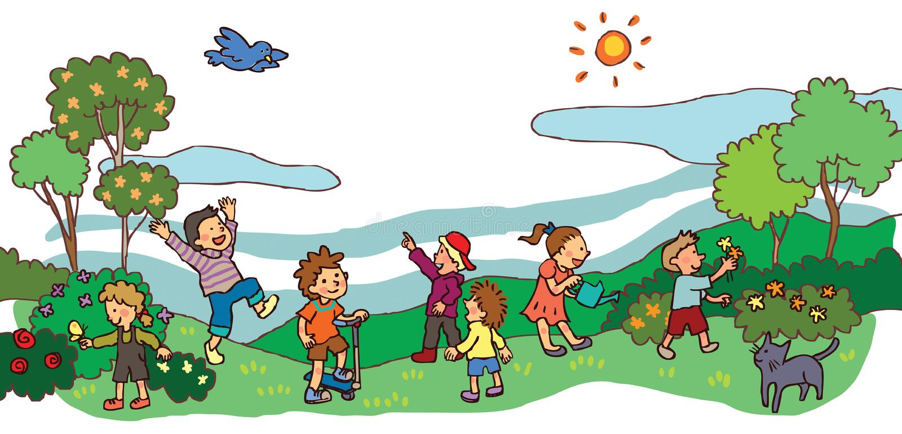

IrinaPapakhinac

Slide 2

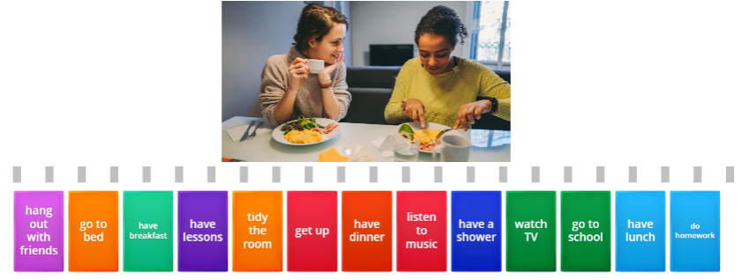
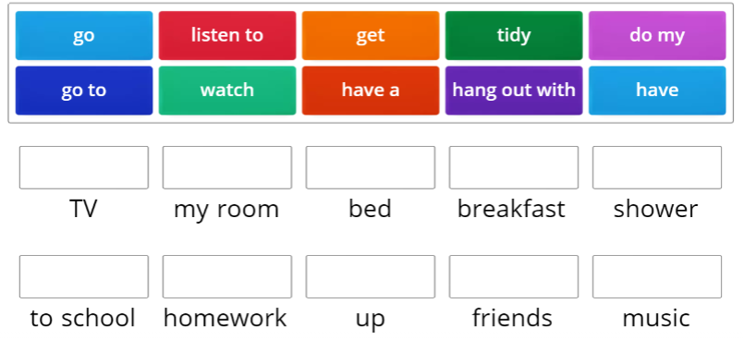
IrinaPapakhinac

Slide 3
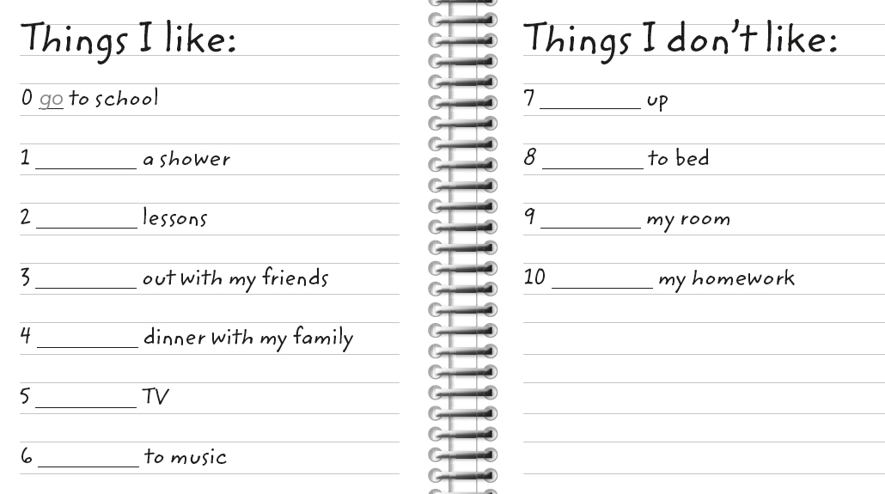
Complete the lists.
get
have
go
have
tidy
hang
do
have
watch
listen
IrinaPapakhinac

Slide 4


IrinaPapakhinac

Slide 5
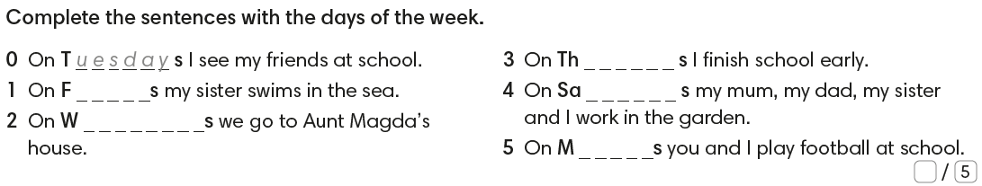
r i d a y
e d n e s d a y
u r s d a y
t u r d a y
o n d a y
IrinaPapakhinac

Slide 6



1. What month is your birthday?
2. What month is Christmas?
3. What month is after February?
4. What month is before August?
IrinaPapakhinac

Slide 7
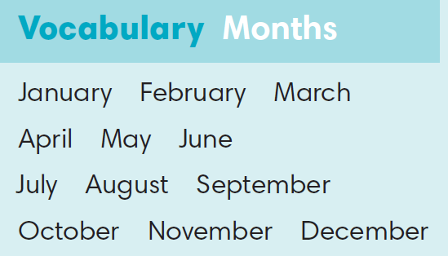
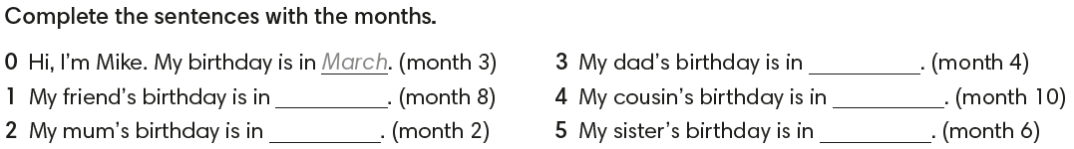
April
August
October
February
June
IrinaPapakhinac

Slide 8

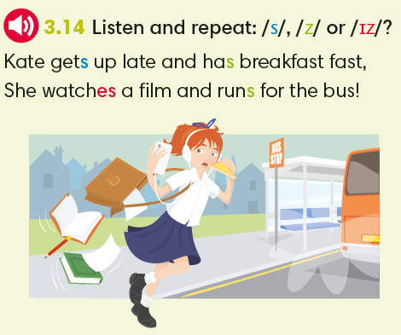
IrinaPapakhinac

Slide 9
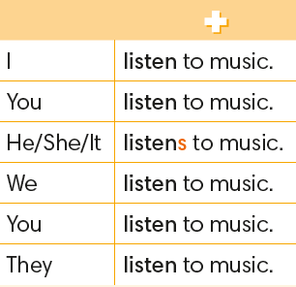
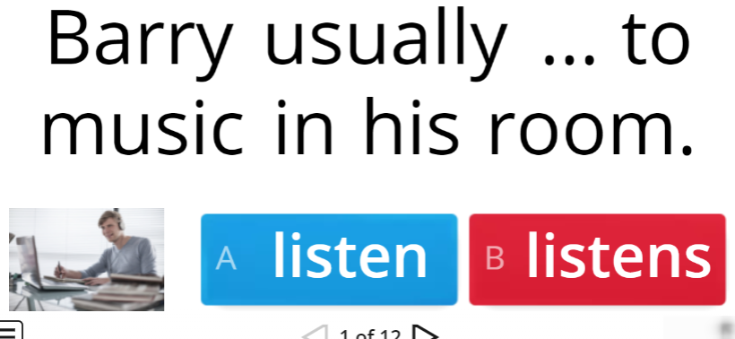
IrinaPapakhinac

Slide 10

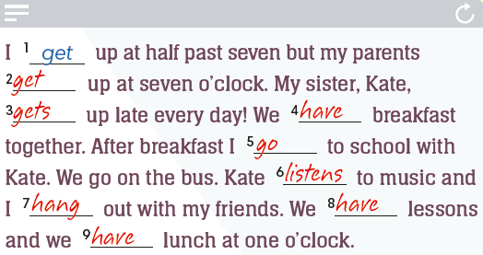
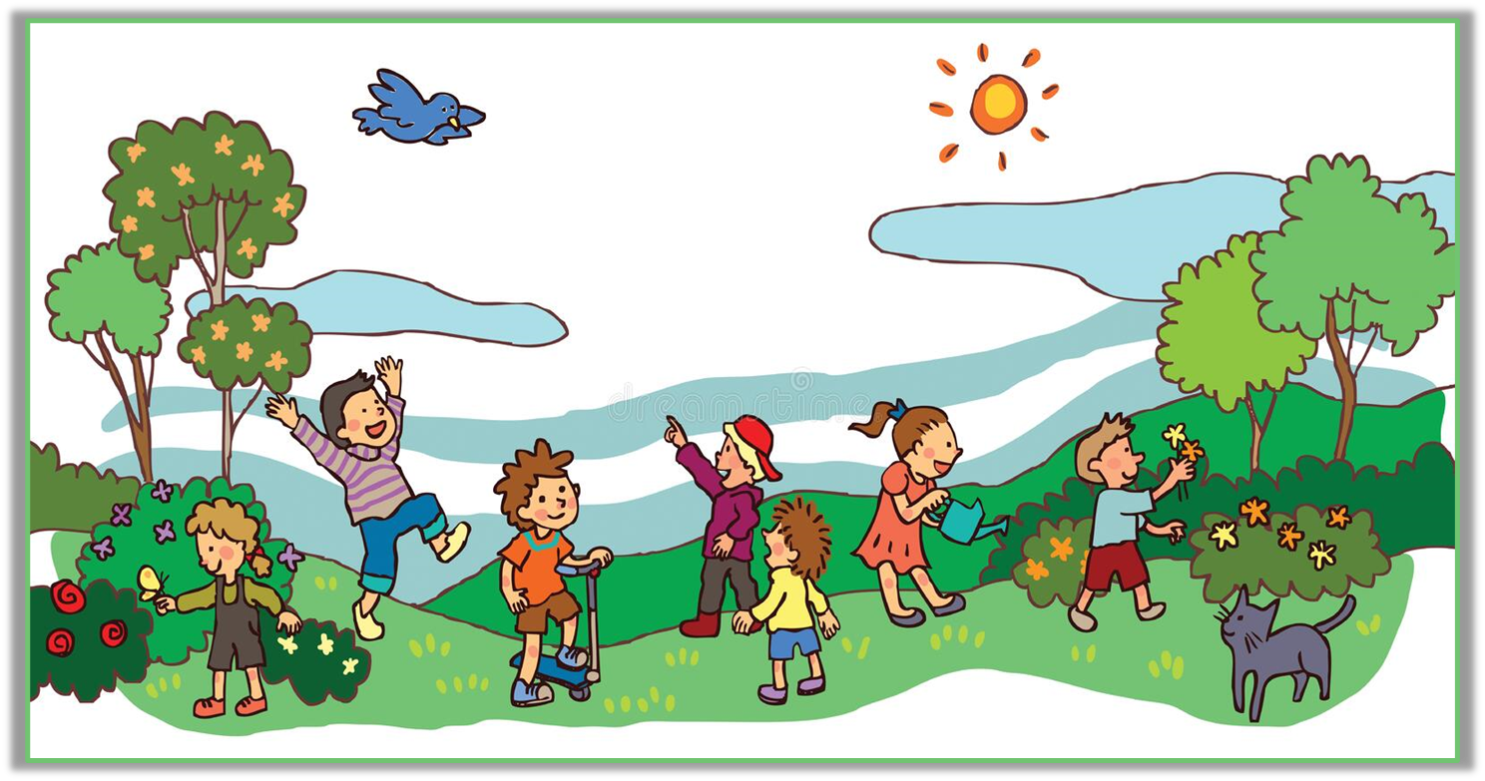
IrinaPapakhinac

Slide 11
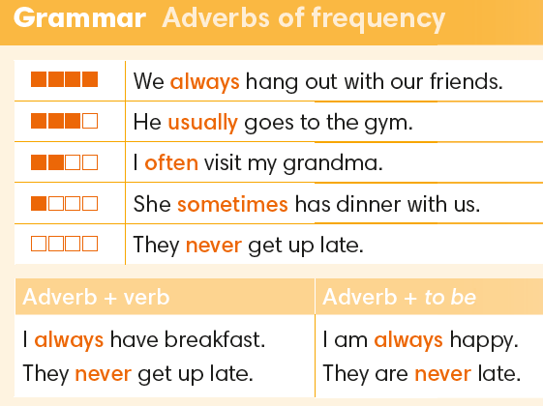
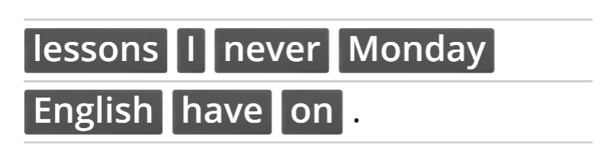
IrinaPapakhinac

Slide 12
Continue the sentences.
1. My brother / sister always …
2. My parents usually …
3. My best friend often …
4. My grandparents sometimes …
5. My teacher never …
6. I always …
IrinaPapakhinac

Slide 13
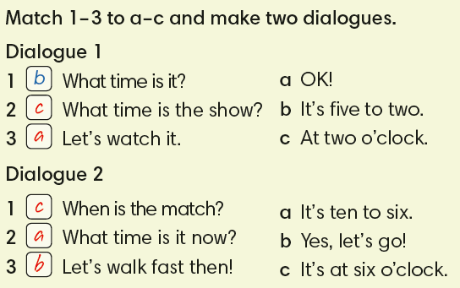
IrinaPapakhinac

Slide 14
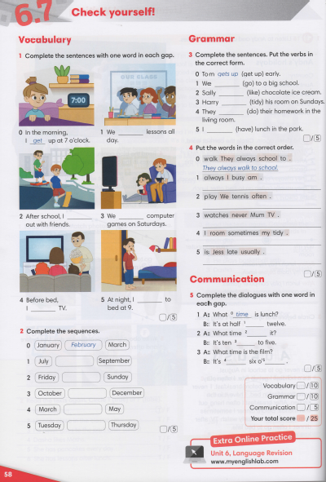
IrinaPapakhinac

