Slide 1





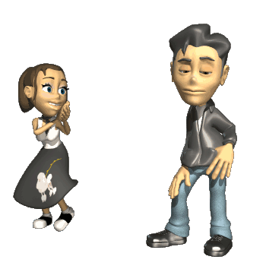
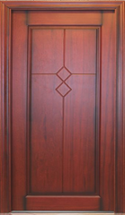
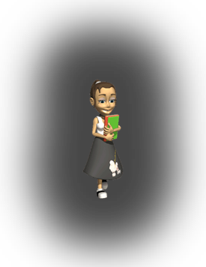
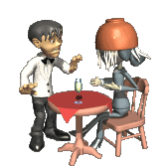

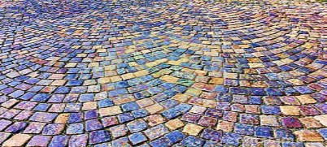
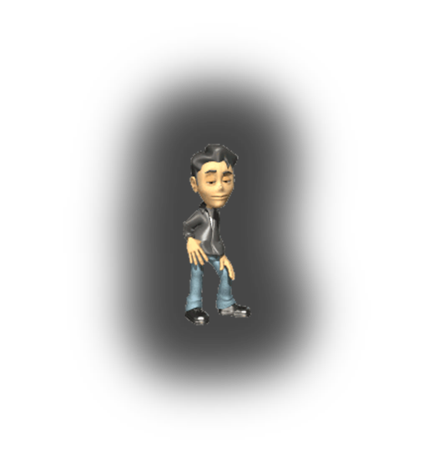


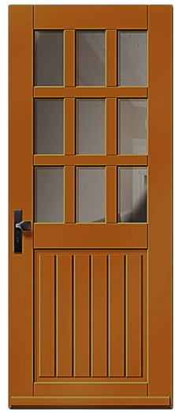
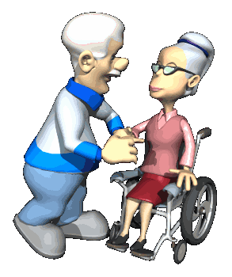
guorkhan.blogspot.com
-------
Cınema
-------
DANCE CLUB
--------------
Restaurant
--------------
SUPER
MARKET
Bank
Café
THEATRE
Darling! Do you remember the days when we were young?
Sweetheart! Alzheimer’s disease is wiping away my memories.
Those were the days!
But I’m here. I will never let you forget. Do you remember! There was a fountain here.
You were 20. You were always on that corner.
That supermarket. It was a restaurant. It was purple. Your favourite colour.
I remember, I was 18 years old. I was very beautiful.
I was a waiter there and I was very awkward.
You were a student.
There was a dance club at the end of the road.
It was very beautiful. And that cinema. It was a theatre and it was red.
And your father was always at the balcony.
And my eyes were always on you!
I will never forget it, because it was the place where I felt in love with you..
You are still very beautiful.
He was always angry with me.

