Slide 1

I learn / throw the new words.

Slide 2
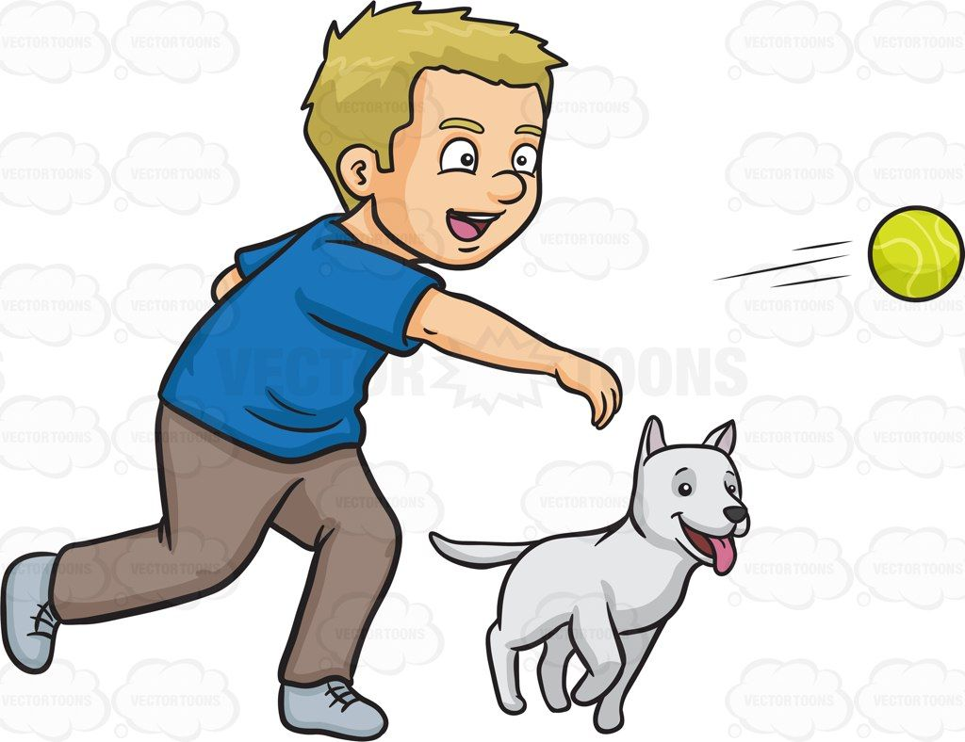
You read / throw the ball.

Slide 3
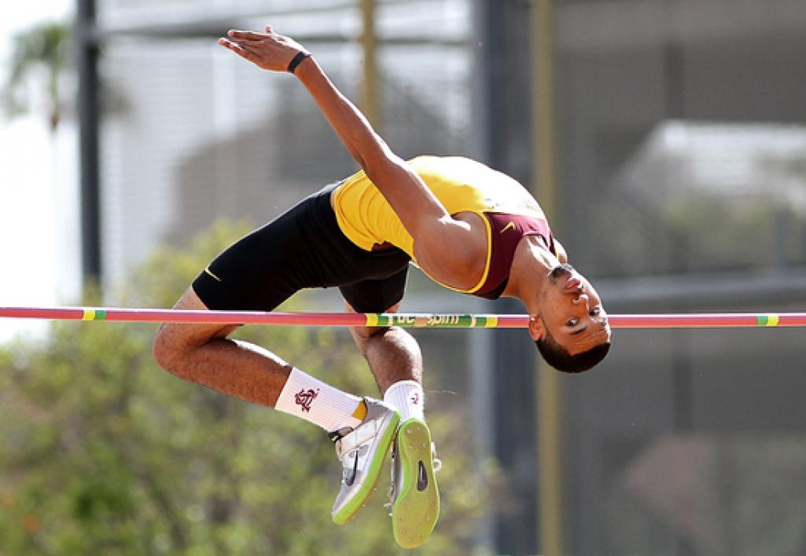
I jump/ run high.

Slide 4
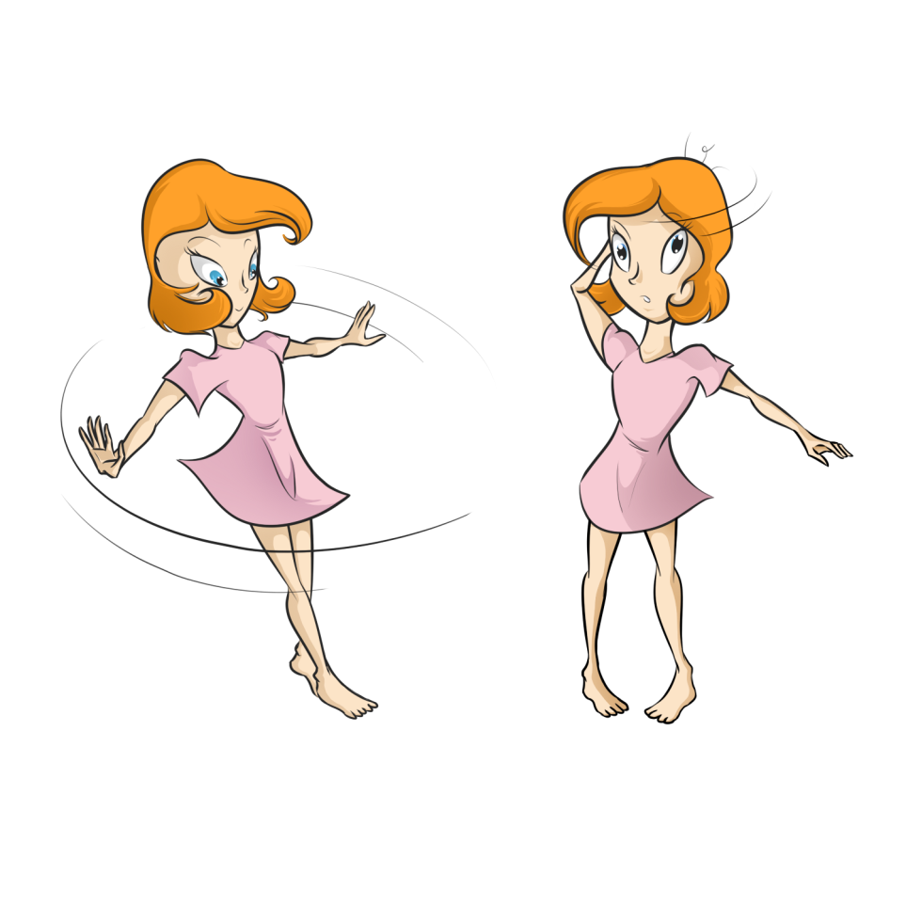
We jump / turn around.

Slide 5

We read/climb a book.

Slide 6

They run /write a story.

Slide 7
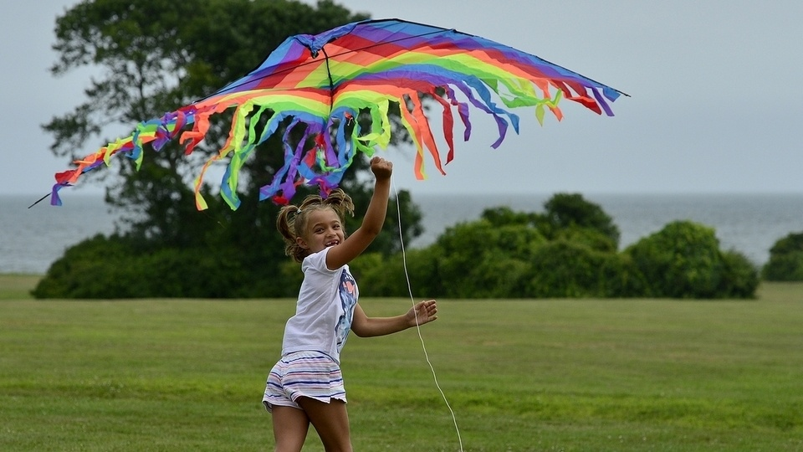
You climb / fly a kite.

Slide 8
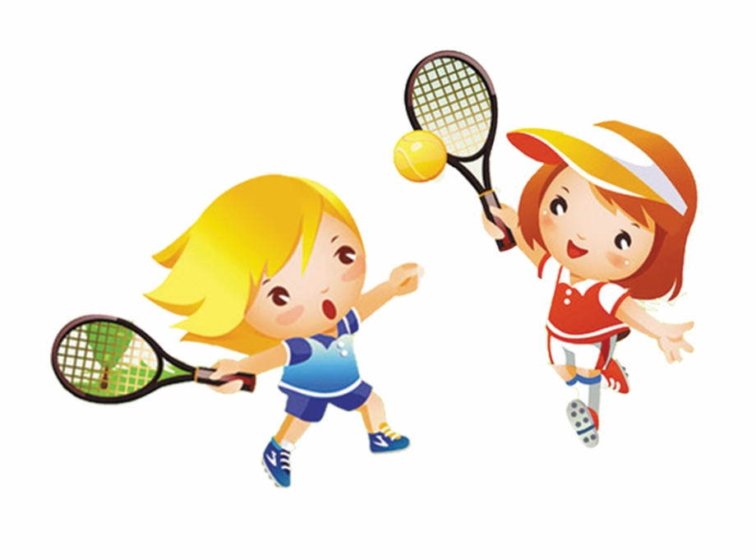
We play / learn tennis.

Slide 9
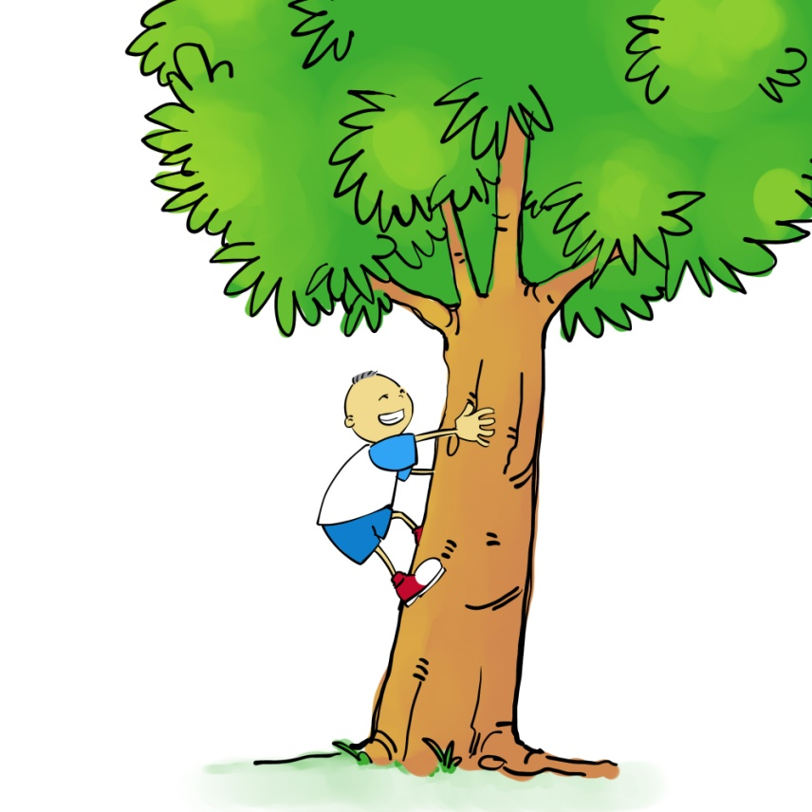
I climb / run a tree.

Slide 10
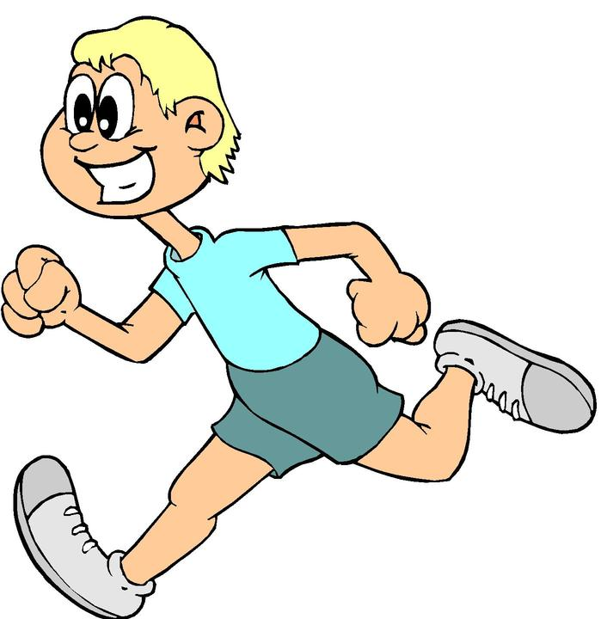
I jump / run fast.

Slide 11
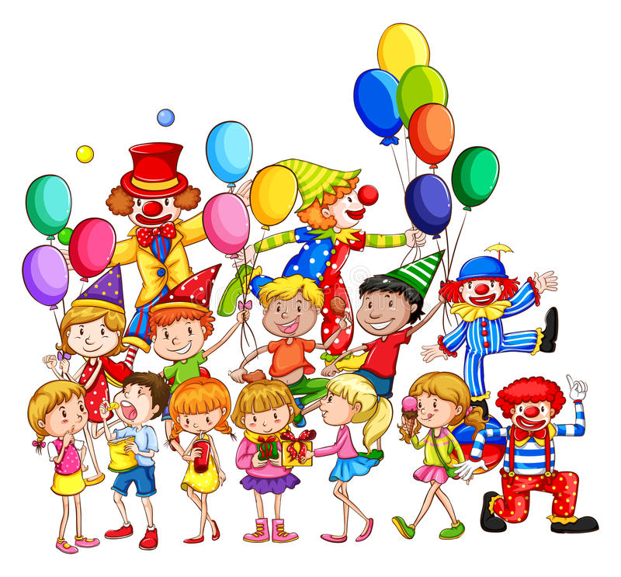
They have / learn fun.

Slide 12
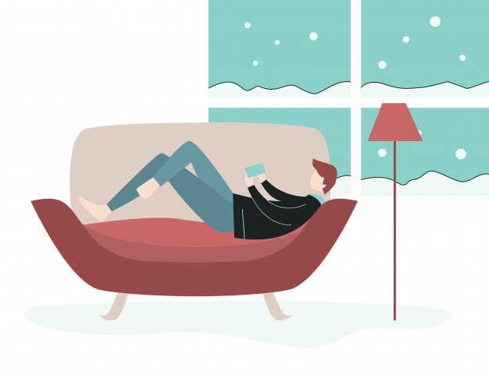
They stay/ cook at home.

Slide 13
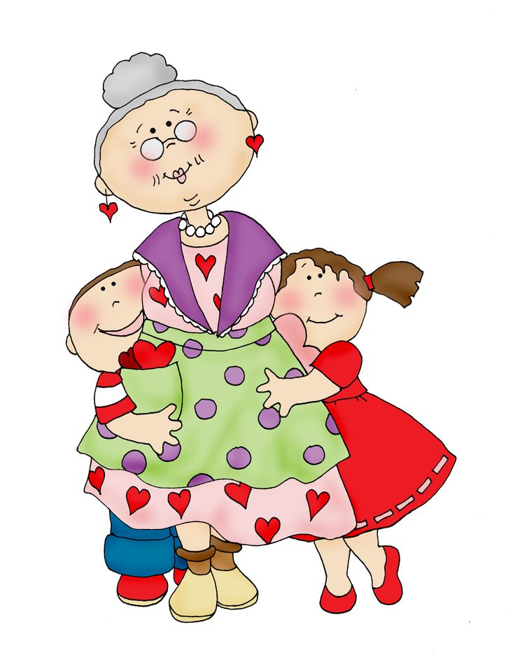
I run / visit my grandma.

Slide 14
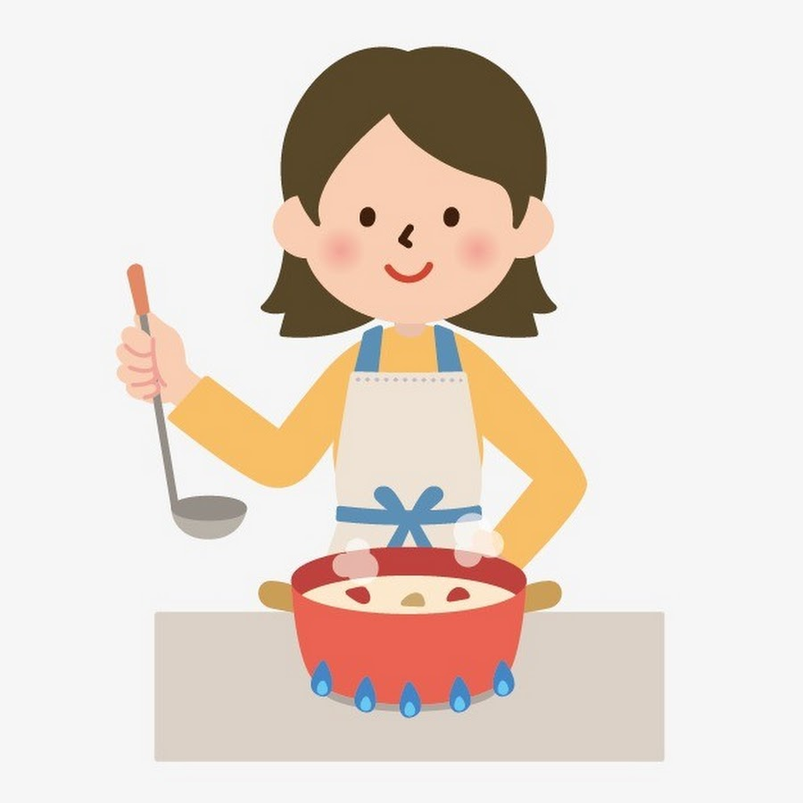
You stay / cook soup.

