Slide 1
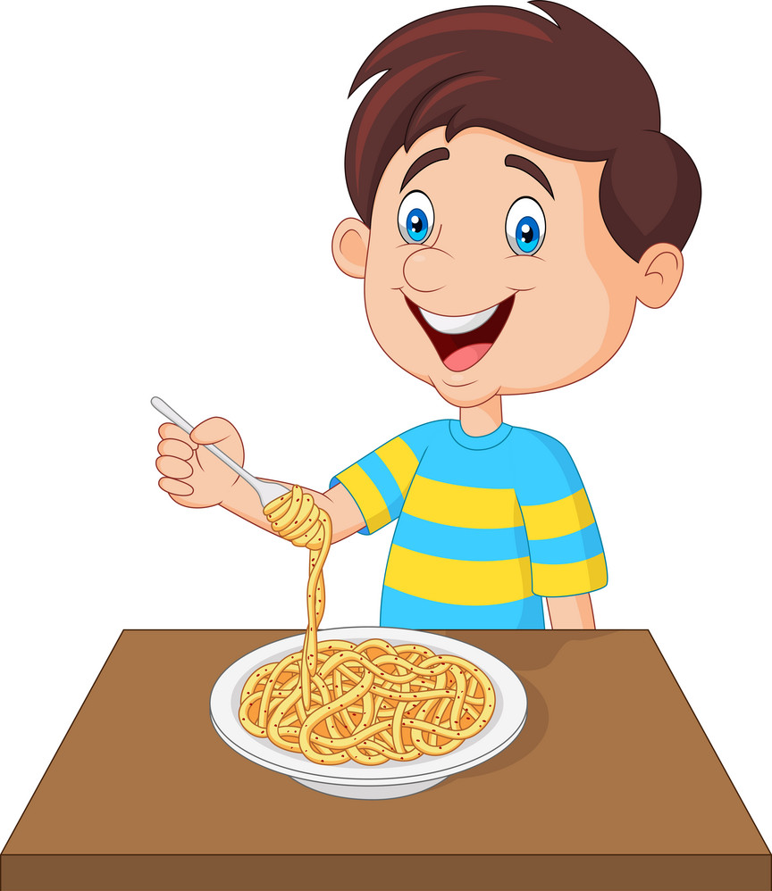
Is he eating ice cream?
Yes, he is. No, he isn’t.

Slide 2
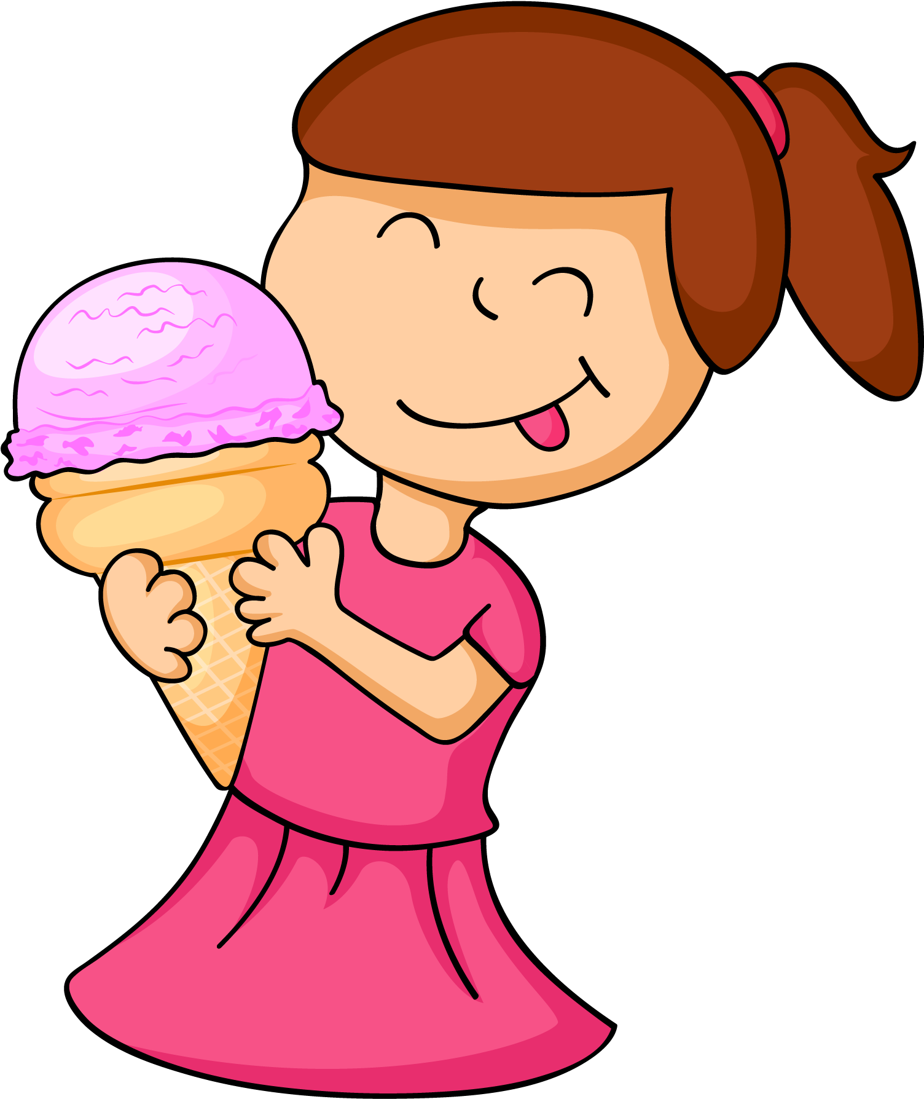
Is she eating ice cream?
Yes, she is. No, she isn’t.

Slide 3
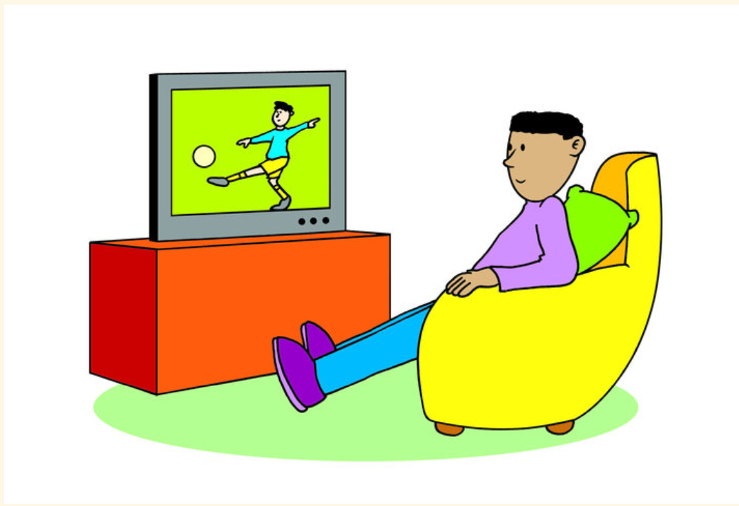
Is he watching cartoons?
Yes, he is. No, he isn’t.

Slide 4
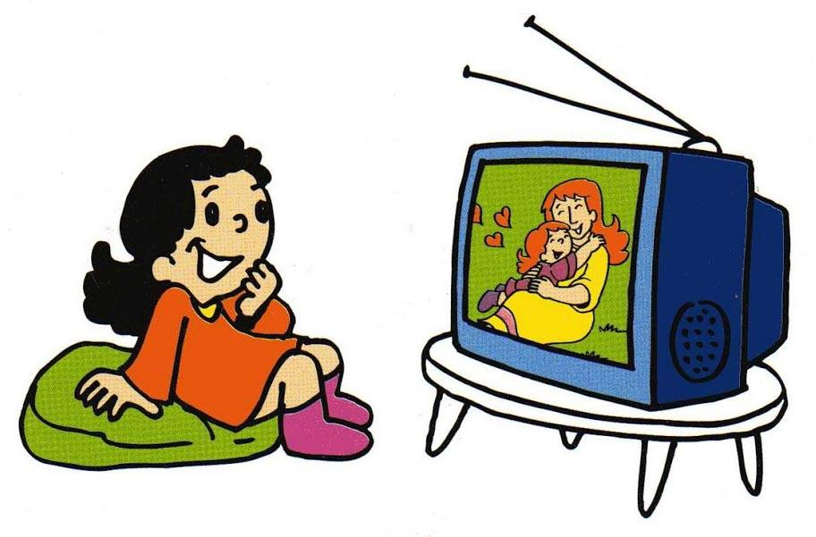
Is she watching a film?
Yes, she is. No, she isn’t.

Slide 5

Is he reading a newspaper?
Yes, he is. No, he isn’t.

Slide 6

Is she reading a book?
Yes, she is. No, she isn’t.

Slide 7
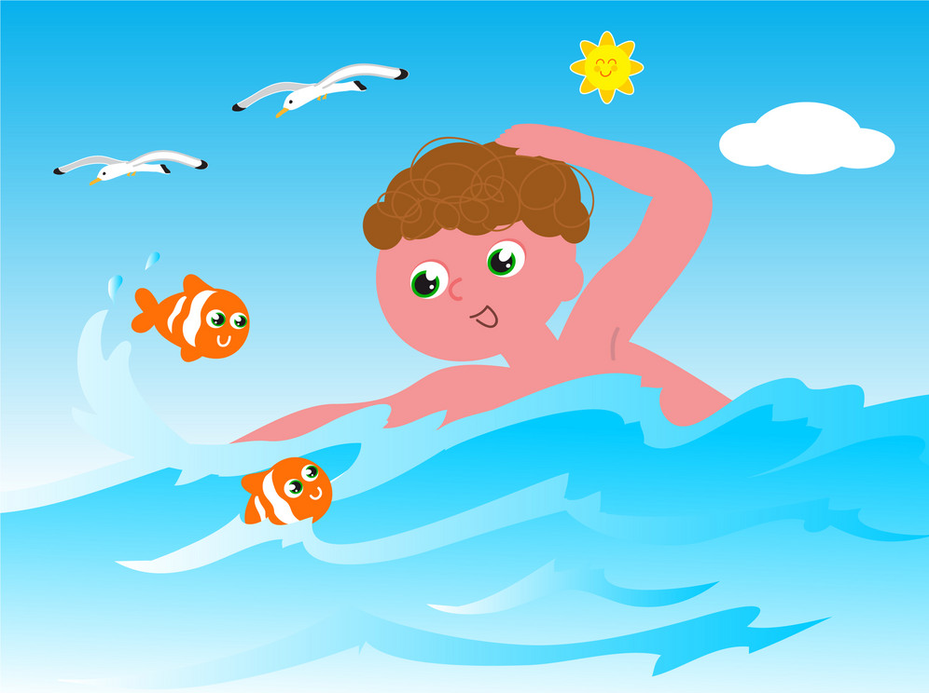
Is he swimming in the pool?
Yes, he is. No, he isn’t.

Slide 8

Is she swimming in the sea?
Yes, she is. No, she isn’t.

Slide 9
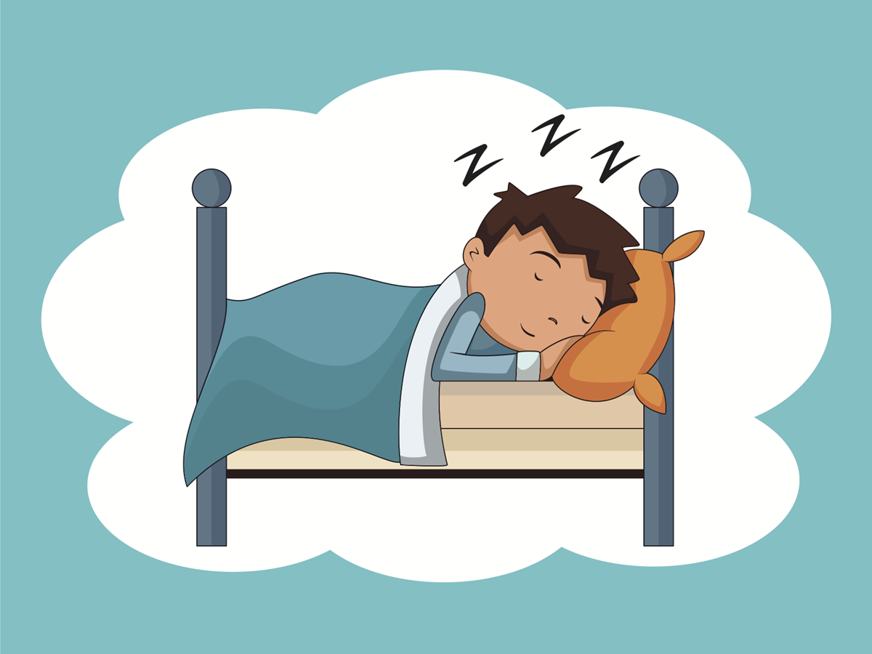
Is he sleeping?
Yes, he is. No, he isn’t.

Slide 10

Is she sleeping?
Yes, she is. No, she isn’t.

