Slide 1
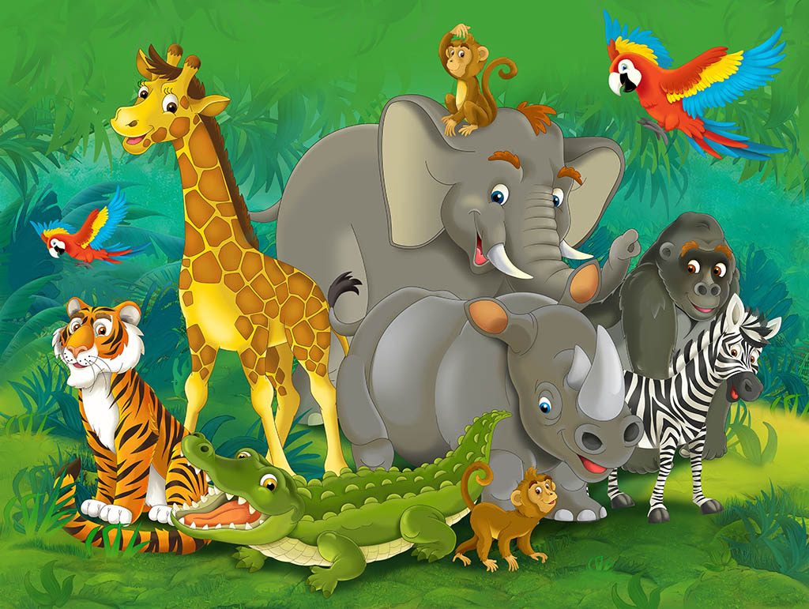
ANIMALS

Slide 2
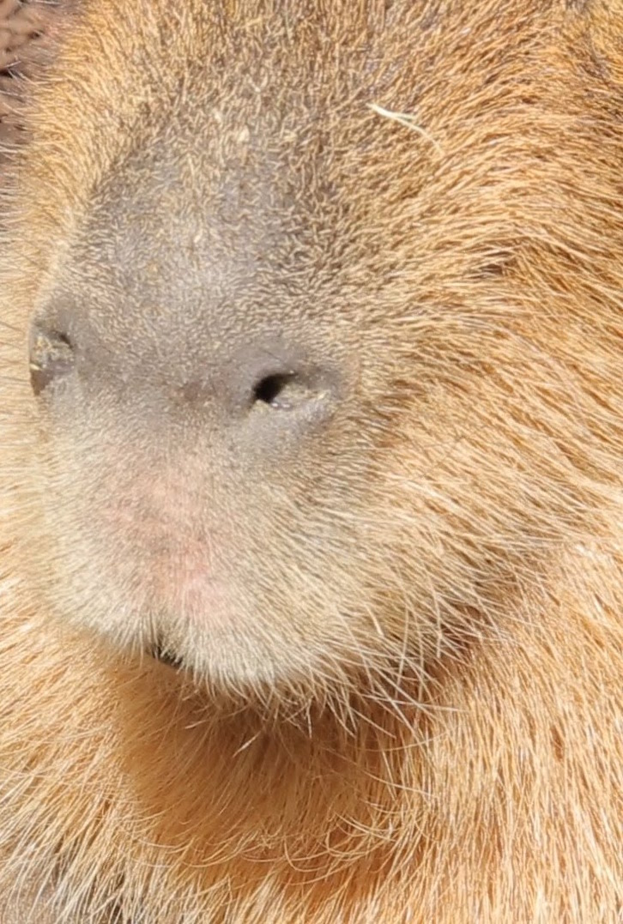
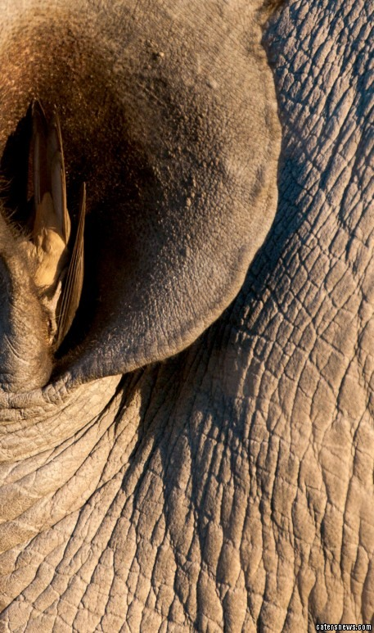
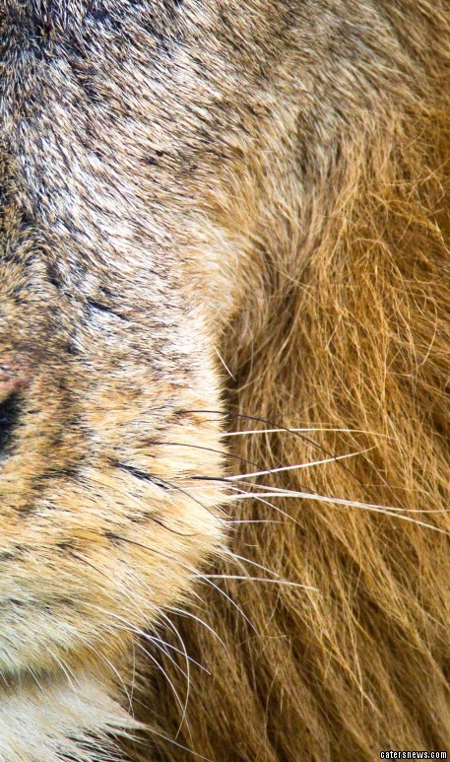
WHERE IS THE LION?
A
B
C

Slide 3
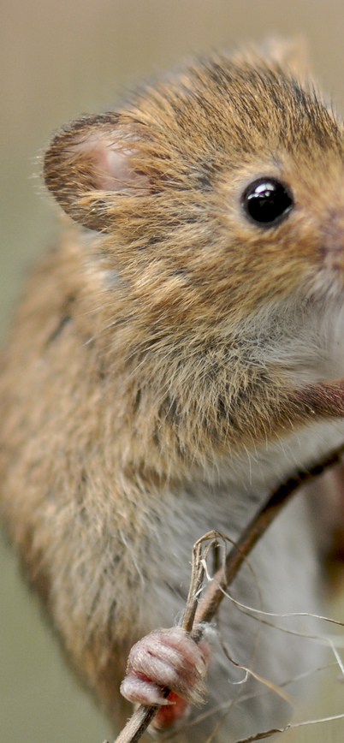
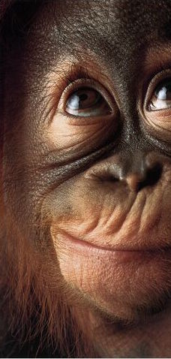
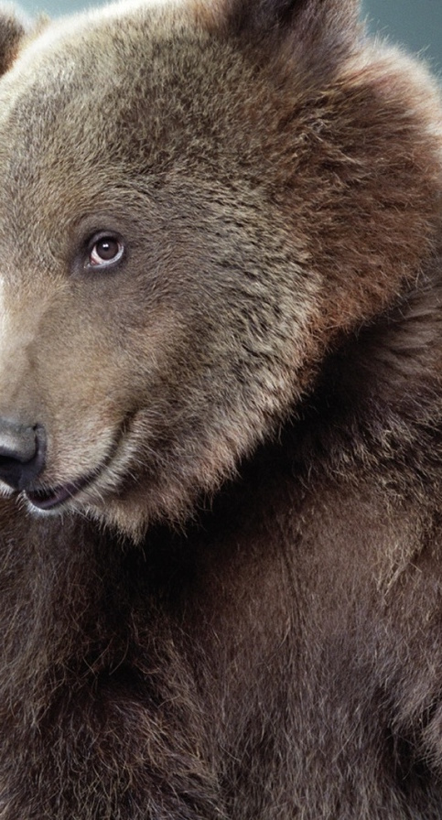
WHERE IS THE MONKEY?
A
B
C

Slide 4
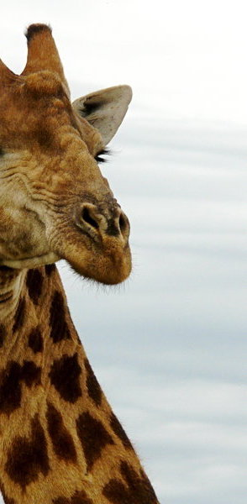
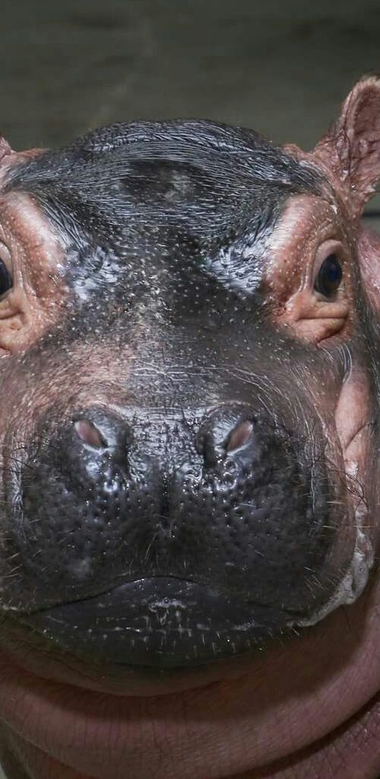
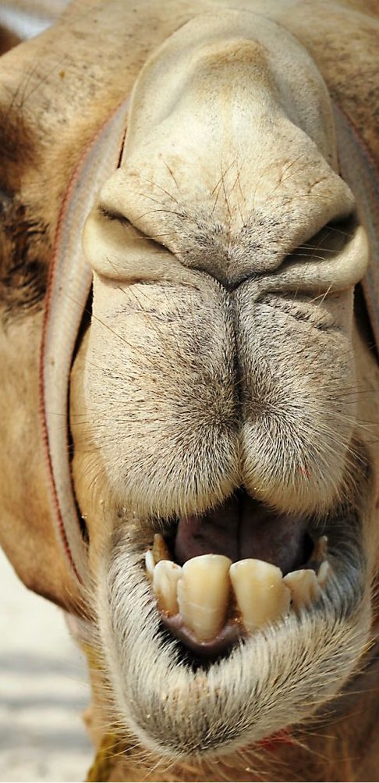
WHERE IS THE GIRAFFE?
A
B
C

Slide 5
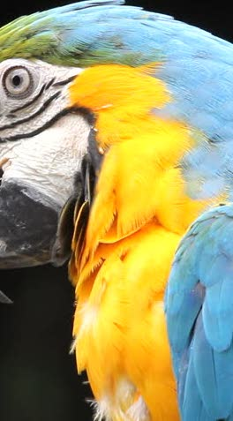
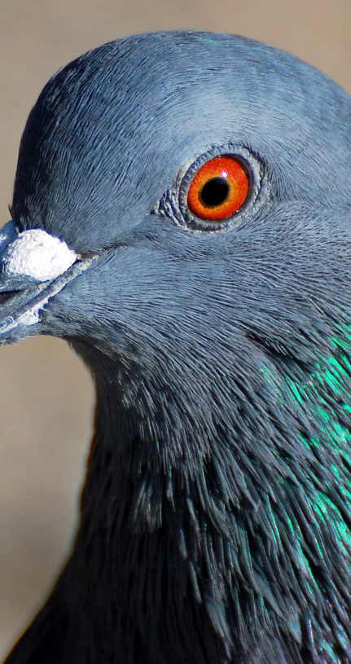
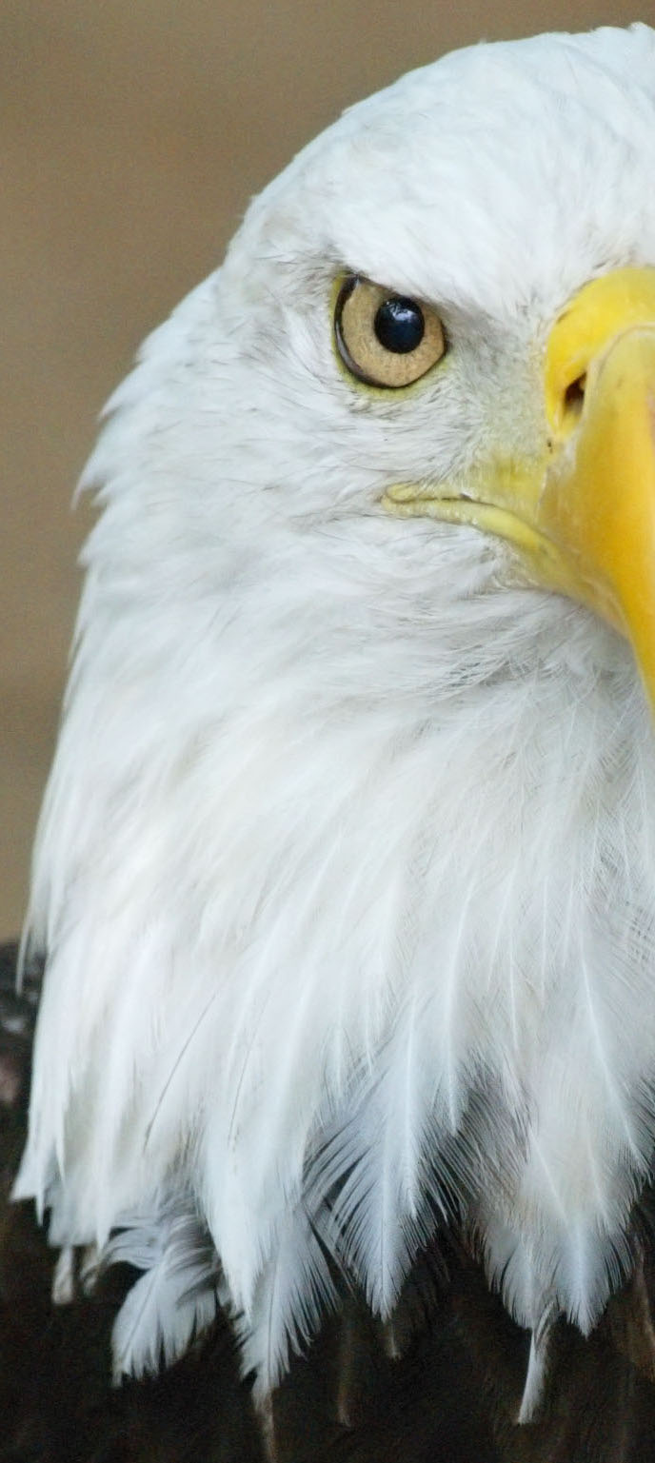
WHERE IS THE EAGLE?
A
B
C

Slide 6
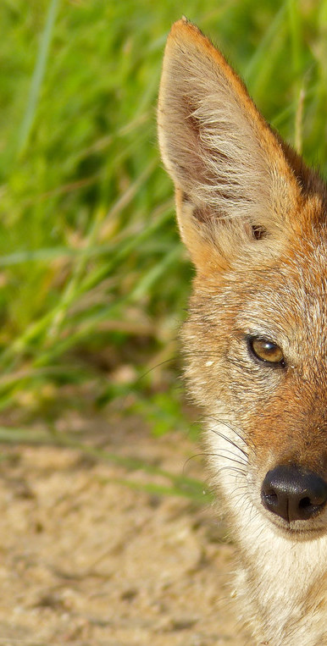
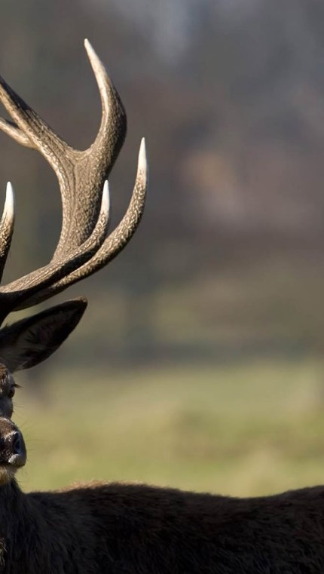
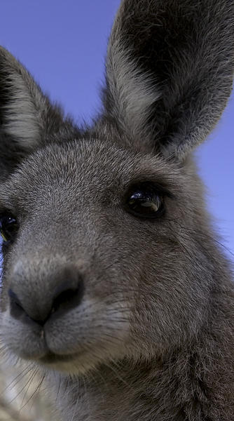
WHERE IS THE DEER?
A
B
C

Slide 7
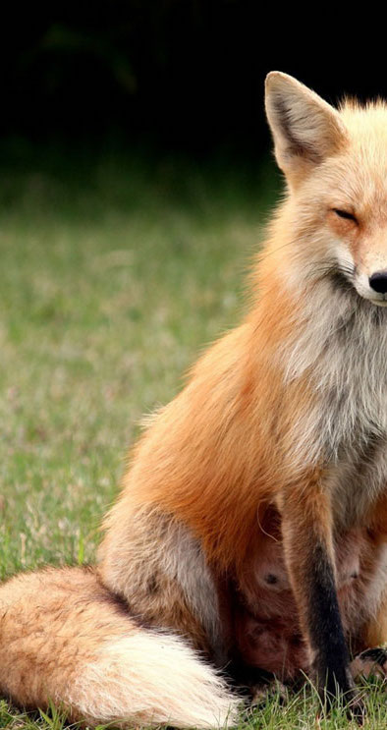
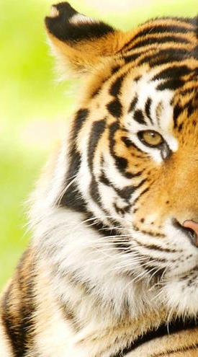
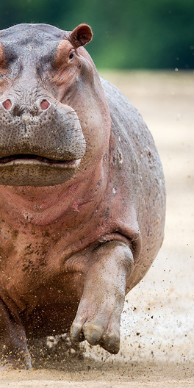
WHERE IS THE HIPPO?
A
B
C

Slide 8
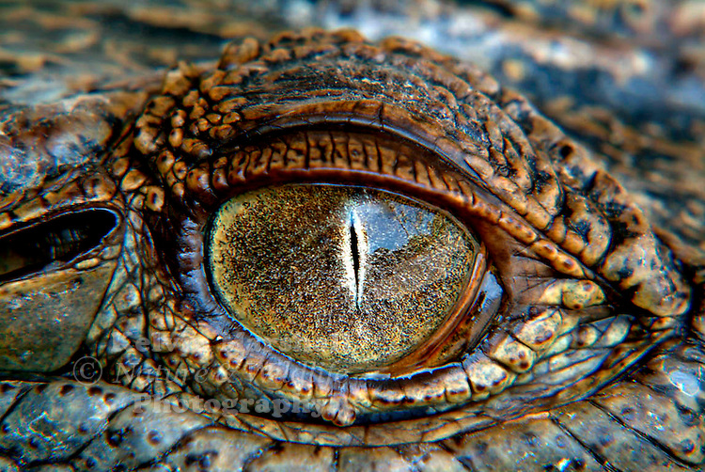
What animal is this?
It’s a CROCODILE

Slide 9
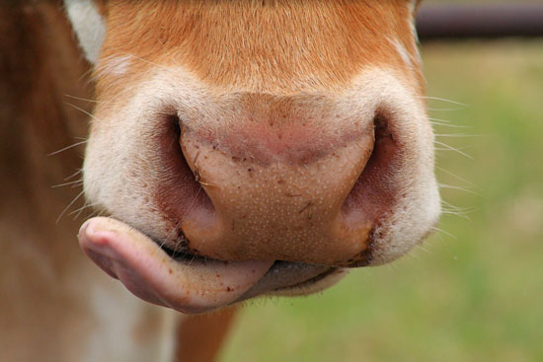
What animal is this?
It’s a COW

Slide 10
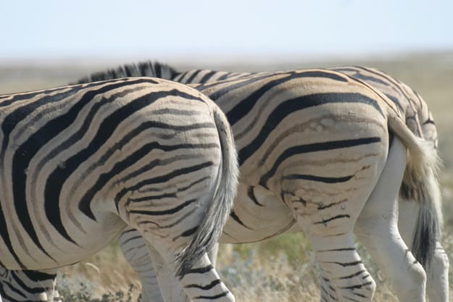
What animal is this?
It’s a ZEBRA

Slide 11
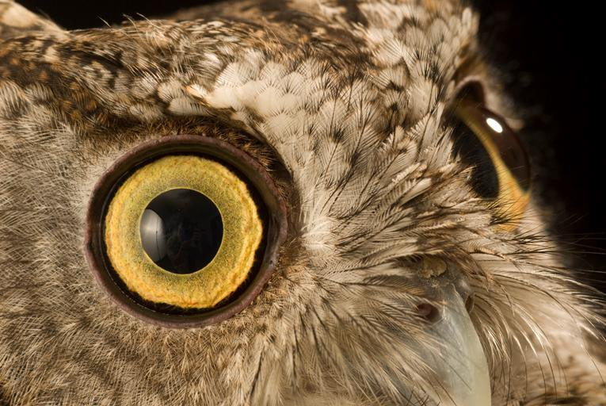
What animal is this?
It’s an
OWL

Slide 12
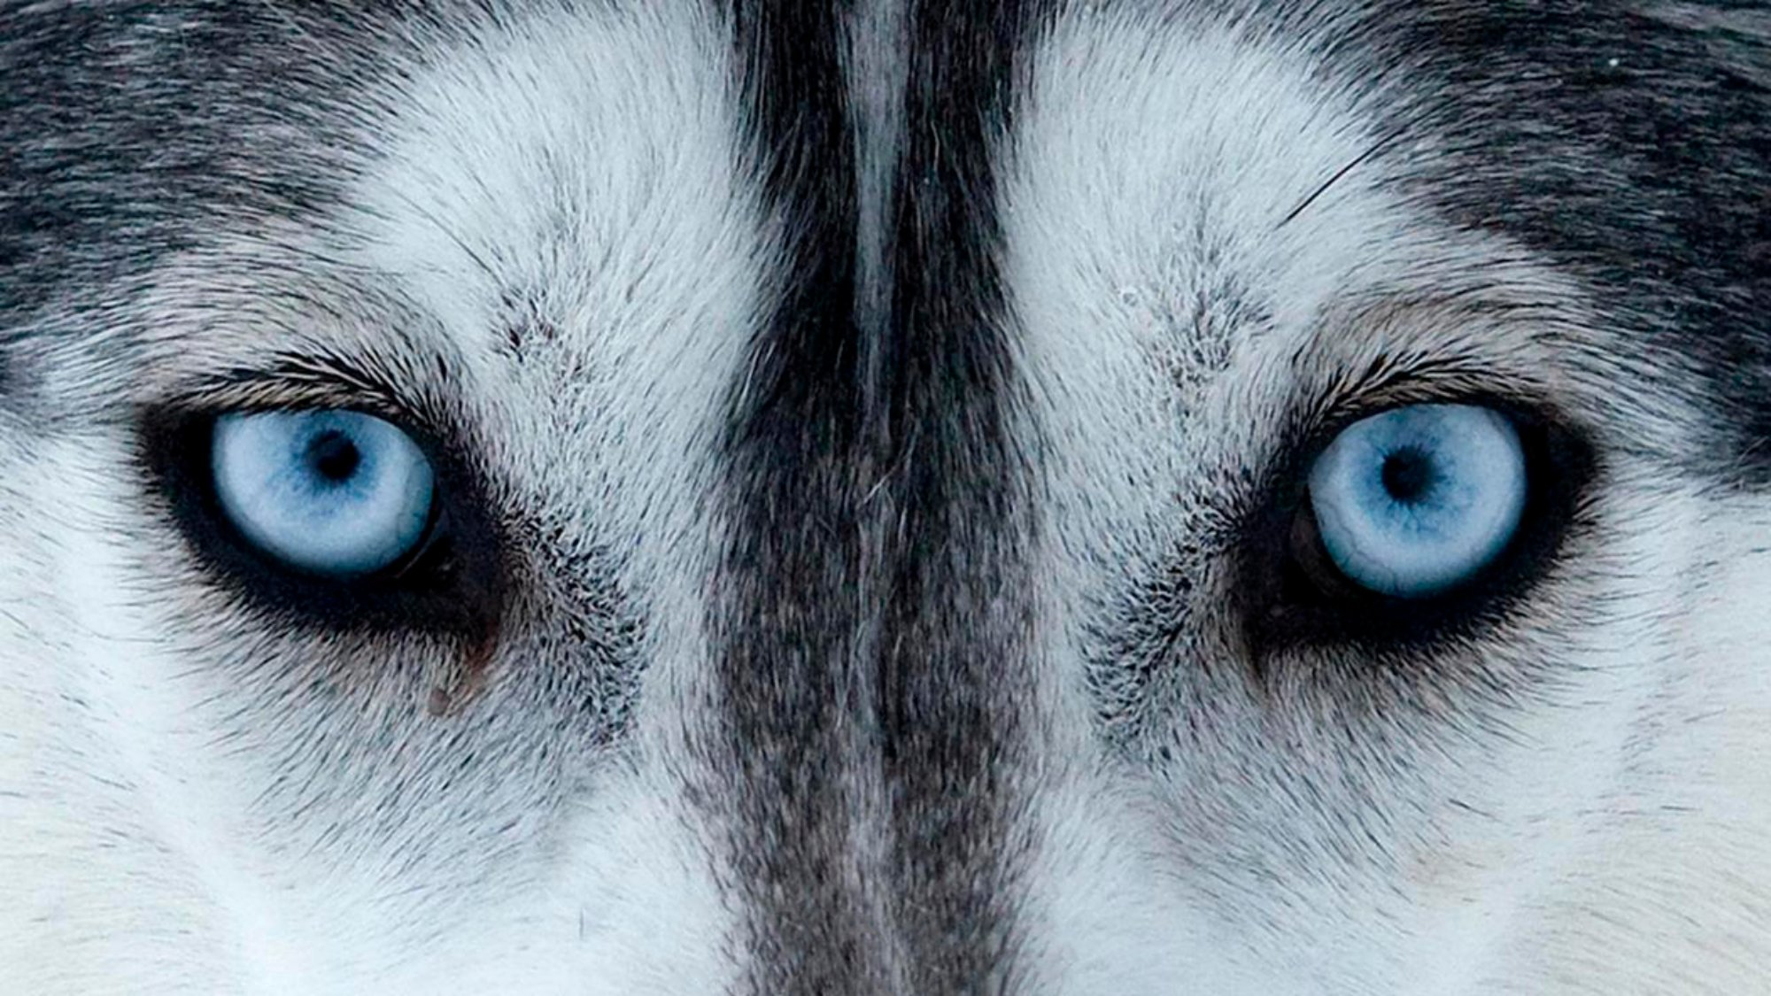
What animal is this?
It’s a
WOLF

Slide 13
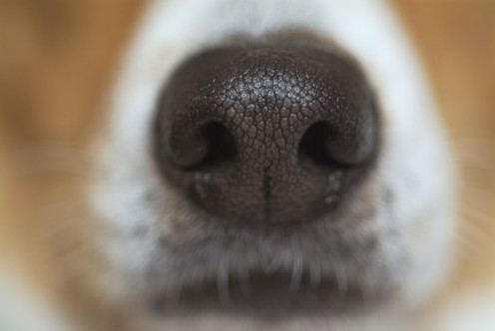
What animal is this?
It’s a
DOG

Slide 14
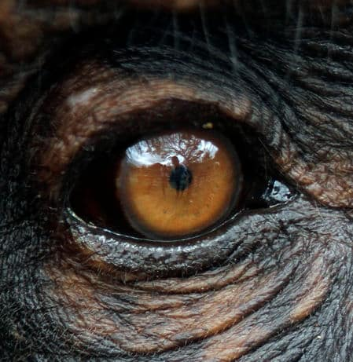
What animal is this?
It’s a
MONKEY

Slide 15
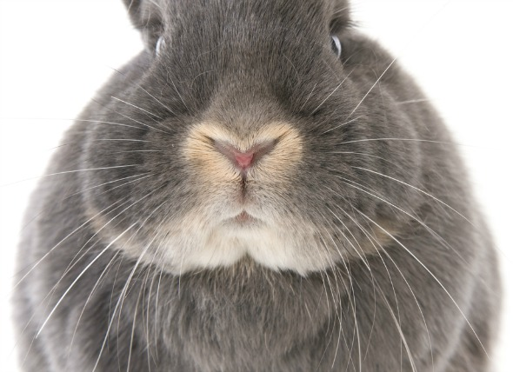
What animal is this?
It’s a
RABBIT

Slide 16
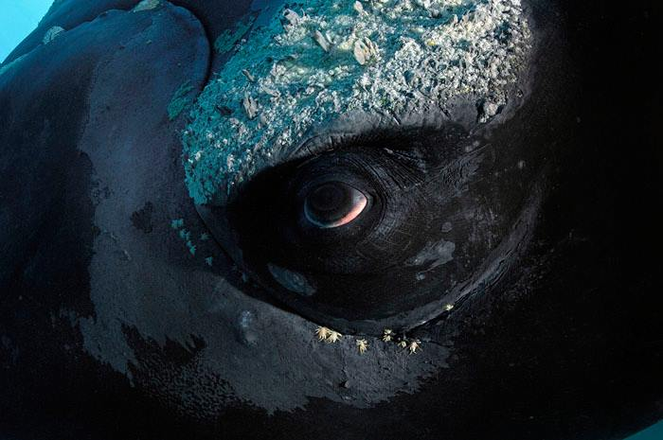
What animal is this?
It’s a
WHALE

Slide 17
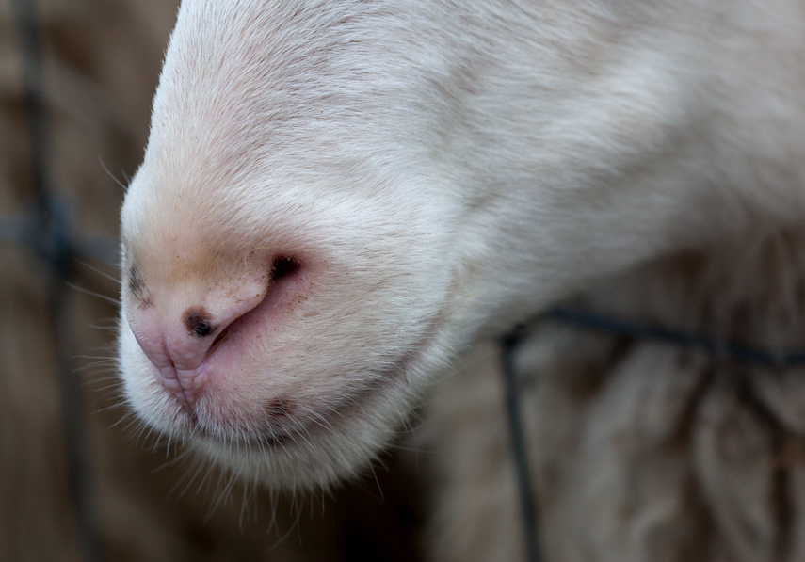
What animal is this?
It’s a
SHEEP

Slide 18
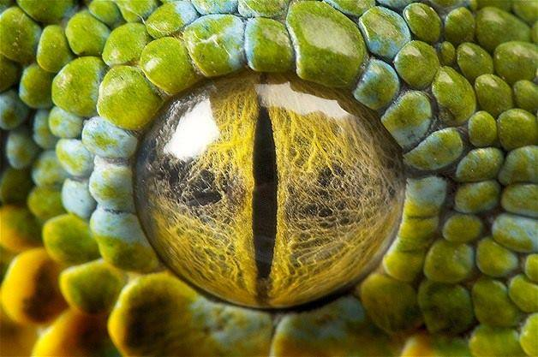
What animal is this?
It’s a
SNAKE

Slide 19
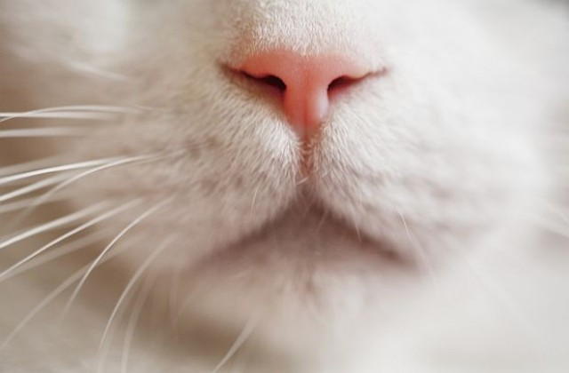
What animal is this?
It’s a
CAT

Slide 20
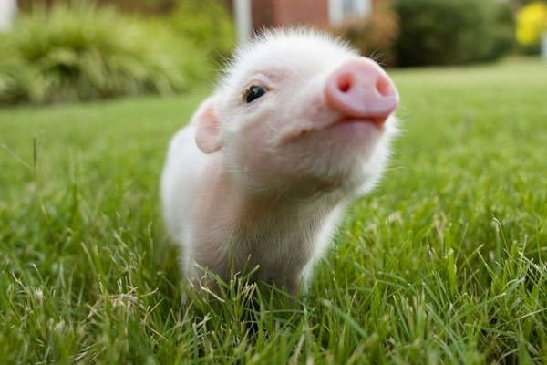
Pig’s Baby
KITTEN
PUPPY
PIGLET
LAMB

Slide 21
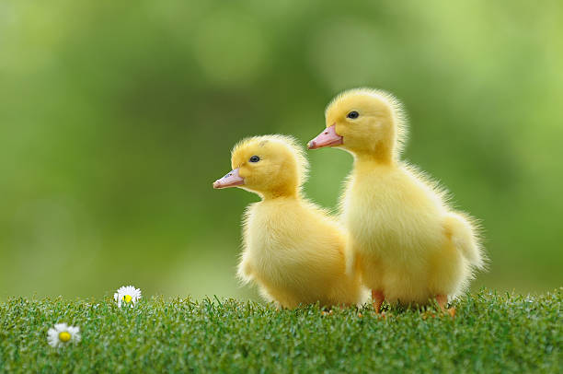
Duck’s Baby
CALF
DUCKLING
LAMB
PUPPY

Slide 22
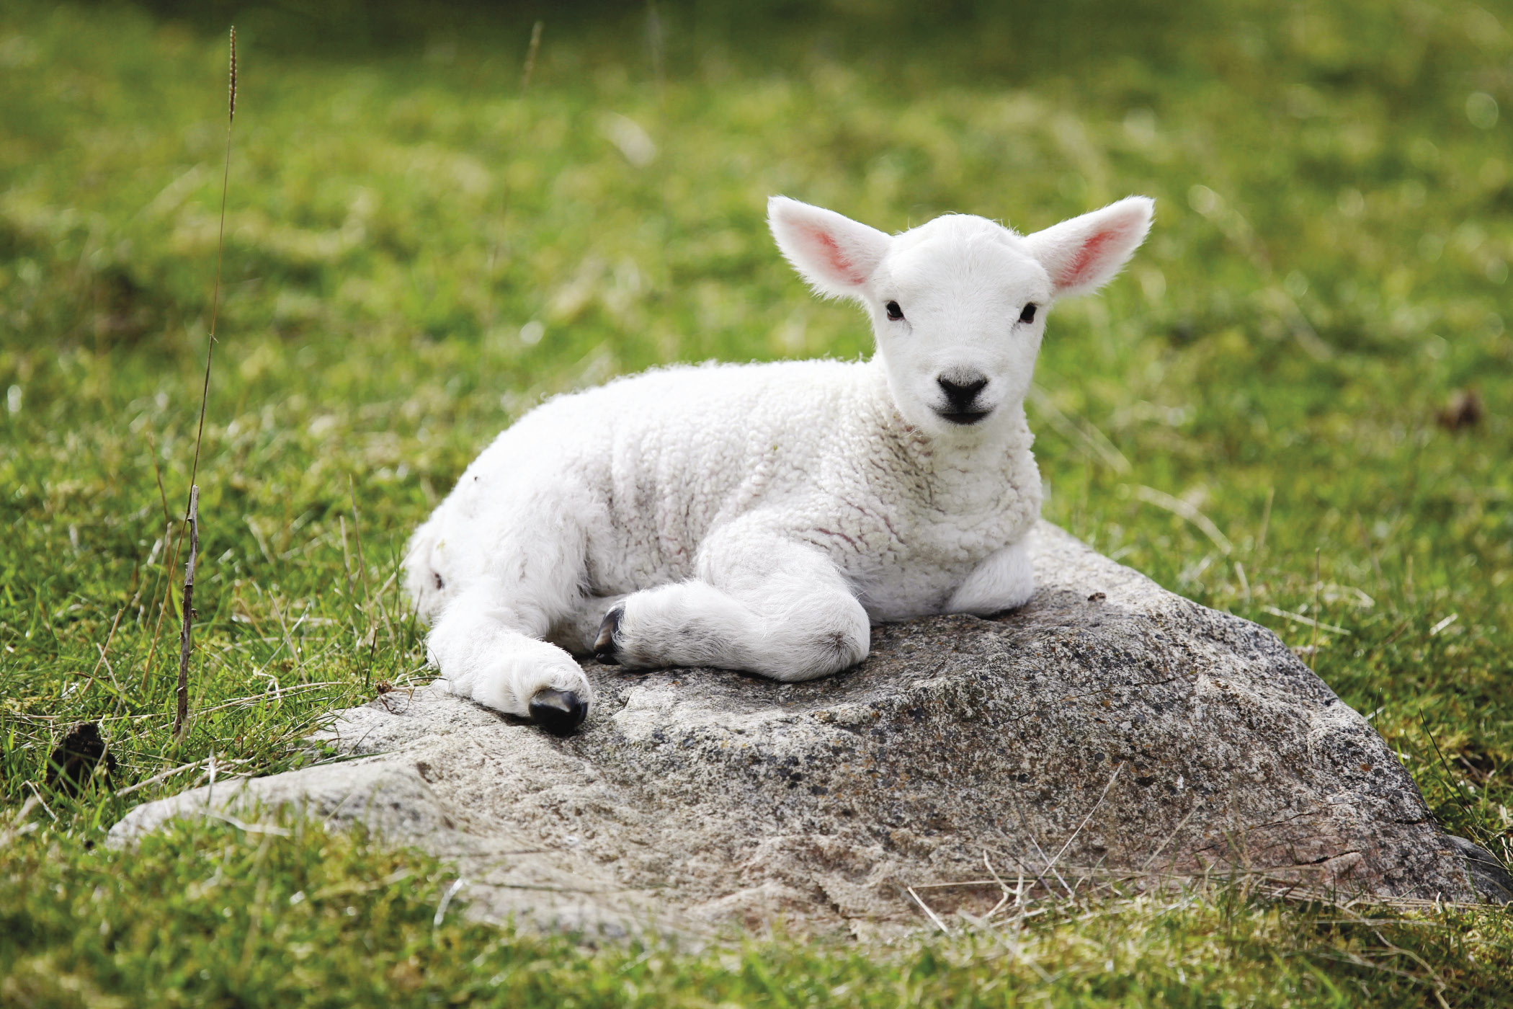
Sheep’s Baby
LAMB
PIGLET
CALF
KITTEN

Slide 23
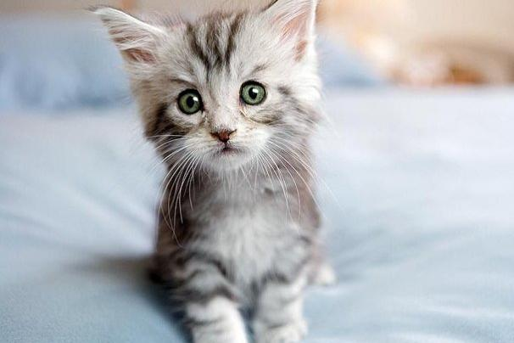
Cat’s Baby
CALF
LAMB
PUPPY
KITTEN

Slide 24
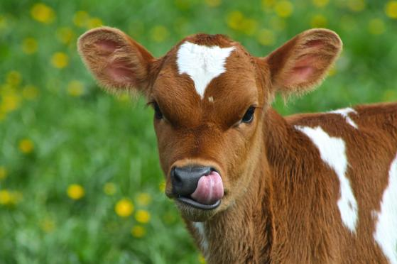
Cow’s Baby
KITTEN
PIGLET
CALF
PUPPY

Slide 25
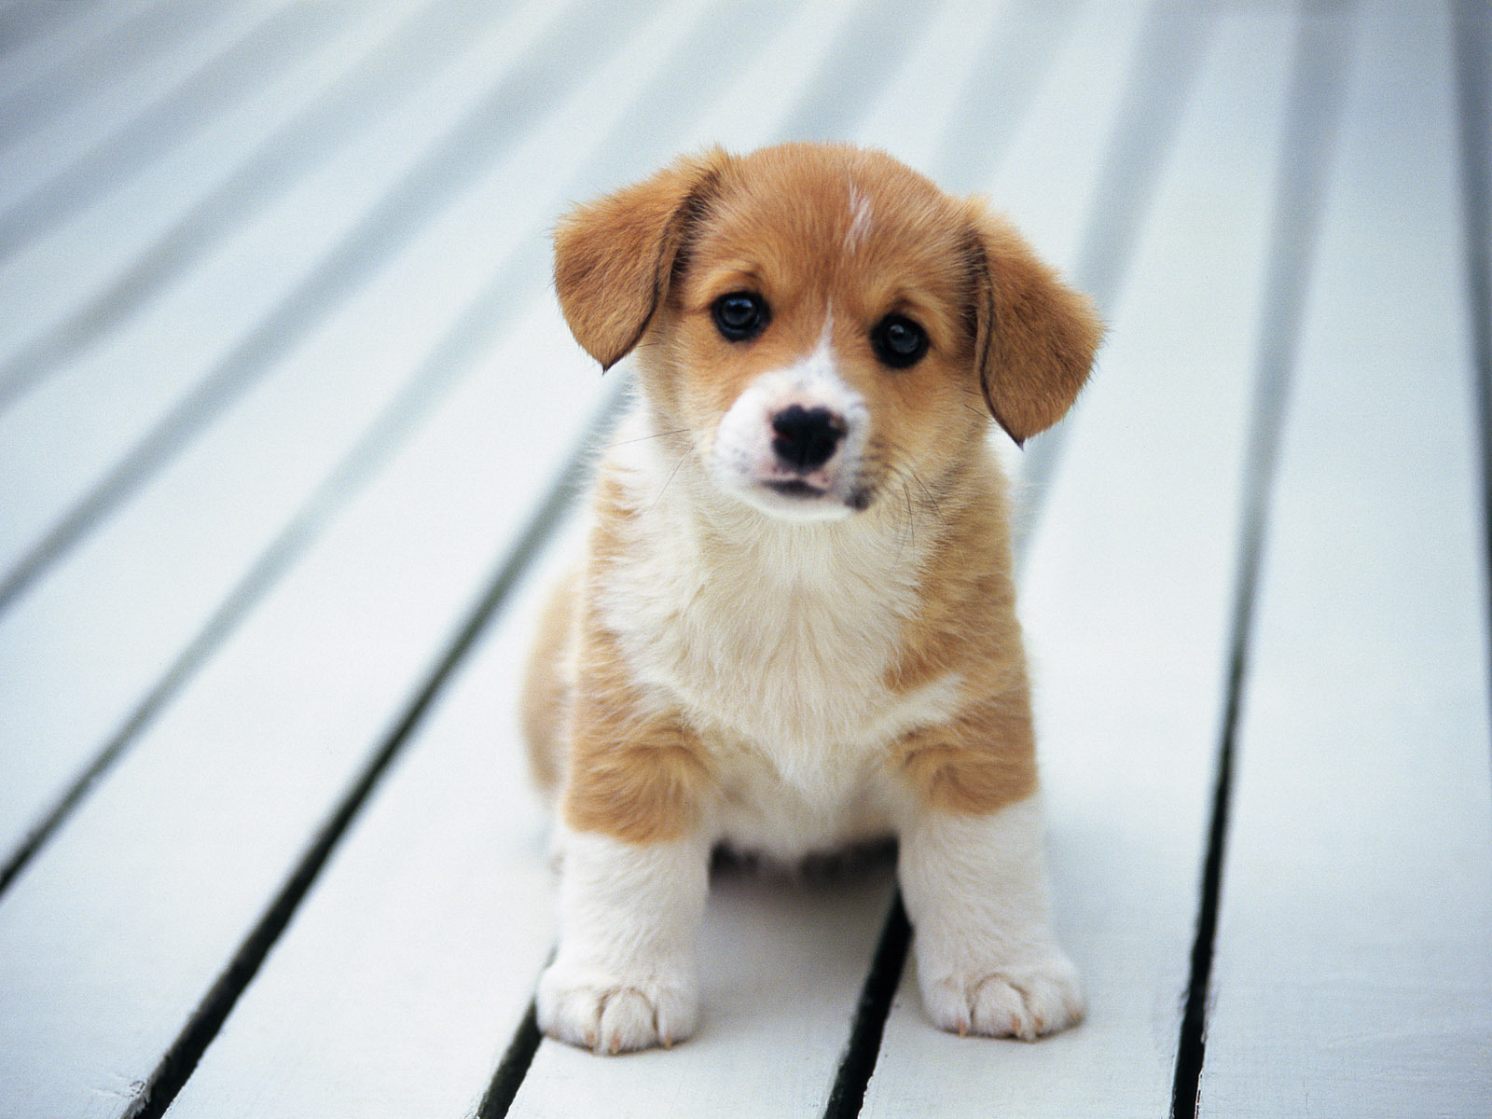
Dog’s Baby
CALF
PUPPY
KITTEN
LAMB

Slide 26
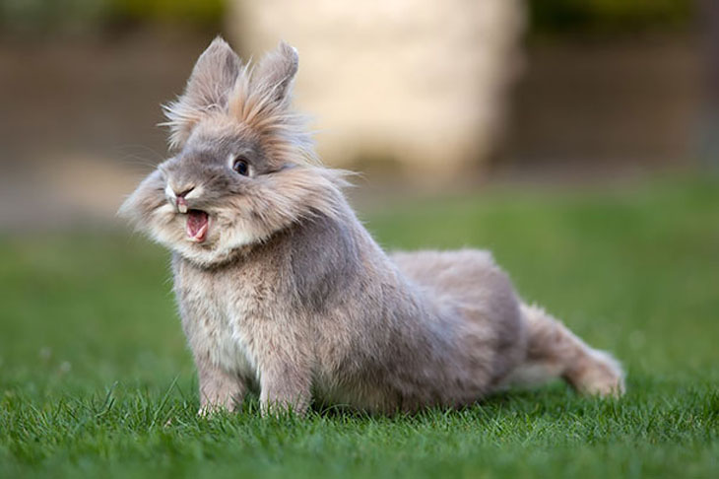
What am I?
1. I am very cute.
2. I can jump.
3. I like carrots.
4. I have long ears.

Slide 27
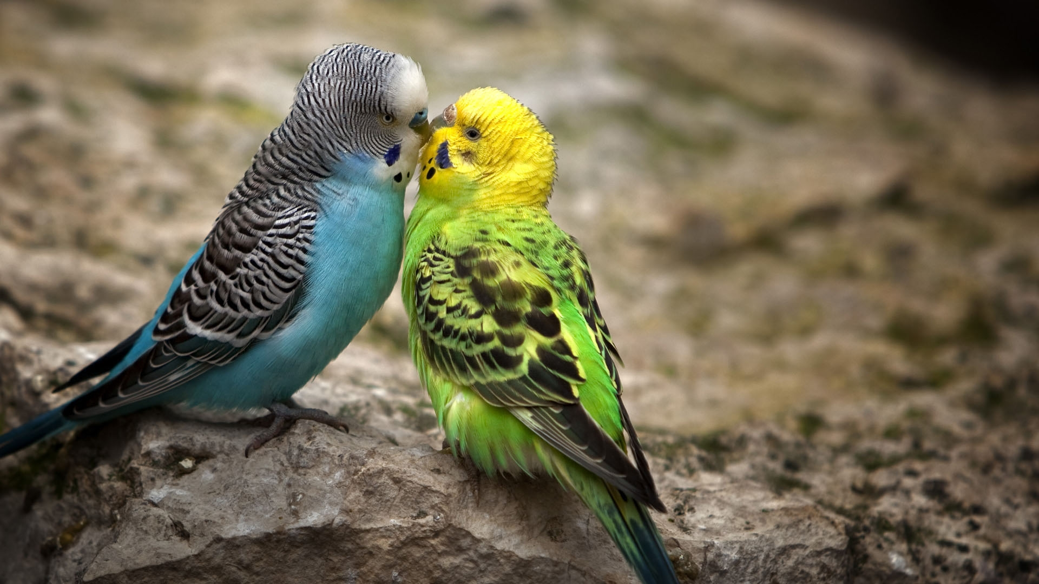
What am I?
1. I am a bird.
2. I can fly.
3. I am very colorful.
4. I live in hot countries.

Slide 28
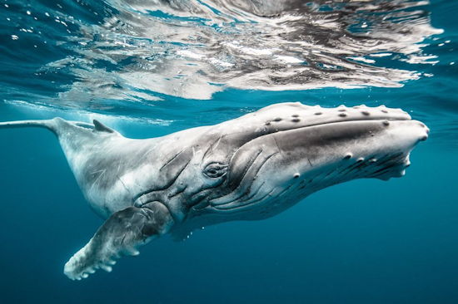
What am I?
1. I can swim.
2. I eat fish.
3. I am blue.
4. I am very big.

Slide 29
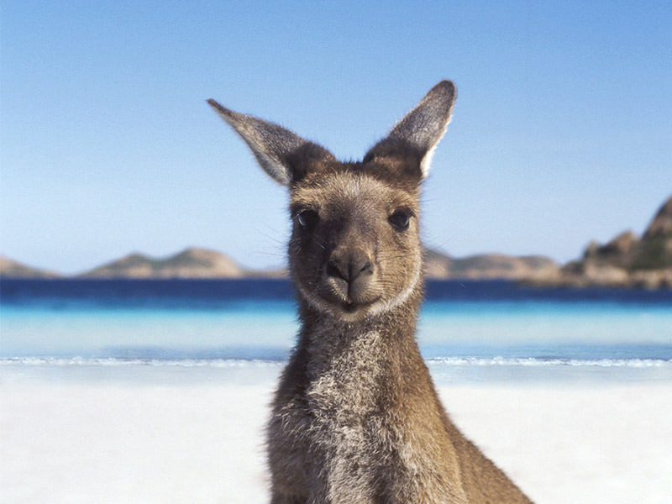
What am I?
1. I can jump.
2. I am brown.
3. I have a very long tail.
4. I live in Australia.

Slide 30
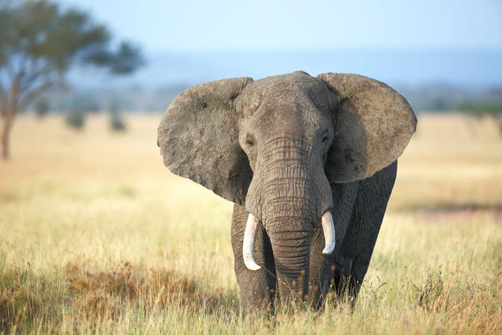
What am I?
1. I eat leaves and grass.
2. I have very big ears.
3. I live in India.
4. I am very big.

Slide 31
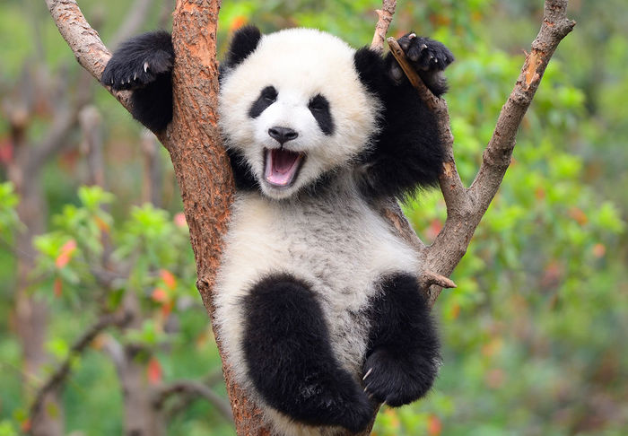
What am I?
1. I am lazy.
2. I like eating.
3. I am black and white.
4. I live in China.

