Slide 1
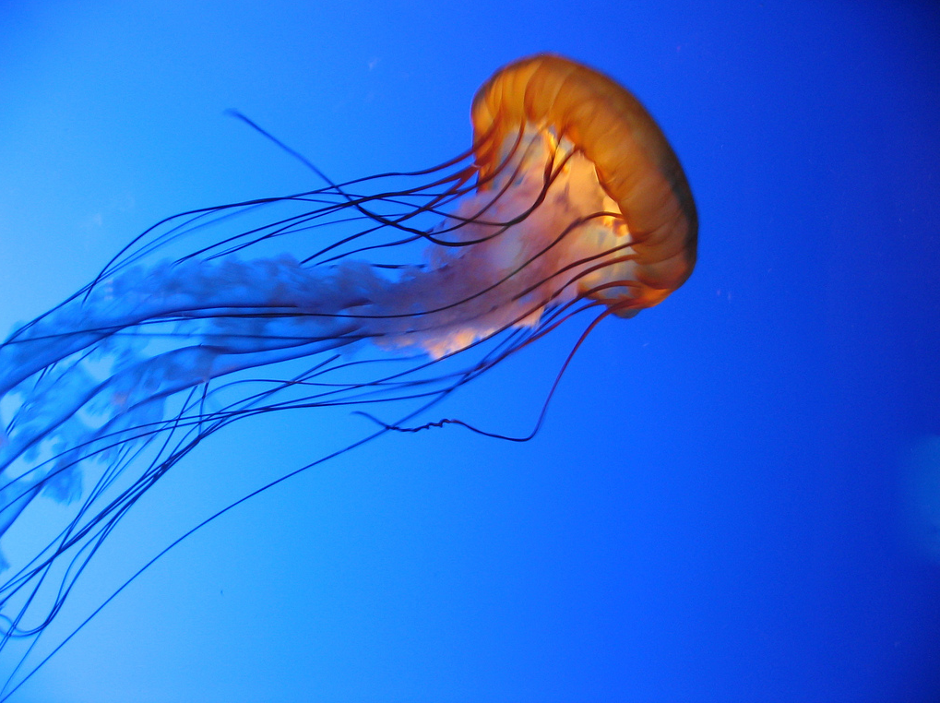
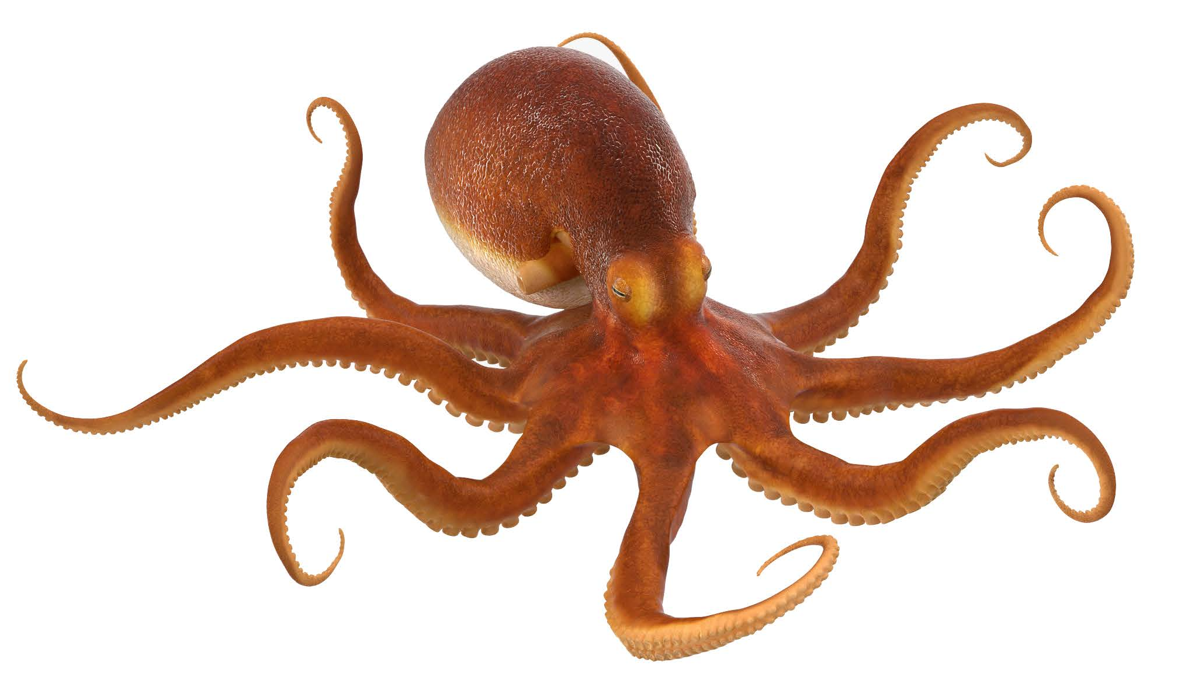
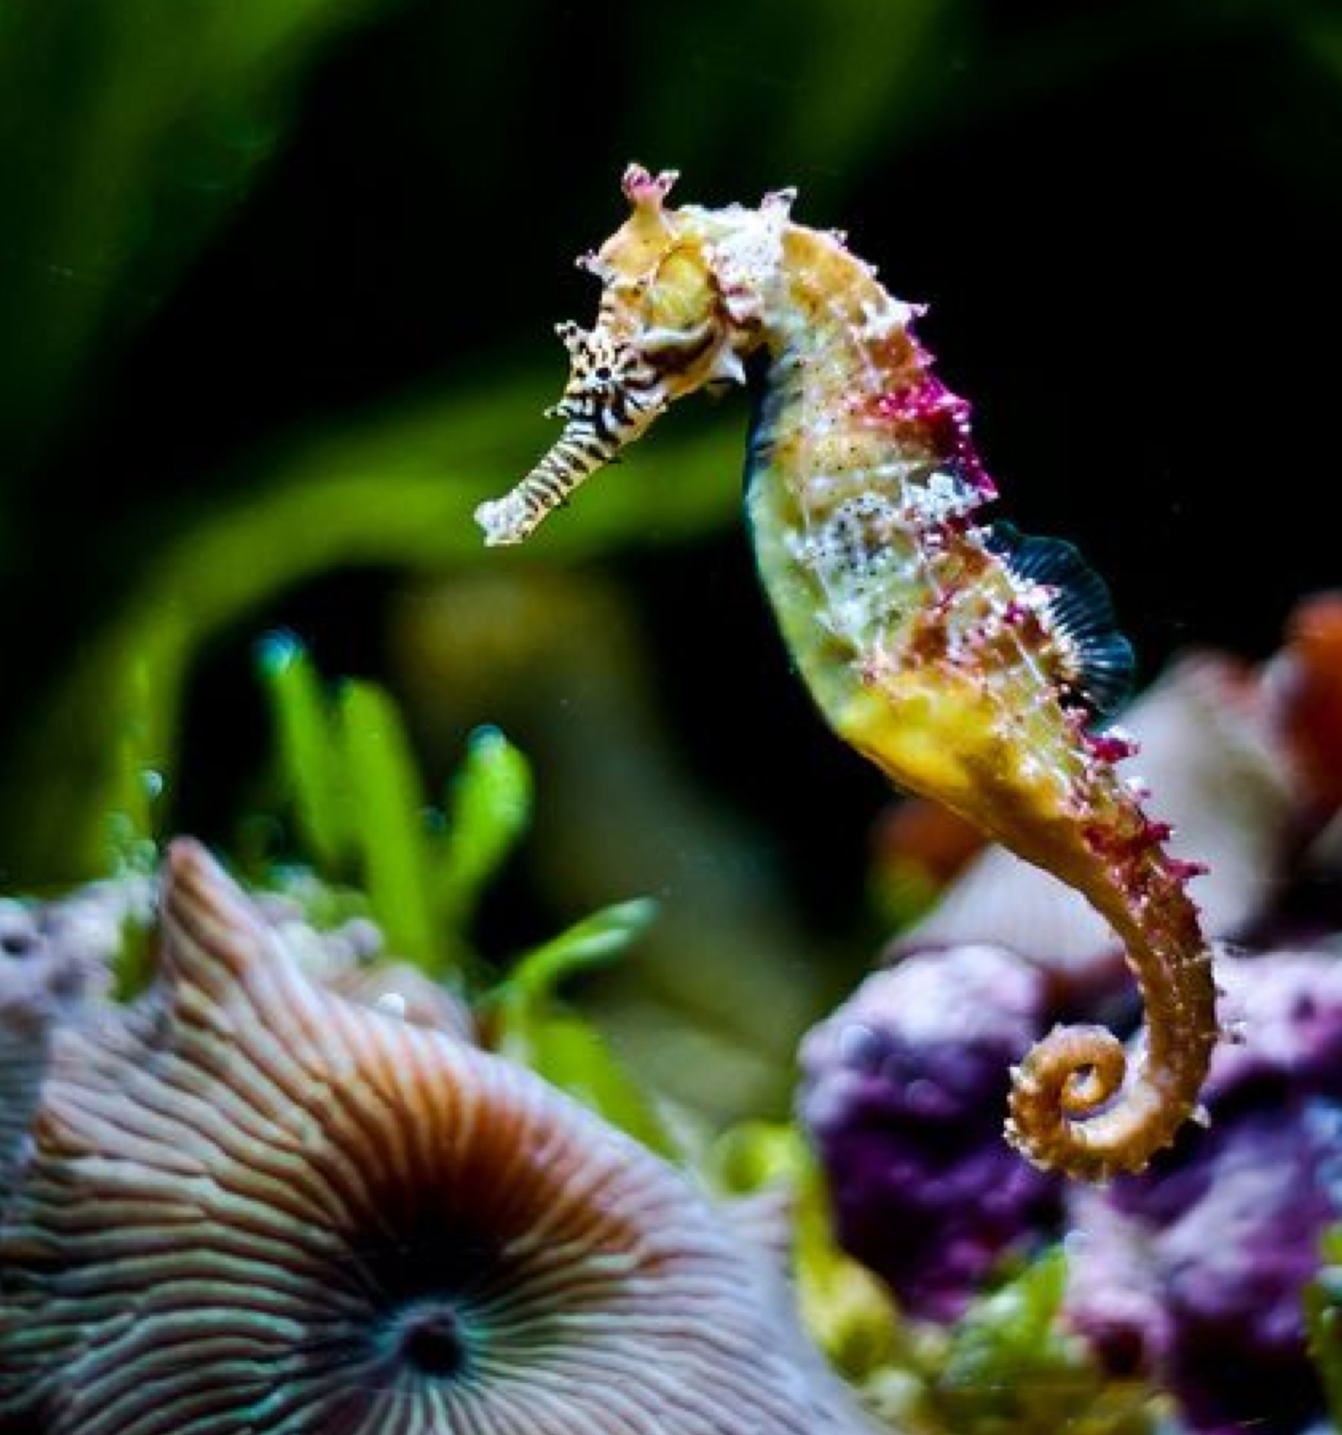
fast

Slide 2
slow

Slide 3
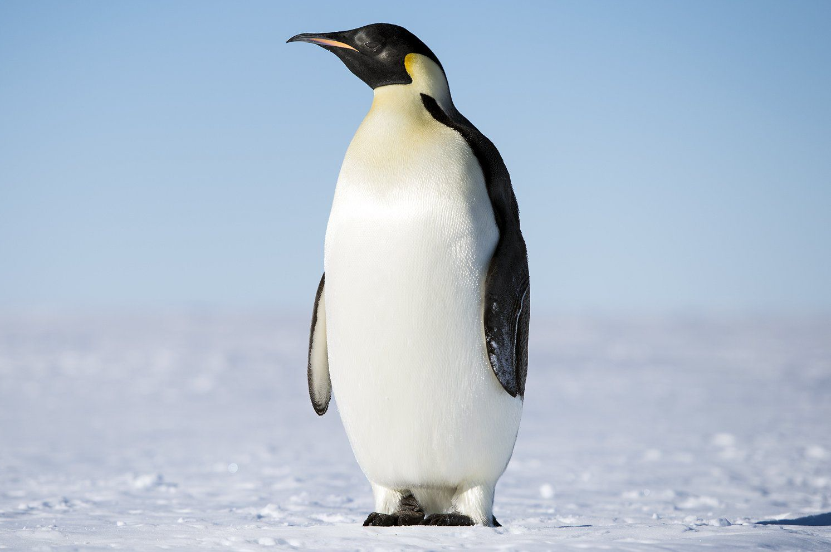
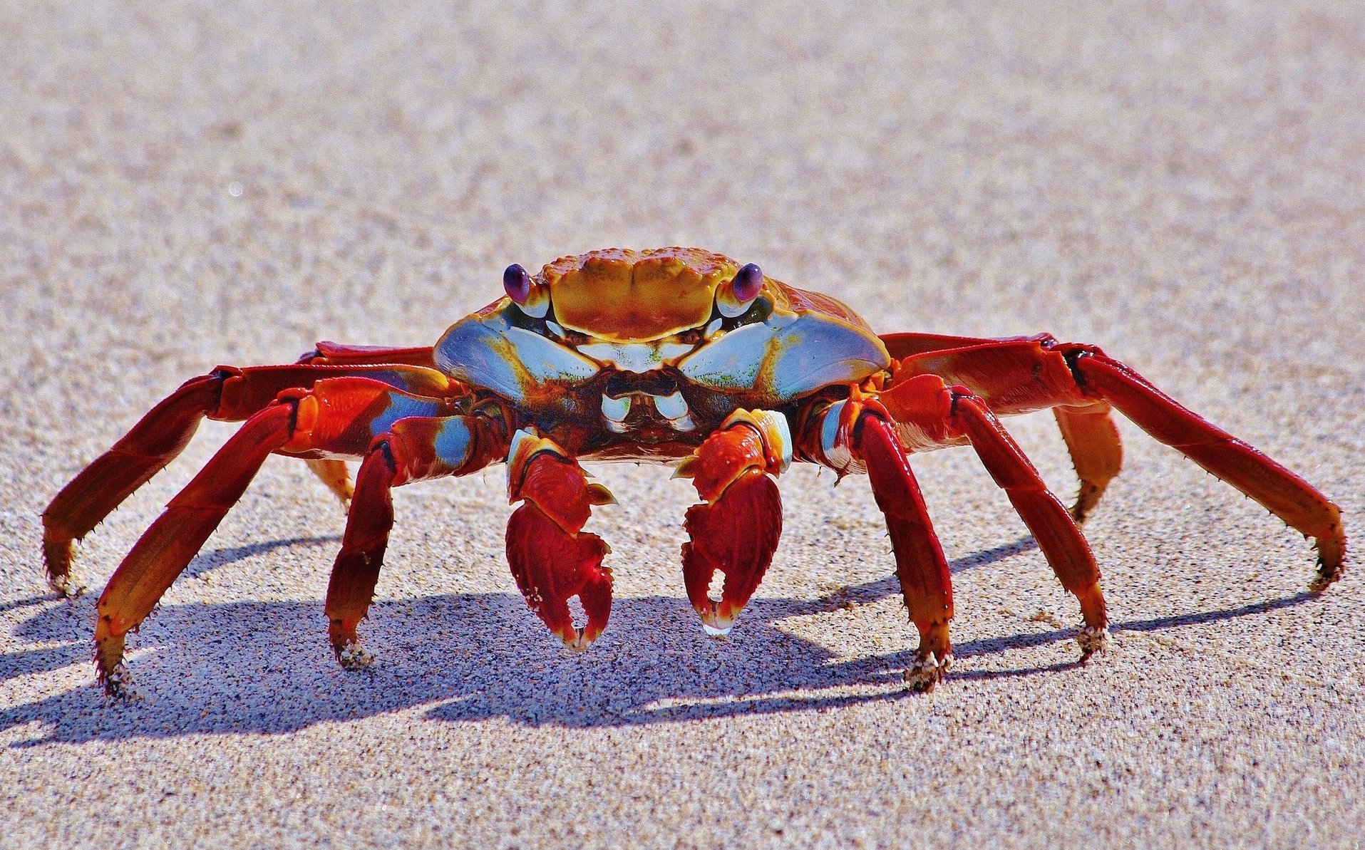

heavy

Slide 4
light

Slide 5
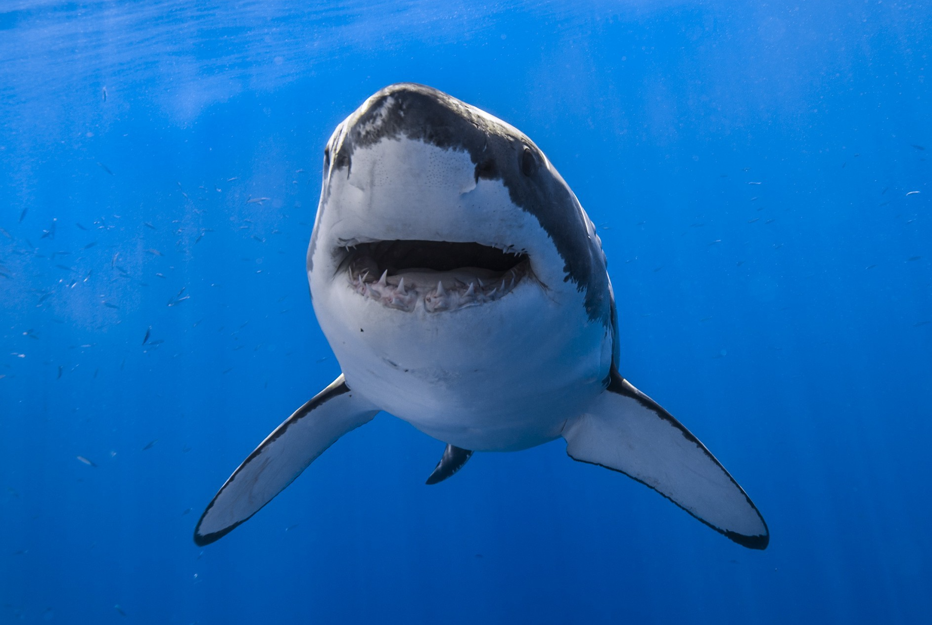
big

Slide 6
tiny

Slide 7
dangerous

Slide 8
friendly

Slide 9
hard

Slide 10
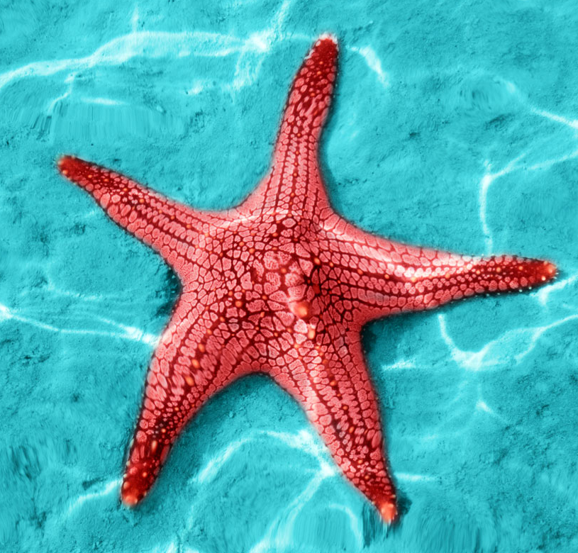
soft

Slide 11
loud

Slide 12
quiet

Slide 13
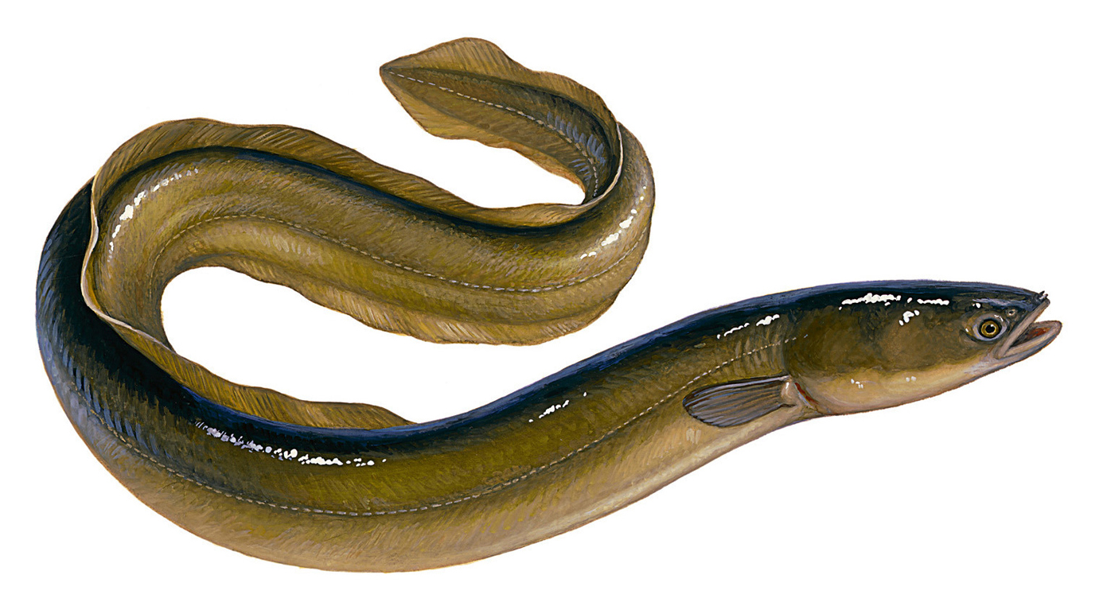
long

Slide 14
short

Slide 15
beautiful

Slide 16
ugly

Slide 17
fat

Slide 18
thin

Slide 19
funny

Slide 20
scary

