Slide 1



IrinaPapakhinac

Slide 2


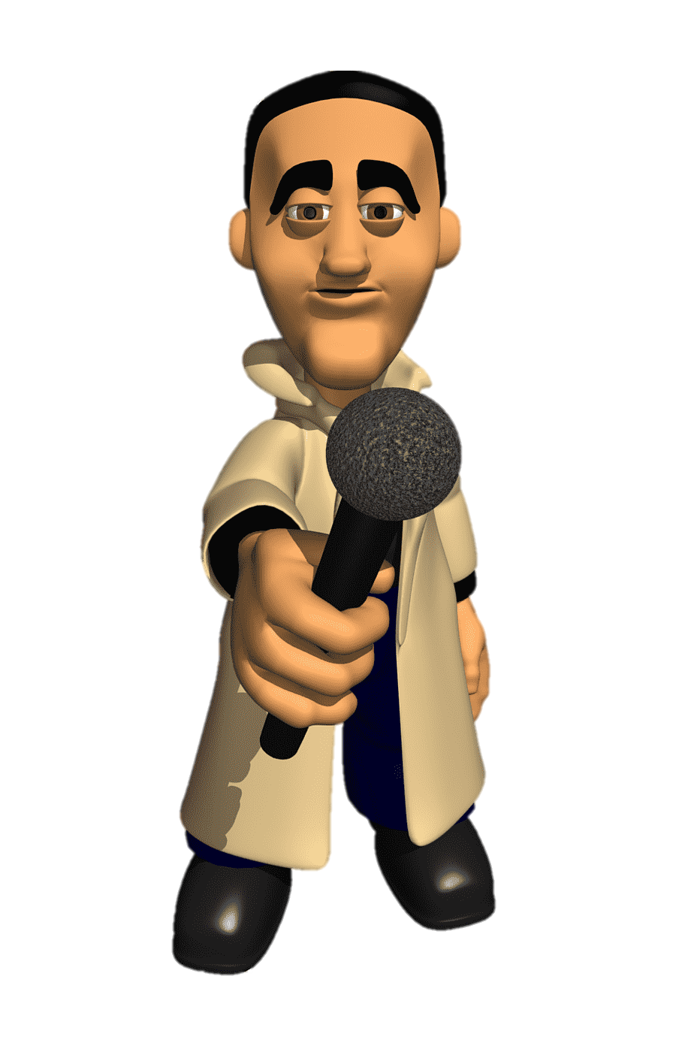
Continue the sentences.
1. My granny can …
2. My brother / sister can …
3. My best friend can …
4. My dad …
5. I can …
6. I can’t …
IrinaPapakhinac

Slide 3
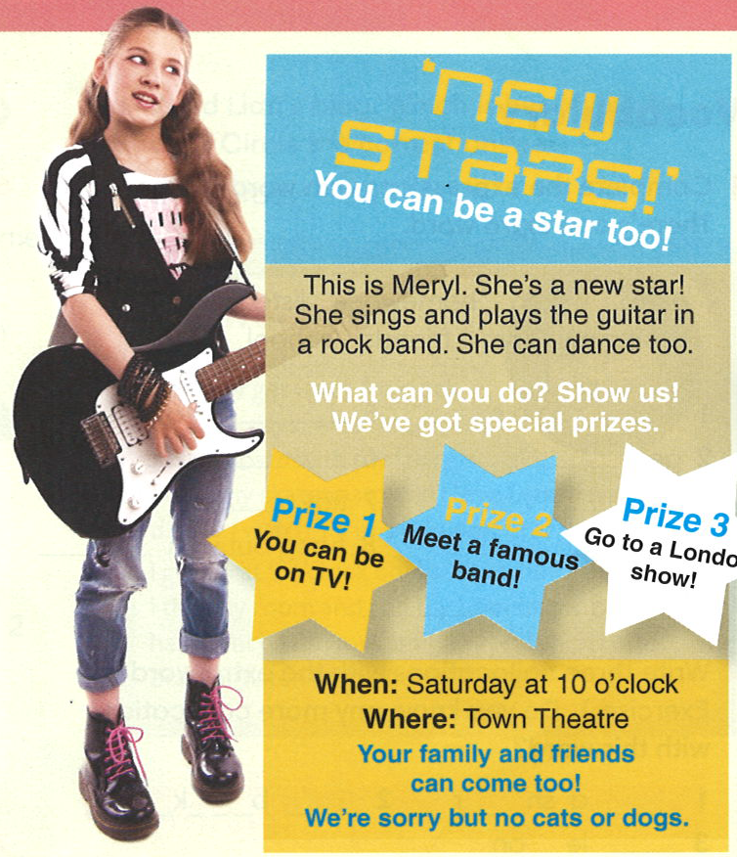

Read the ad.
What is it about?
IrinaPapakhinac

Slide 4
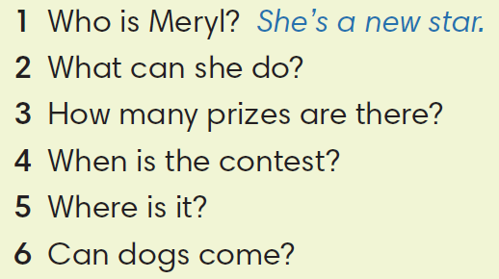
Read the ad again and answer the questions.
IrinaPapakhinac

Slide 5
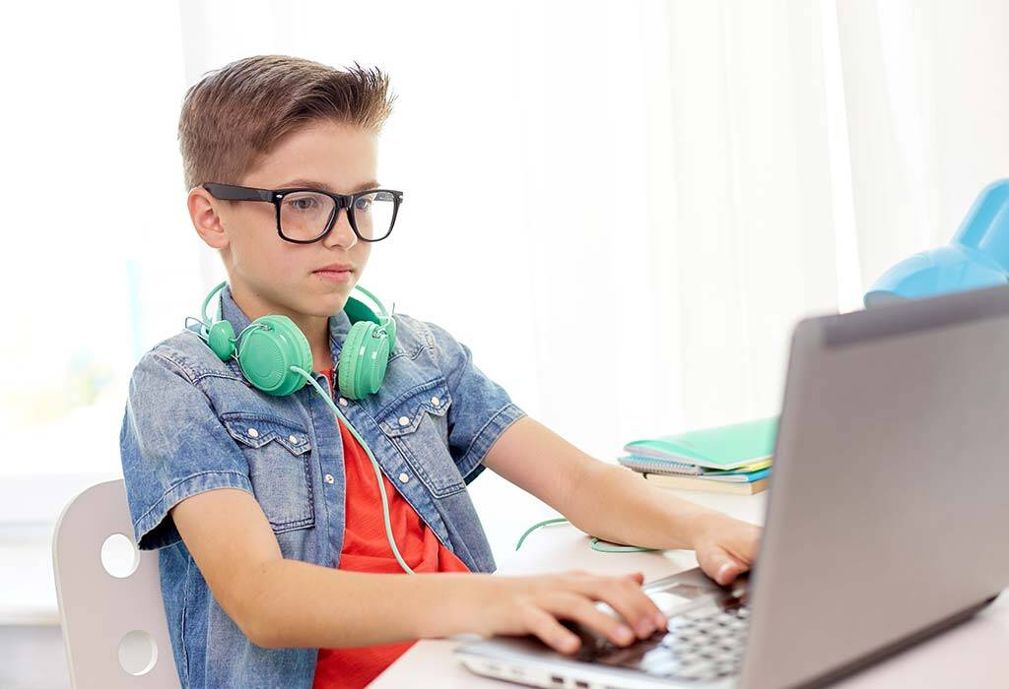

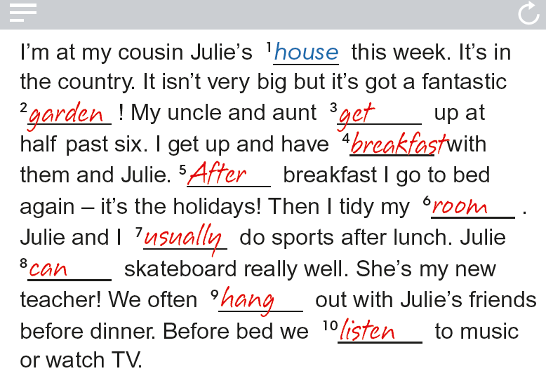

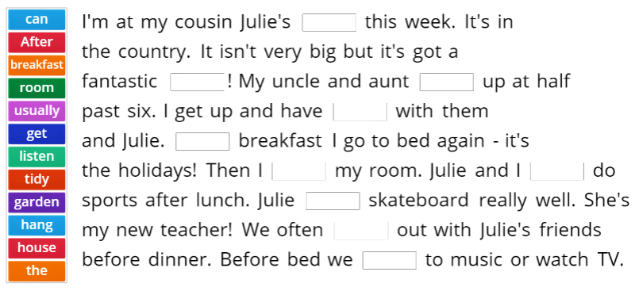
Read Dan’s blog.
Where is he today?
IrinaPapakhinac

Slide 6
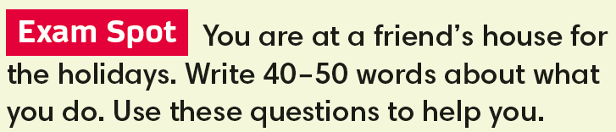
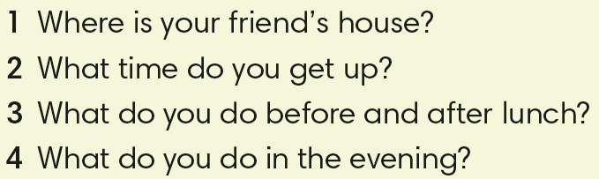
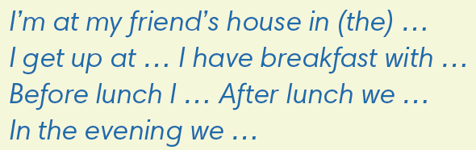
IrinaPapakhinac

Slide 7
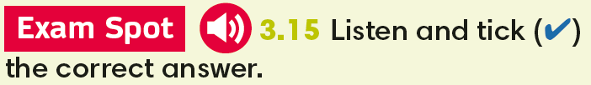
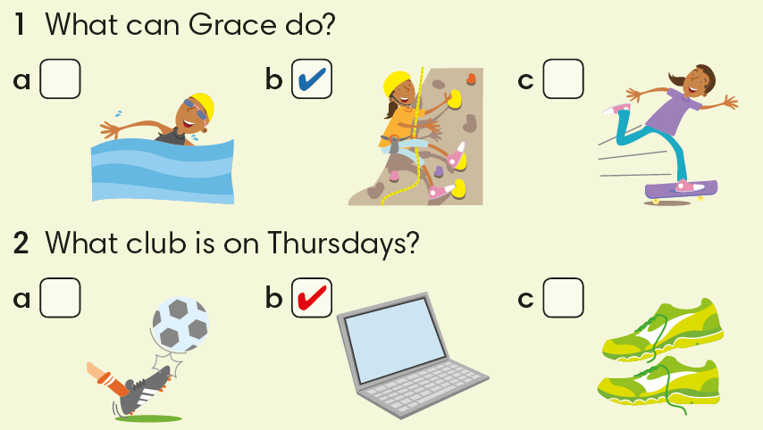

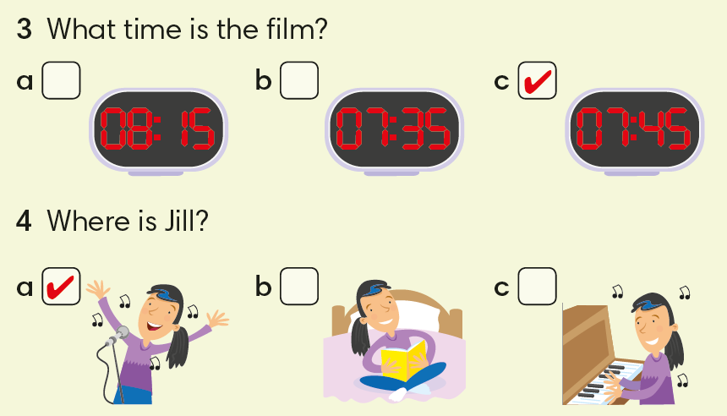
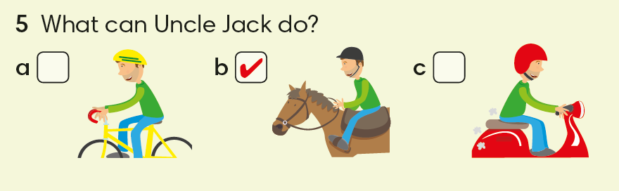
IrinaPapakhinac

Slide 8
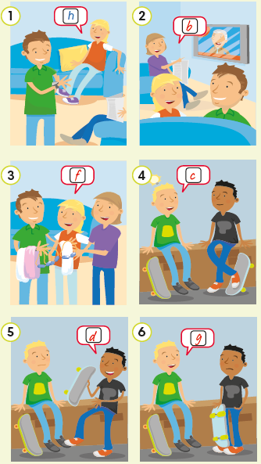

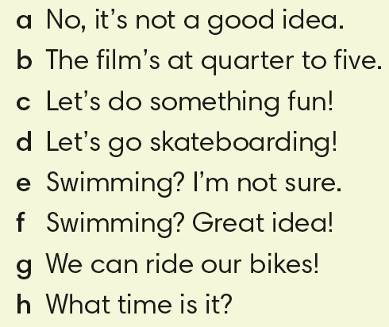
IrinaPapakhinac

Slide 9
1. What’s your favourite month?
2. Who can sing in your family?
3. What cool things can you do?
4. Have you got a book in English?
IrinaPapakhinac

Slide 10
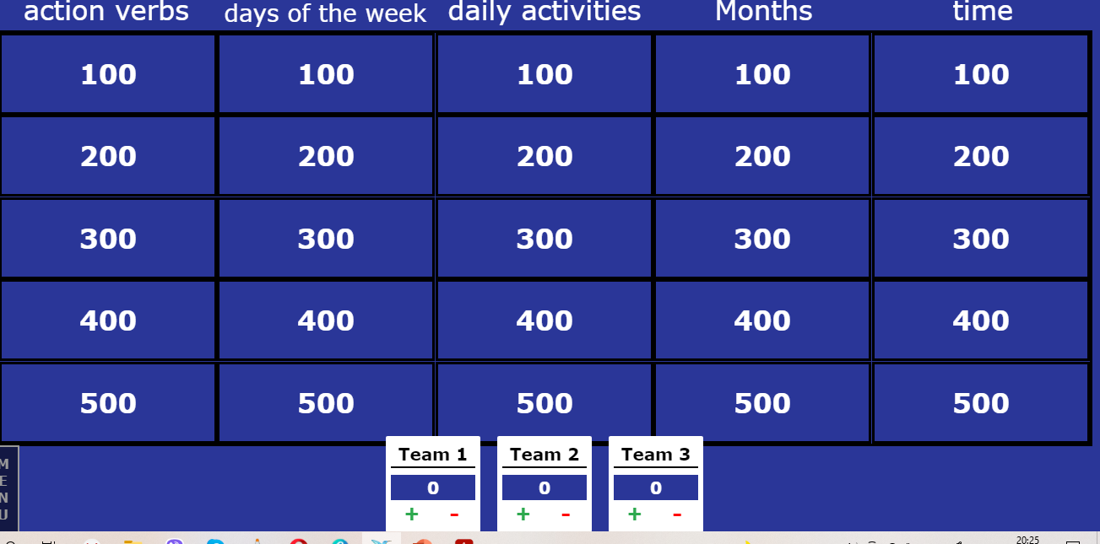
IrinaPapakhinac

Slide 11
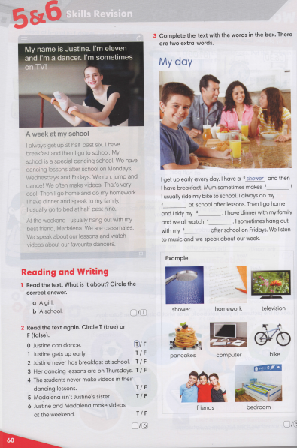
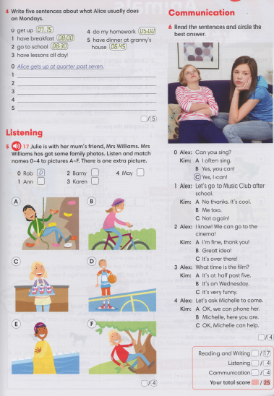
IrinaPapakhinac

Slide 12
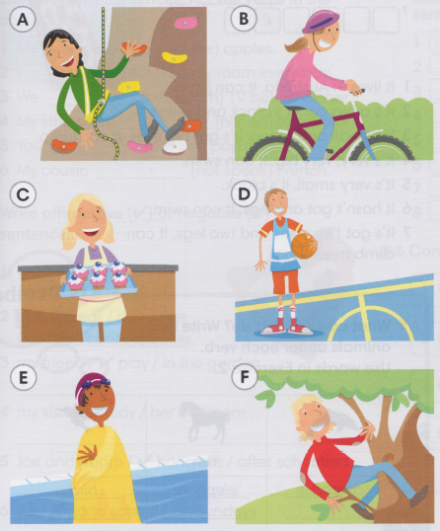
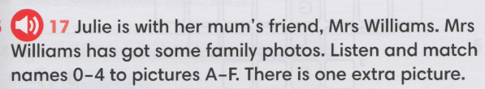

A
B
E
C
IrinaPapakhinac

