Slide 1
Academy Stars 2
Unit 1

Slide 2
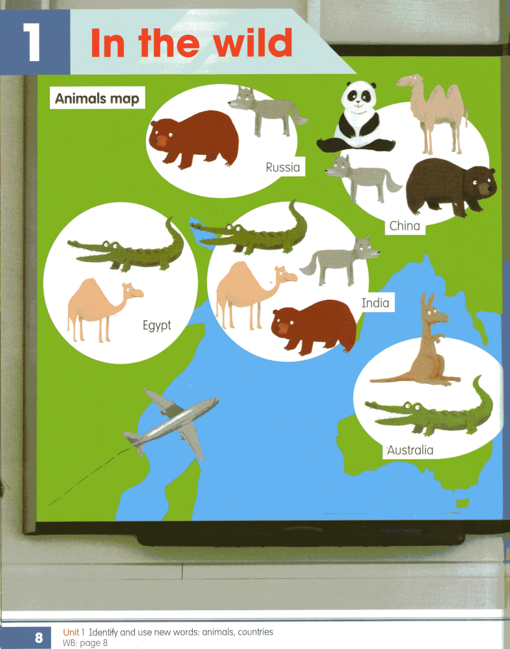

Slide 3






Australia
Russia
India
Egypt
China
Ukraine

Slide 4
Australia
Russia
India
Egypt
China
Ukraine

Slide 5
Australia
Russia
Egypt
China
Ukraine

Slide 6
Australia
Russia
India
Egypt
China
Ukraine

Slide 7
Australia
Russia
India
China
Ukraine

Slide 8
Australia
Russia
India
Egypt
China
Ukraine

Slide 9
Australia
Russia
India
Egypt
China

Slide 10
Australia
Russia
India
Egypt
China
Ukraine

Slide 11
Australia
India
Egypt
China
Ukraine

Slide 12
Australia
Russia
India
Egypt
China
Ukraine

Slide 13
Russia
India
Egypt
China
Ukraine

Slide 14
Australia
Russia
India
Egypt
China
Ukraine

Slide 15
Australia
Russia
India
Egypt
Ukraine

Slide 16
Australia
Russia
India
Egypt
China
Ukraine

Slide 19
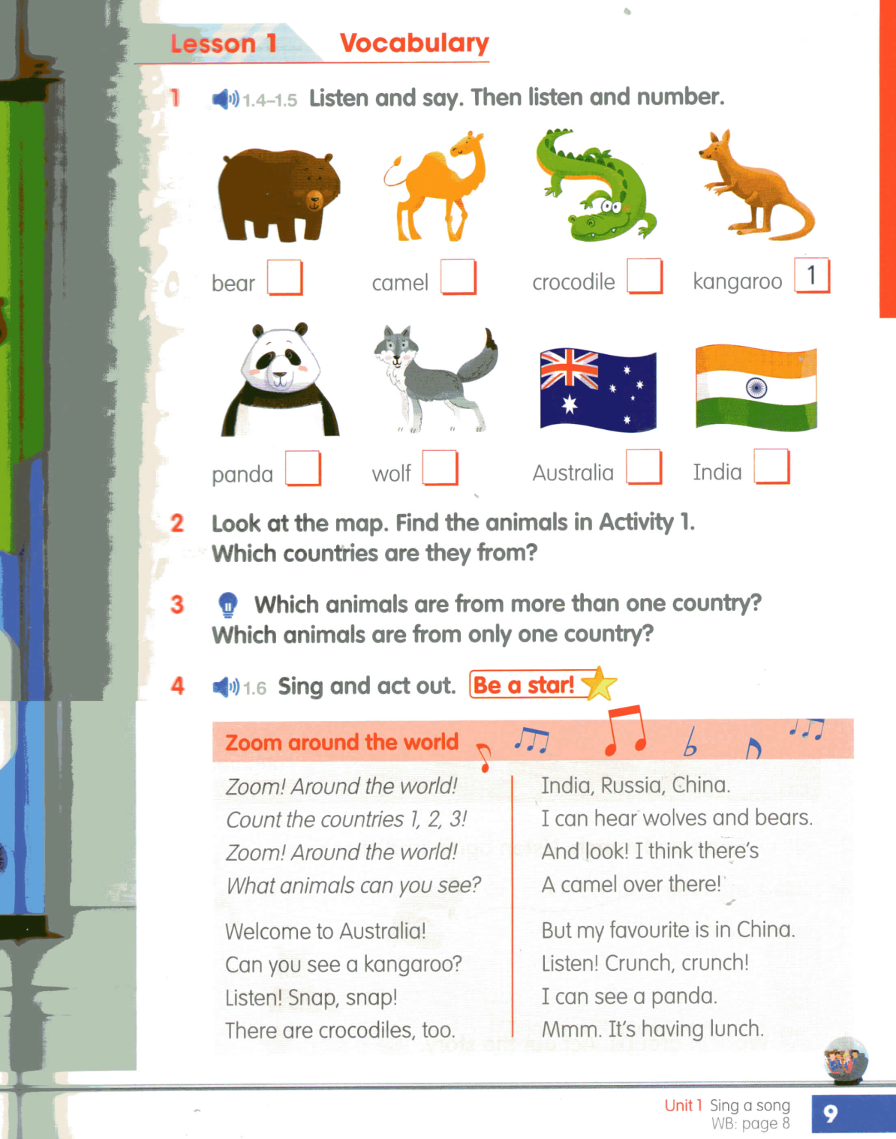

Slide 20
Look at the map. Find the animals in Activity 1. Which countries are they from?

Slide 21
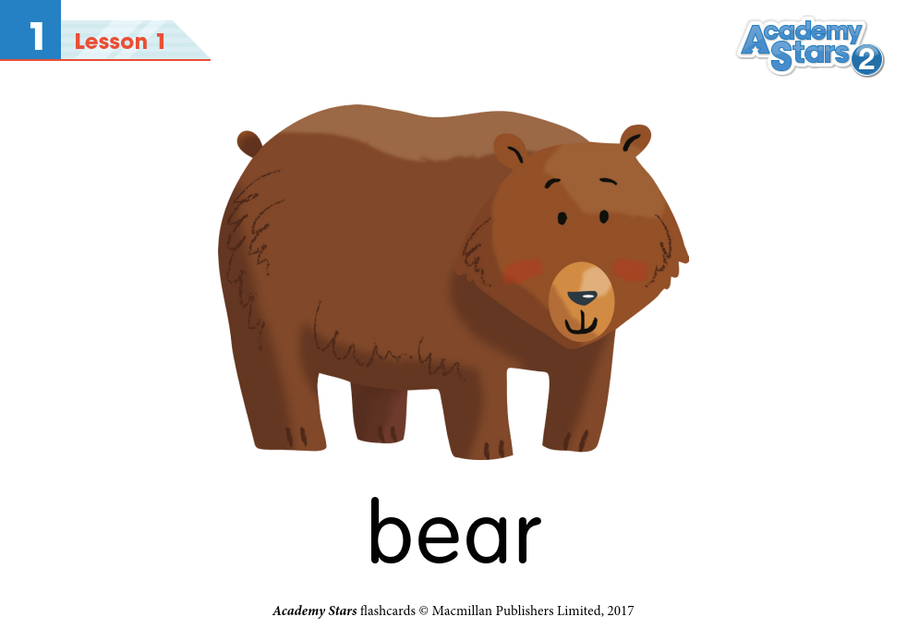

Slide 22


Slide 23


Slide 24


Slide 25
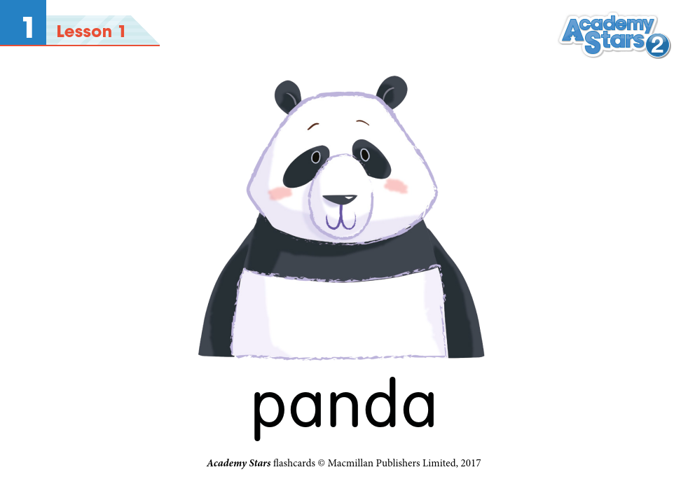

Slide 26
