Slide 1
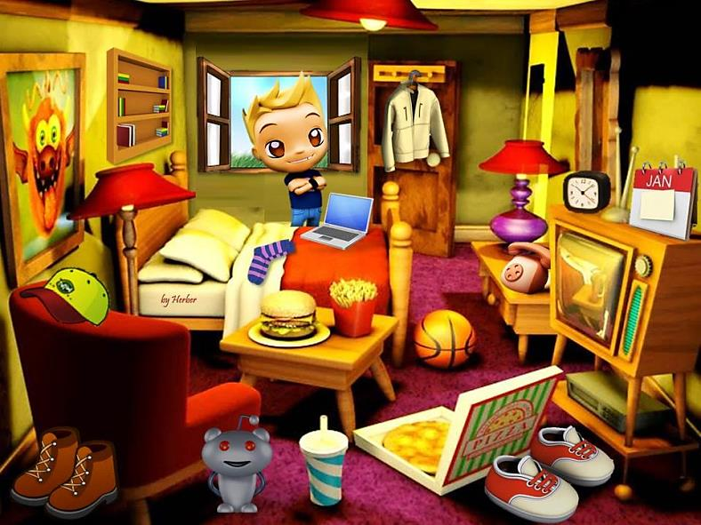


TO BE - PAST SIMPLE

Slide 2
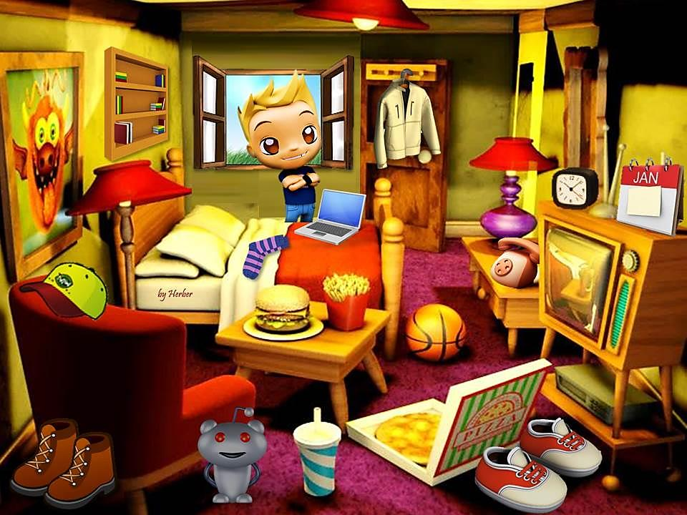

This is Tom’s room last Sunday.
was
wasn’t
were
weren’t
The room _______ untidy.
1/12

Slide 3
This is Tom’s room last Sunday.
was
wasn’t
were
weren’t
The laptop _______ next to the phone.
2/12

Slide 4
This is Tom’s room last Sunday.
was
wasn’t
were
weren’t
The calendar _______ next to the clock.
3/12

Slide 5
This is Tom’s room last Sunday.
was
wasn’t
were
weren’t
The pizza _______ on the table.
4/12

Slide 6
This is Tom’s room last Sunday.
was
wasn’t
were
weren’t
The boots _______ behind the armchair.
5/12

Slide 7
This is Tom’s room last Sunday.
was
wasn’t
were
weren’t
The books _______ on the TV set.
6/12

Slide 8
This is Tom’s room last Sunday.
was
wasn’t
were
weren’t
The window _______ open.
7/12

Slide 9
This is Tom’s room last Sunday.
was
wasn’t
were
weren’t
The socks _______ on the floor.
8/12

Slide 10
This is Tom’s room last Sunday.
was
wasn’t
were
weren’t
The basketball _______ on the bed.
9/12

Slide 11
This is Tom’s room last Sunday.
was
wasn’t
were
weren’t
The chips _______ on the table.
10/12

Slide 12
This is Tom’s room last Sunday.
was
wasn’t
were
weren’t
The socks _______ on the bed.
11/12

Slide 13
This is Tom’s room last Sunday.
was
wasn’t
were
weren’t
EXIT
The boots _______ behind the pizza.
12/12

