Slide 1

SHOULD OR SHOULDN’T!?

Slide 2
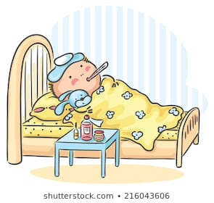

He has flu.
He ________ stay at home.
SHOULD

Slide 3
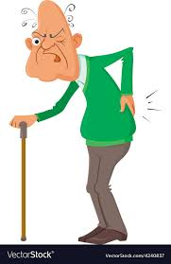

He has backache.
He ________carry heavy things.
SHOULDN’T

Slide 4
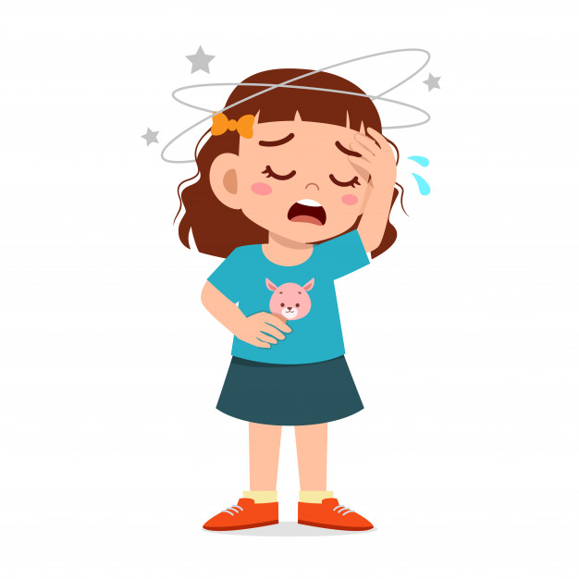
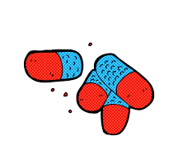
She has a headache.
She ________ take painkiller.
SHOULD

Slide 5
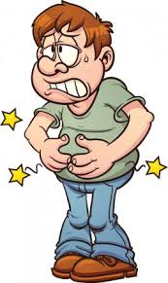
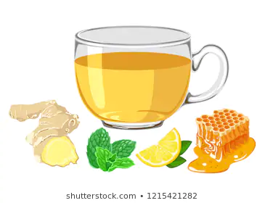
Steve has stomachache.
He ________ drink lemon and mint tea.
SHOULD

Slide 6
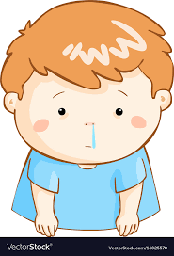
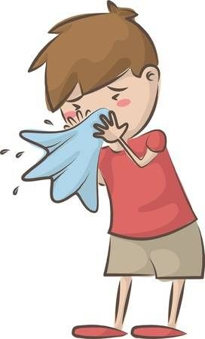
You have runny nose.
You ________ blow your nose.
SHOULD

Slide 7
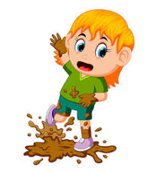
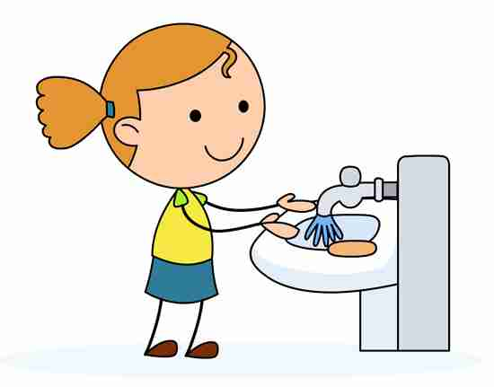
Daisy has dirty hands.
She ________ wash her hands.
SHOULD

Slide 8
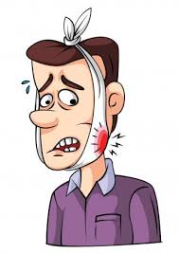
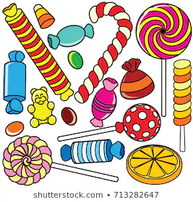
My brother has toothache.
He ________ eat candies.
SHOULDN’T

Slide 9
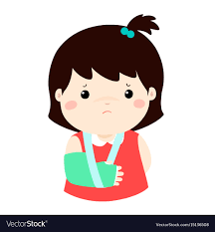
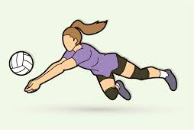
Jennifer has a broken arm.
She ________ play volleyball.
SHOULDN’T

Slide 10
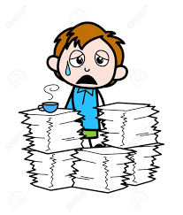
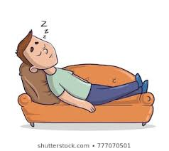
He feels tired.
He ________ have a rest.
SHOULD

Slide 11
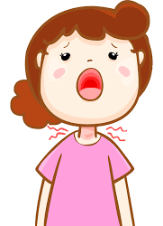
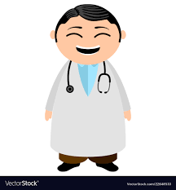
Caroline has a sore throat.
She ________ go to a doctor.
SHOULD

Slide 12
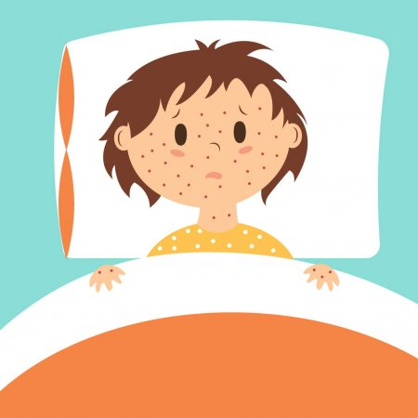

She has measles.
She ________ go to school.
SHOULDN’T

Slide 13
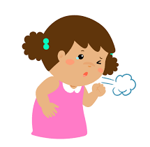
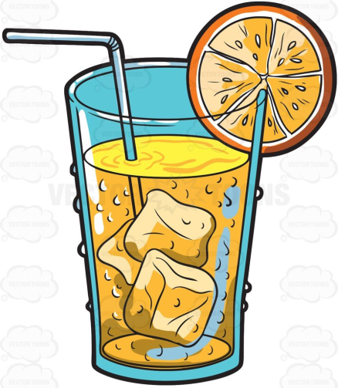
She has a cough.
She ________ drink cold drinks.
SHOULDN’T

Slide 14
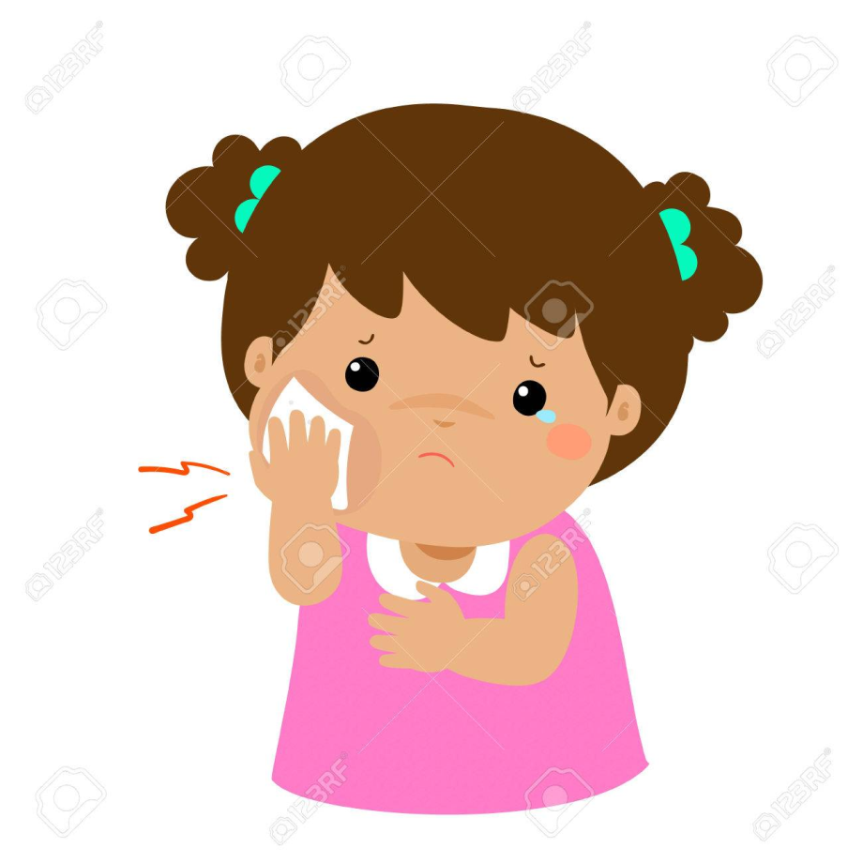
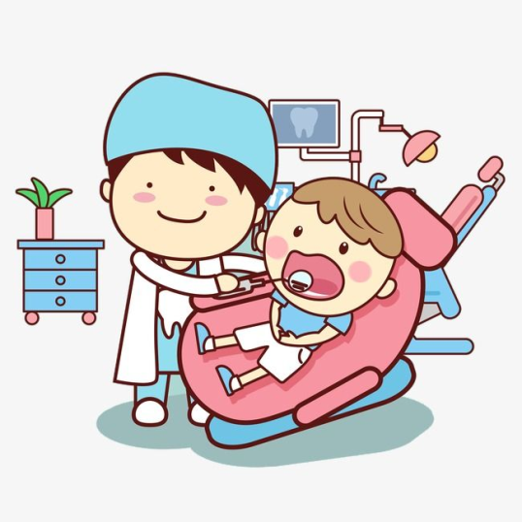
She has toothache.
She ________ go to a dentist.
SHOULD

Slide 15
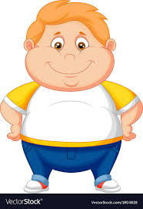
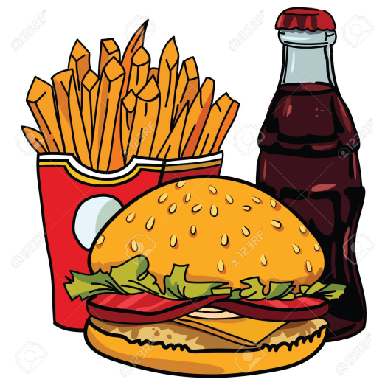
Matt is fat.
He ________ eat junk food.
SHOULDN’T

Slide 16
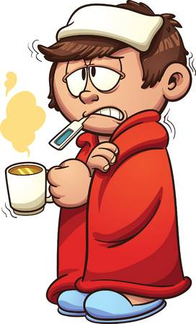
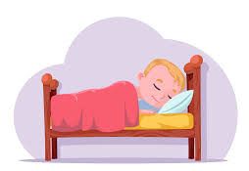
Peter has cold.
He ________ have a rest.
SHOULD

Slide 17
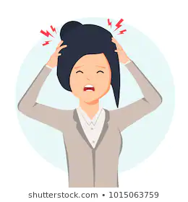

She has headache.
She ________ take medicine.
SHOULD

