Slide 1
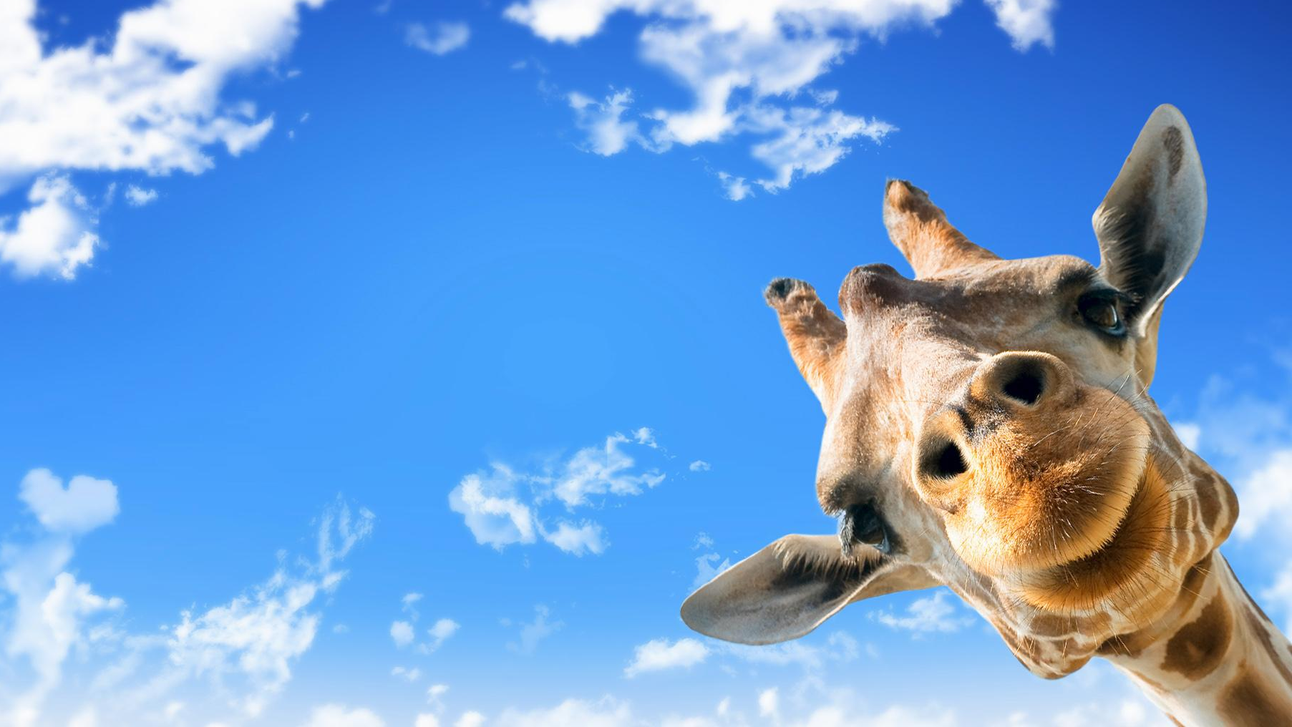




IrinaPapakhinac

Slide 2

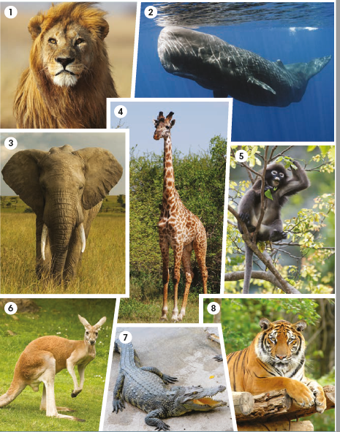
Label the animals in the photos.
elephant
monkey
tiger
giraffe
lion
crocodile
kangaroo
whale
What other animals do you know?
IrinaPapakhinac

Slide 3
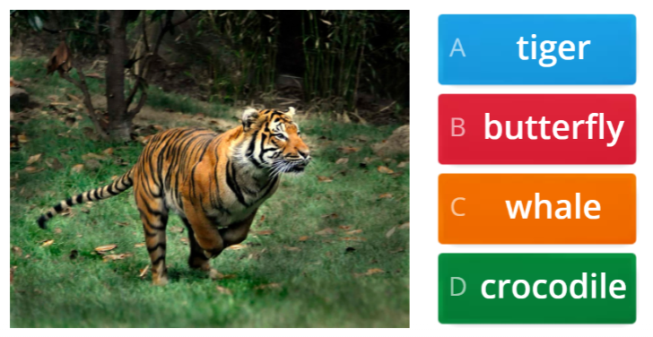
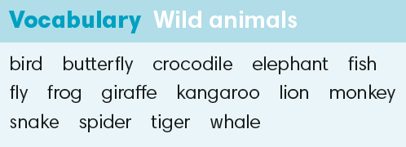

IrinaPapakhinac

Slide 4
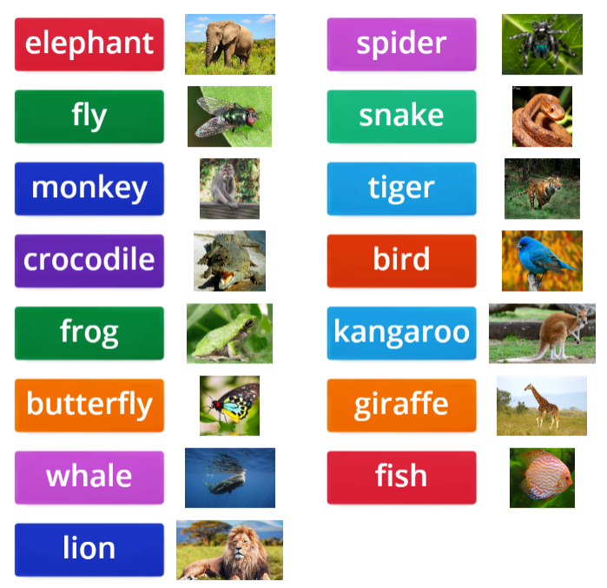
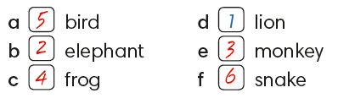
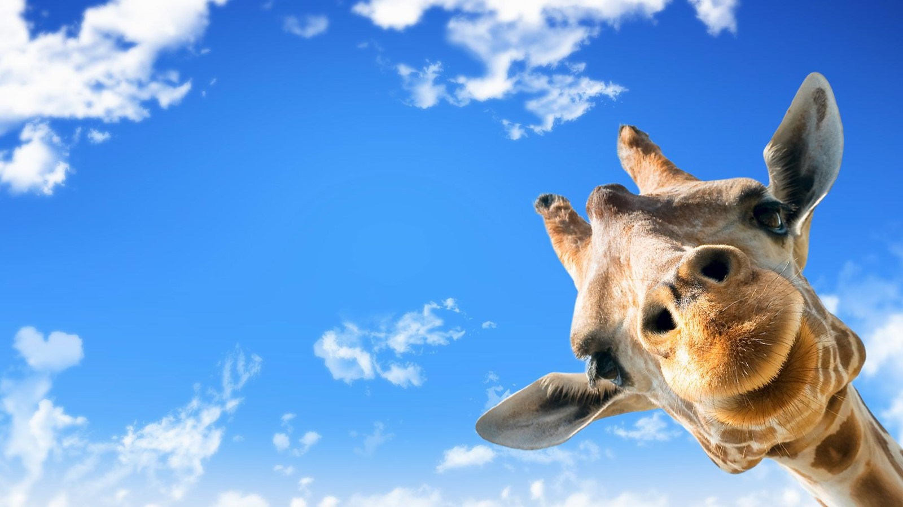
Listen to the animals
and number the words.
IrinaPapakhinac

Slide 5
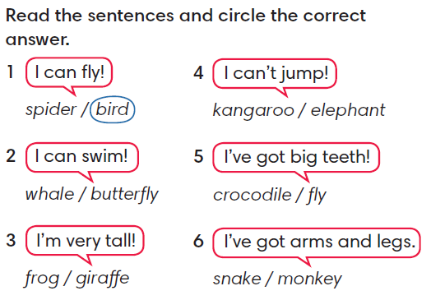
IrinaPapakhinac

Slide 6
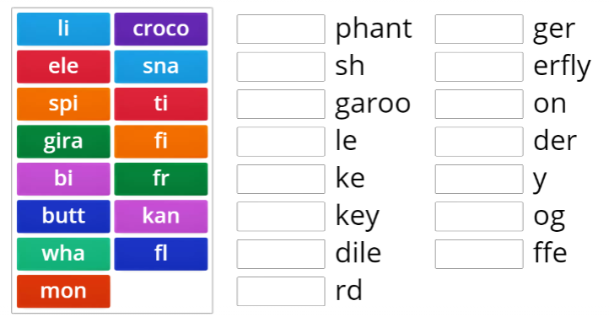
IrinaPapakhinac

Slide 7
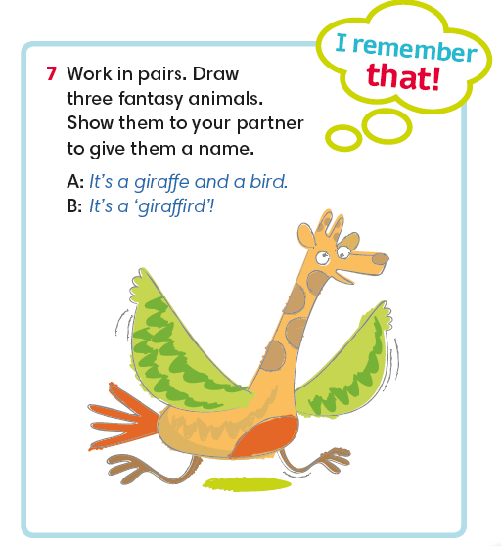
IrinaPapakhinac

Slide 8
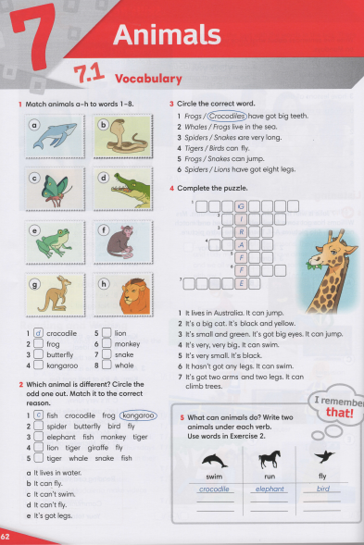


IrinaPapakhinac

Slide 9
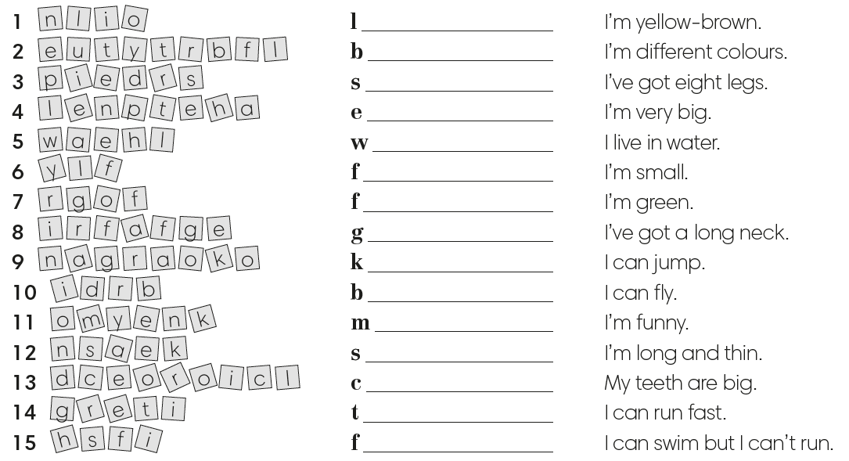
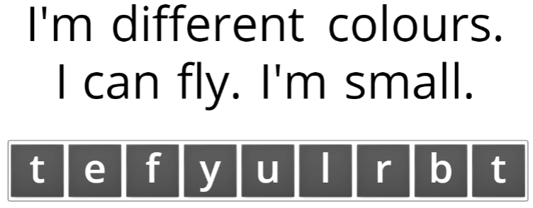
IrinaPapakhinac

