Slide 1


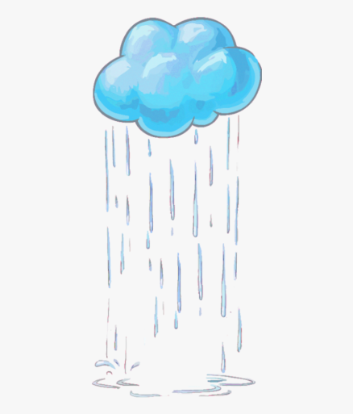
It always ________ in spring.

Slide 2
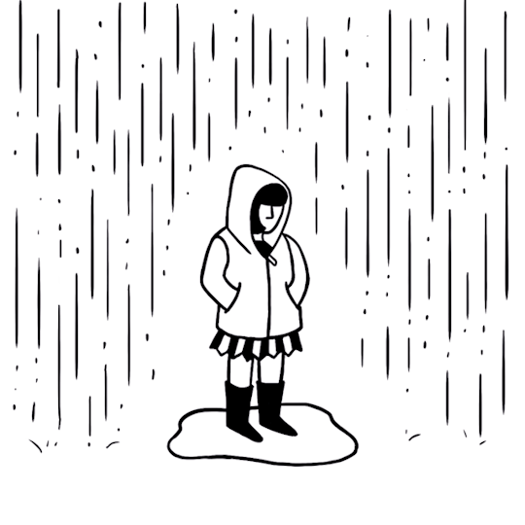
It ________ now.

Slide 3


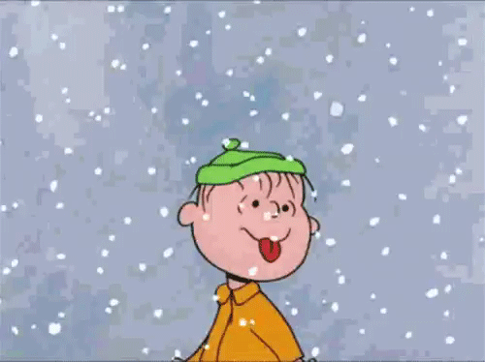
It ________ now.

Slide 4
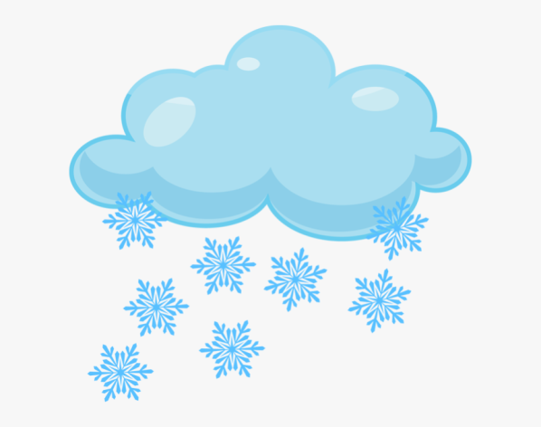
It always ________ in winter.

Slide 5


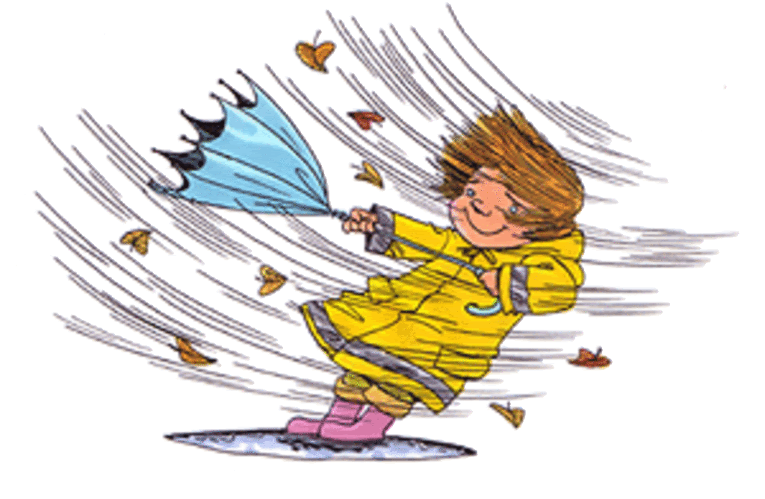
The wind always ________ in autumn.

Slide 6
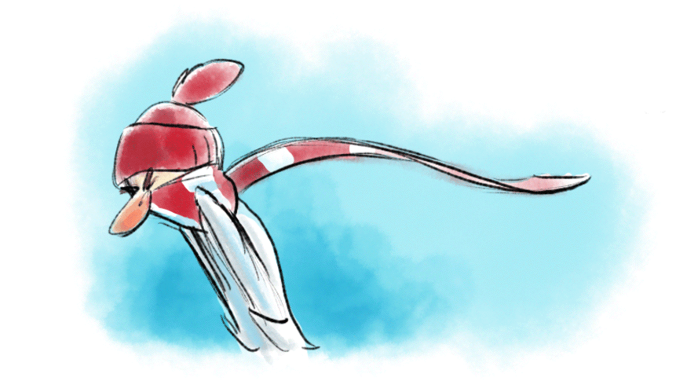
The wind ________ now.

Slide 7


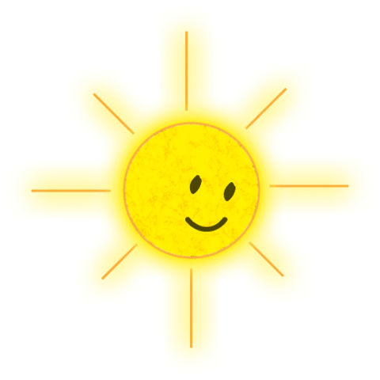
The sun ________ now.

Slide 8

The sun always ________ in summer.

Slide 9


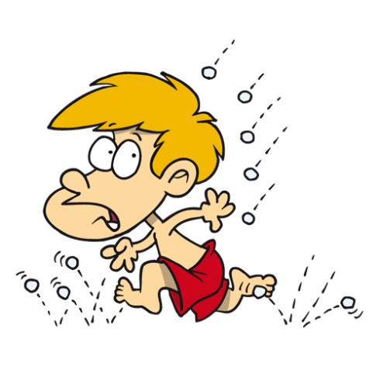
It always ________ in summer.

Slide 10
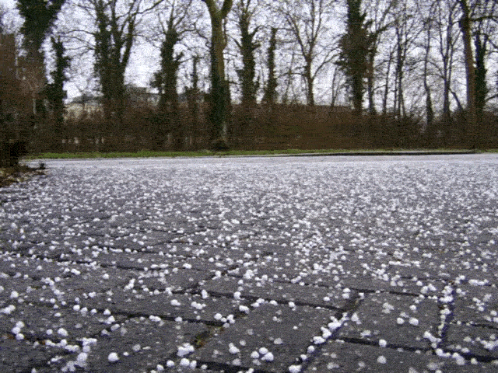
It ________ now.

