Slide 1
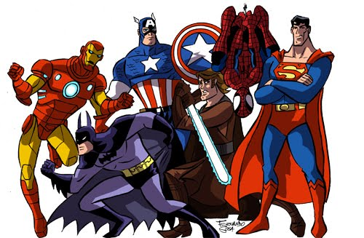
SUPERHEROES and
SUPERPOWERS

Slide 2
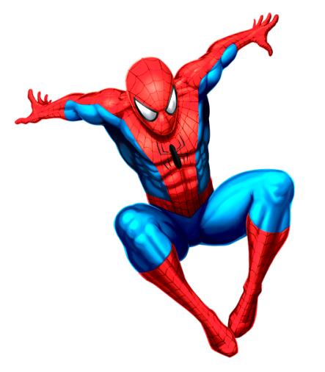
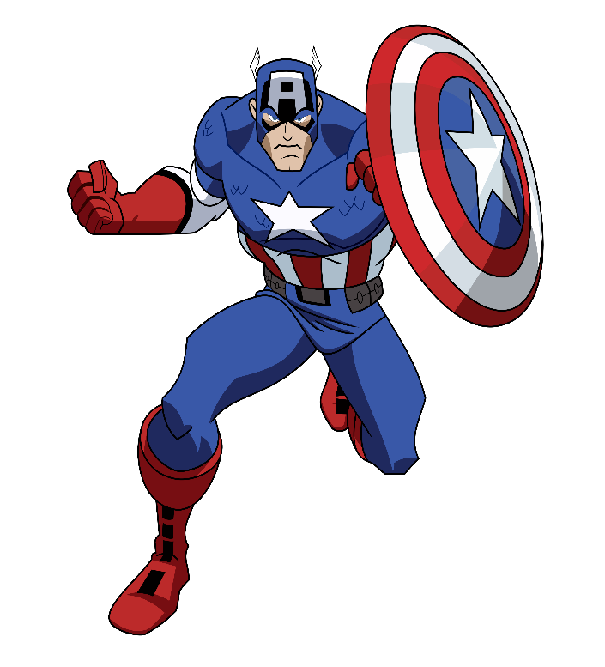
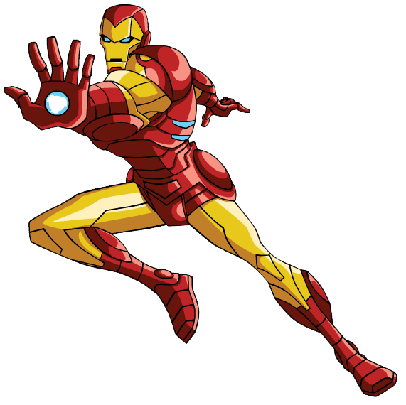
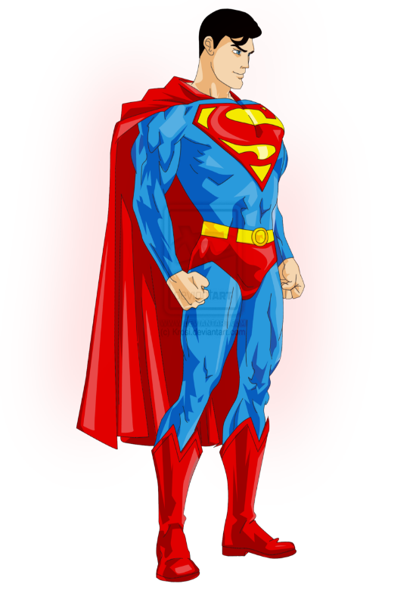
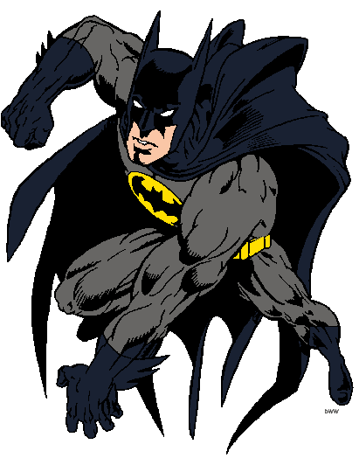
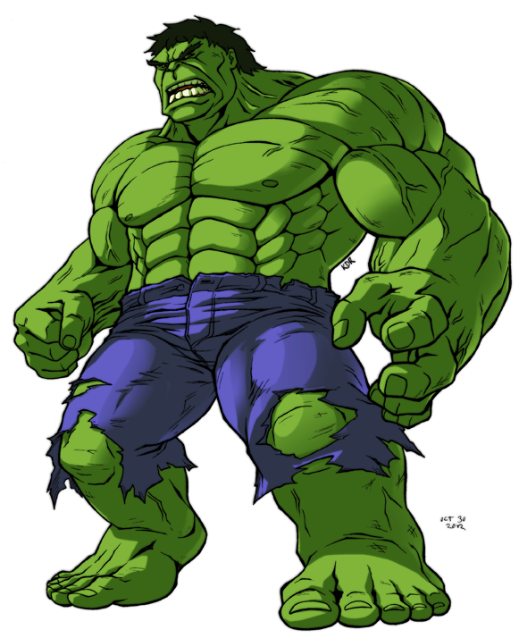
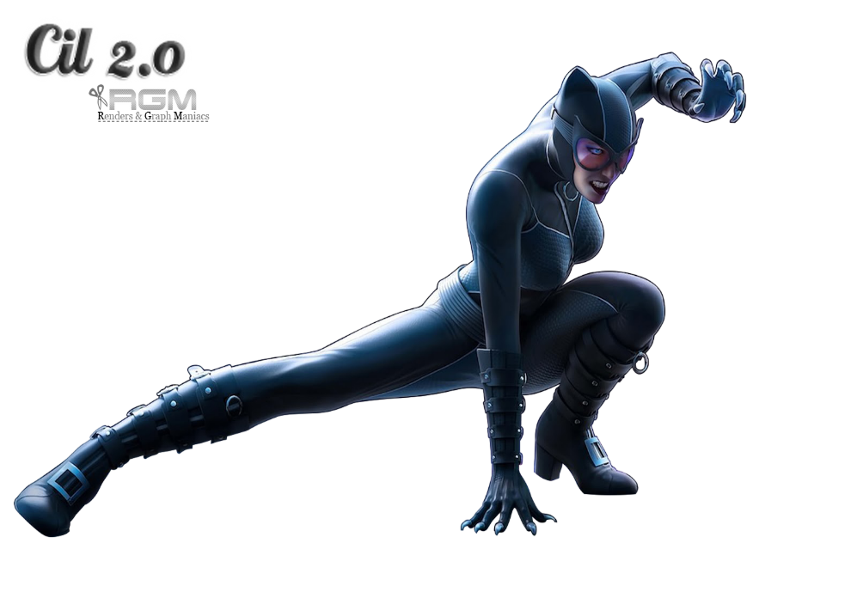
SPIDERMAN
IRONMAN
CAPTAIN AMERICA
HULK
SUPERMAN
CATWOMAN
BATMAN

Slide 3
YELLOW
WHITE
BLACK
PURPLE
RED
GREEN
BATMAN
BLUE
HULK
SUPERMAN
SPIDERMAN
CAPTAIN AMERICA
IRONMAN
CATWOMAN

Slide 4
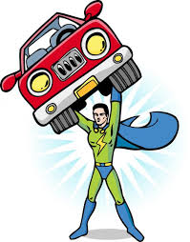

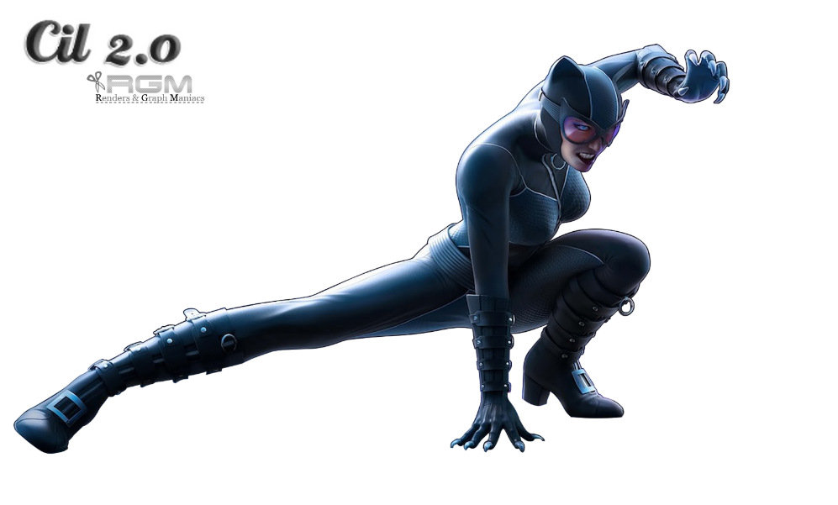
WHO IS STRONG?
She
isn’t!

Slide 5
WHO IS FAST?

Slide 6

WHO IS CLEVER?
He
isn’t!

Slide 7
WHO CAN FLY?
He
can’t!

Slide 8
WHO CAN JUMP HIGH?

Slide 9

WHO CAN CLIMB?

Slide 10
1.
1.
Strong
Fast
Clever
Fly
Climb
Jump
2.
2.
3.
3.

Slide 11

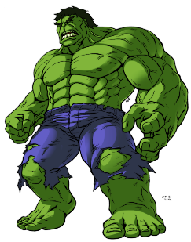


is …………………………. but he isn’t …………………………… .
He can ……………………. but he can’t ………………………… .
is …………………………. but he isn’t ……………………………… He can ……………………. but he can’t ………………………… .
is …………………………. but she isn’t ……………………………… She can ……………………. but she can’t ………………………… .
is …………………………. but he isn’t ……………………………… He can ……………………. but he can’t ………………………… .

