Slide 1
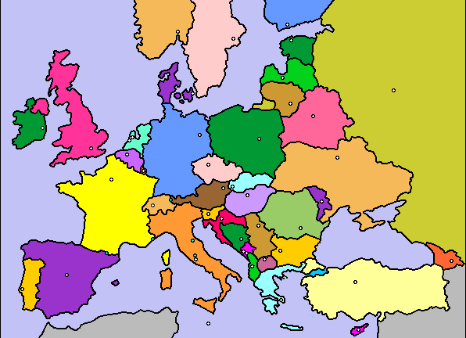





Slide 2

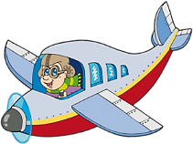
If you go to London …

Slide 3
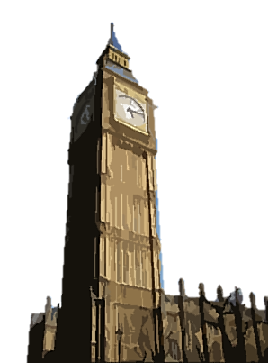
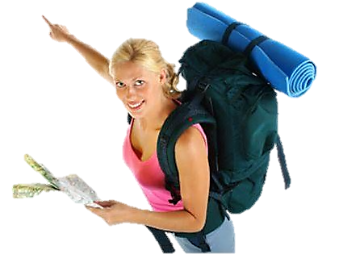

… you will see the ________
Big Ben
NEXT

Slide 4

If you go to Rome …

Slide 5
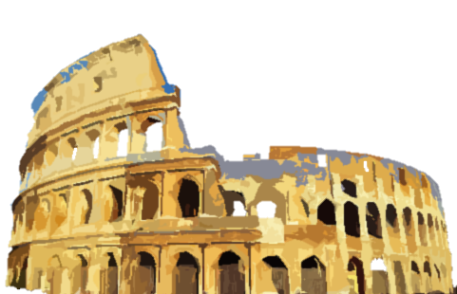
… you will see the ___________
Coliseum
NEXT

Slide 6

If you go to Berlin …

Slide 7
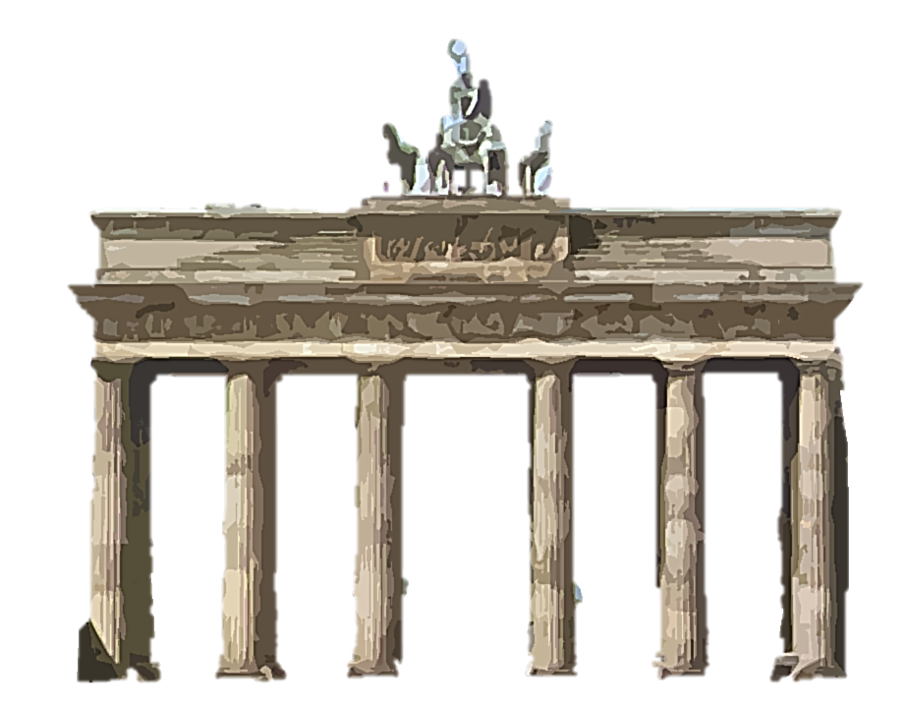
… you will see the _________________
Brandenburg Gate
NEXT

Slide 8

If you go to Paris …

Slide 9
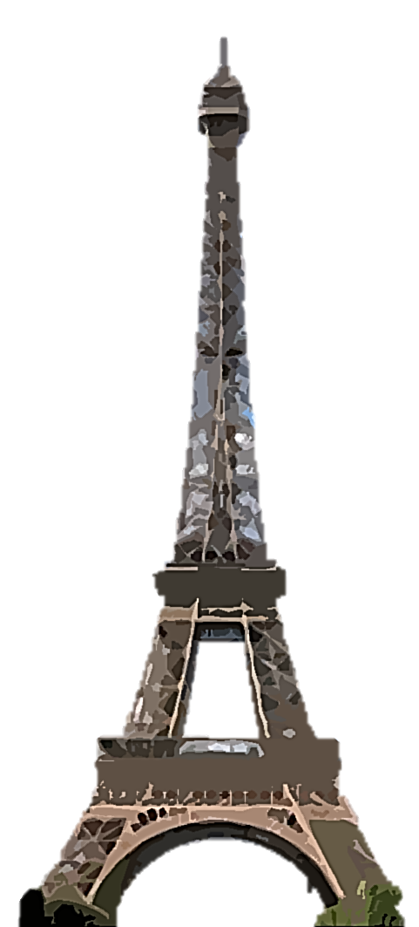
… you will see the ______________
Eiffel Tower
NEXT

Slide 10

If you go to Madrid …

Slide 11
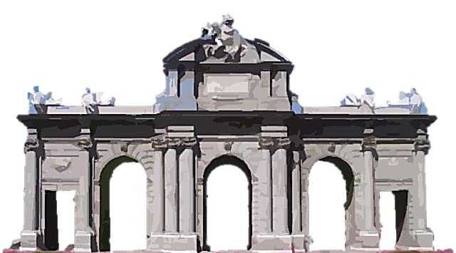
… you will see the _____________
Alcalá Gate
NEXT

Slide 12

If you go to Athens …

Slide 13
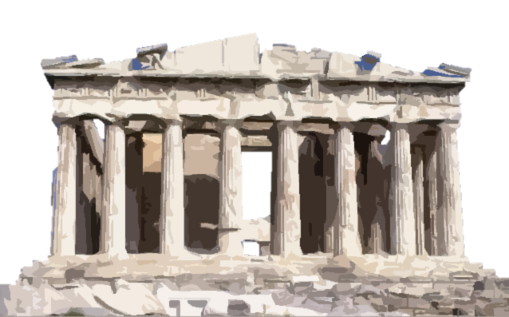
… you will see the ____________
Parthenon
NEXT

Slide 14

If you go to Moscow …

Slide 15
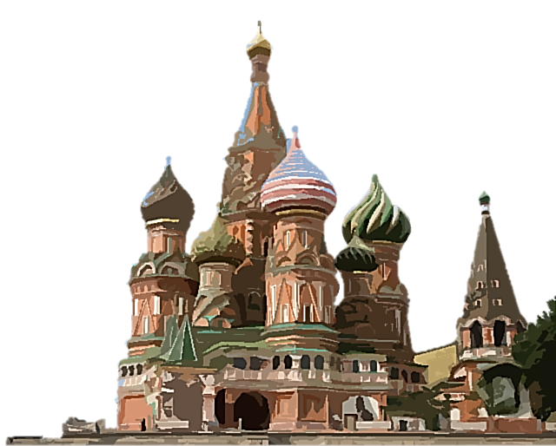
… you will see ___________________
Saint Basil’s Cathedral
NEXT

Slide 16

If you go to Brussels …

Slide 17
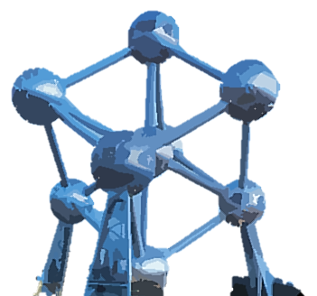
… you will see the ___________
Atomium
NEXT

Slide 18

If you go to Istanbul …

Slide 19
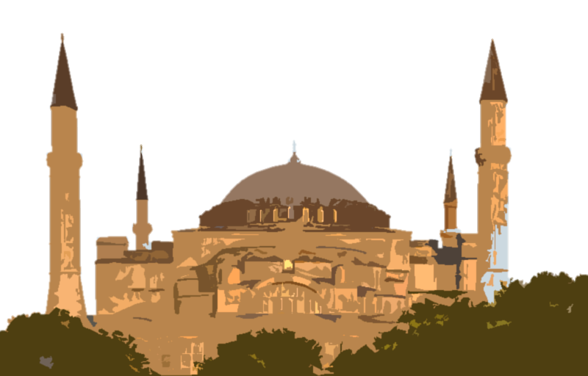
… you will see ____________
Saint Sophia
NEXT

Slide 20

If you go to Copenhagen …

Slide 21
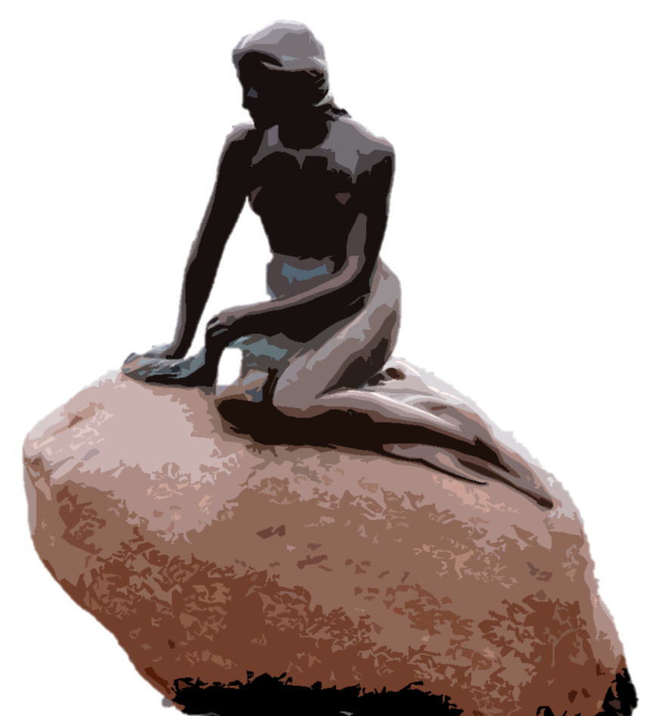
… you will see the _____________
Little Mermaid
NEXT

Slide 22

If you go to Vienna …

Slide 23
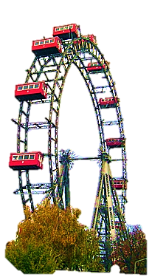
… you will see the ___________
Big Wheel
NEXT

Slide 24
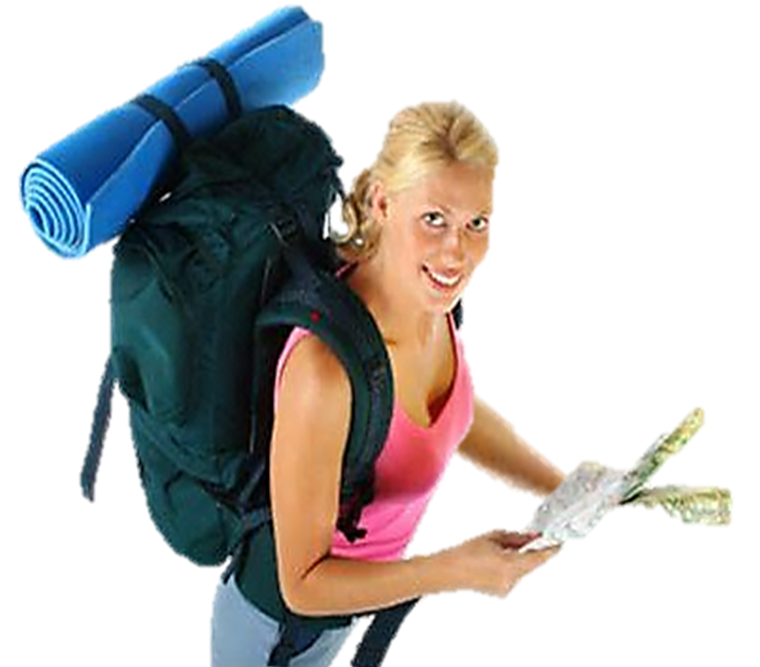
BYE BYE!

