Slide 1

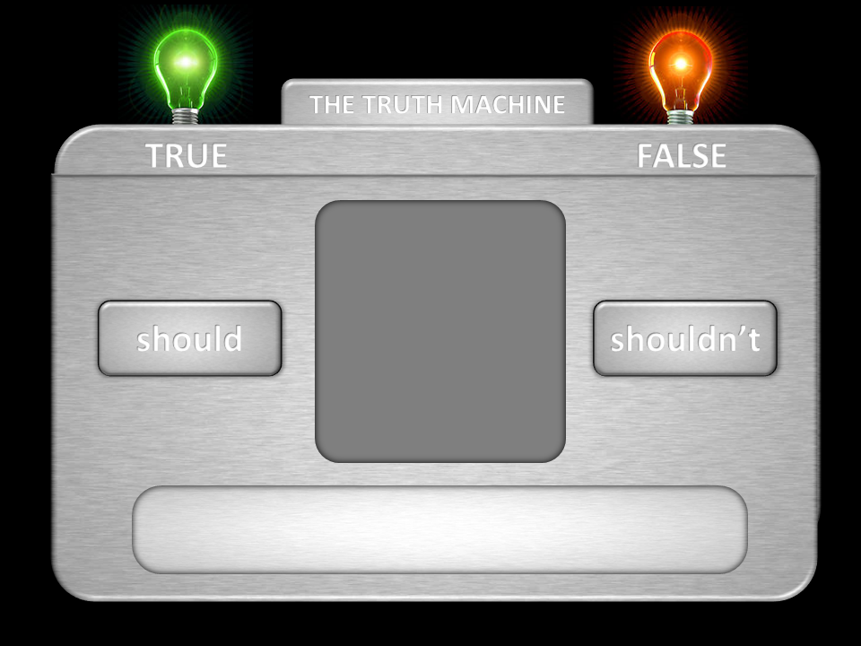
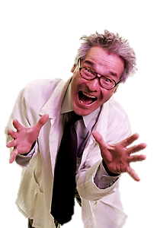


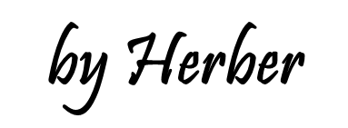
should
shouldn’t
Click on the right option
to complete the sentences

Slide 2





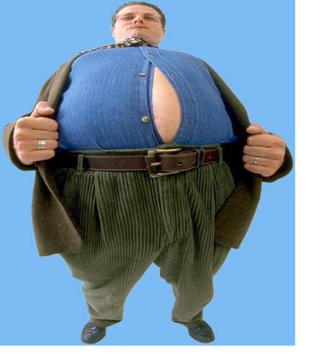



THE TRUTH MACHINE
TRUE
FALSE
1/10
should
shouldn’t
He is too fat.
He __________ eat so much junk food.
shouldn’t
shouldn’t

Slide 3
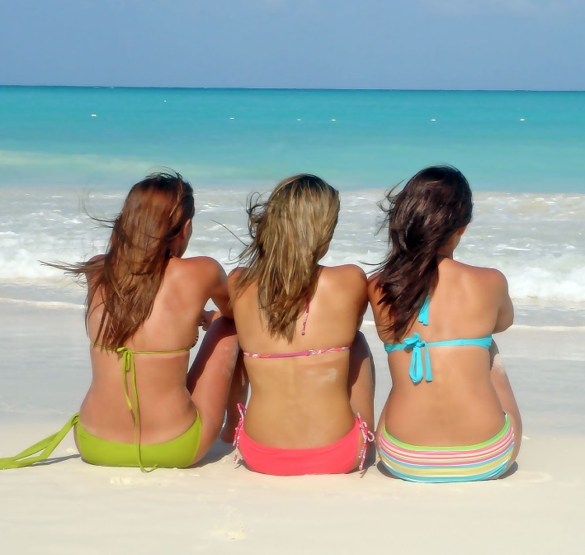
THE TRUTH MACHINE
TRUE
FALSE
2/10
should
shouldn’t
It’s sunny and hot today.
They __________ put some sun cream on.
should
should

Slide 4

THE TRUTH MACHINE
TRUE
FALSE
3/10
should
shouldn’t
It’s a great film.
You __________ go and see it.
should
should

Slide 5
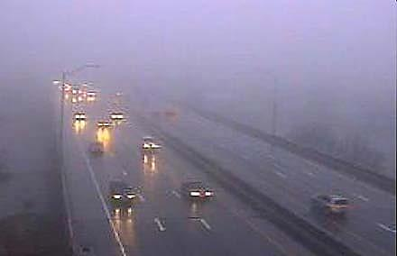
THE TRUTH MACHINE
TRUE
FALSE
4/10
should
shouldn’t
It’s foggy today.
You __________ drive too fast.
shouldn’t
shouldn’t

Slide 6
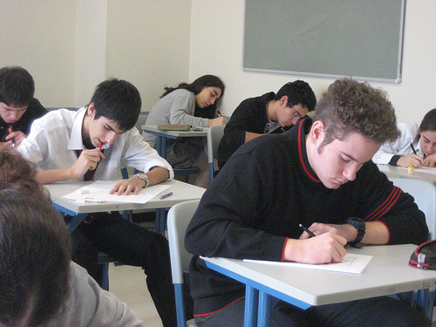
THE TRUTH MACHINE
TRUE
FALSE
5/10
should
shouldn’t
You have an exam tomorrow morning.
You __________ go to the party tonight.
shouldn’t
shouldn’t

Slide 7
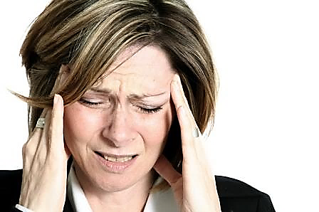
THE TRUTH MACHINE
TRUE
FALSE
6/10
should
shouldn’t
She has a terrible headache.
She __________ take some aspirin.
should
should

Slide 8
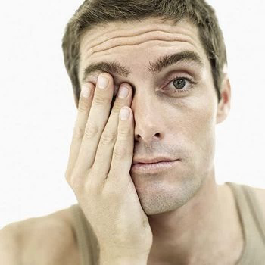
THE TRUTH MACHINE
TRUE
FALSE
7/10
should
shouldn’t
My eyes are tired.
I _________ spend much time in front of the computer.
shouldn’t
shouldn’t

Slide 9
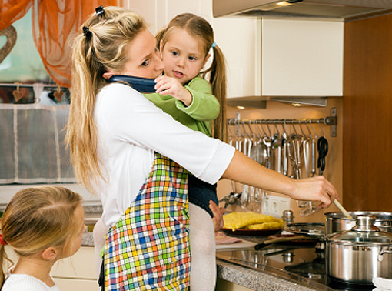
THE TRUTH MACHINE
TRUE
FALSE
8/10
should
shouldn’t
Your mum is really busy.
You __________ help her with the housework.
should
should

Slide 10
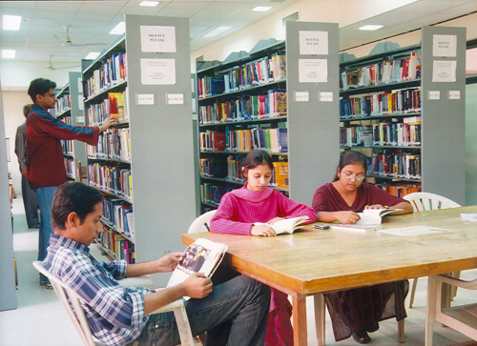
THE TRUTH MACHINE
TRUE
FALSE
9/10
should
shouldn’t
You are in a library.
You __________ talk so loud.
shouldn’t
shouldn’t

Slide 11
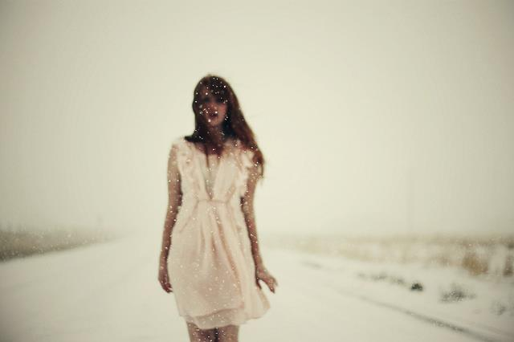

THE TRUTH MACHINE
TRUE
FALSE
10/10
should
shouldn’t
It’s too cold here.
She __________ wear winter clothes.
should
should

