Slide 1
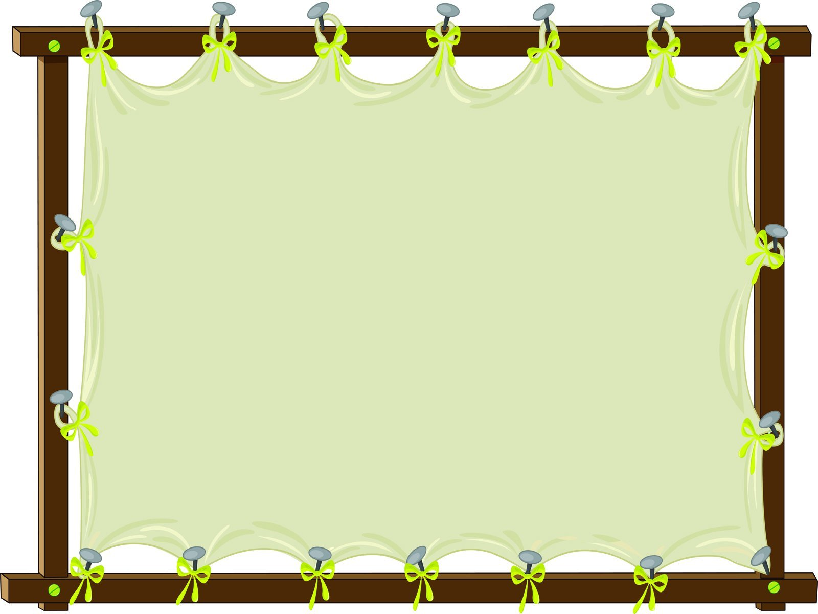
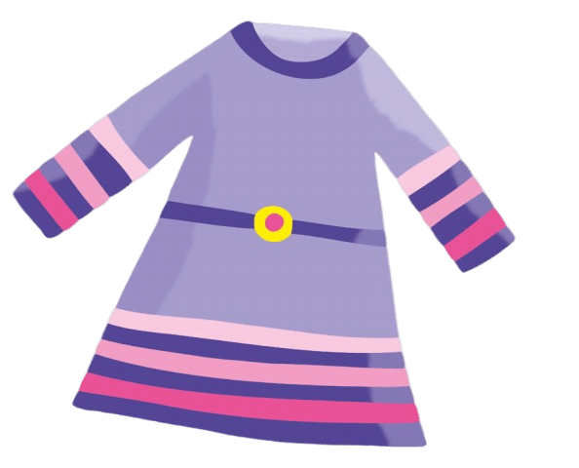
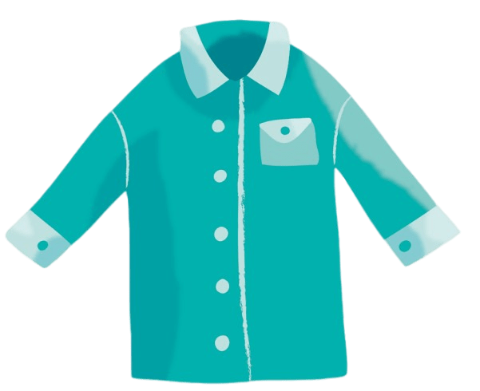
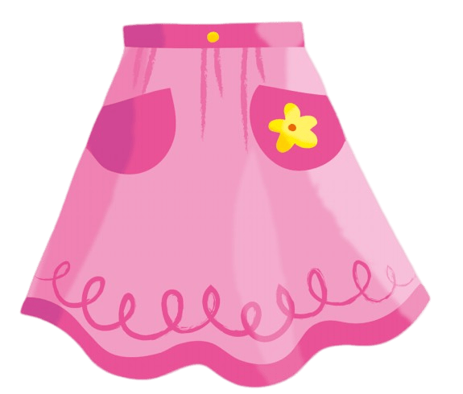
skirt
1
2
3

Slide 2
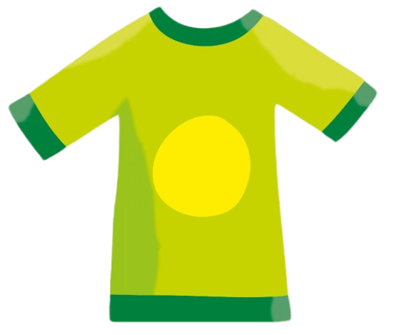
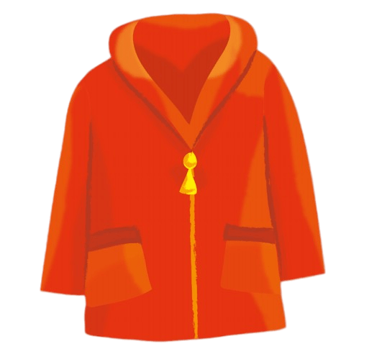
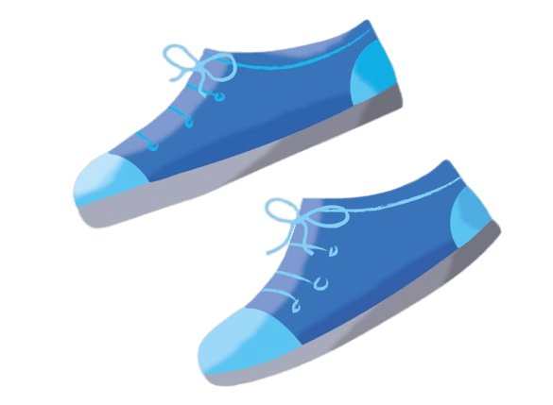
shoes
1
2
3

Slide 3
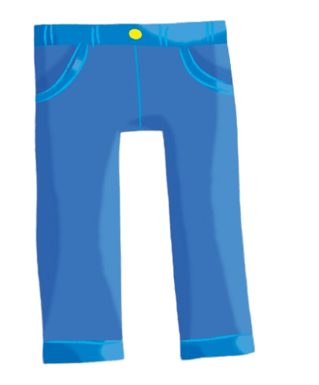
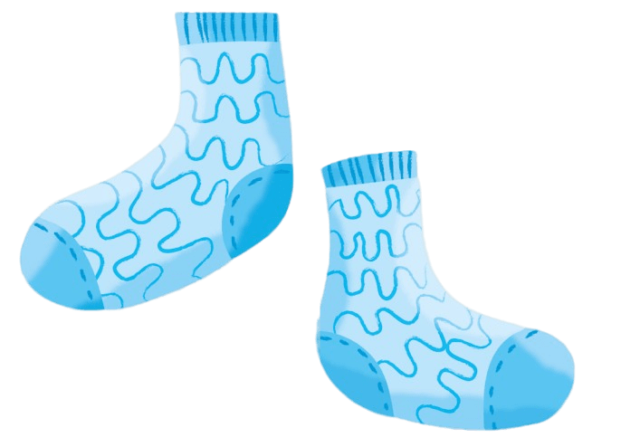
shirt
1
2
3

Slide 4
jacket
1
2
3

Slide 5
T-shirt
1
2
3

Slide 6
trousers
1
2
3

Slide 7
socks
1
2
3

Slide 8
dress
1
2
3

Slide 9
jacket
1
2
3

Slide 10
skirt
1
2
3

Slide 11
dress
1
2
3

Slide 12
shirt
1
2
3

Slide 13
shoes
1
2
3

Slide 14
trousers
1
2
3

Slide 15
socks
1
2
3

Slide 16
T-shirt
1
2
3

