Slide 1
square
round

Slide 2
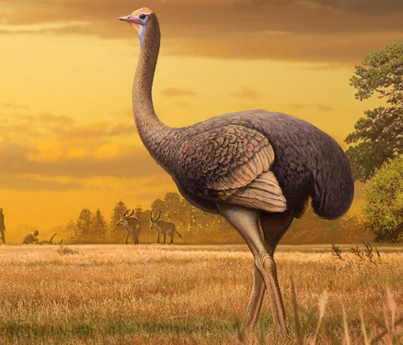
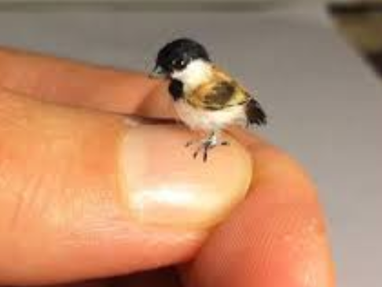
tiny
enormous

Slide 3
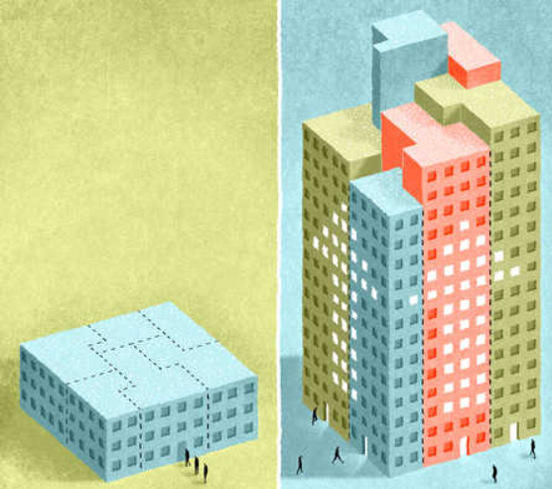
low
high

Slide 4

friendly

Slide 5

funny

