Slide 1
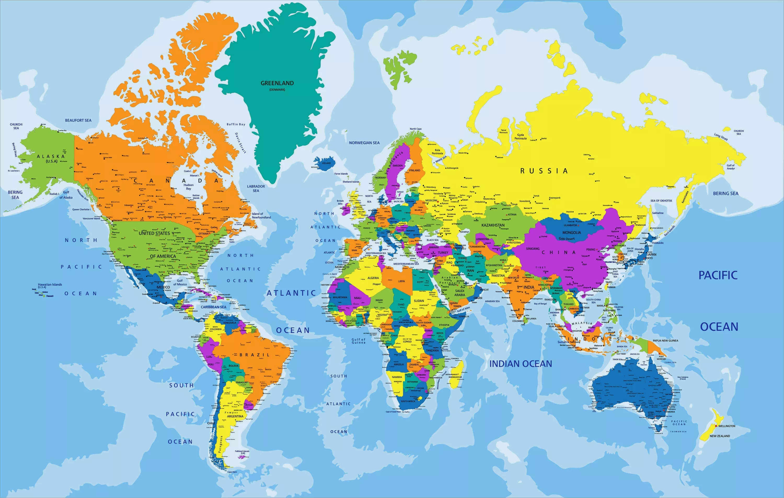

IrinaPapakhina

Slide 2
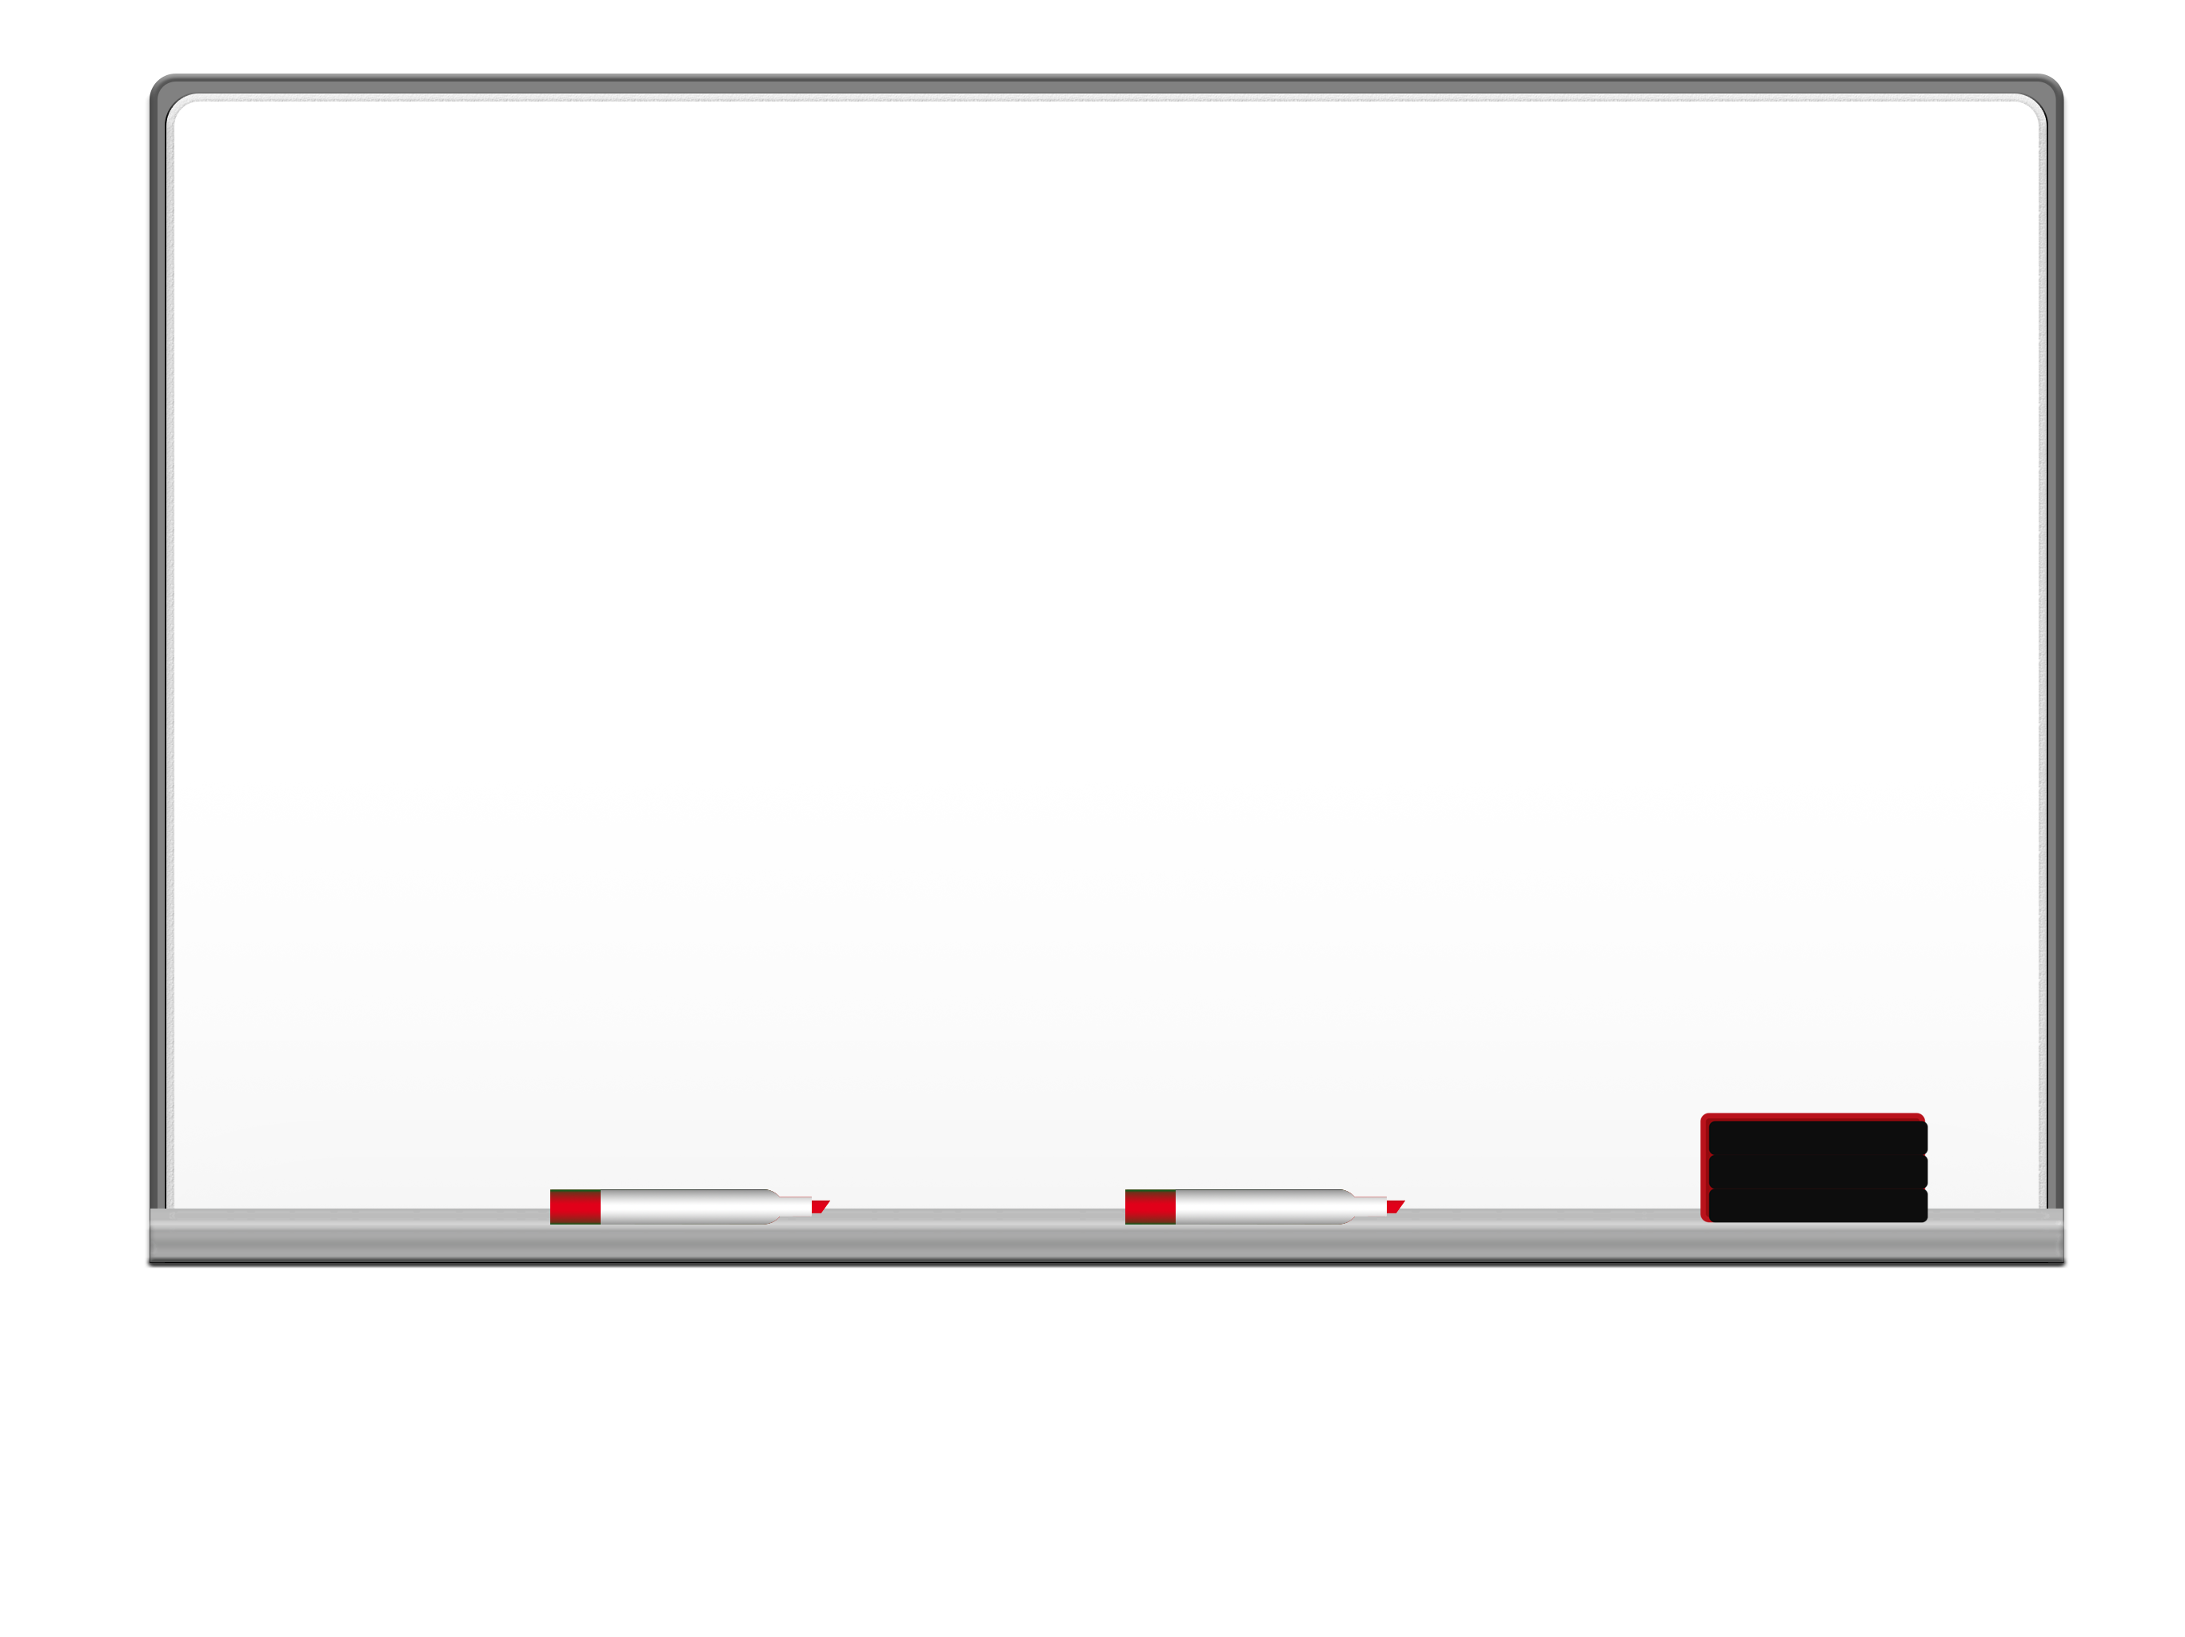
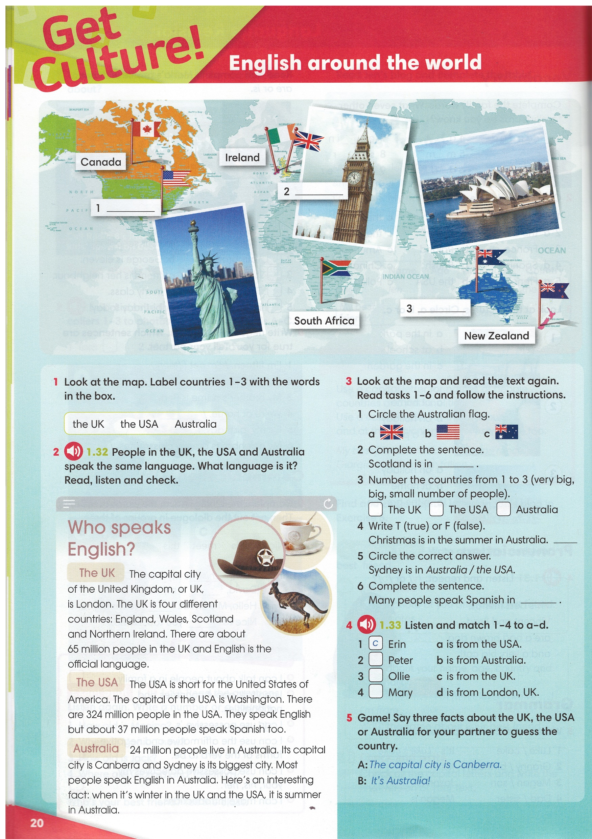
Look at the map.
Label countries 1 – 3 with their names.
the UK
Australia
the USA
IrinaPapakhina

Slide 3
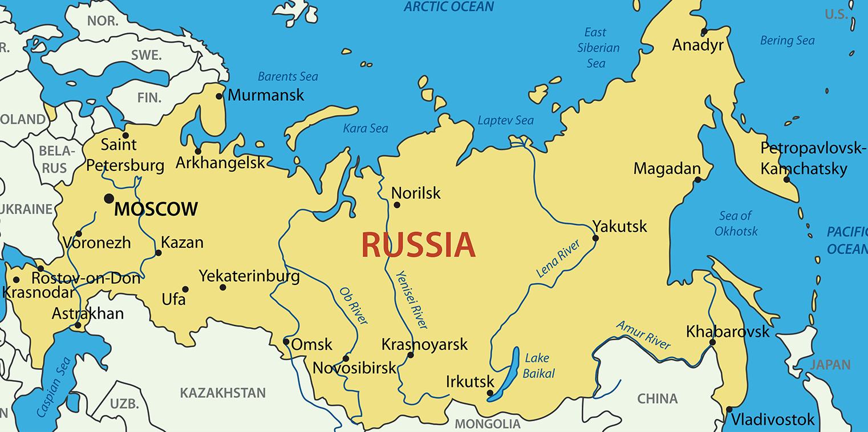
Moscow is the CAPITAL CITY of Russia.
People in Russia speak Russian.
Russian is the OFFICIAL LANGUAGE of Russia.
IrinaPapakhina

Slide 4

Read the text and underline
the capital cities of
the UK, the USA and Australia.
Read the text again
and complete the sentences.
There are about 65 million people in the UK
and __________ is the official language.
They speak __________ but about 37 million
people speak Spanish too.
c) Most people speak __________ in Australia.
English
English
English
IrinaPapakhina

Slide 5
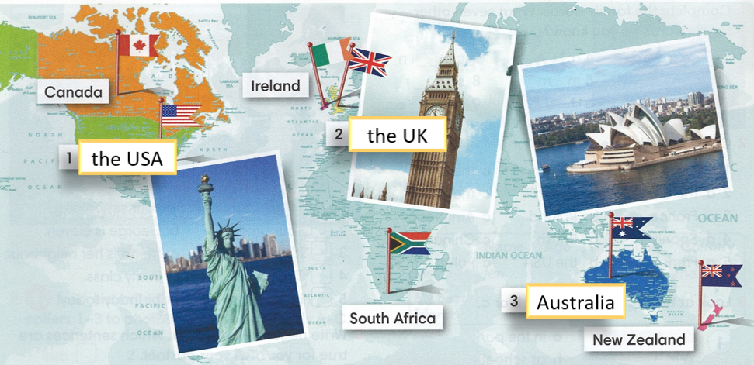

the UK
2
1
3
T
the USA

Slide 6
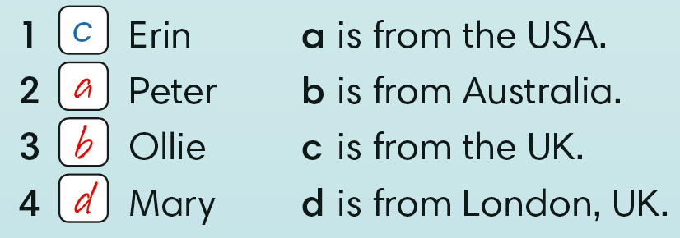
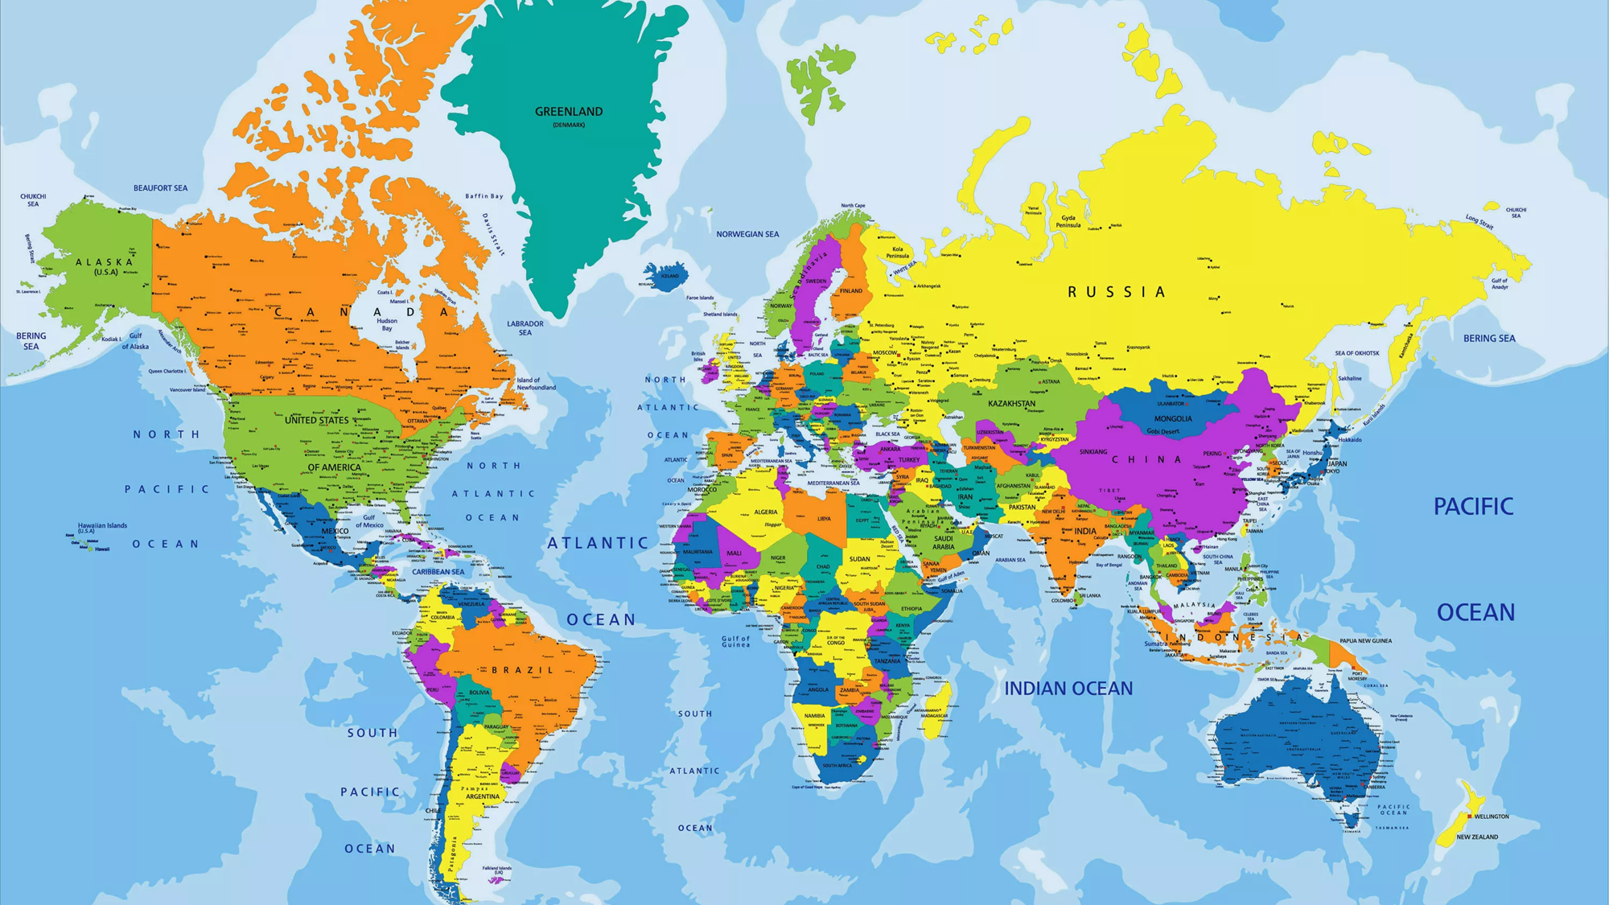
Listen and match.
IrinaPapakhina

Slide 7
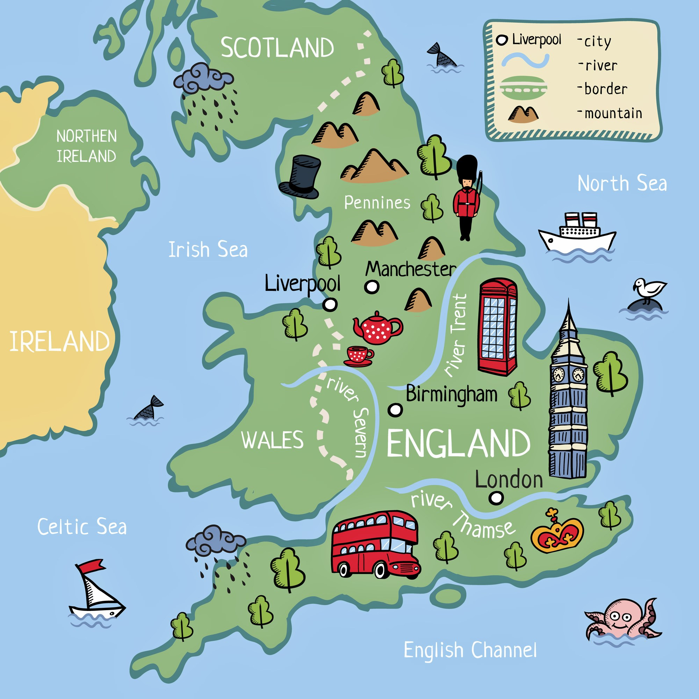
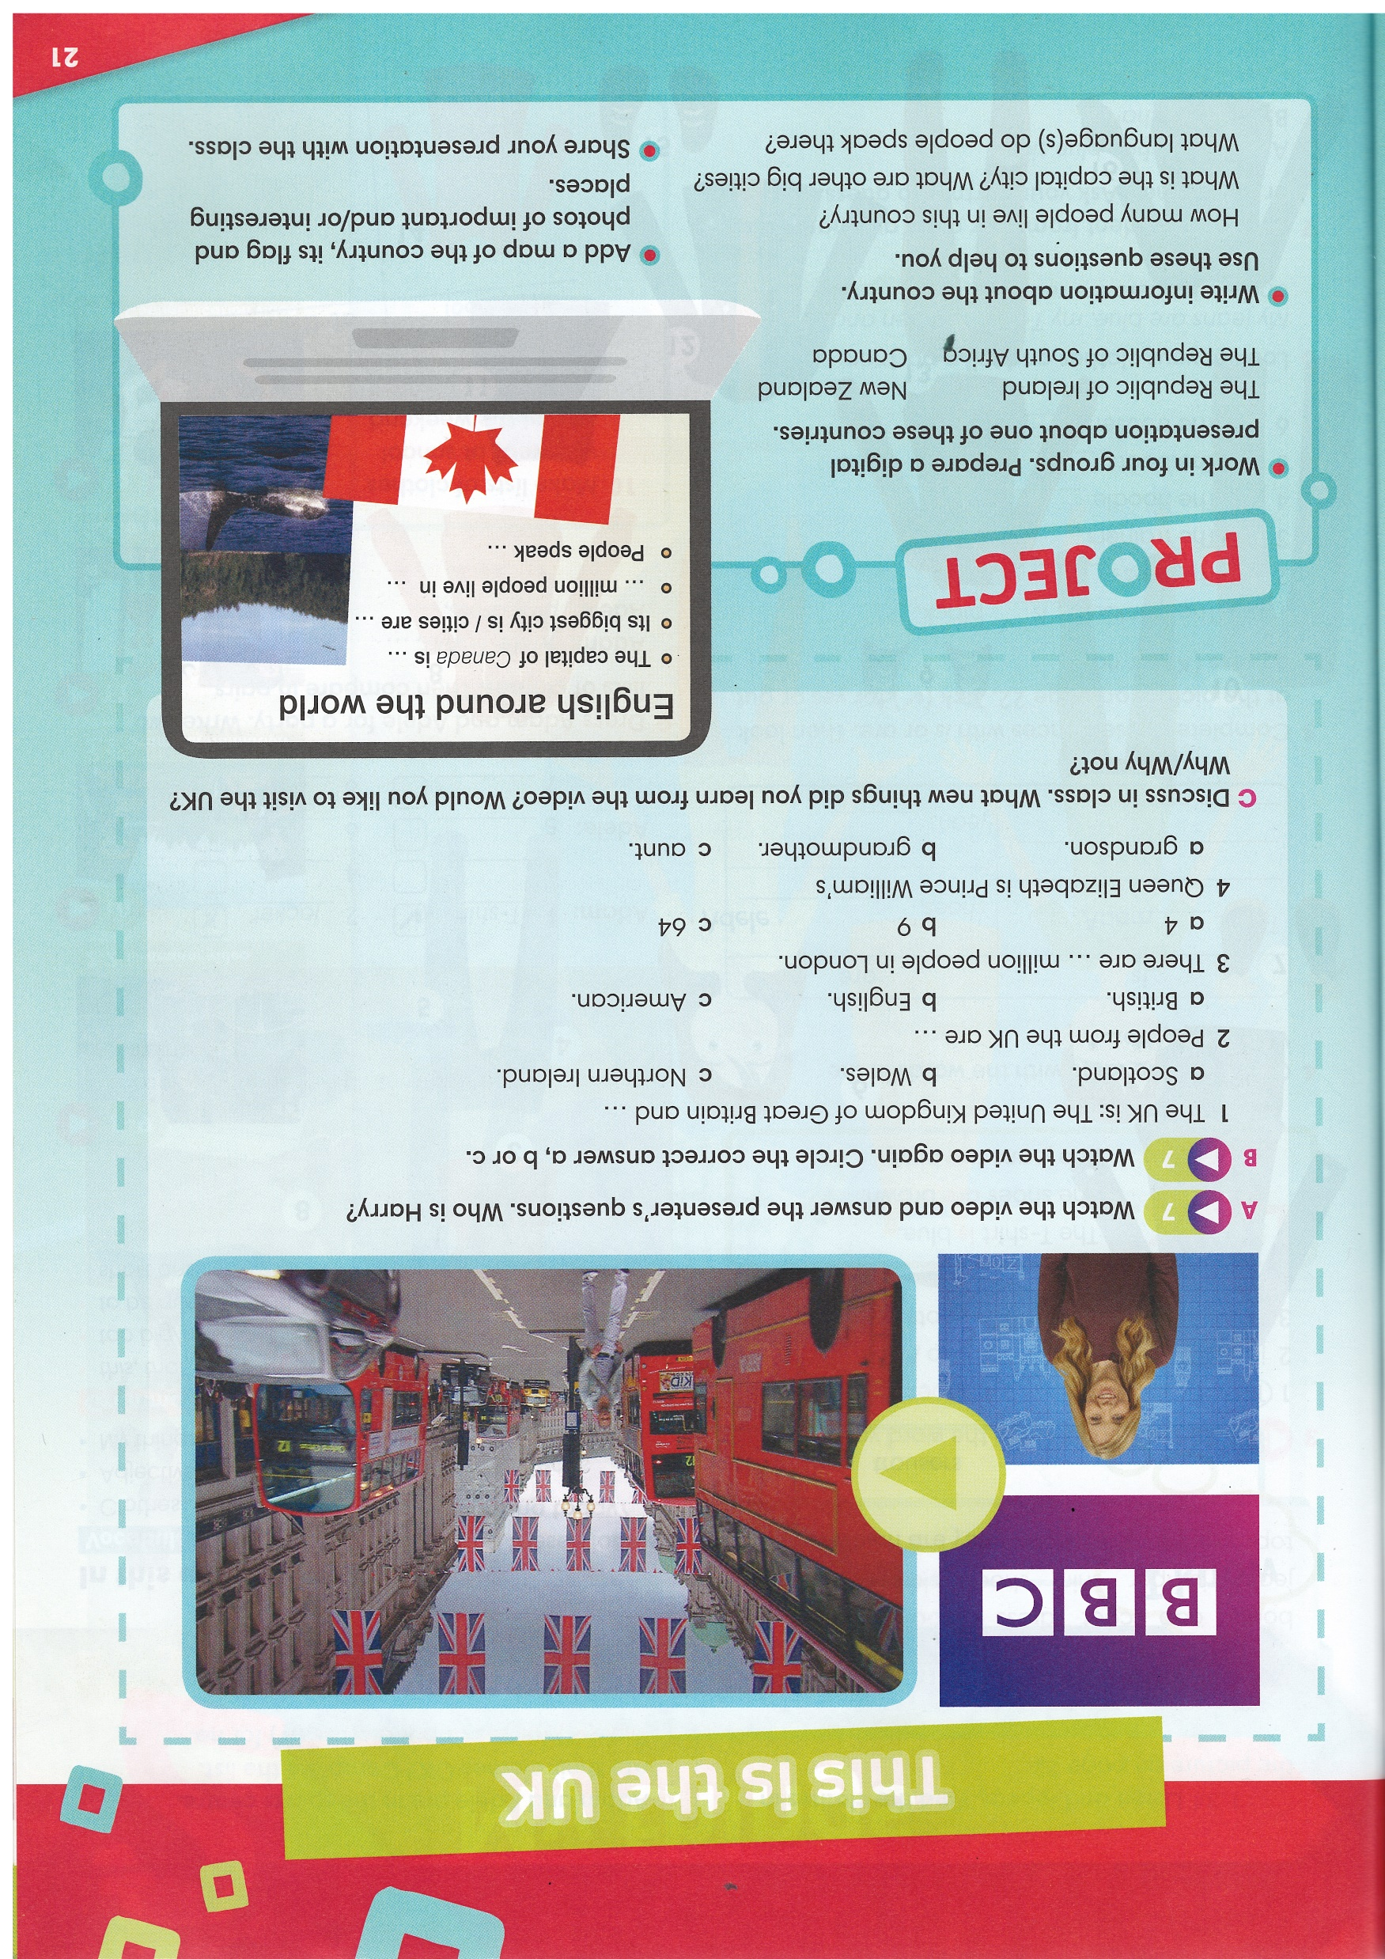

Do the Quiz.
Watch the video and check your answers.
IrinaPapakhina

Slide 8
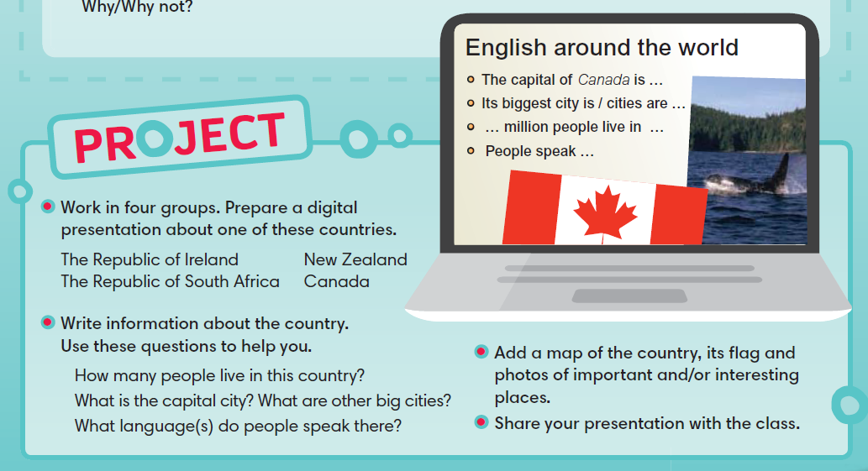
IrinaPapakhina

Slide 9
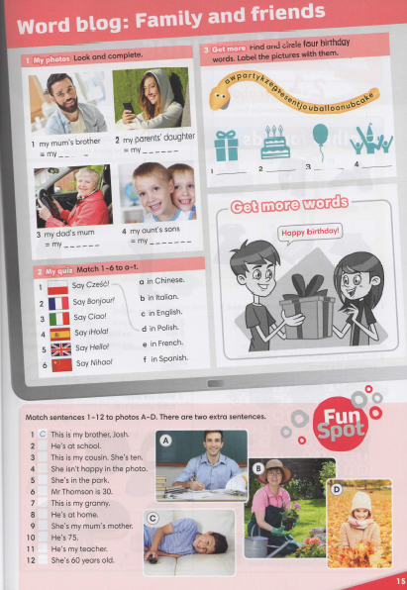


IrinaPapakhina

