Slide 1
SOME/ANY/A/AN + food
HOW MANY/HOW MUCH

Slide 2
FILL IN THE MISSING QUANTIFIERS AND FOOD WORDS

Slide 3
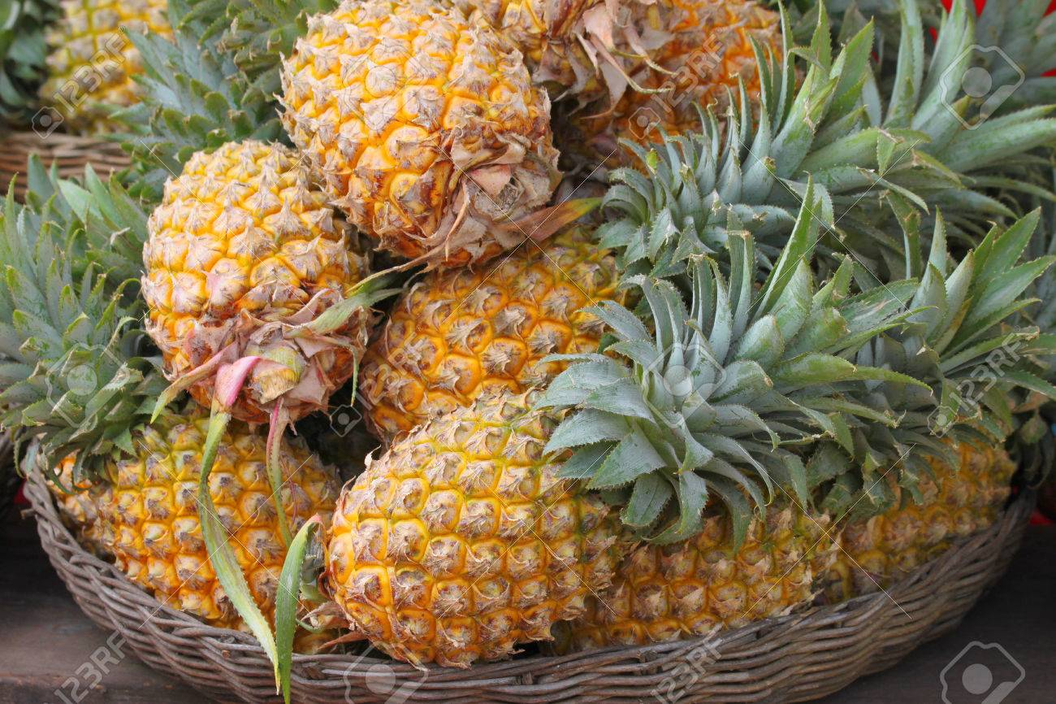
There are______ ___________ in the basket.
some
pineapples

Slide 4
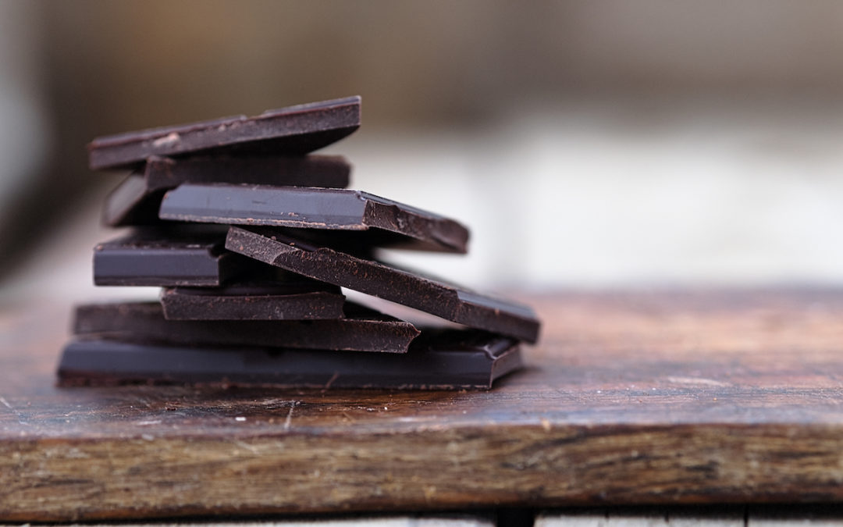
There isn’t______ ___________ on the table.
any
chocolate

Slide 5
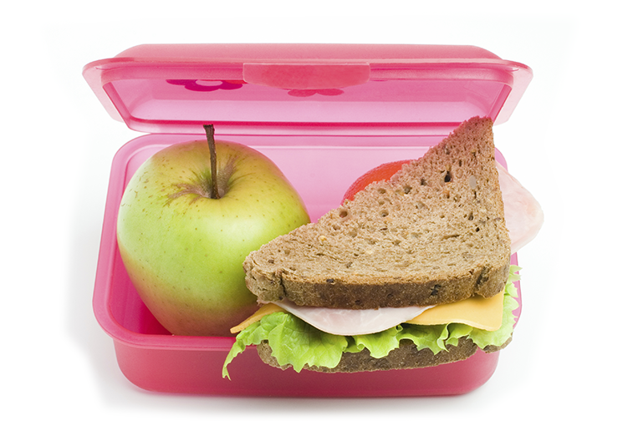
Is there______ ___________ in your box?
a
sandwich
YES

Slide 6
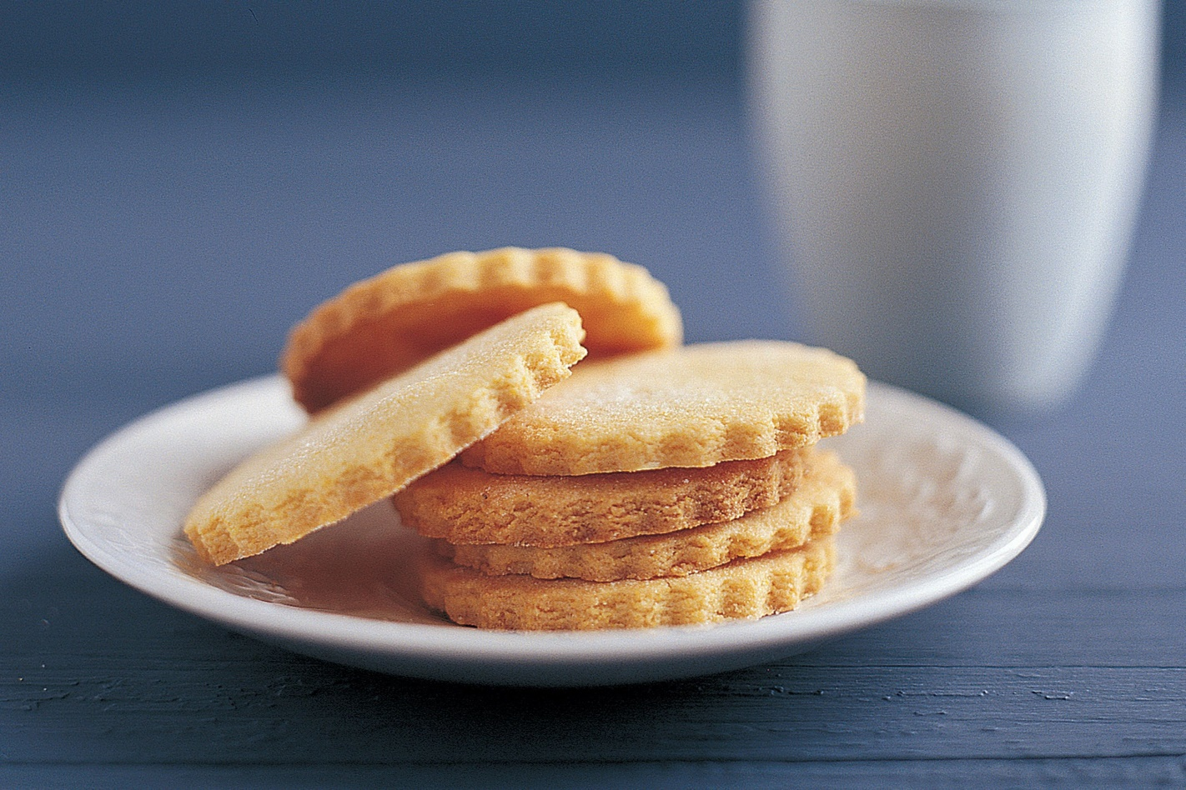
Are there______ ___________ left?
any
biscuits
NO

Slide 7
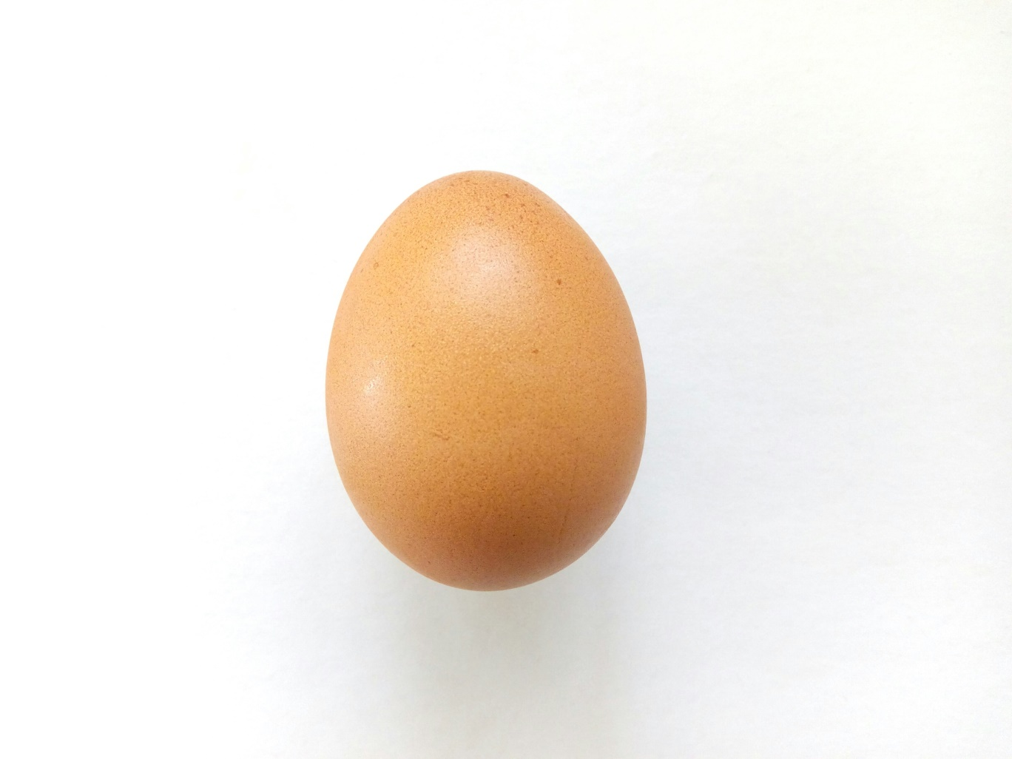
There isn’t ______ ___________ .
an
egg

Slide 8
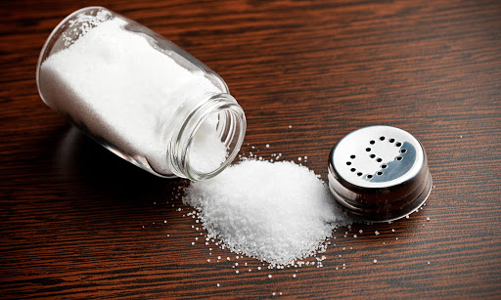
There is ______ ___________ .
some
salt

Slide 9

Is there______ ___________?
any
cream
YES

Slide 10
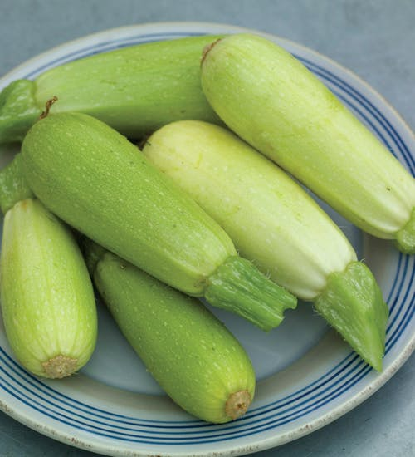
Are there______ ______________?
any
courgettes
YES

Slide 11
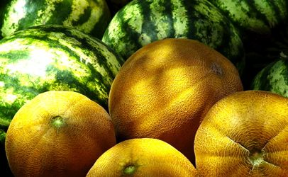
There aren’t ______ ________ in the supermarket . There are only _______ __________.
any
melons
some
watermelons

Slide 12
Fill in the missing verb ‘to be’ in its correct form (+, -, ?) + a/an/some/any

Slide 13
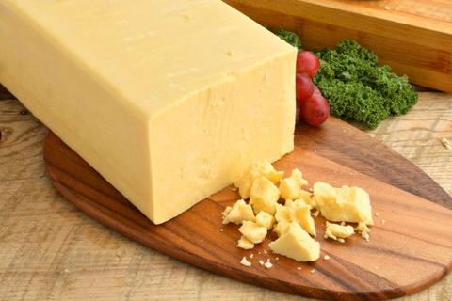
There_____ _______ cheese. (+)
is
some

Slide 14
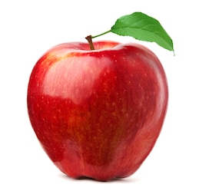
There_____ _______ apple. (-)
isn’t
an

Slide 15
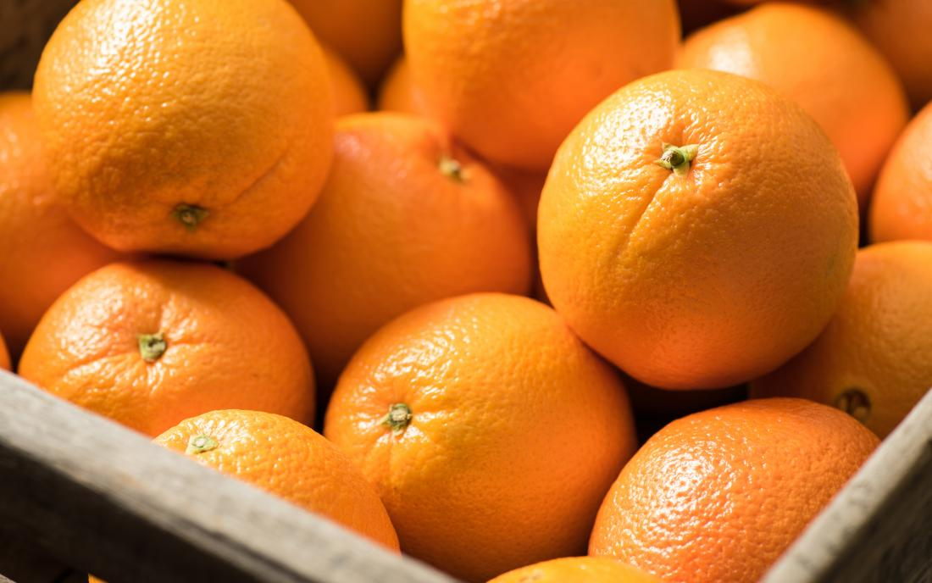
_____ there _______ oranges. (?)
Are
any
YES

Slide 16
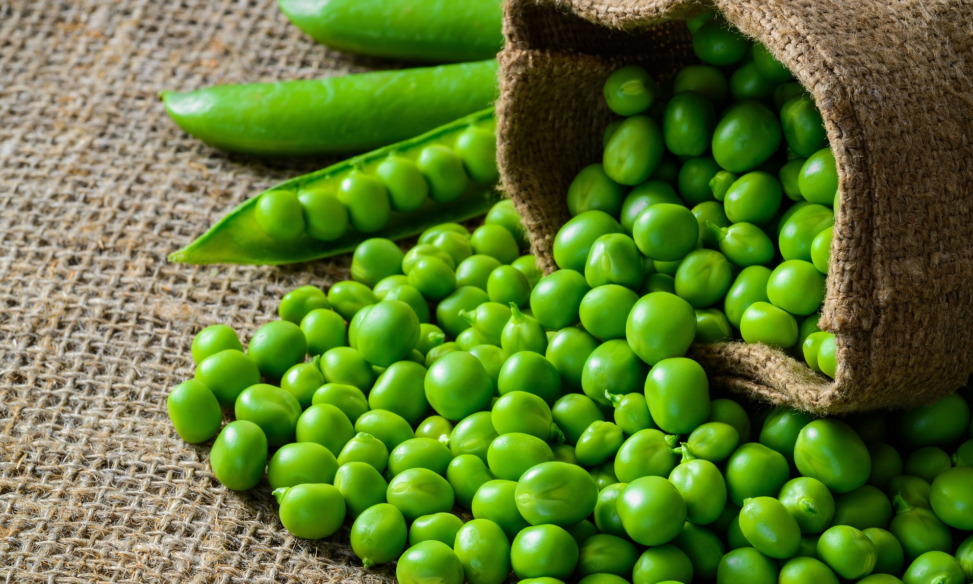
There_____ _______ peas. (+)
are
some

Slide 17
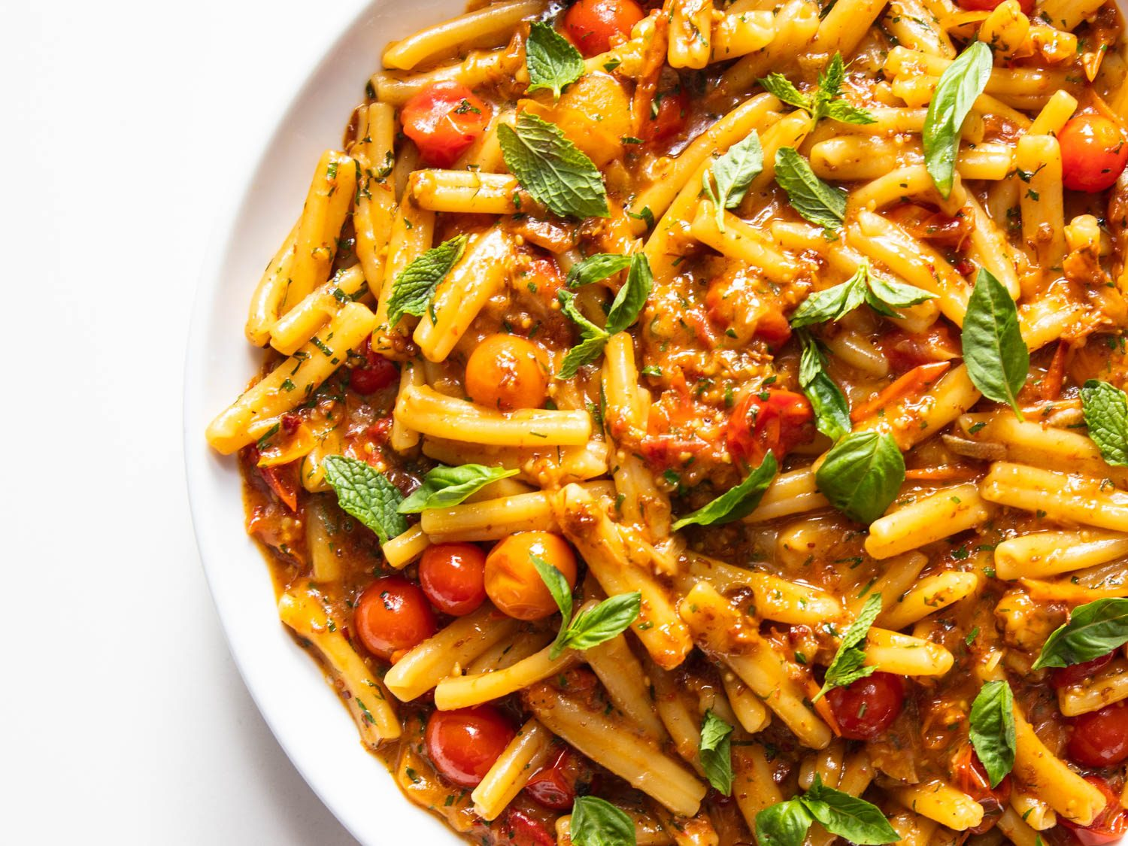
There_____ _______ pasta. (-)
isn’t
any

Slide 18
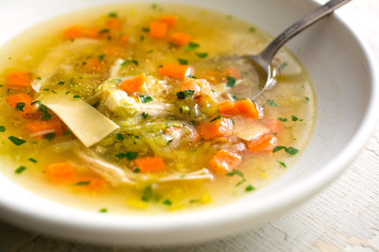
_____ there _______ soup. (?)
Is
any
NO

Slide 19
CONTAINERS

Slide 20
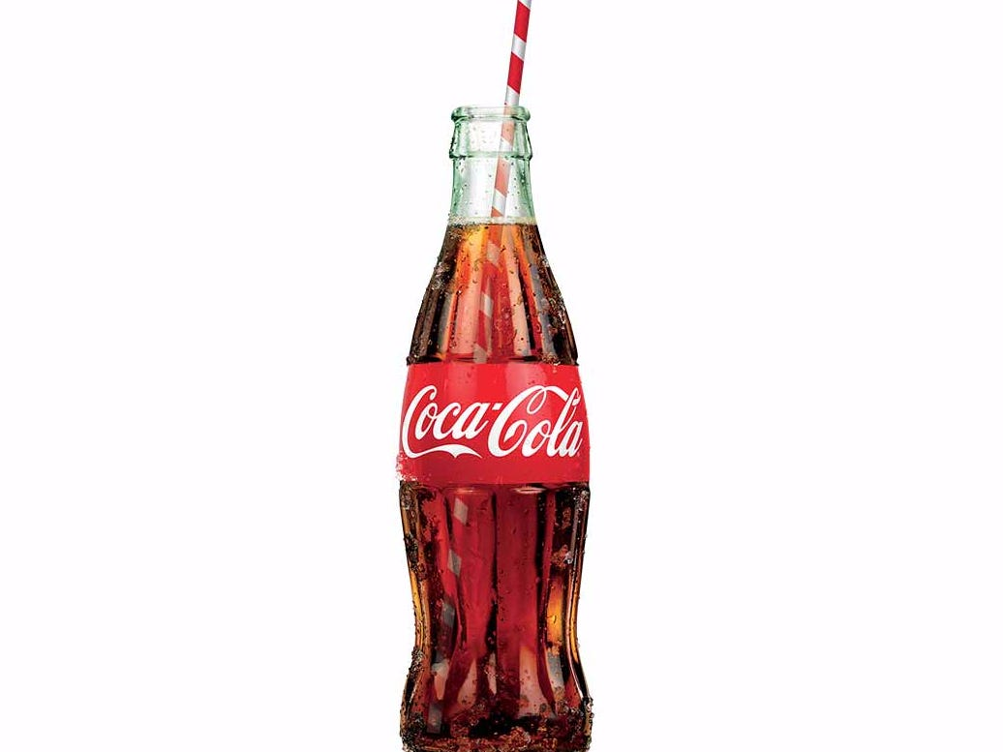
___________of Coke
A BOTTLE

Slide 21
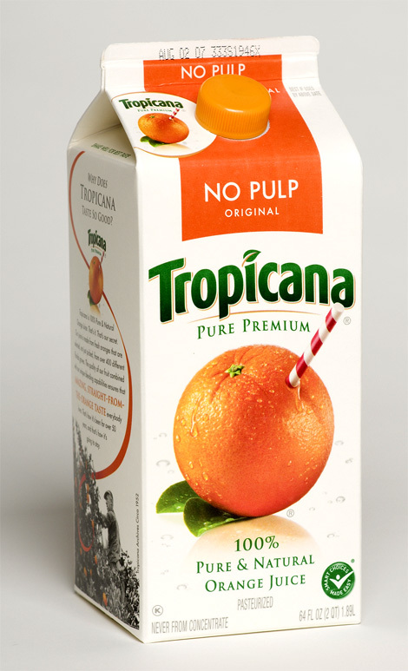
___________of juice
A CARTON

Slide 22
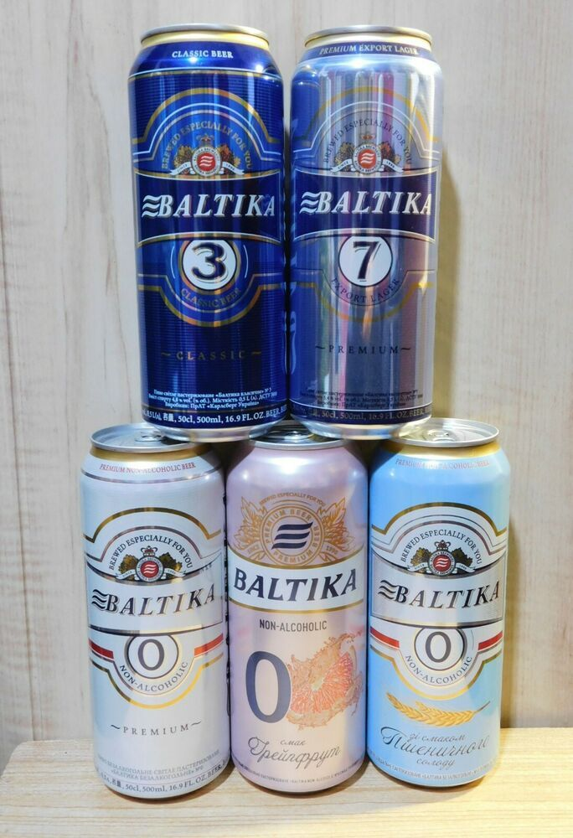
___________of beer
5 CANS

Slide 23

___________of water
3 GLASSES

Slide 24
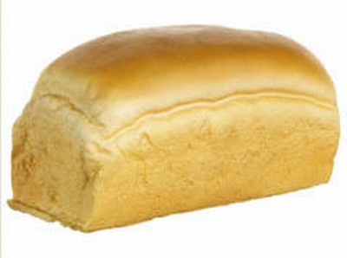
___________of bread
A LOAF

Slide 25
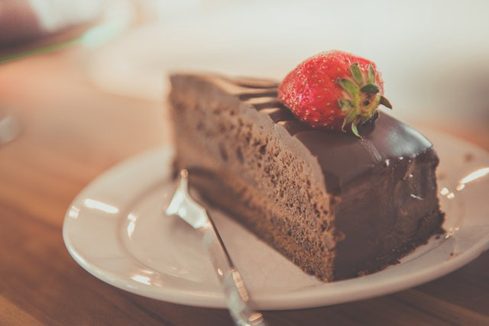
___________of cake
A PIECE

Slide 26
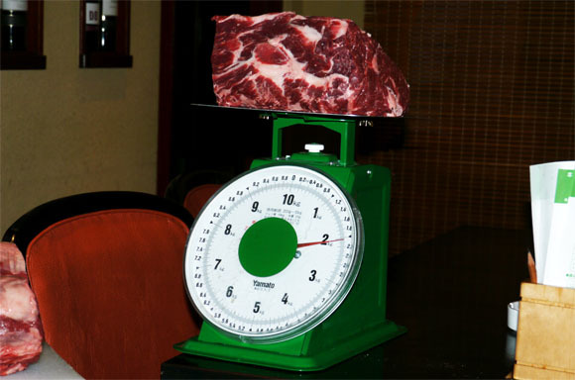
___________of meat
2 KILOS

Slide 27
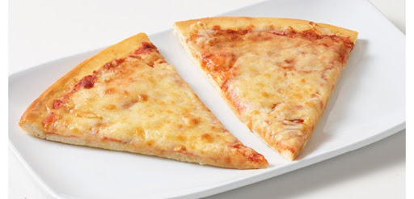
___________of pizza
2 slices

Slide 28
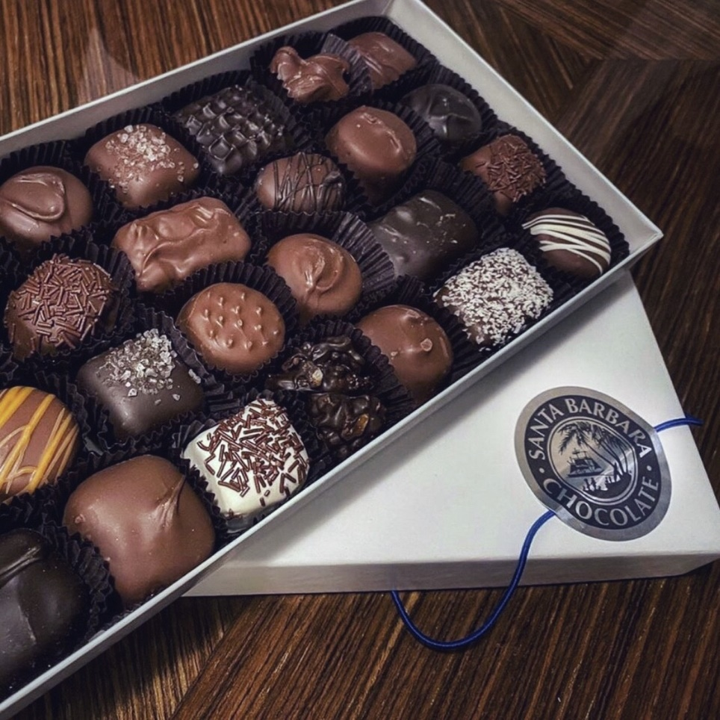
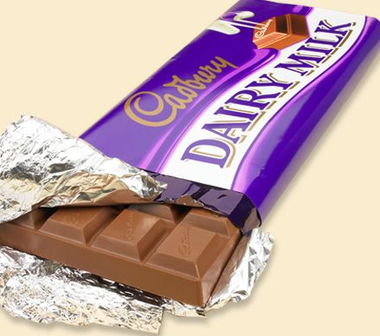
___________of chocolate and _________of chocolate
A BOX
A BAR

Slide 29
FILL IN HOW MUCH OR HOW MANY. ASK AND ANSWER THE QUESTIONS

Slide 30
HOW MUCH
___________________WATER DO YOU DRINK A DAY?
___________________CUPS OF COFFE DO YOU DRINK EVERY DAY?
___________________SUGAR DO YOU HAVE WITH YOUR COFFE OR TEA?
___________________OIL OR BUTTER DO YOU EAT WITH YOUR FOOD?
___________________RED MEAT DO YOU EAT EVERY WEEK?
___________________BREAD/RICE/PASTA DO YOU EAT EVERY DAY?
___________________VEGETABLES DO YOU EAT EVERY DAY?
___________________FRUIT DO YOU EAT EVERY DAY?
___________________SWEETS DO YOU EAT EVERY DAY?
___________________CIGARETTES DO YOU SMOKE ECVERY DAY?
___________________HOURS D O YOU SLEEP EVERY NIGHT?
___________________TIME DO YOU WORK ON A COMPTER EVERY DAY?
___________________TIMES DO YOU EXERCISE EVERY WEEK?
HOW MANY
HOW MUCH
HOW MUCH
HOW MUCH
HOW MUCH
HOW MANY
HOW MUCH
HOW MANY
HOW MANY
HOW MANY
HOW MUCH
HOW MANY

