Slide 1
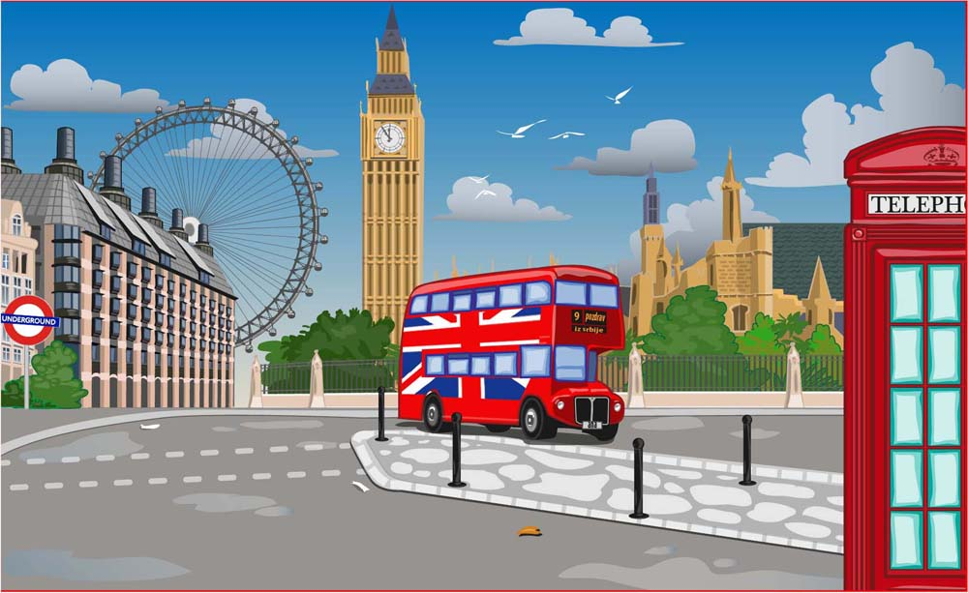


IrinaPapakhinac

Slide 2


1. What do you know about London?
2. What can you do in London?
IrinaPapakhinac

Slide 3

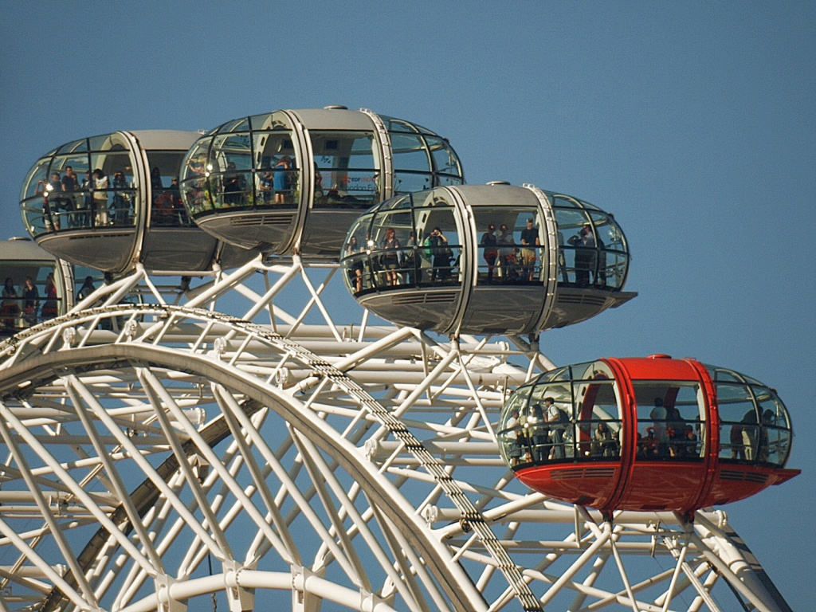
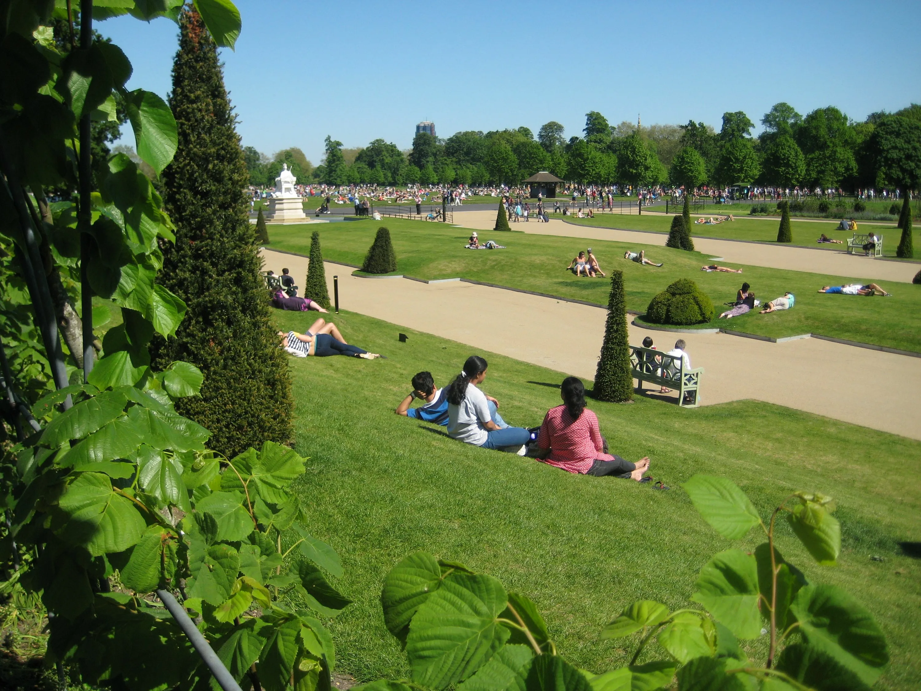
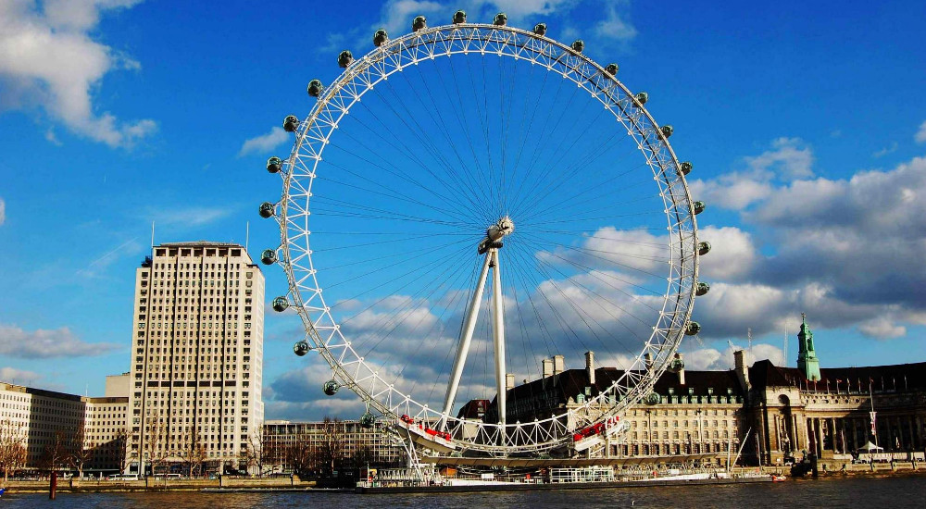
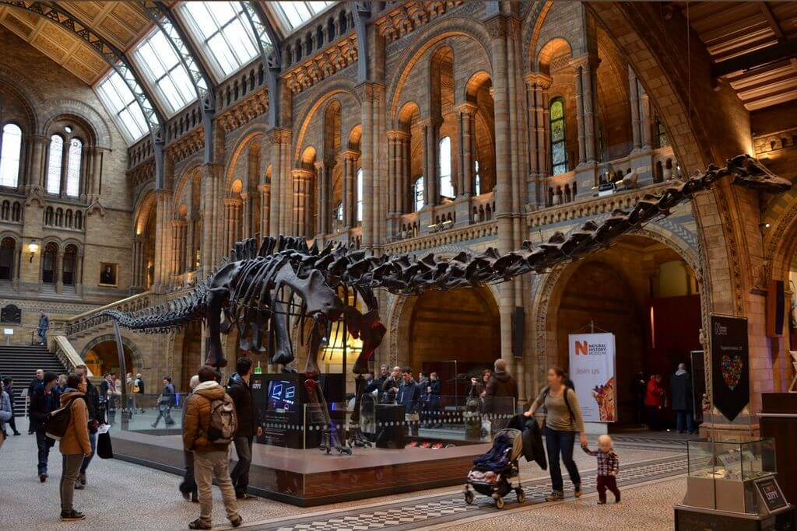
The London Eye and the Thames
Hyde Park
Look at the photos.
Which of these places would you like to visit?
Natural History Museum
IrinaPapakhinac

Slide 4
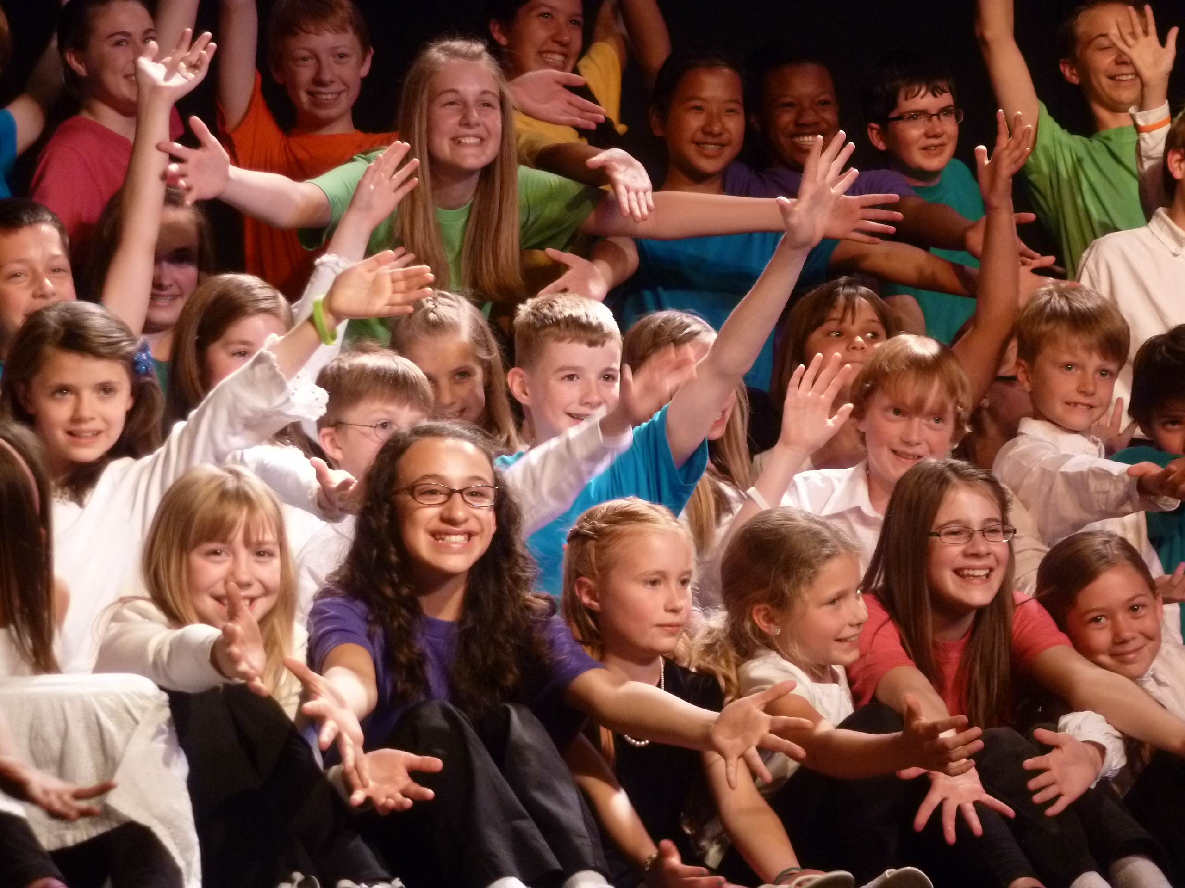
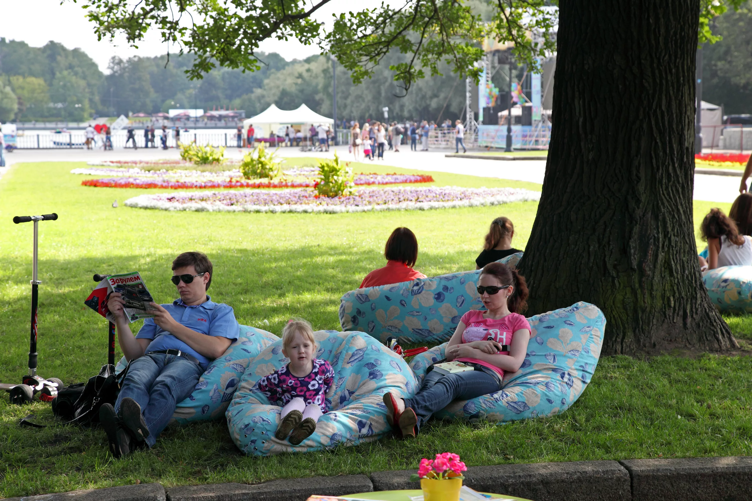
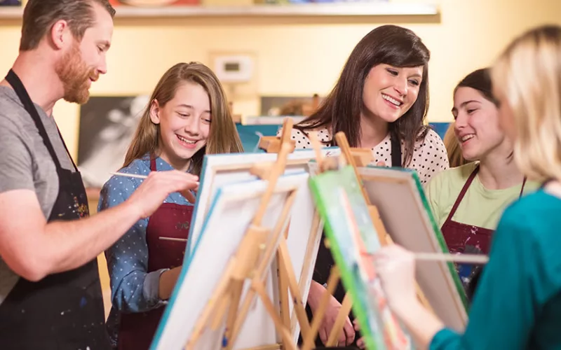
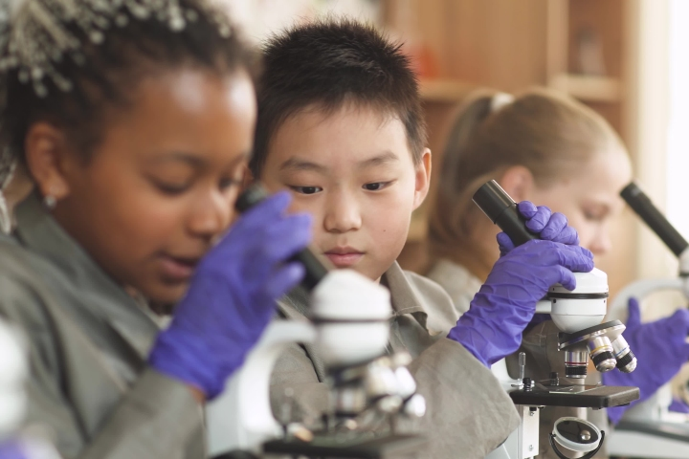
A
C
B
D
Look at the photos.
Where are the children?
What can they do there?
IrinaPapakhinac

Slide 5
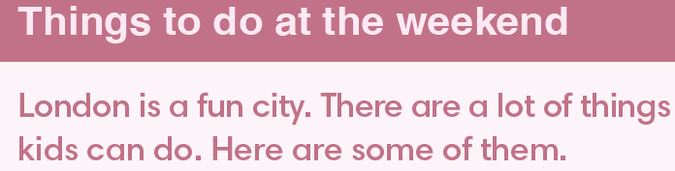

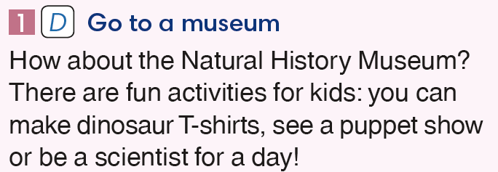
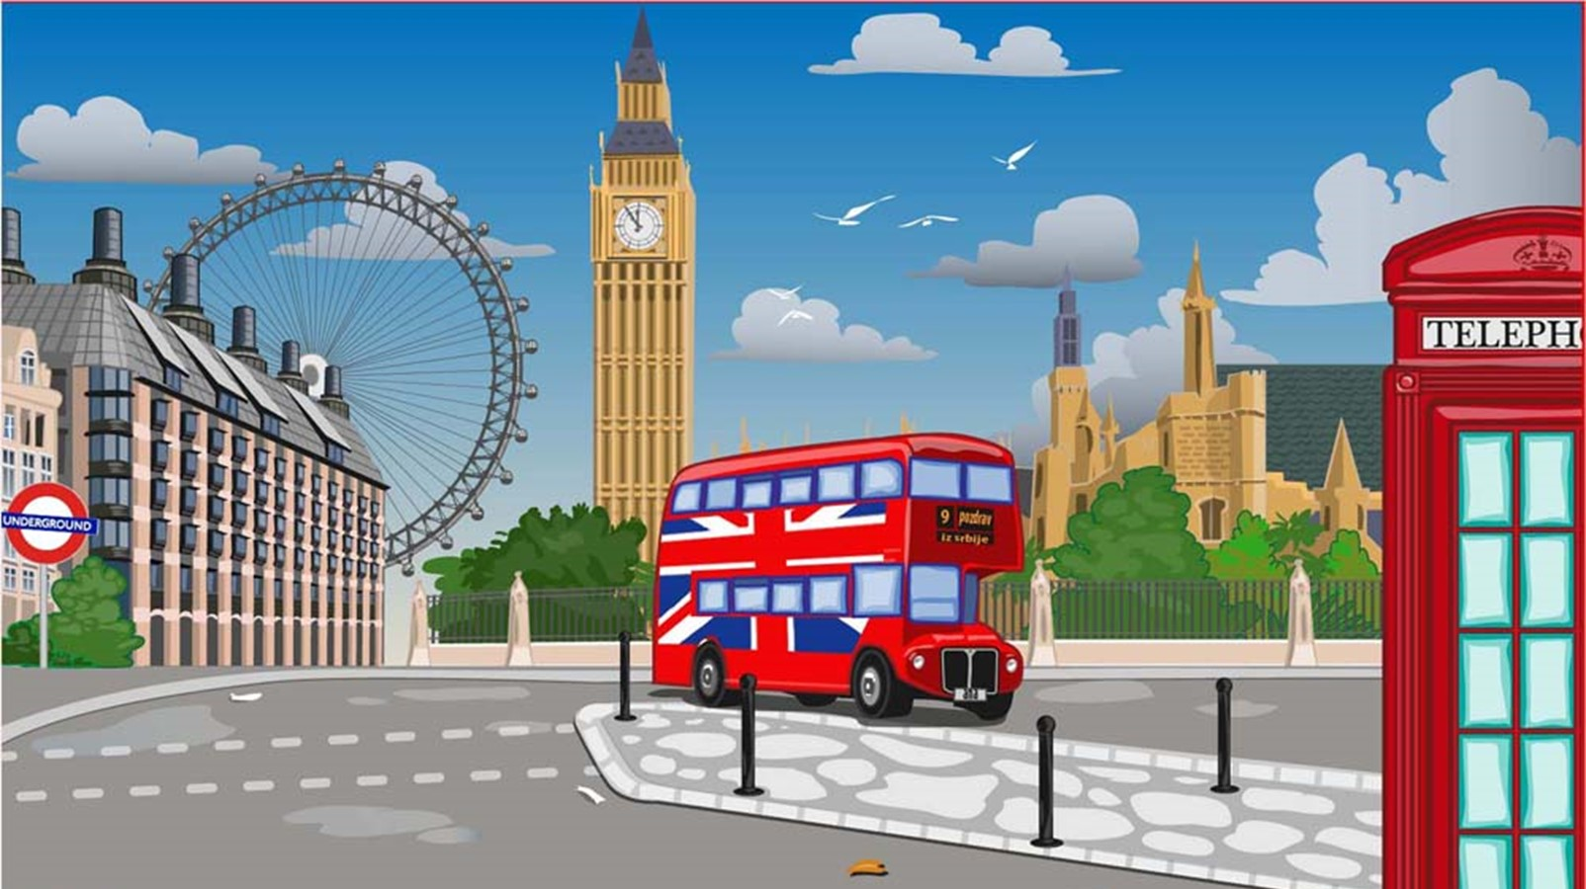
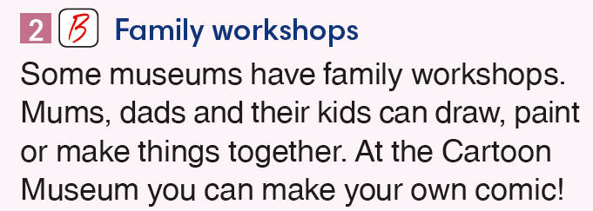
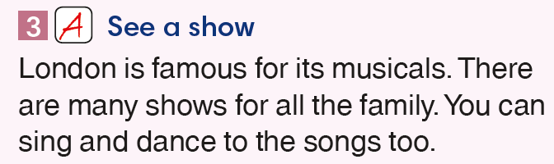
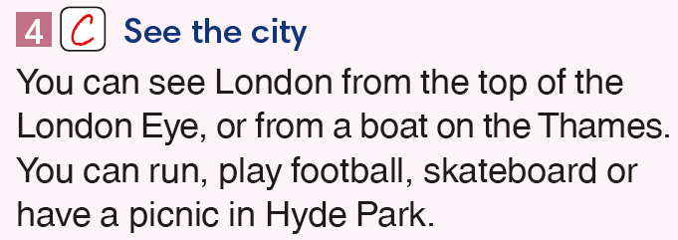
A
Match photos A – D to paragraphs 1 – 4.
B
C
D
IrinaPapakhinac

Slide 6
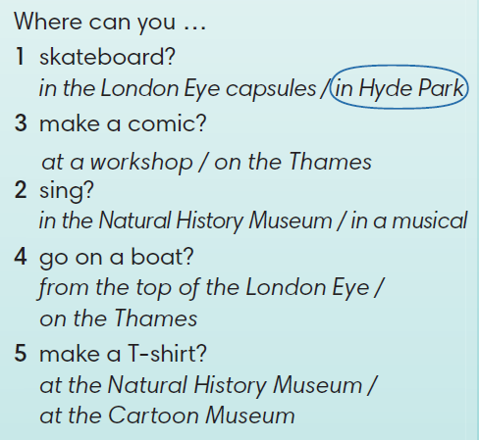
Read the test again and circle the correct answer.
IrinaPapakhinac

Slide 7
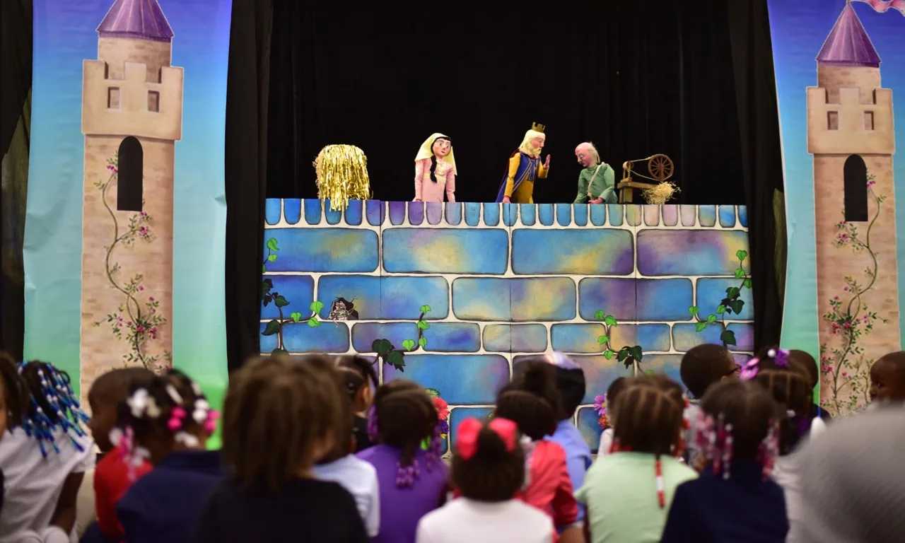

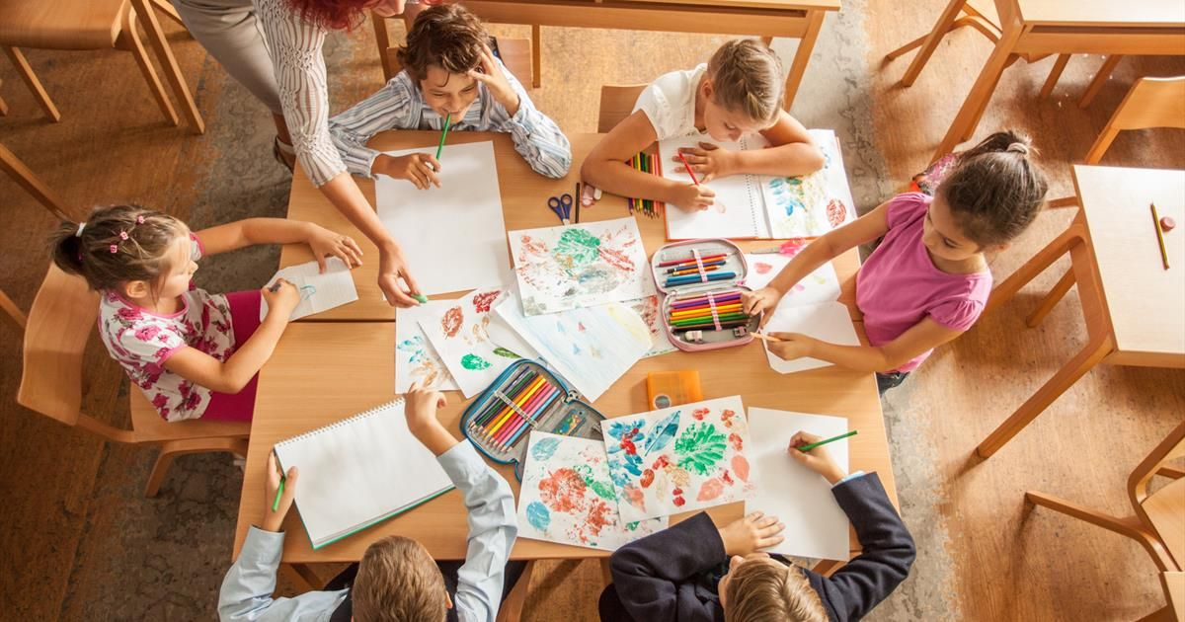
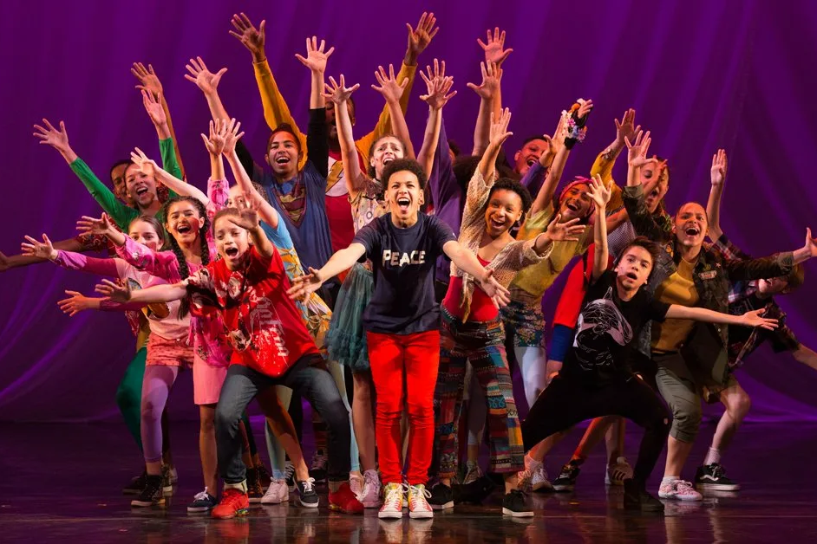
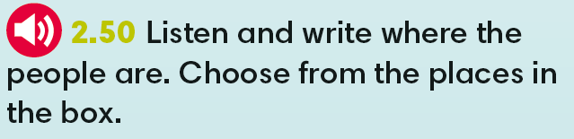
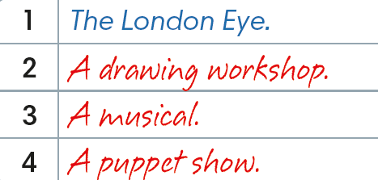
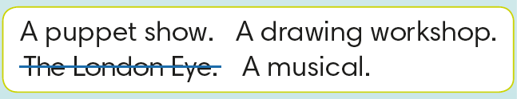
A
C
B
D
IrinaPapakhinac

Slide 8
1. What do you like shopping for? (food, clothes, sports things, … )
2. Do you prefer big or small shops? Why?
3. Do you buy things online?

Slide 9
1. What can kids do where you live?
2. Have you got a park / river / / museum / theatre ?
3. What is your favourite weekend activity?
IrinaPapakhinac

Slide 10

GUESS
What do British kids like doing at the weekend?
Watch the video and check your answers.
IrinaPapakhinac

Slide 11
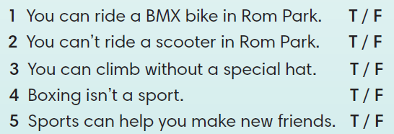
IrinaPapakhinac

Slide 12
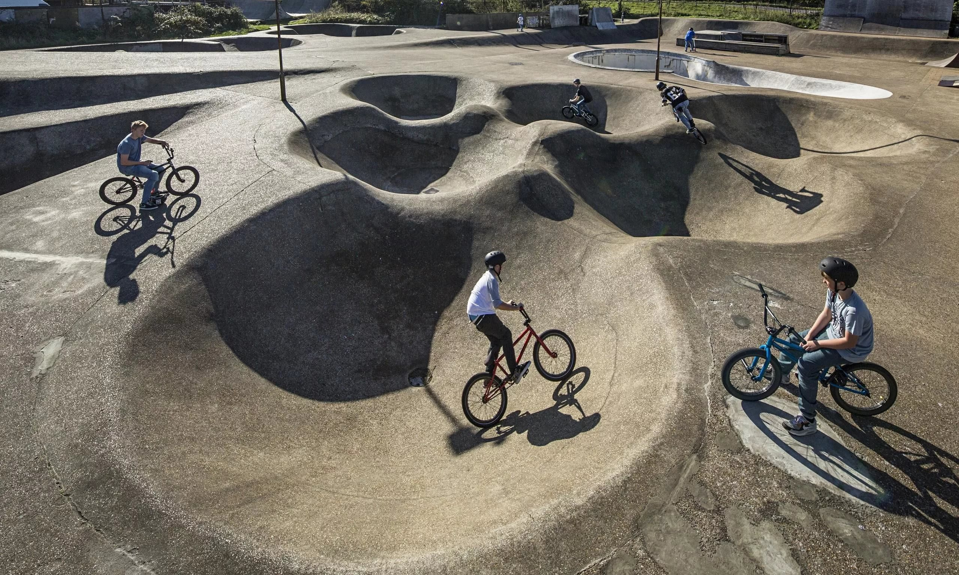
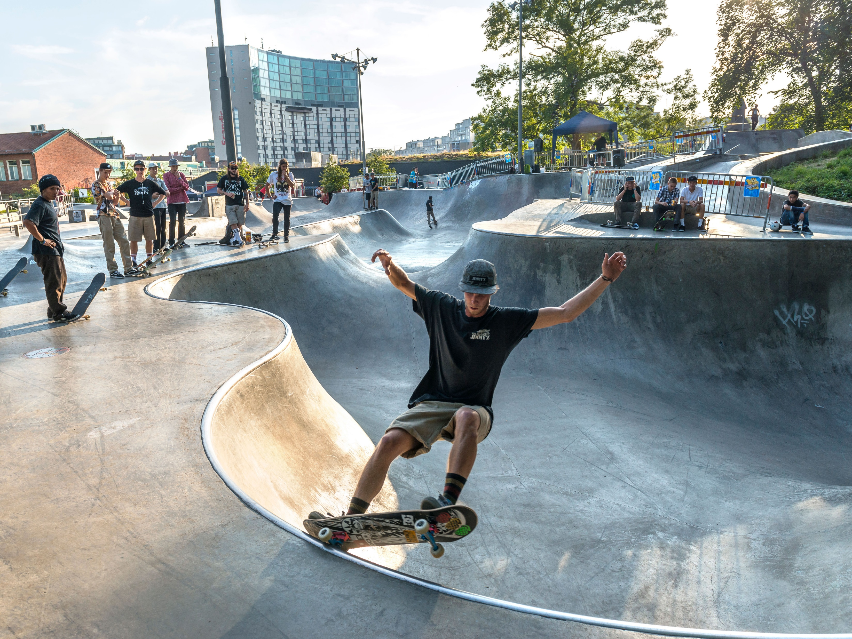
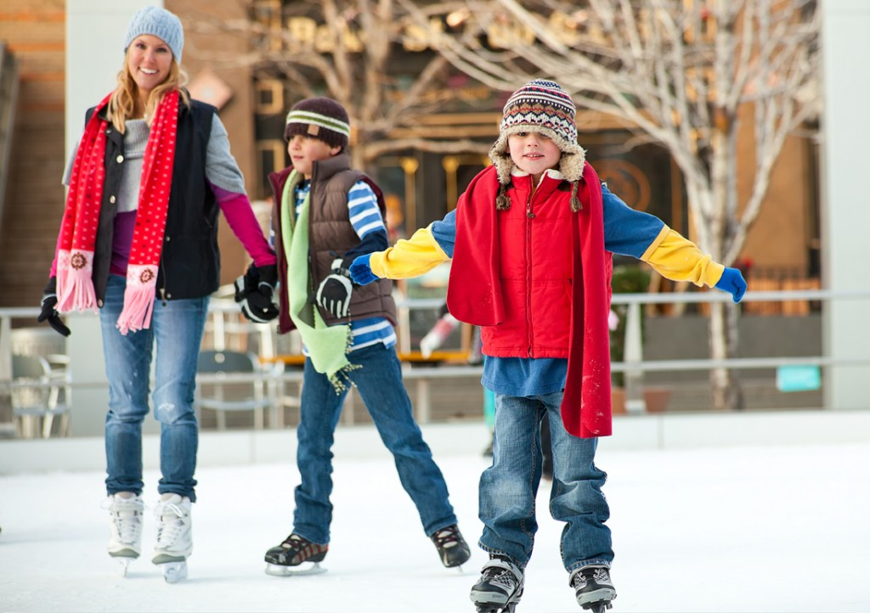
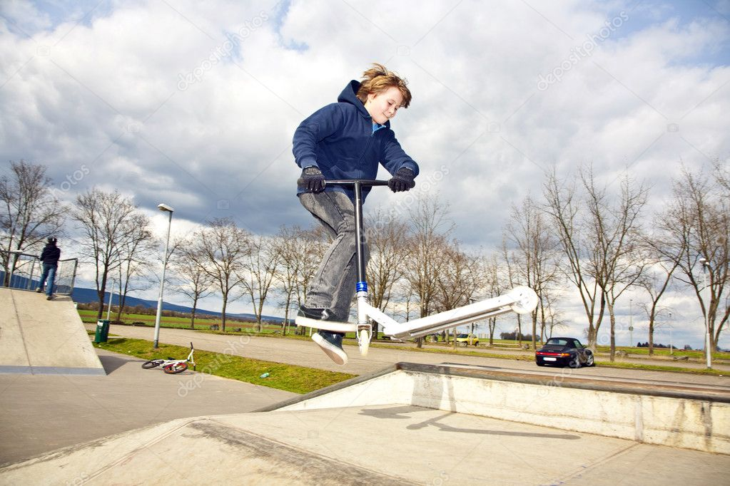
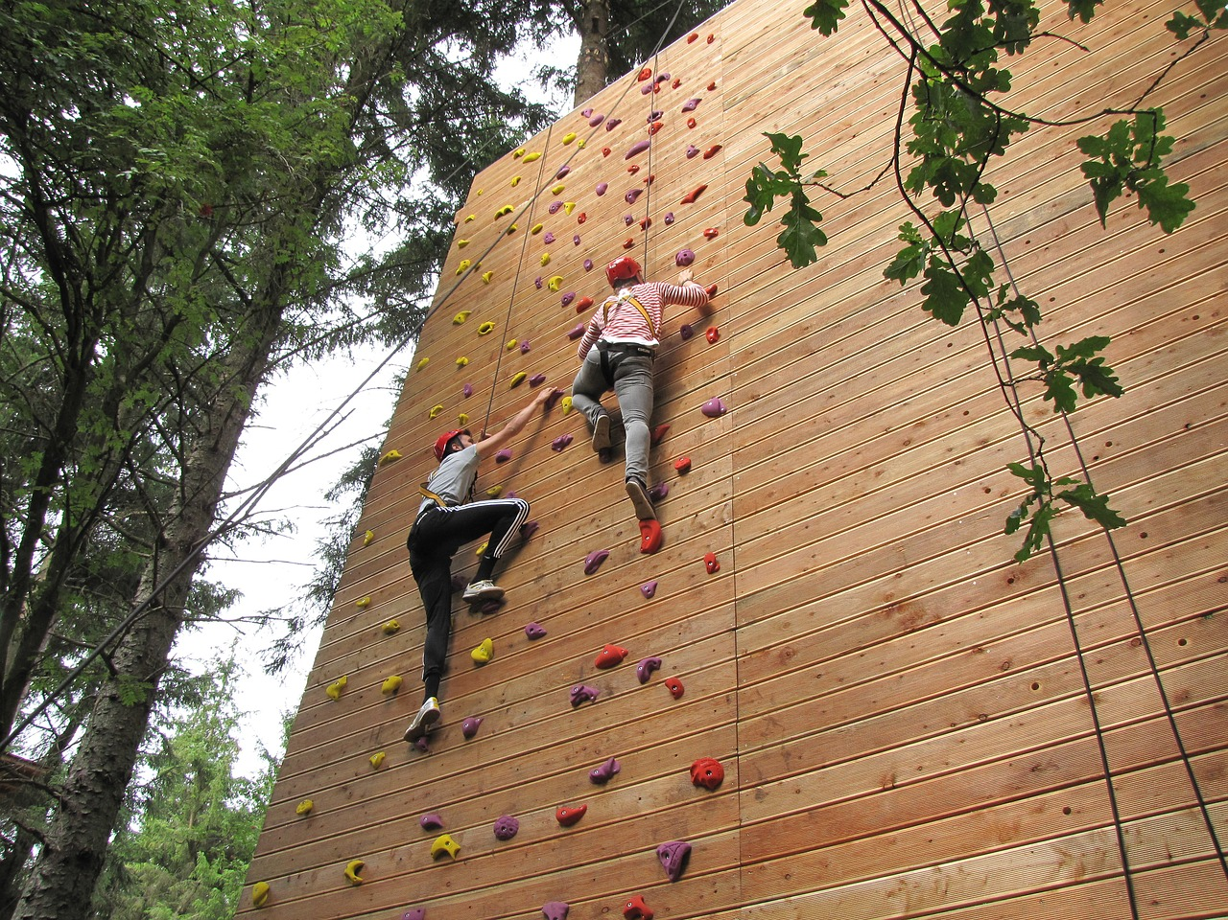
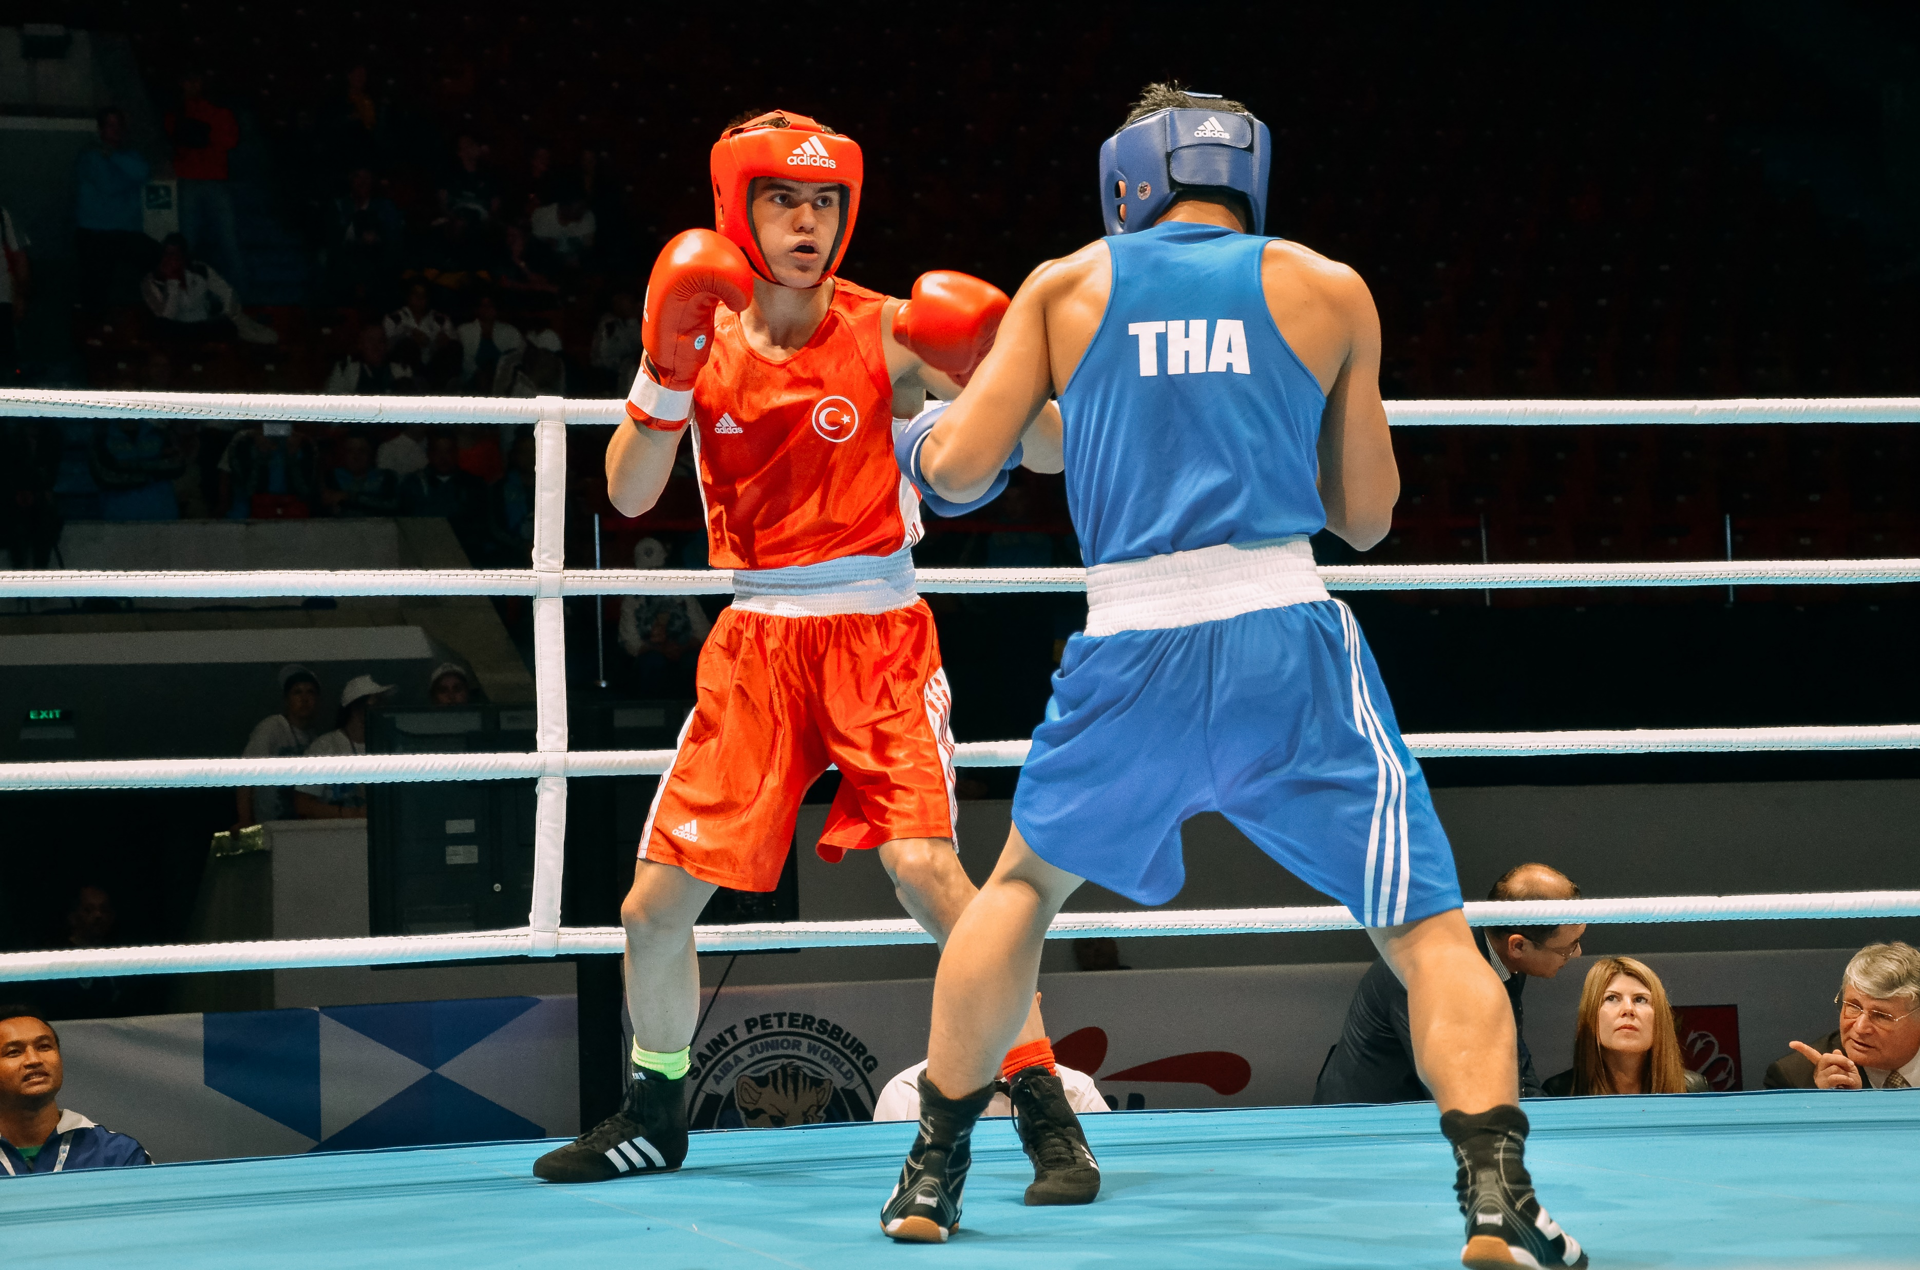
Which of these sports and activities can you do?
ride a BMX bike
skateboard
ice-skate
ride a scooter
climb the wall
do boxing
IrinaPapakhinac

Slide 13
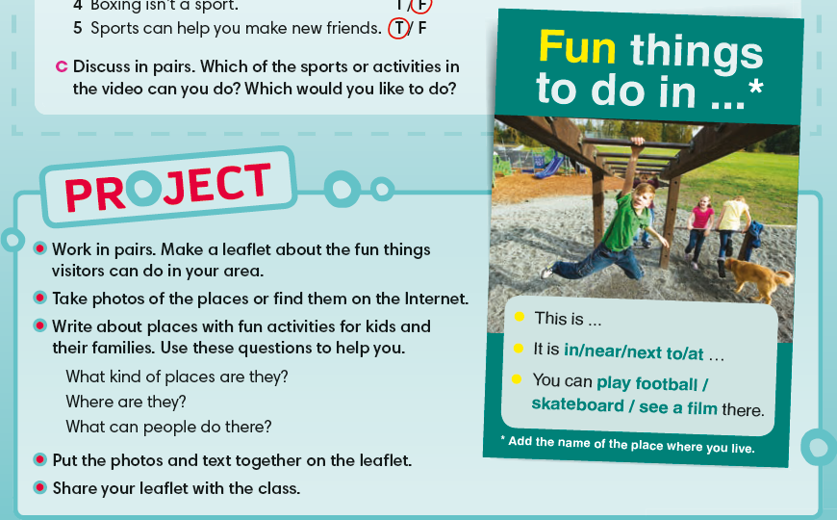
IrinaPapakhinac

Slide 14
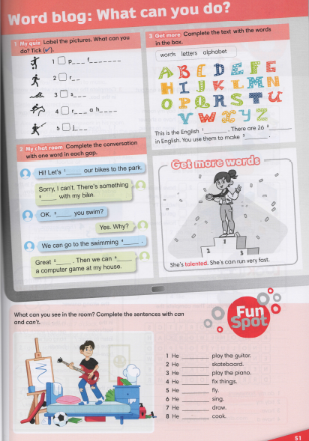


IrinaPapakhinac

