Slide 1
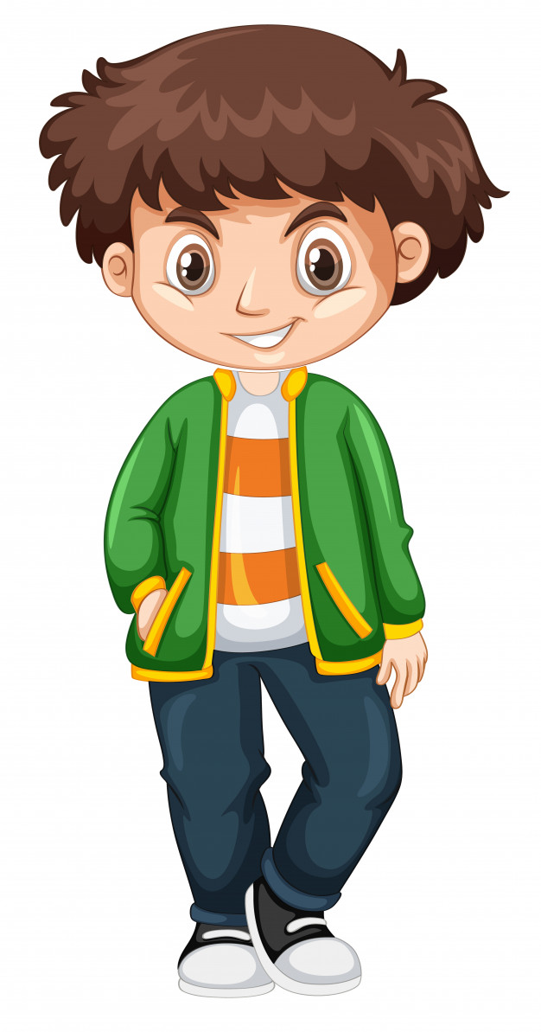
Look and remember!

Slide 2
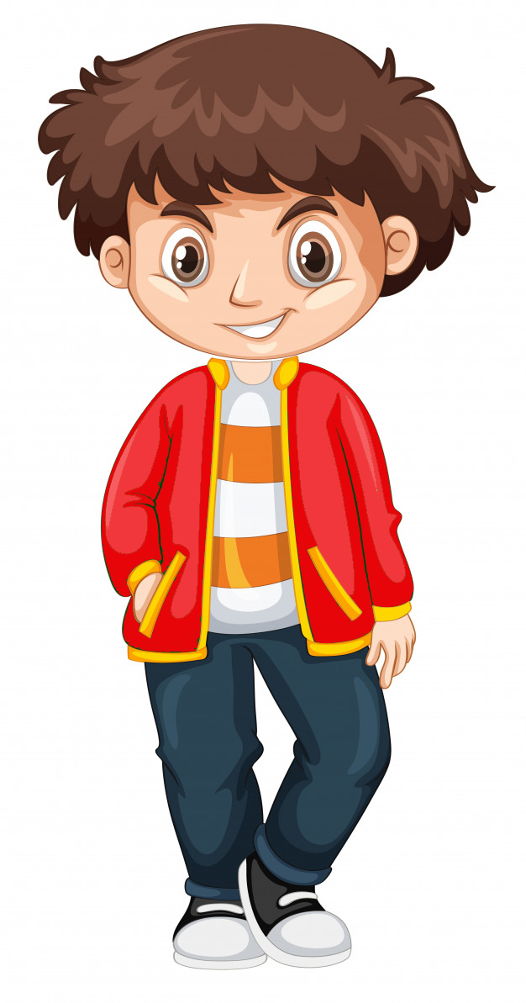
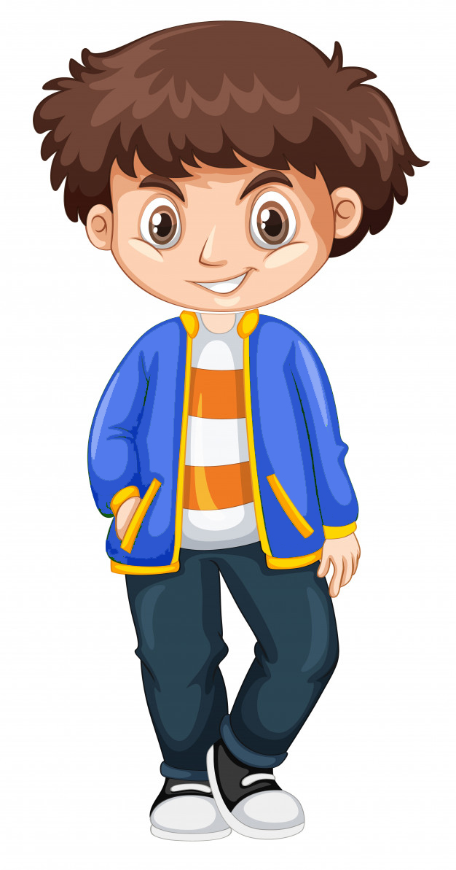
What colour was his jacket?

Slide 3
His jacket was green

Slide 4
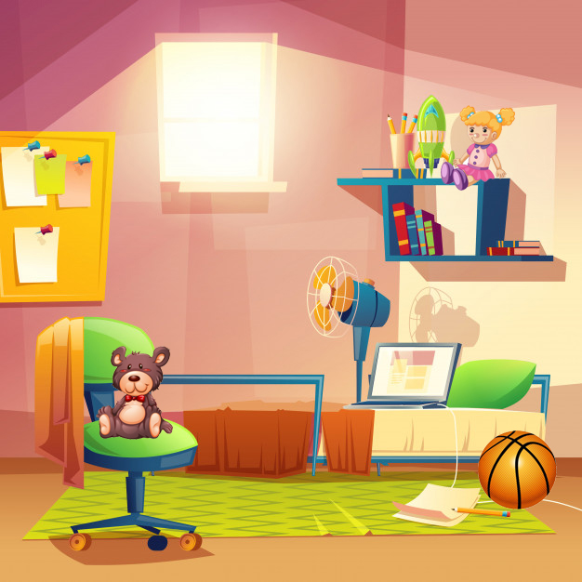
Look and remember!

Slide 5

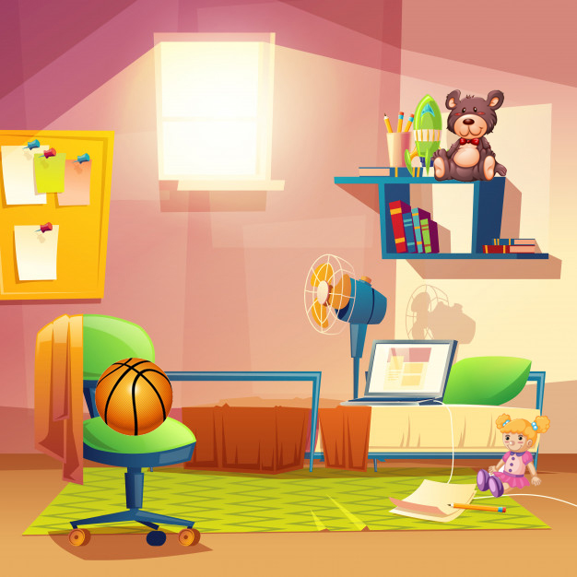
Where was the teddy?

Slide 6
The teddy was on the chair

Slide 7
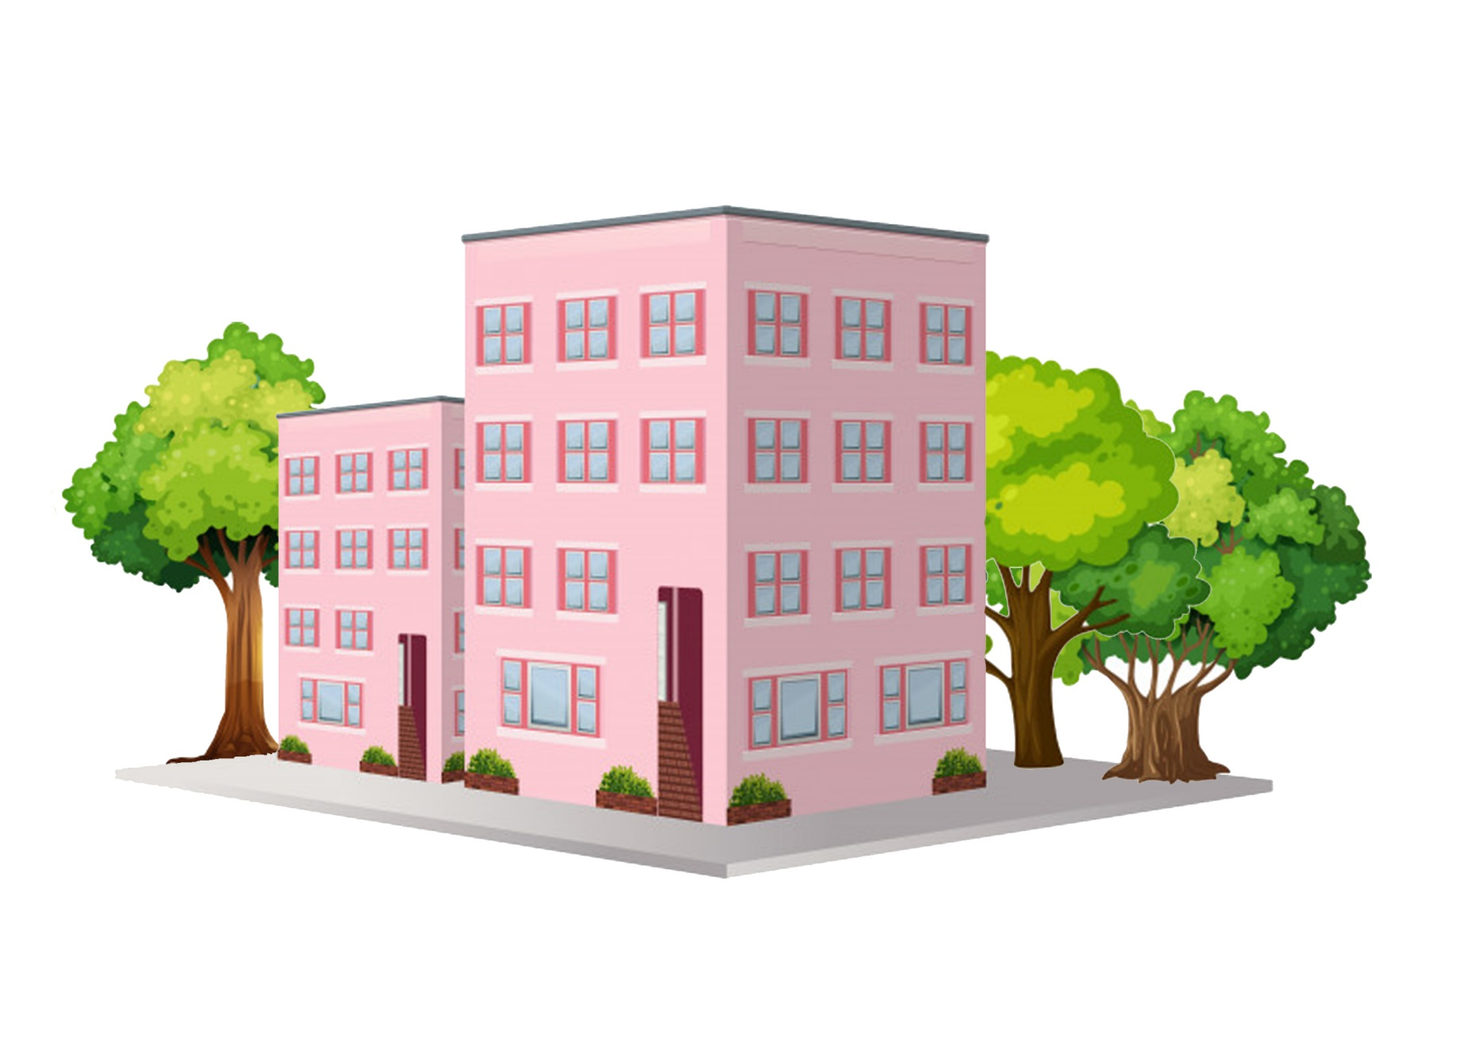
Look and remember!

Slide 8

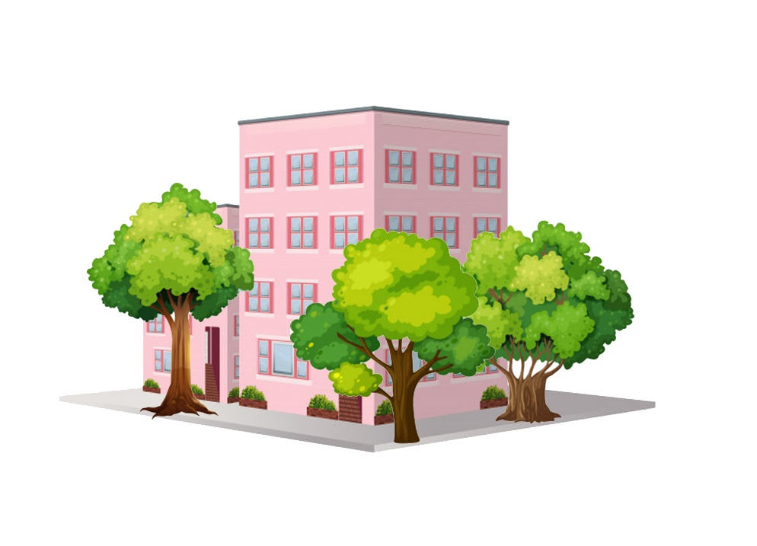
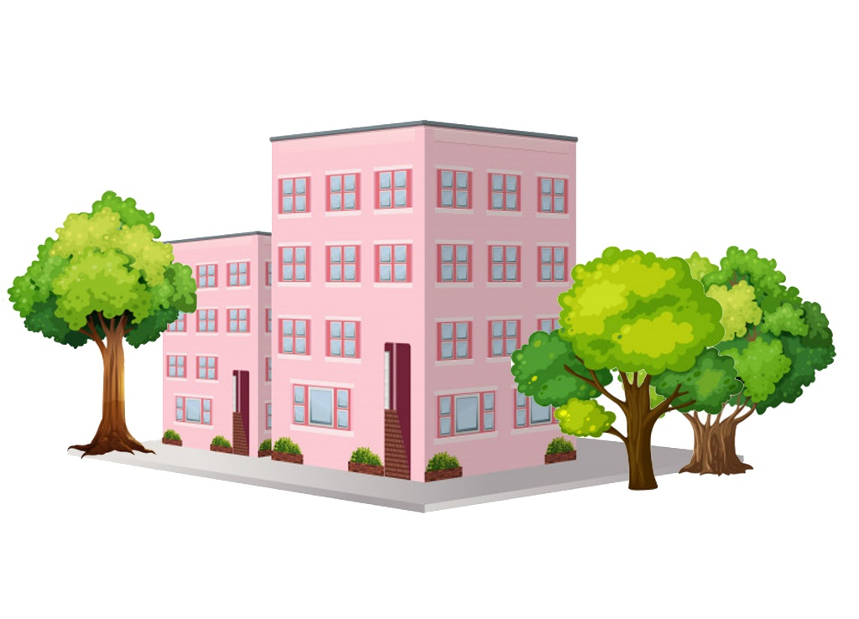
Where were the trees?

Slide 9
They were behind the house

Slide 10
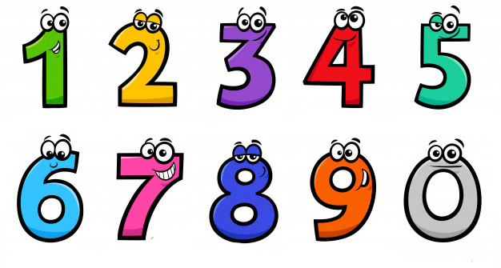
Look and remember!

Slide 11
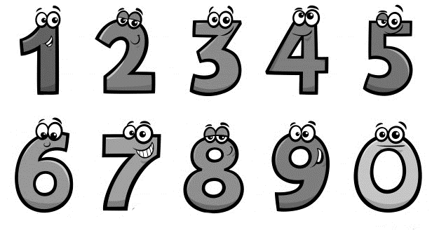
What colour was ‘three’?

Slide 12
It was purple

Slide 13

Look and remember!

Slide 14


What was the time?

Slide 15
It was 11 o’clock

Slide 16
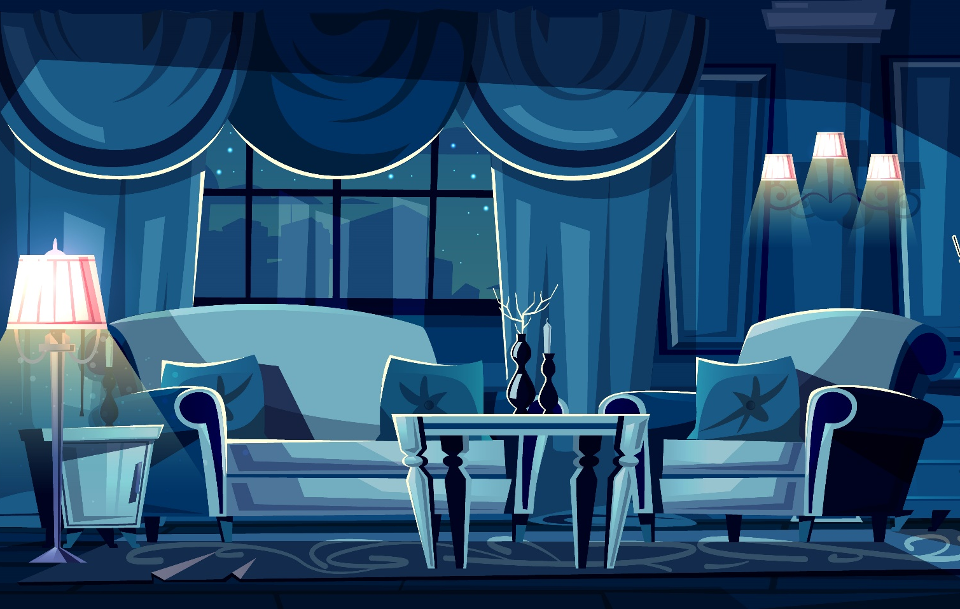
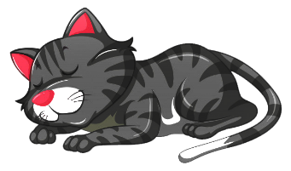

Look and remember!

Slide 17
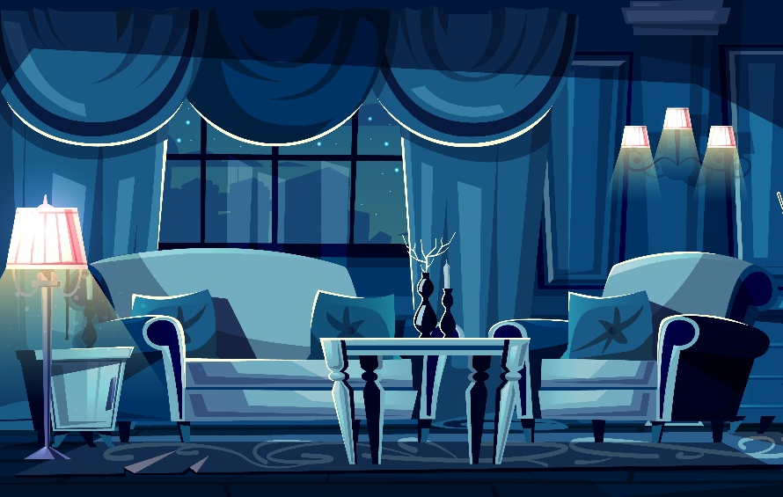
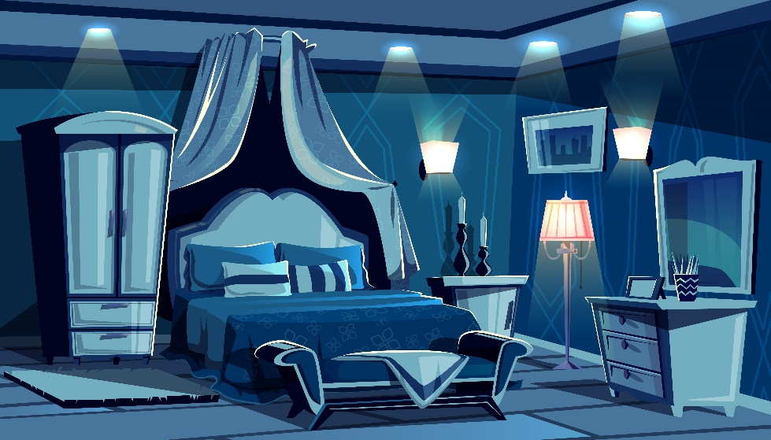
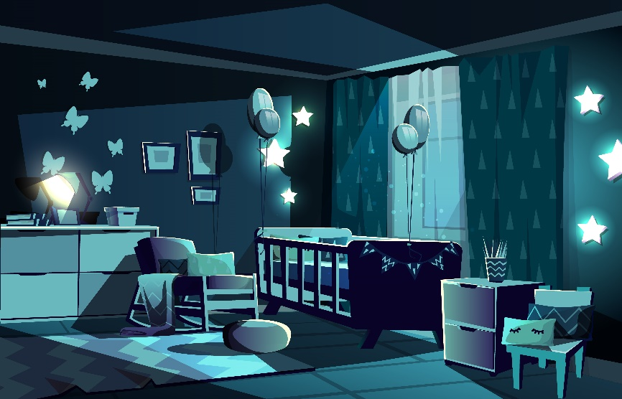


Where were the cats?

Slide 18
They were in the living room

