Slide 1



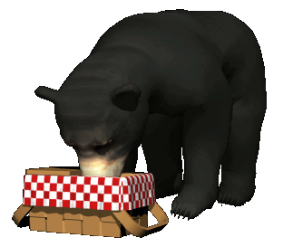

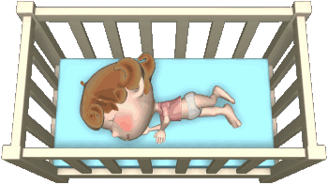
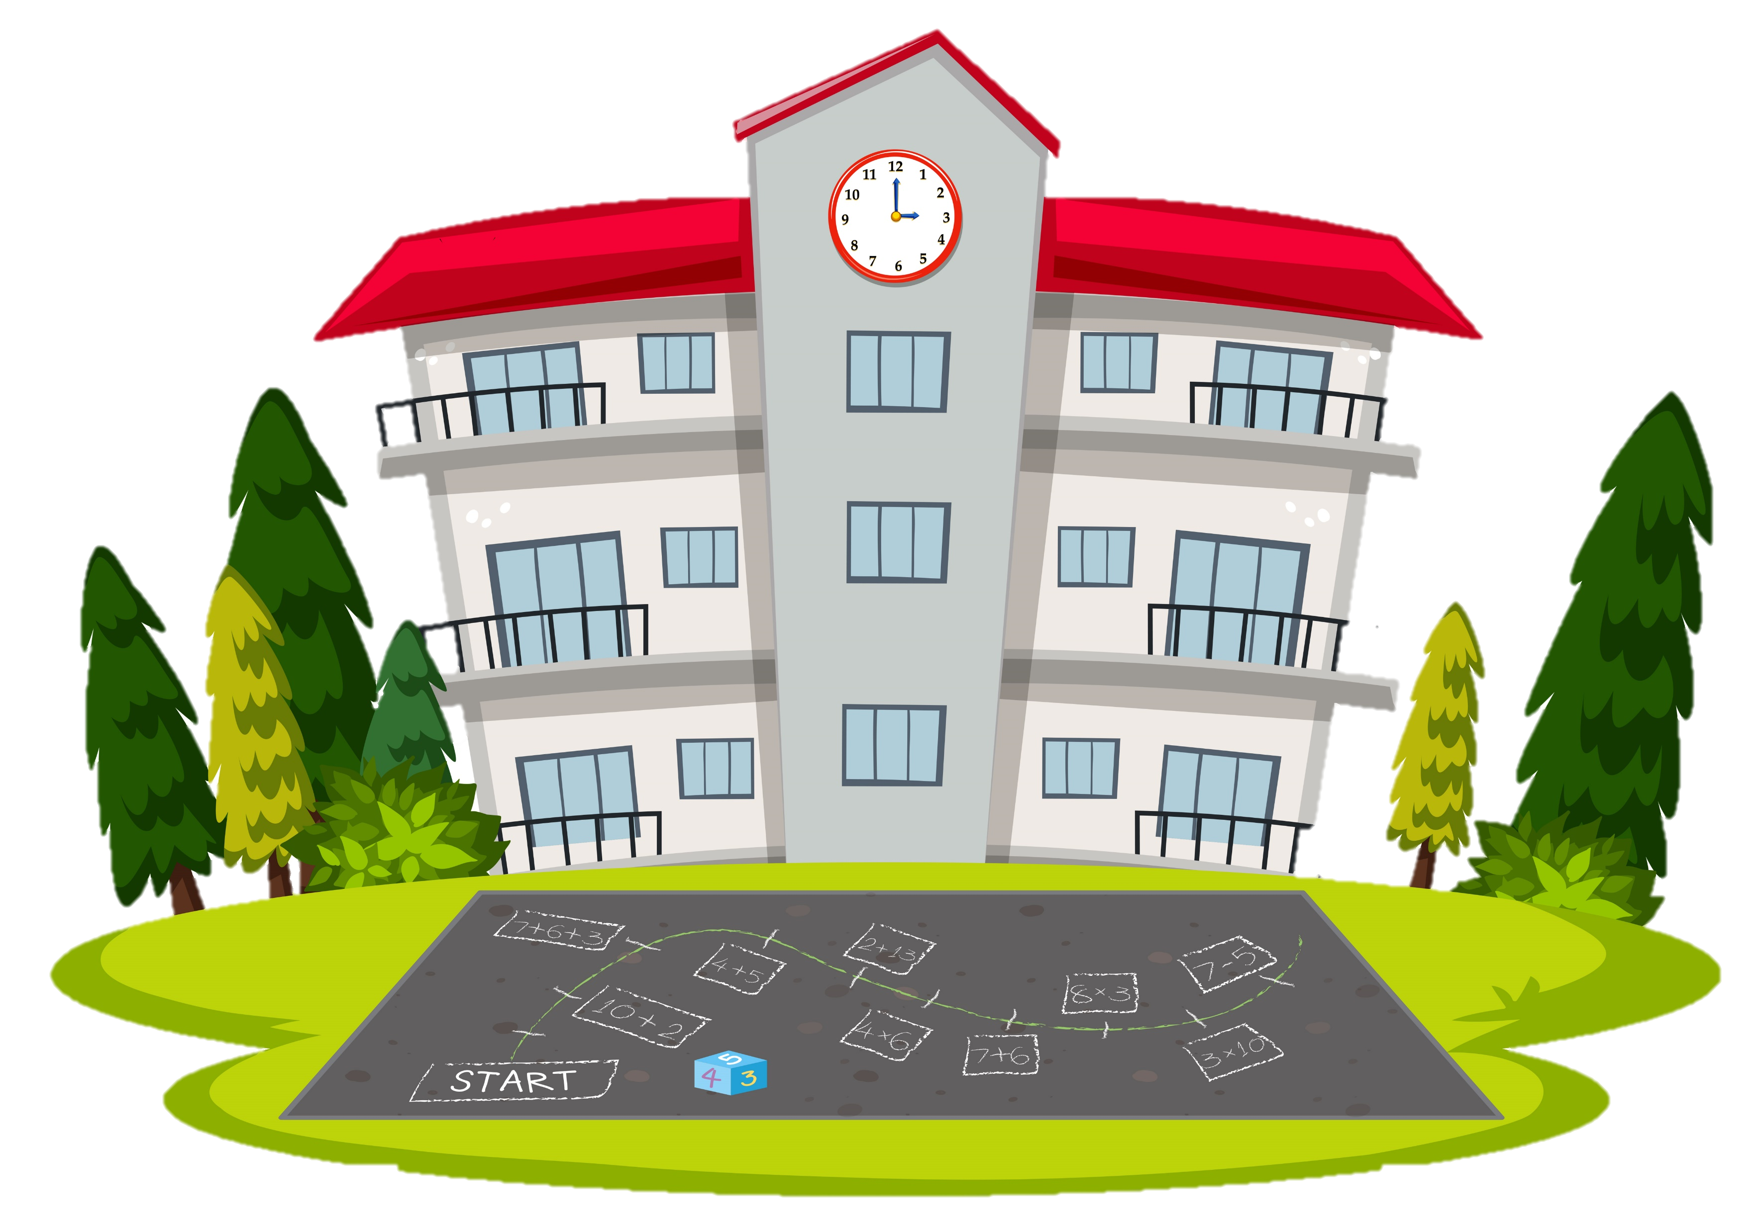



www.vk.com/egppt
NEXT
Make a question.
A bear ate our lunch.
Who ate our lunch?
How did their baby sleep at night?
Their baby slept well at night.
She went to school.
Where did she go?
He bought a house.
What did he buy?

Slide 2
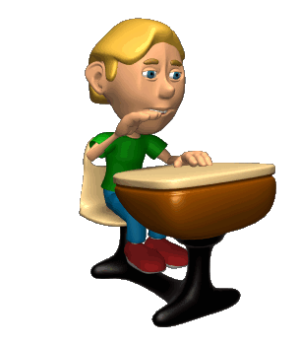


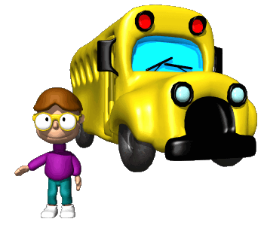
www.vk.com/egppt
NEXT
Make a question.
He wanted to answer.
What did he want?
Where was she?
She was at school.
What did he wait?
He went to the doctor because he felt ill.
He waited for a bus.
Why did he go to the doctor?

Slide 3
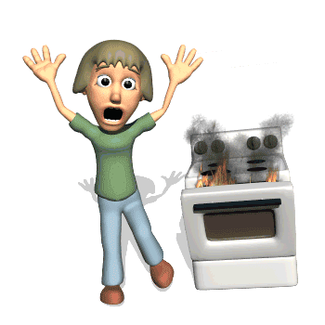
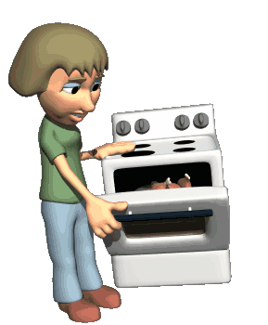
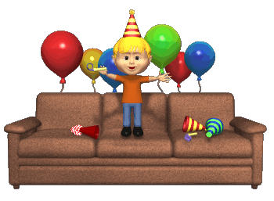
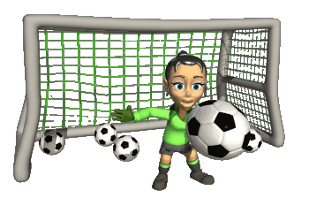
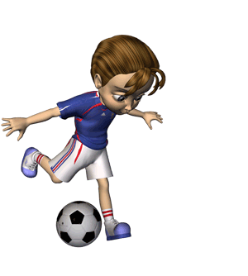
www.vk.com/egppt
NEXT
Make a question.
She wanted to cook dinner.
What did she want to cook?
She burnt dinner.
What did she do?
When did they play football?
He celebrated his birthday at home.
They played football after school.
Where did he celebrate his birthday?

Slide 4

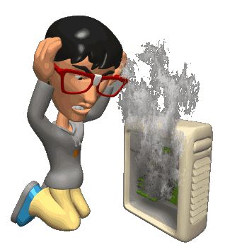

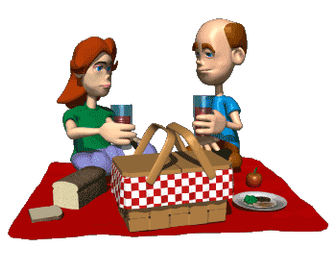

www.vk.com/egppt
Make a question.
Why was he angry?
Where was she?
He was angry because of his computer.
She was at work.
What was the weather like?
The weather was good.
When did he see a ghost?
He saw a ghost last week.

