Slide 1





IrinaPapakhinac

Slide 2

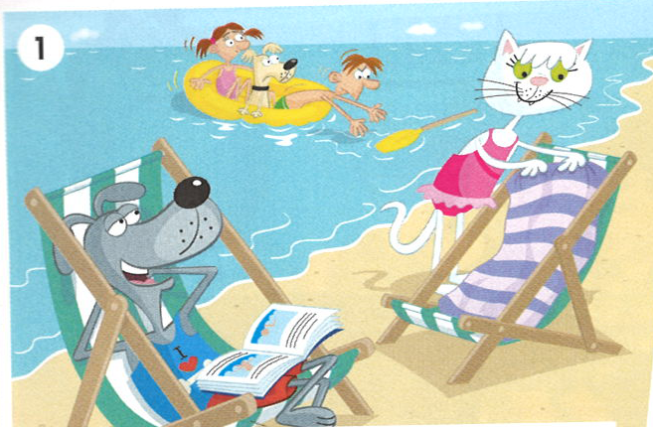
Look at the pictures.
Where are Dug and Kit?
2. Dug is a superhero.
GUESS
What can he do?
IrinaPapakhinac

Slide 3
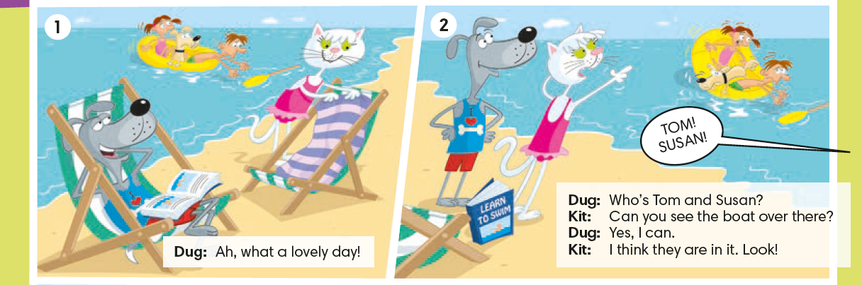

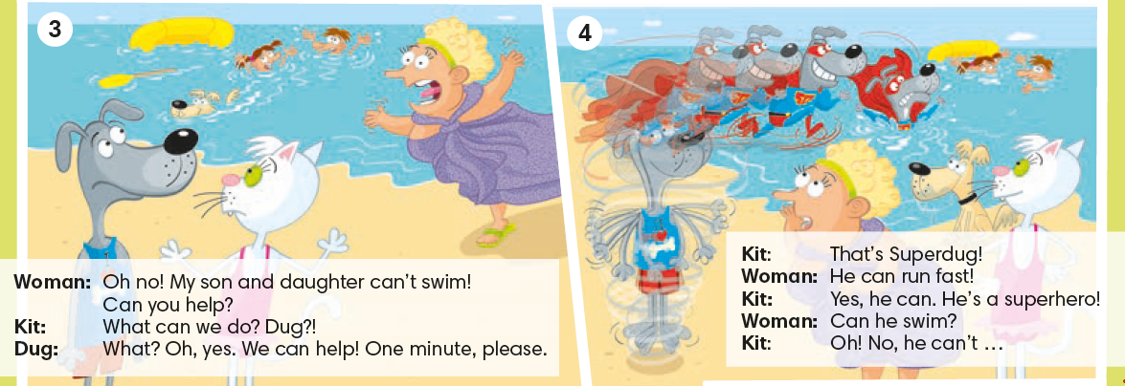
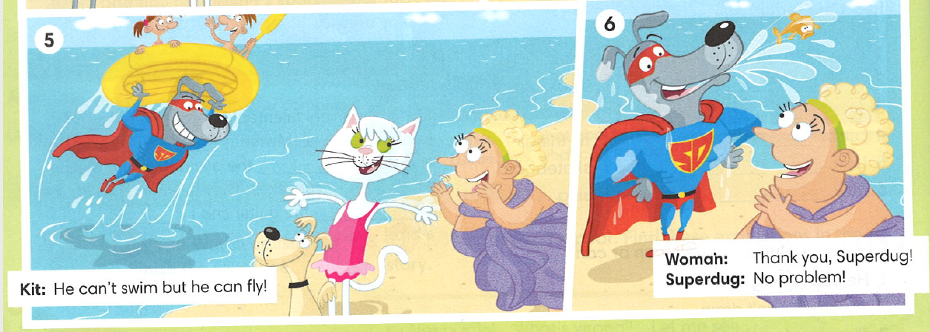
Read the cartoon and check your answers.
IrinaPapakhinac

Slide 4

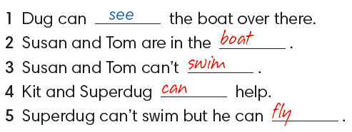

IrinaPapakhinac

Slide 5
Complete the sentences.
Picture 2
Kit: _____ you see a boat over there?
Dug: Yes, I _____ .
Picture 4
Woman: _____ he swim?
Kit: Oh! No, he _____ …
Can
can
Can
can’t
IrinaPapakhinac

Slide 6
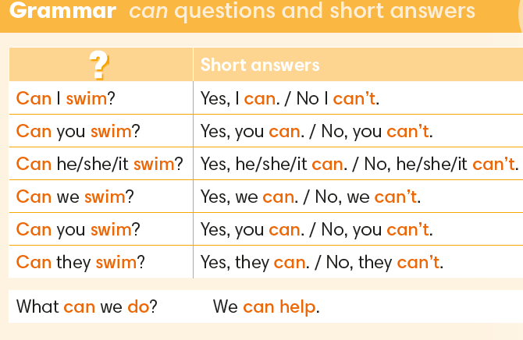
IrinaPapakhinac

Slide 7
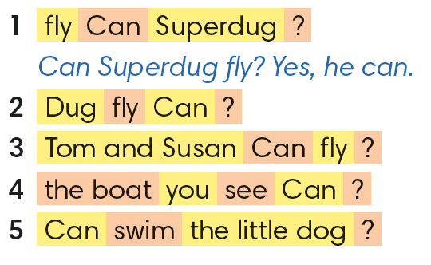
Make questions and give short answers.
2.Can Dug fly?
Yes, he can.
3. Can Tom and Susan fly?
No, they can’t.
4. Can you see a boat?
Yes, I / we can.
5. Can the little dog swim?
Yes, it can.
IrinaPapakhinac

Slide 8

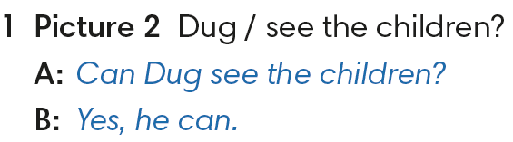
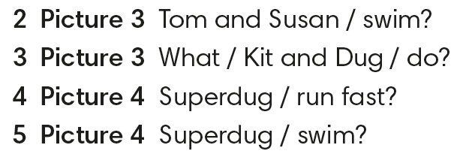
IrinaPapakhinac

Slide 9
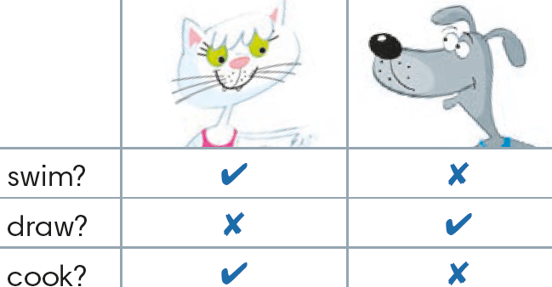
1. Ask and answer questions about Kit and Dug.
2. Say what Kit and Dug can / can/t do.
IrinaPapakhinac

Slide 10
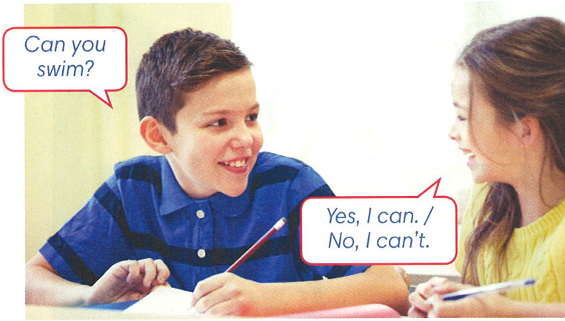

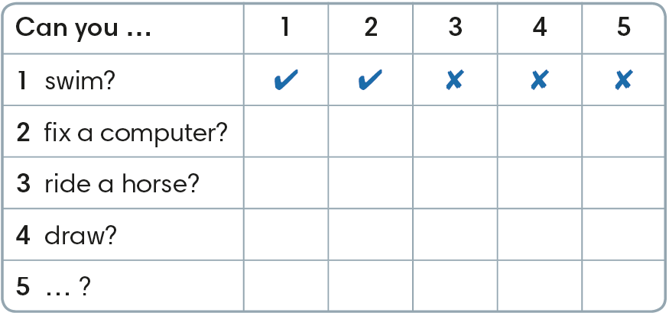

IrinaPapakhinac

Slide 11

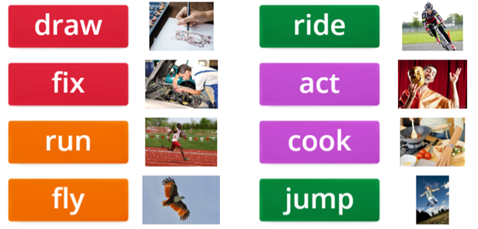
Listen to the rap and tick the activities that you can hear.
Can you do these activities?
IrinaPapakhinac

Slide 12
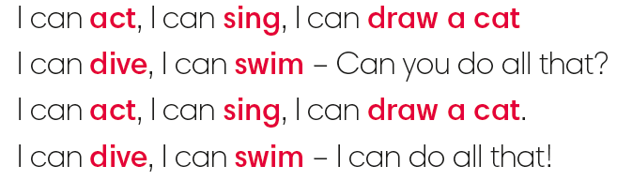
Sing the Activities Rap.
IrinaPapakhinac

Slide 13
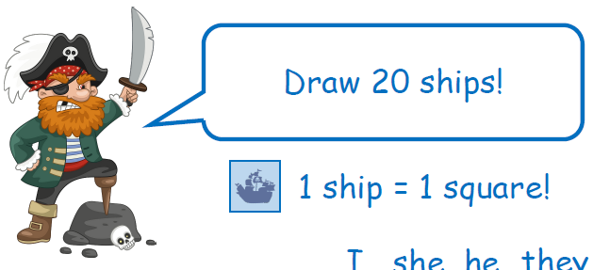
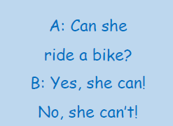
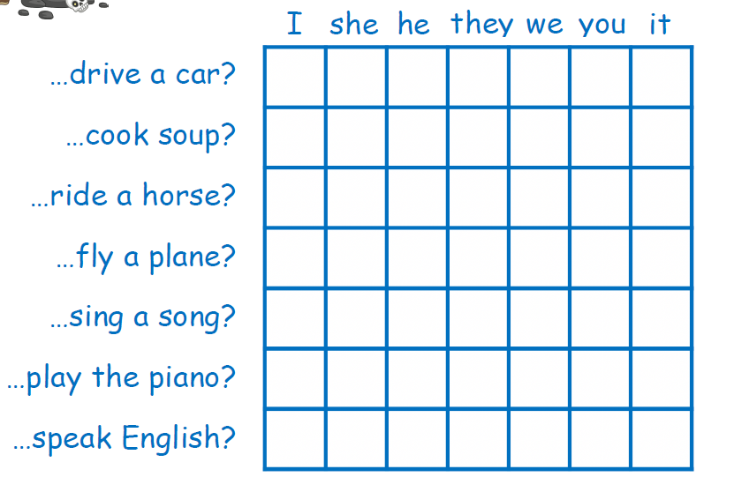

Find 20 ships!
IrinaPapakhinac

Slide 14
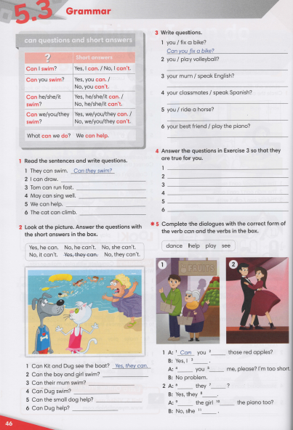


IrinaPapakhinac

Slide 15
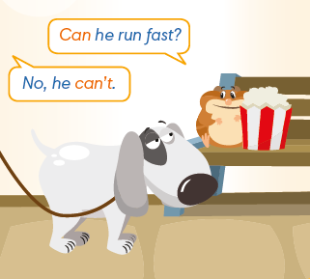

Look at the picture.
What can’t the dog do?
GUESS
2. What can the dog do?
Watch the video and check your answers.
IrinaPapakhinac

Slide 16
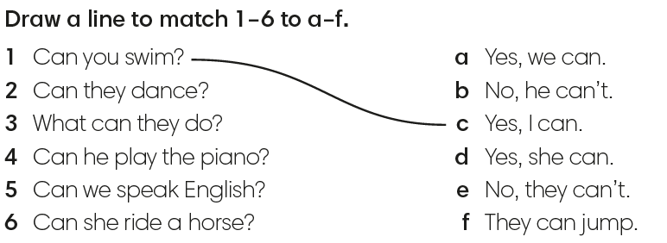
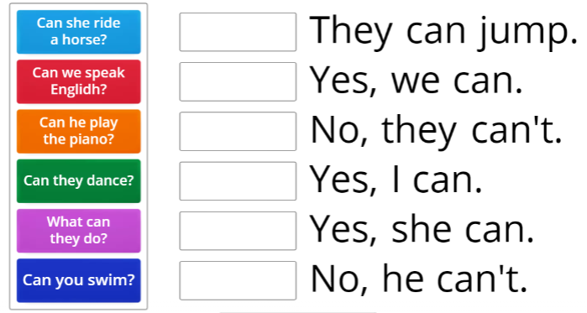
IrinaPapakhinac

Slide 17
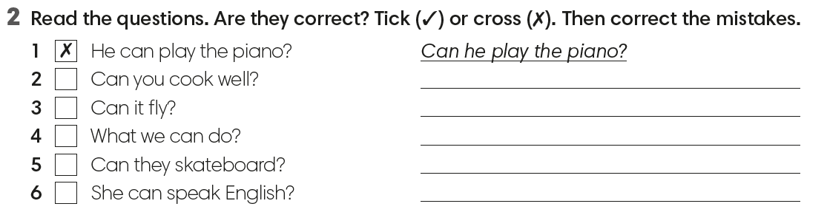


What can they do?
Can she speak English?
IrinaPapakhinac

Slide 18
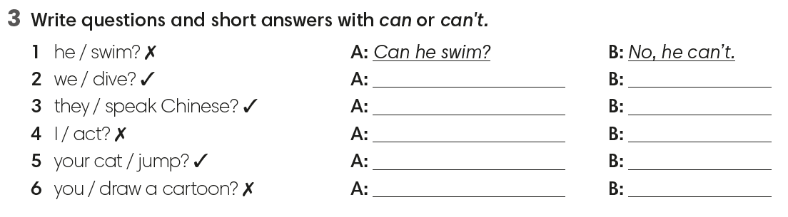
Can we dive?
Yes, we can.
Can they Speak Chinese?
Yes, they can.
Can I act?
No, you can’t.
Can your cat jump?
Yes, it can.
Can you draw a cartoon?
No, I can’t.
IrinaPapakhinac

Slide 19
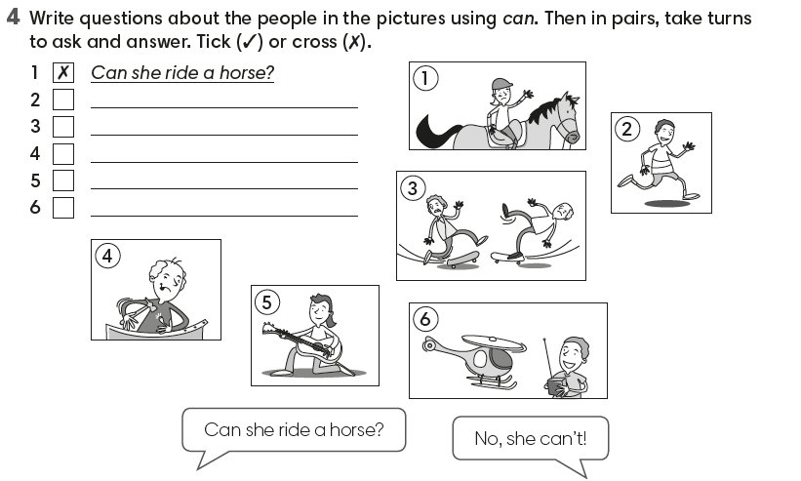
IrinaPapakhinac

