Slide 1
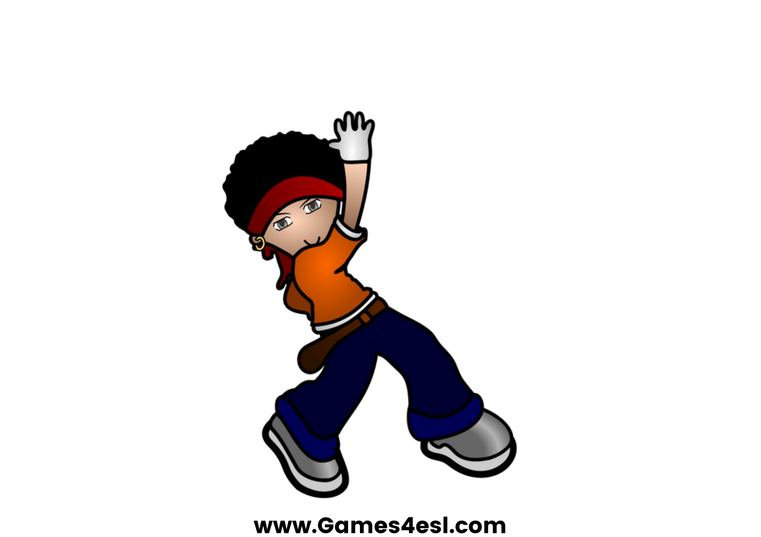
dance
SHOW

Slide 2

sing
SHOW

Slide 3
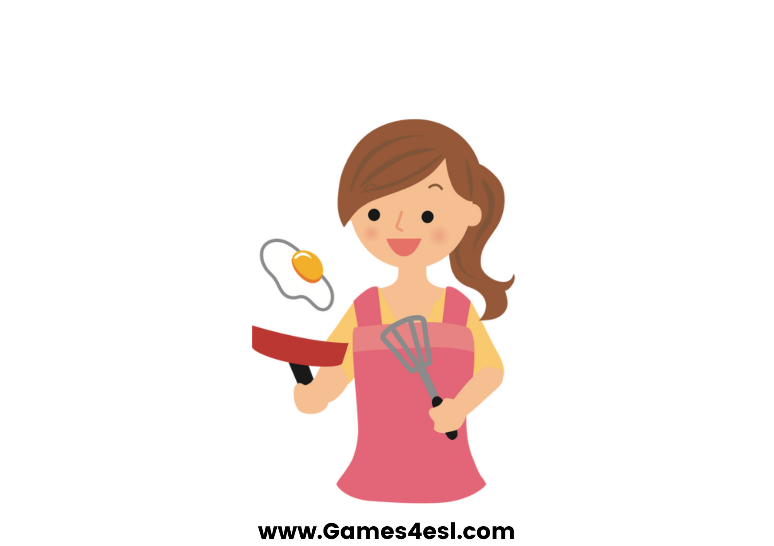
cook
SHOW

Slide 4
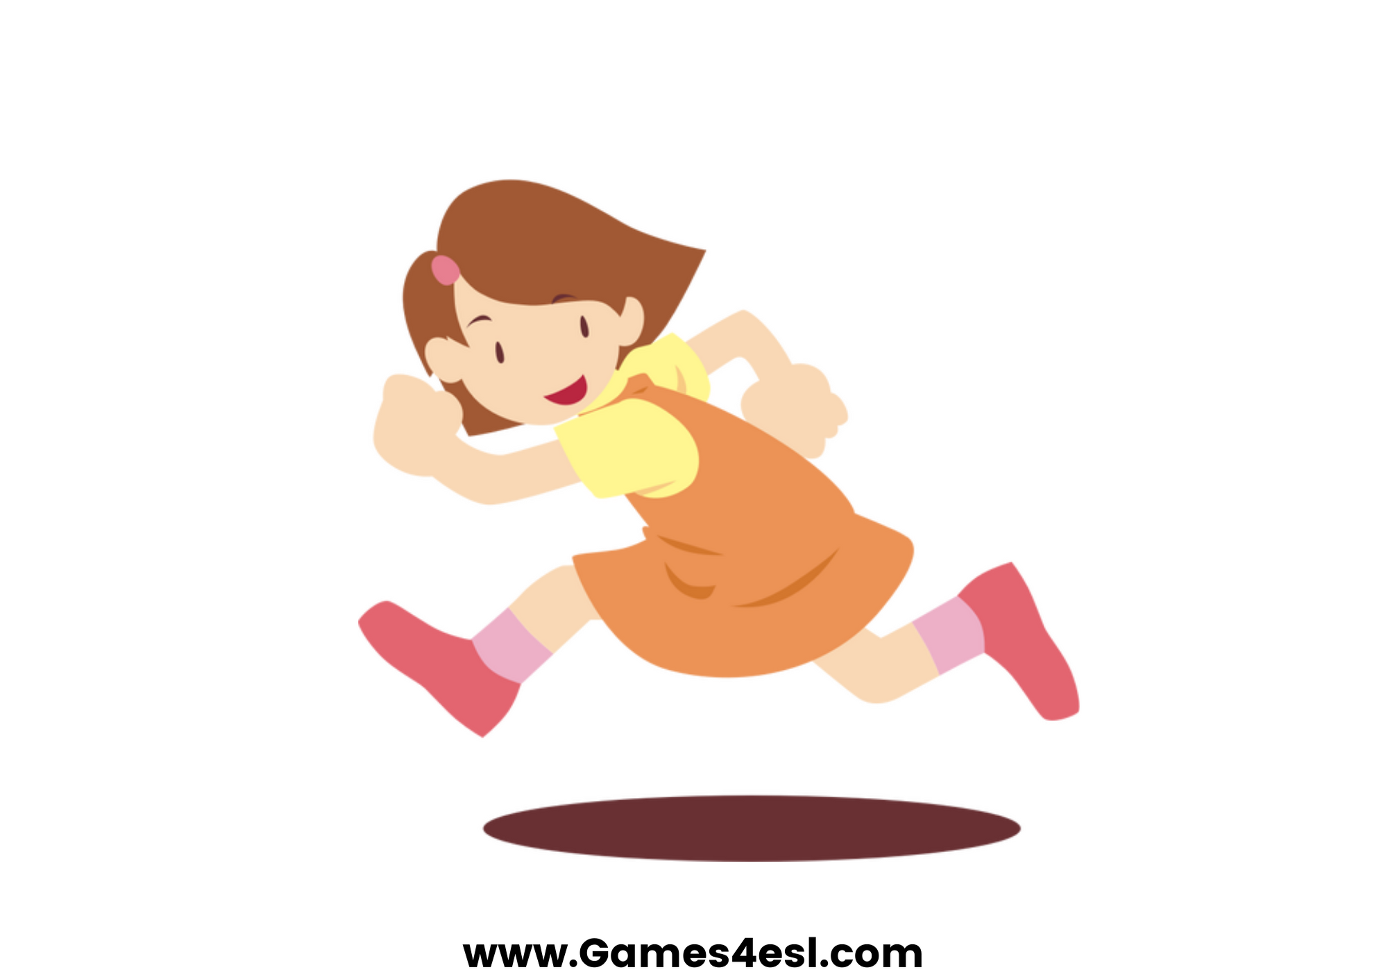
run
SHOW

Slide 5
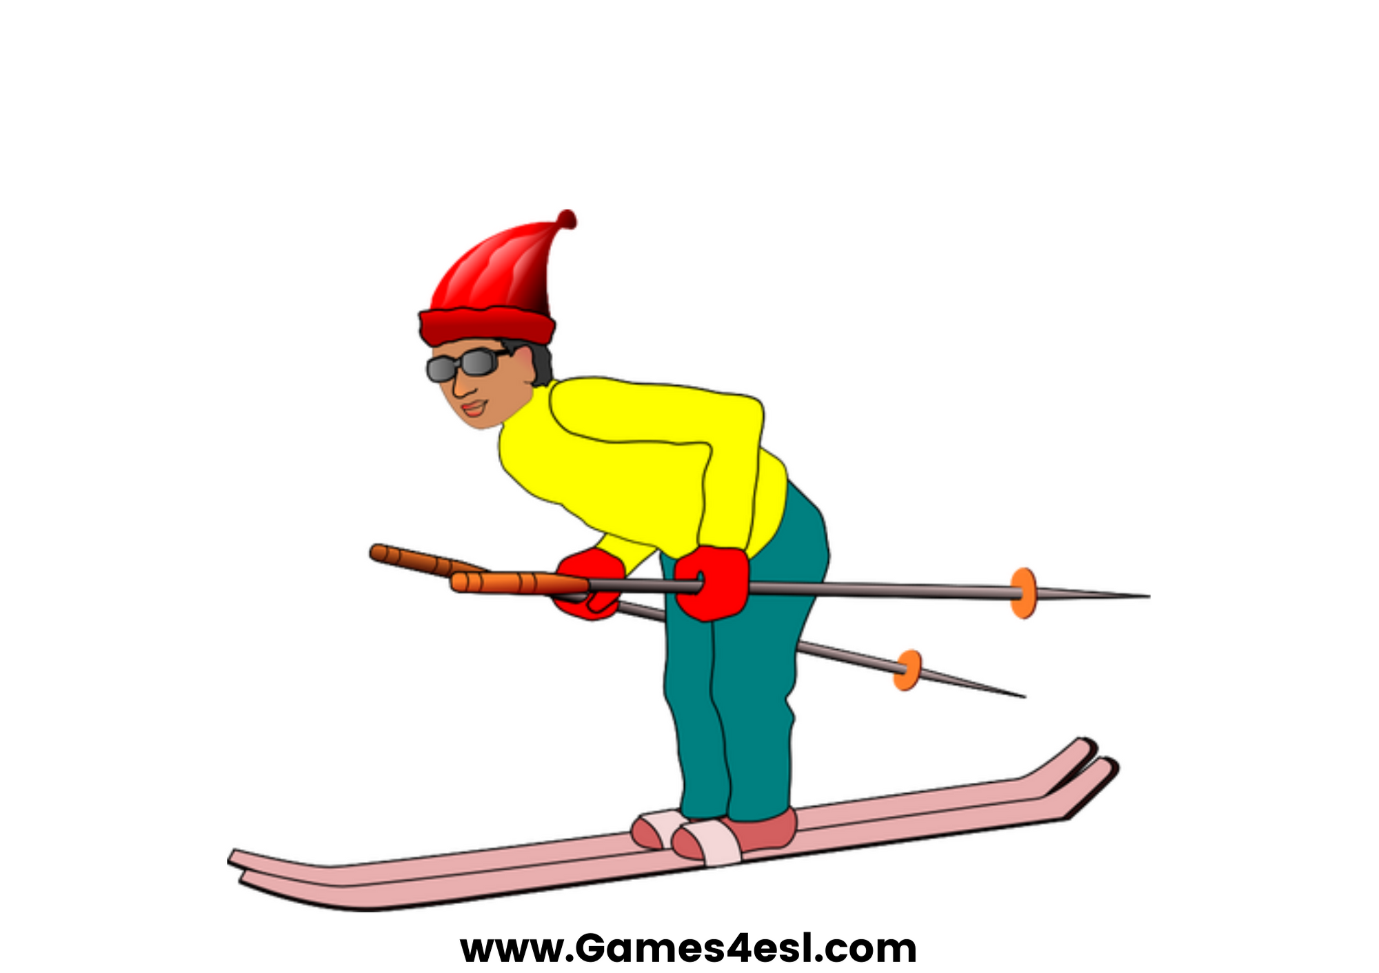
ski
SHOW

Slide 6
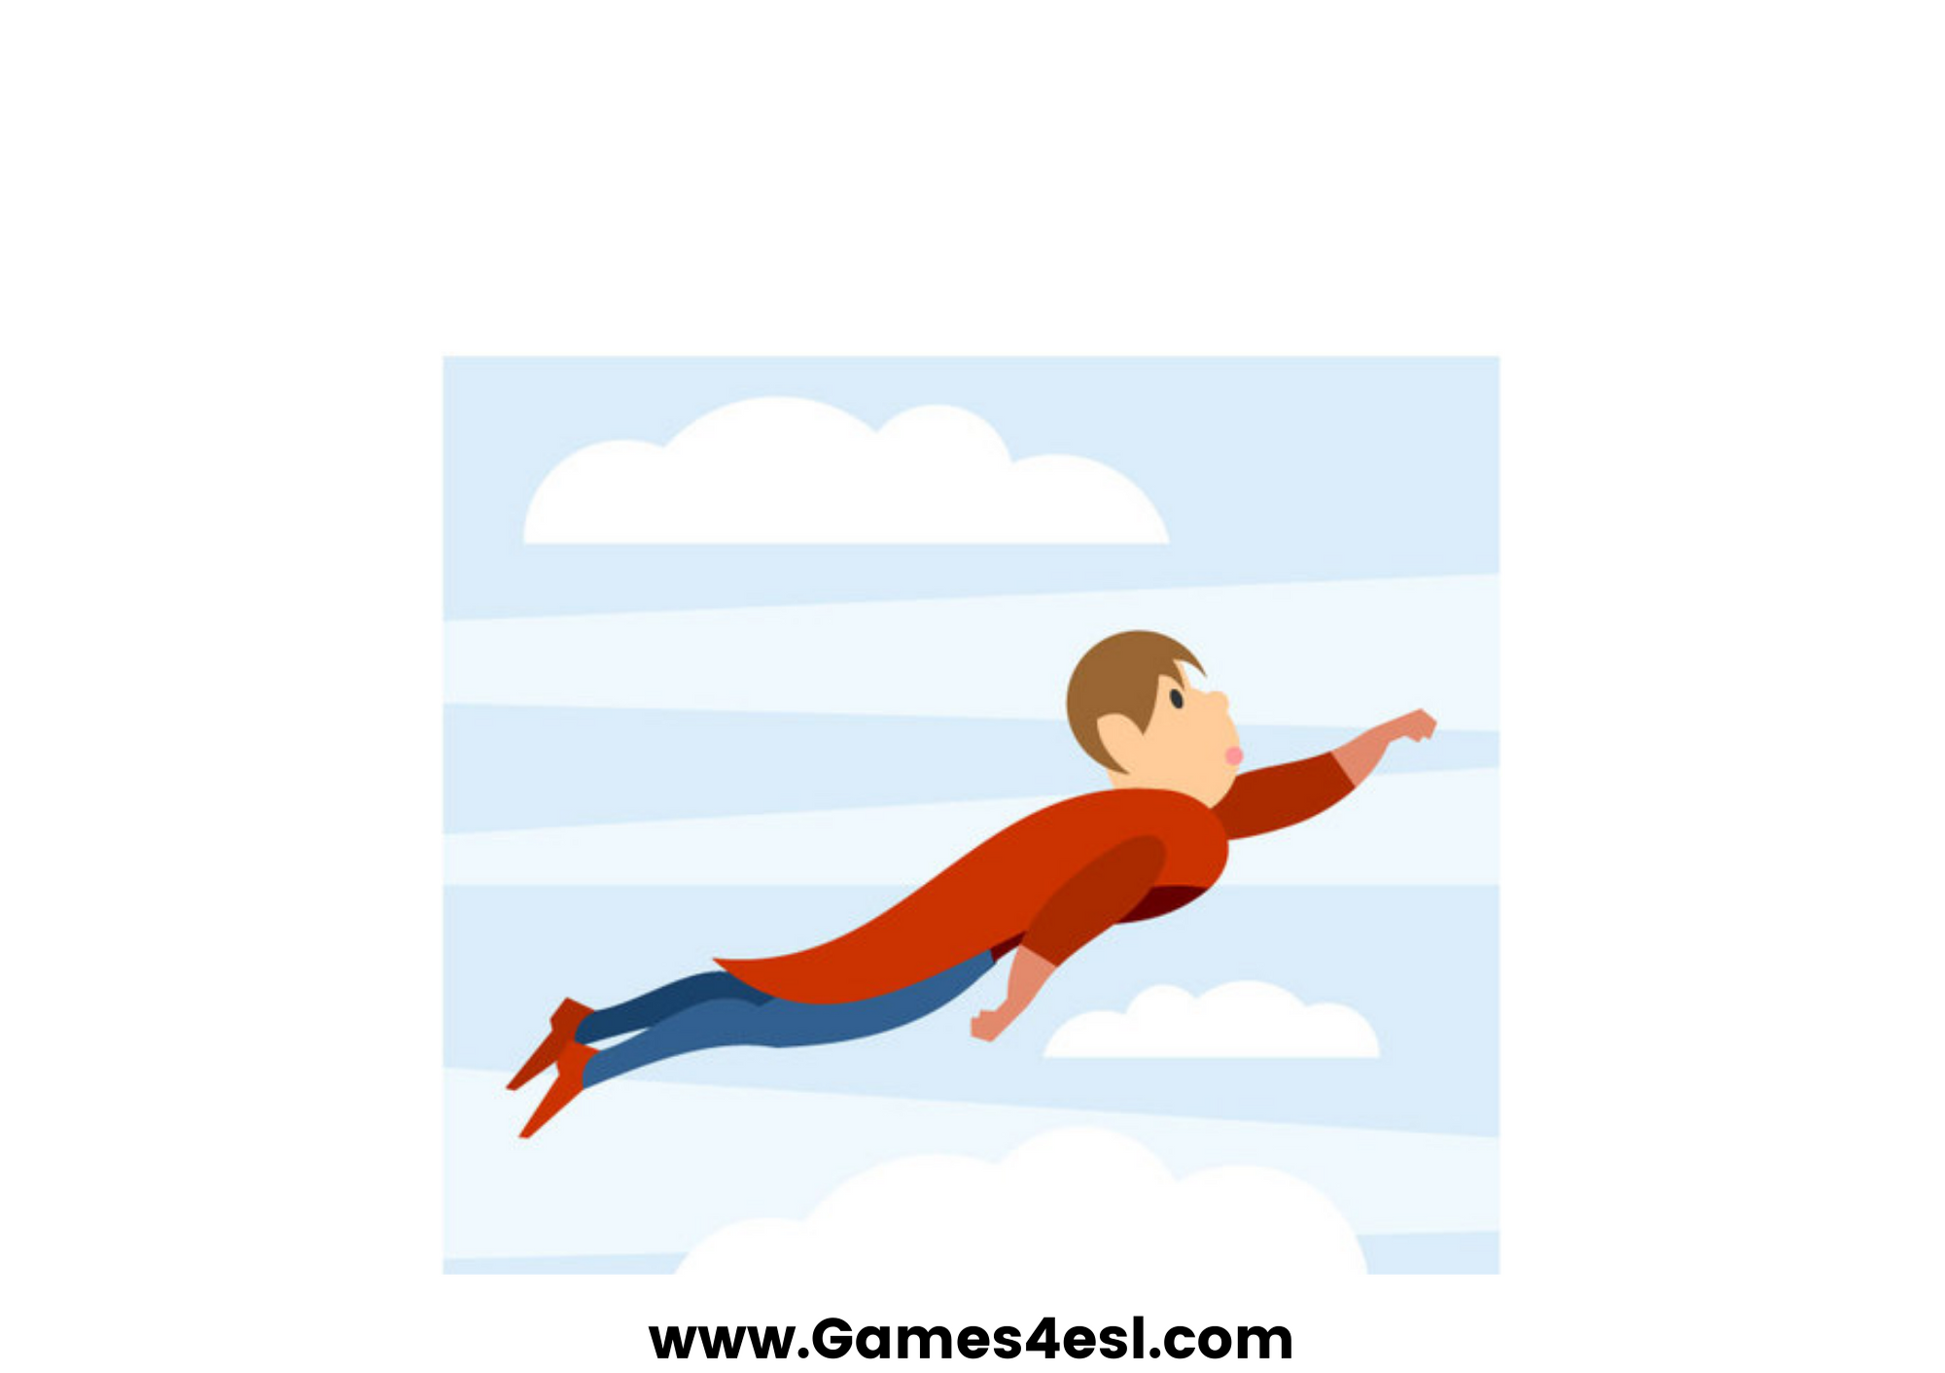
fly
SHOW

Slide 7
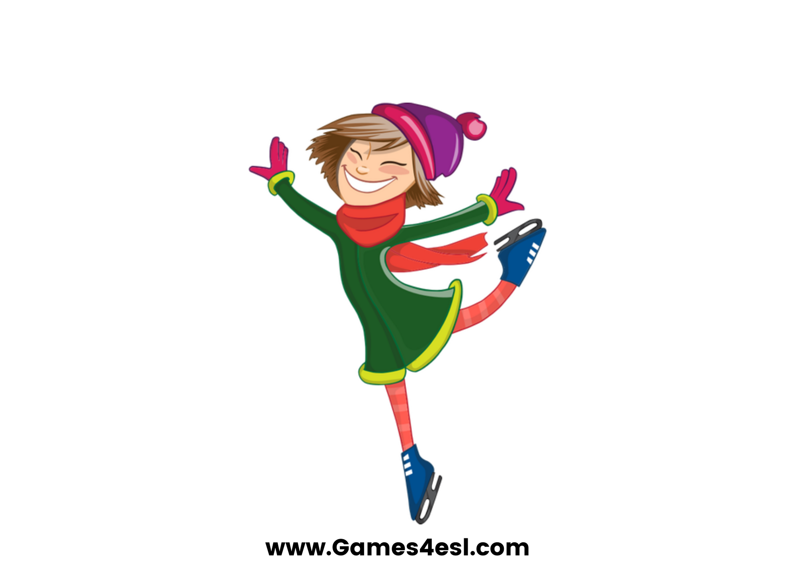
skate
SHOW

Slide 8
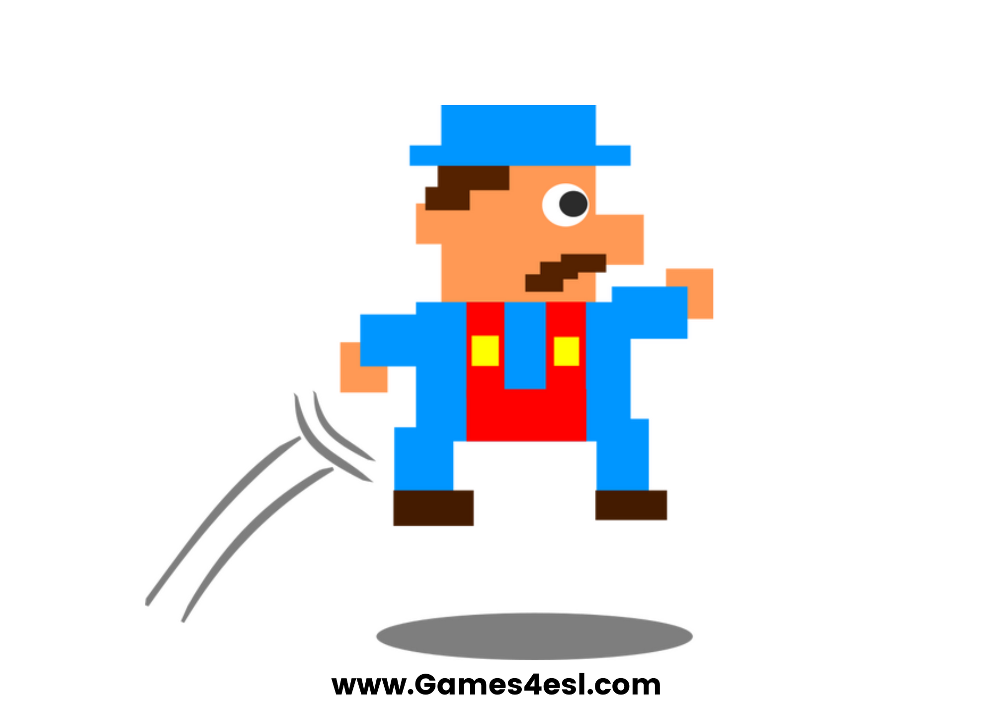
jump
SHOW

