Slide 1
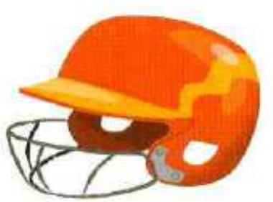
have to / I / a helmet / wear

Slide 2
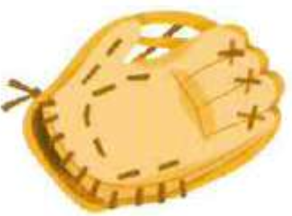
a glove / bring / He / has to

Slide 3
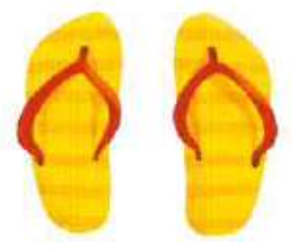
have to / don’t / You / flip flops / wear

Slide 4
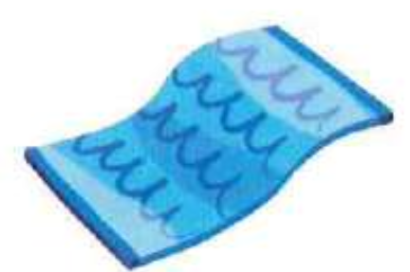
Liza / a towel / doesn’t / bring / have to

Slide 5
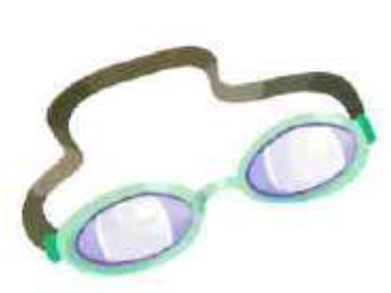
We / goggles / wear / have to

Slide 6
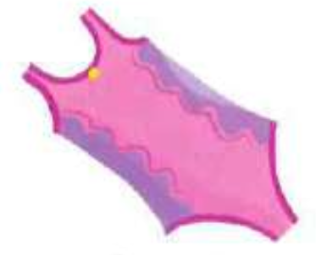
has to / Mary / a swimming costume / wear

Slide 7
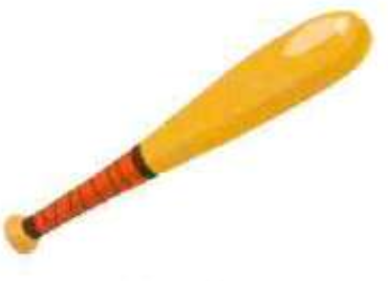
bats / bring / don’t / They / have to

Slide 8
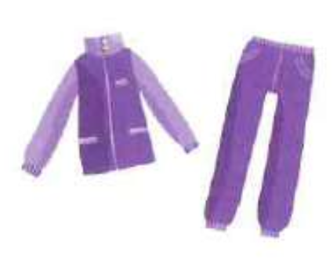
doesn’t / wear / have to / Ben / a tracksuit

Slide 9
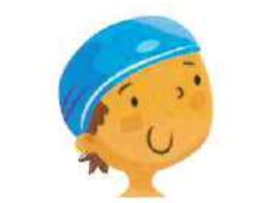
Bob/ wear / has to / a swimming cap

Slide 10
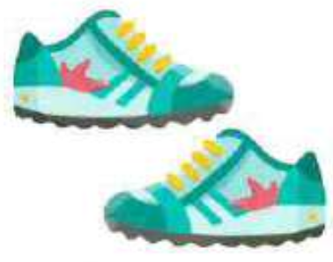
doesn’t / trainers / have to / wear / Liza

