Slide 1
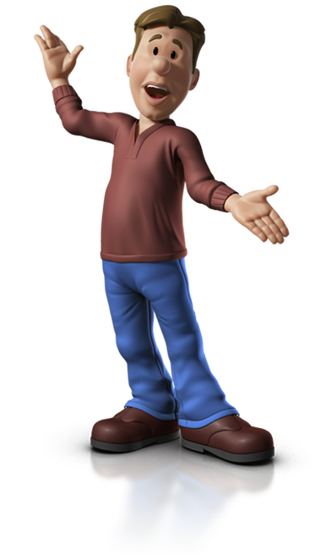

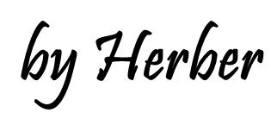
PRESENT SIMPLE AFFIRMATIVE

Slide 2
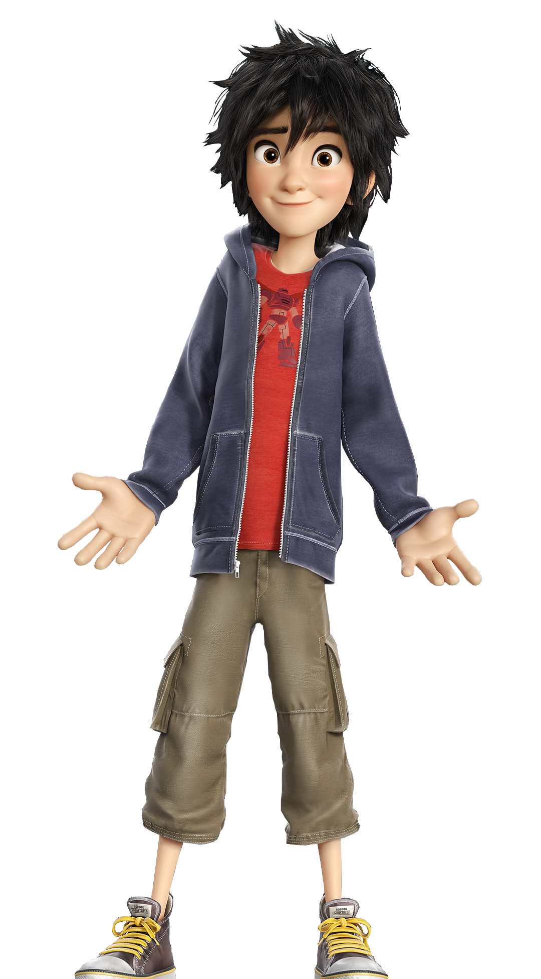
I am here

Slide 3
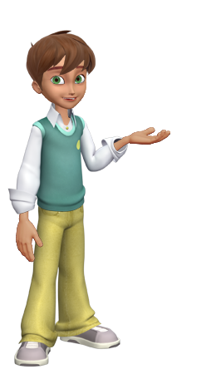
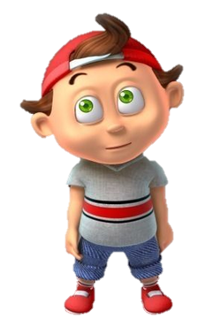
And you are there

Slide 4
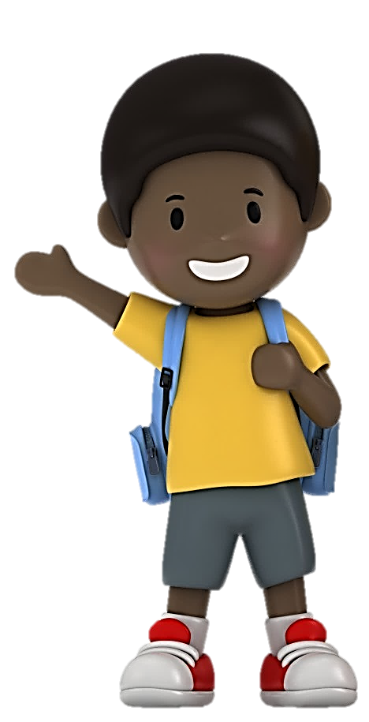
He is happy

Slide 5
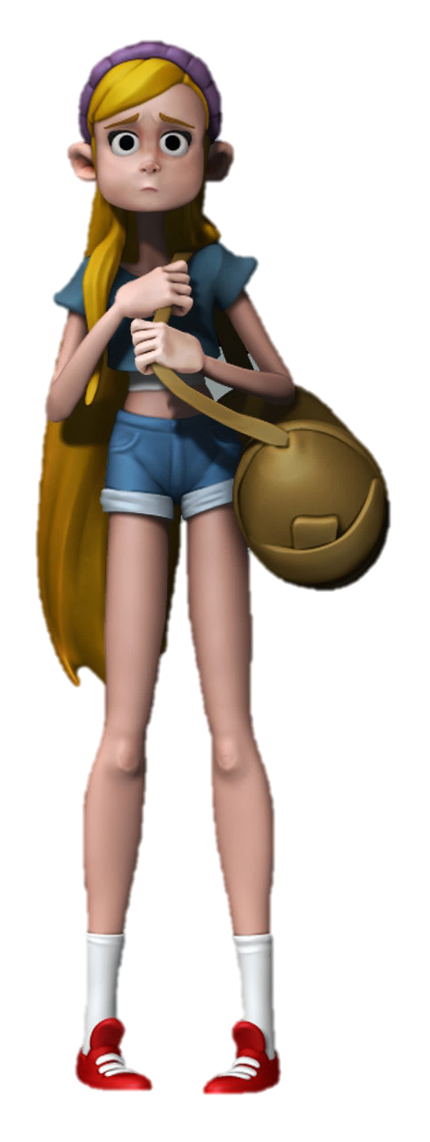
And she is sad

Slide 6
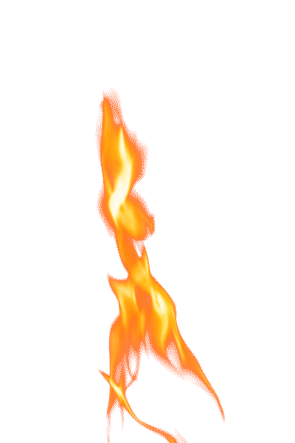
It is burning

Slide 7
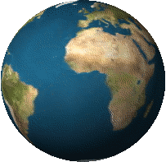
The world is turning

Slide 8
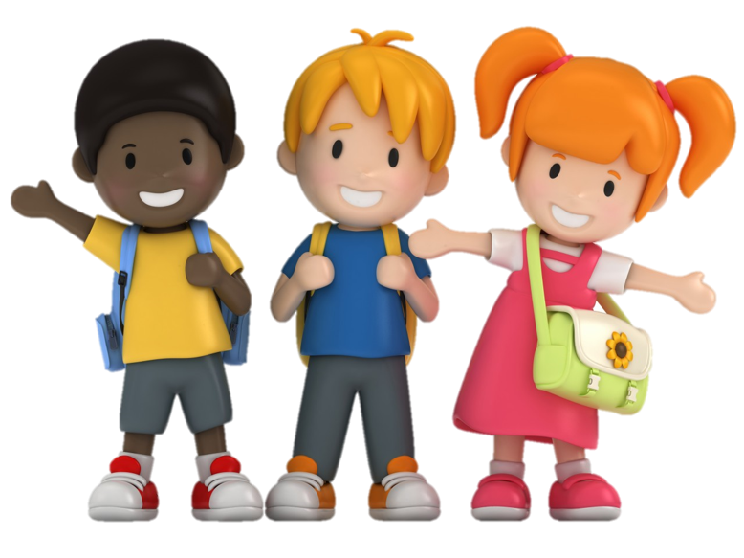
We are people

Slide 9
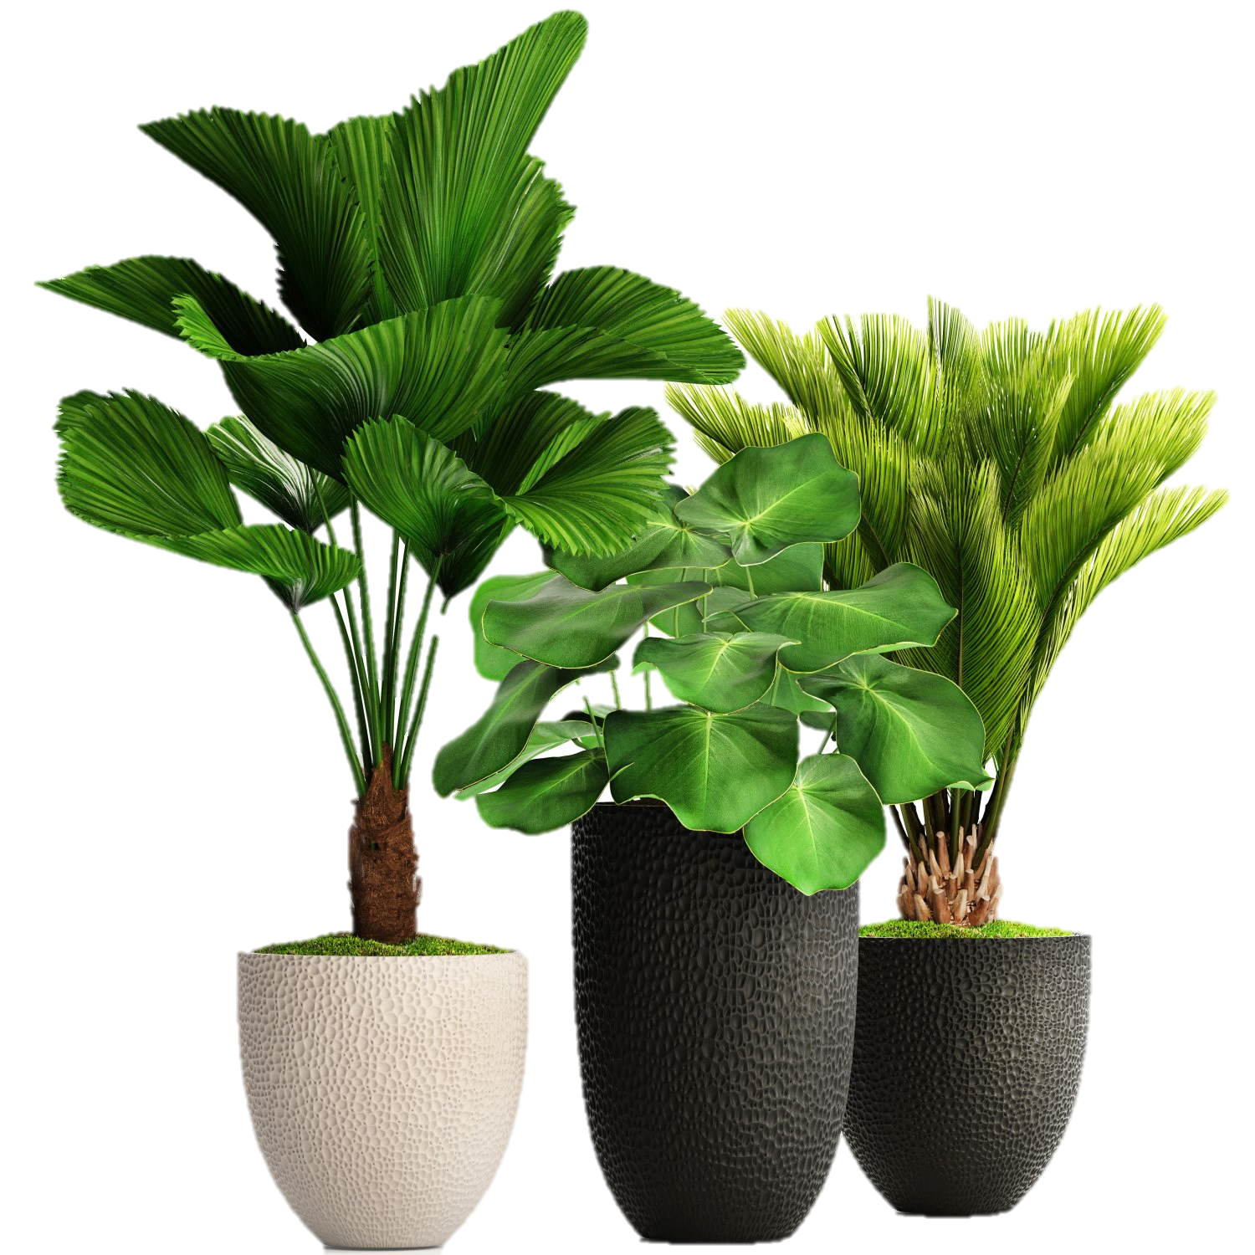
And they are plants

Slide 10
Fill in the gaps with the correct form of to be.
Click on the slide to check.
Click here if you want to listen to the song again

Slide 11
I ____ here
am

Slide 12

And you _____ there
are

Slide 13
He ___ happy
is

Slide 14
And she ___ sad
is

Slide 15
It ___ burning
is

Slide 16
The world ___ turning
is

Slide 17
We ___ people
are

Slide 18
You ___ people
are

Slide 19
And they _____ plants
are
Click here if you want to listen to the song again
EXIT

