Slide 1






Where’s
Giving directions

Slide 2
Mr. Sleuth is receiving
some instructions to investigate a case.
Look at the city map and guess where he is going to.

Slide 3
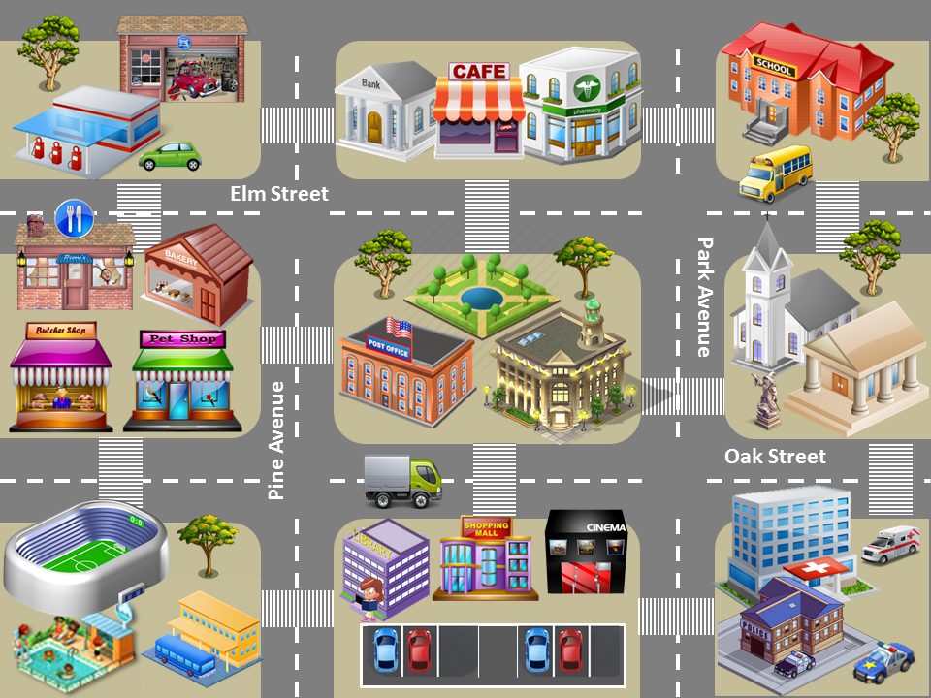

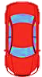

GAS STATION
Hill Road
MUSEUM
Lake Road
Go straight on Elm Street, pass the park, turn right on Park Avenue and turn left on Oak Street. Stop on the left, across from the hospital and next to the church.
CHECK
NEXT

Slide 4
SCHOOL
Hill Road
Lake Road
STADIUM
Go straight on Oak Street, pass the post office and the city hall, turn left on Park Avenue and turn right on Elm Street. Stop on the left, across from the church.
CHECK
NEXT

Slide 5
PHARMACY
Hill Road
Lake Road
SWIMMING POOL
Go straight on Elm Street, pass the café and the bank, turn left on Pine Street and turn right on Oak Street. Pass the pet shop and the buthcer shop. Turn left on Hill Road. Stop on the left next to the stadium.
CHECK
NEXT

Slide 6
GARAGE
Hill Road
Lake Road
HOSPITAL
Go straight on Oak Street, pass the cinema and the shopping mall, turn right on the corner of the post office, go straight on Pine Avenue, and cross Elm Street. It’s on the left across from the bank behind the gas station.
CHECK
NEXT

Slide 7
RESTAURANT
Hill Road
Lake Road
POLICE STATION
Go straight on Elm Street, turn right on Pine Avenue, turn left on Oak Street and turn right on Park Avenue. It’s next to the hospital across from the car park.
CHECK
NEXT

Slide 8
SCHOOL
Hill Road
Lake Road
BUS STATION
Go straight on Lake Road. Turn right on the corner of the museum. Go straight on Oak Street. Cross Park Avenue and pass the town hall and the post office. Turn left on Pine Avenue. Pass the library. It’s across from the car park.
CHECK
EXIT

