Slide 1



IrinaPapakhinac

Slide 2


1. Which pets are popular in your country?
2. Do you know any unusual pets? What are they?
3. Would you like to have an exotic animal as a pet?
IrinaPapakhinac

Slide 3
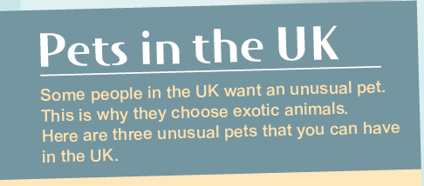

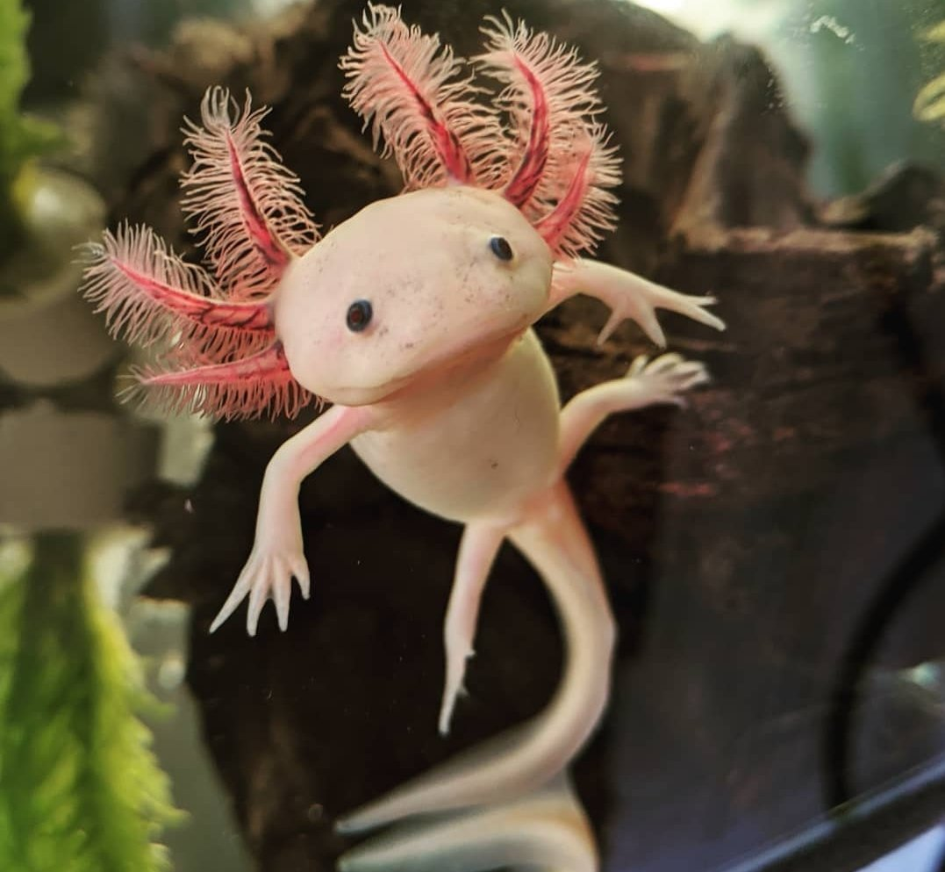
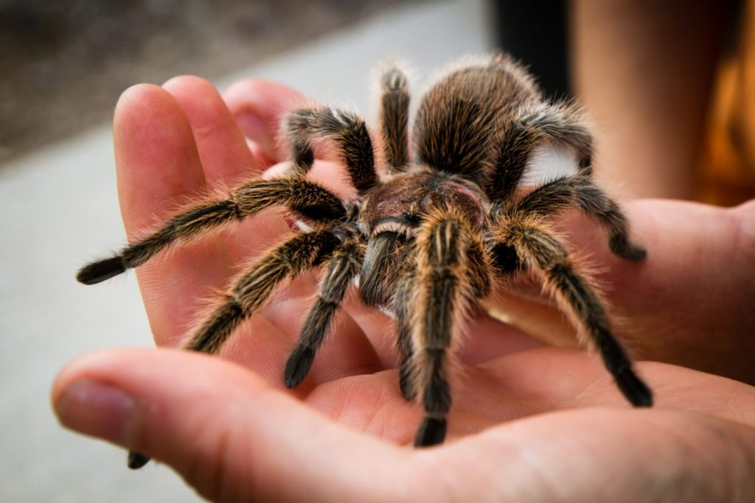
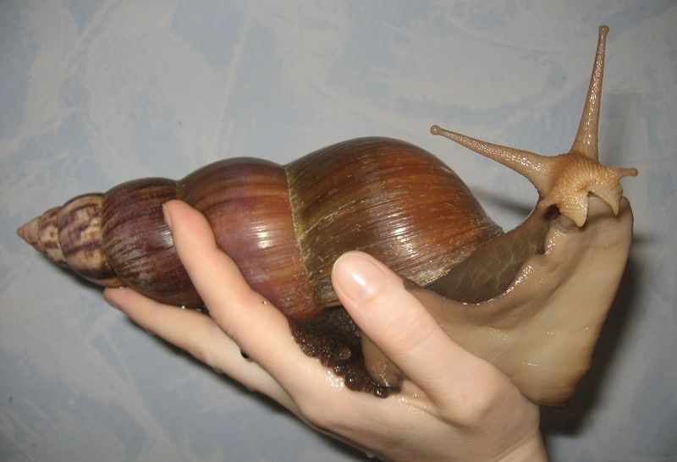
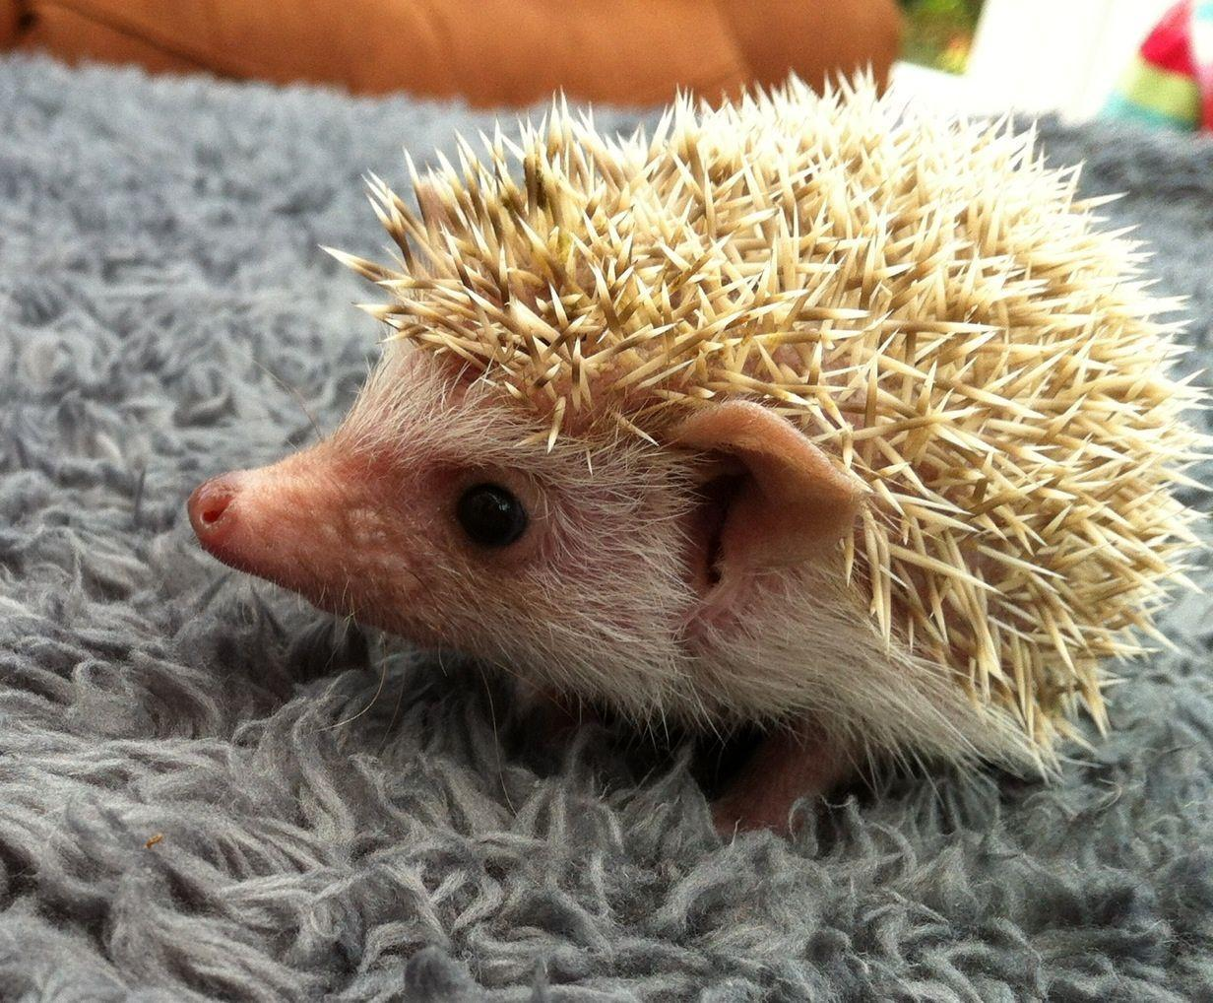

Listen and tick the pictures with pets that people have on the UK.
A
B
C
D
IrinaPapakhinac

Slide 4
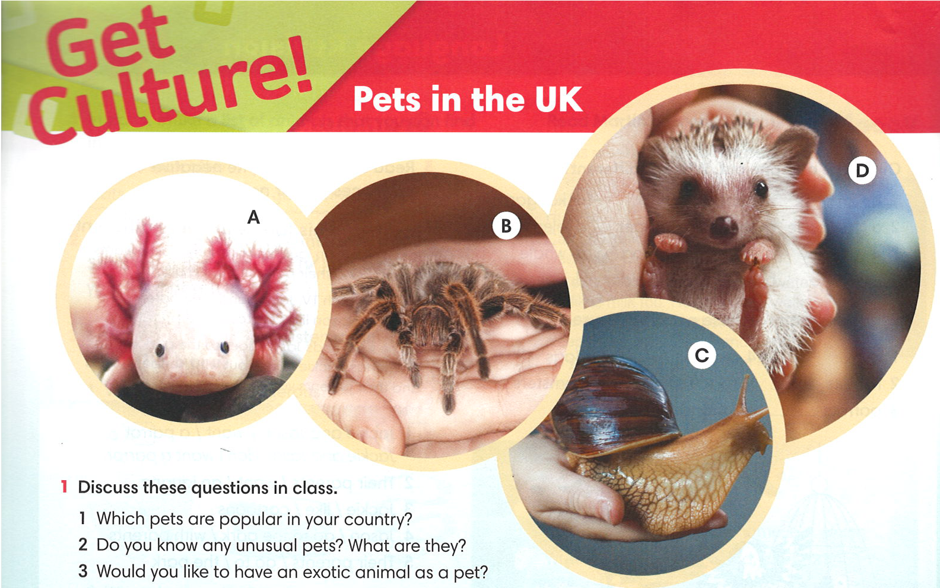
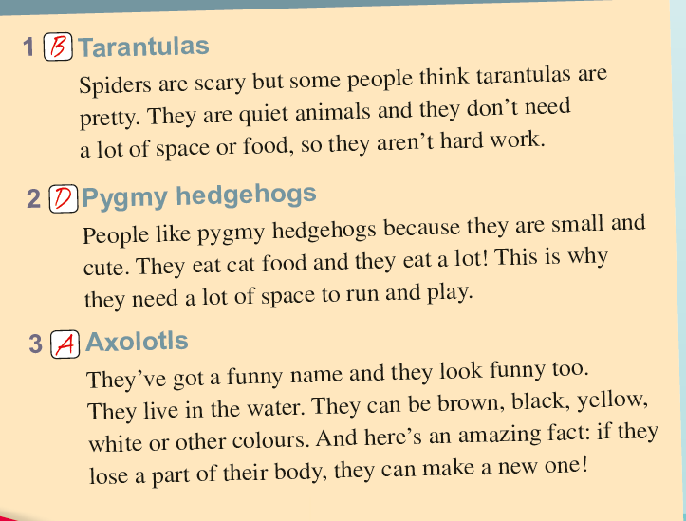
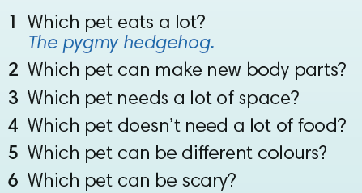
Read the text and answer the questions.
IrinaPapakhinac

Slide 5
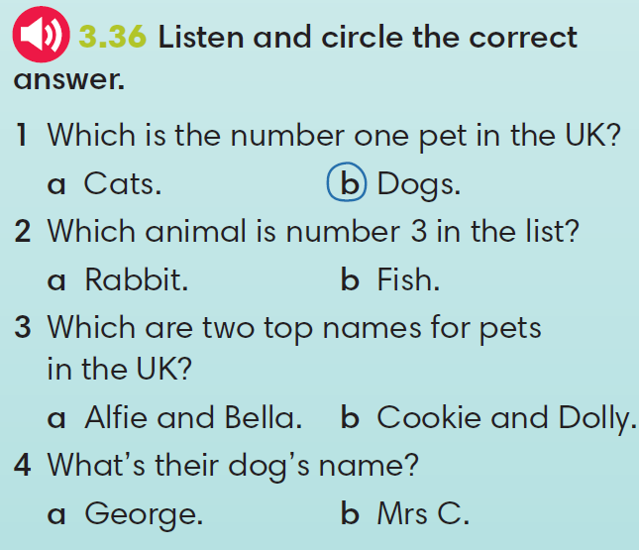
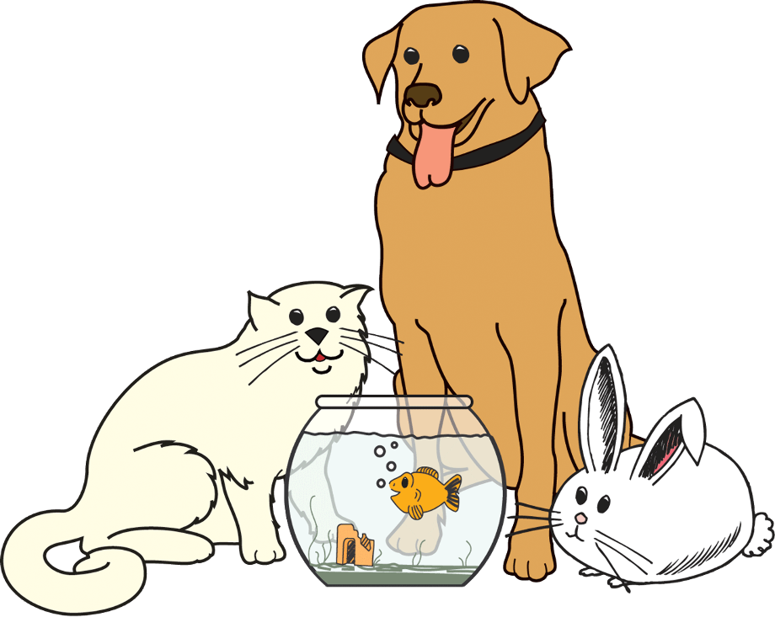
IrinaPapakhinac

Slide 6
A
B
C
D
Imagine you can have one of the animals in the photos A-D.
Which of the animals would you choose? Why?
Think of a name for your animal.
IrinaPapakhinac

Slide 7


GUESS: What animals will you see in the film?
IrinaPapakhinac

Slide 8
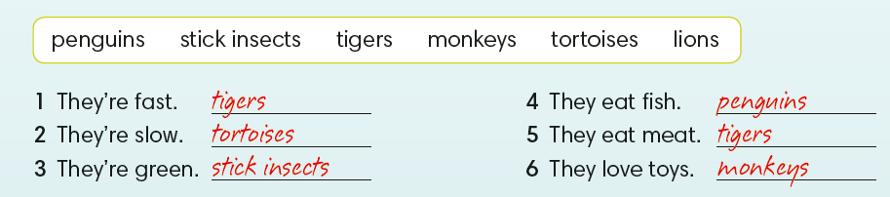
What animals are these sentences about?
IrinaPapakhinac

Slide 9
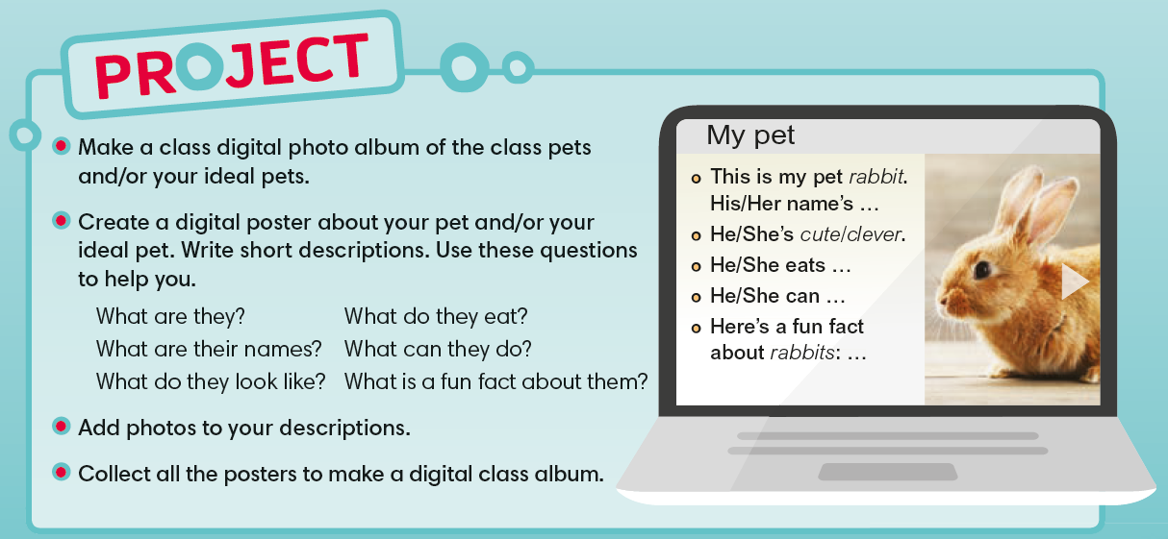
IrinaPapakhinac

Slide 10
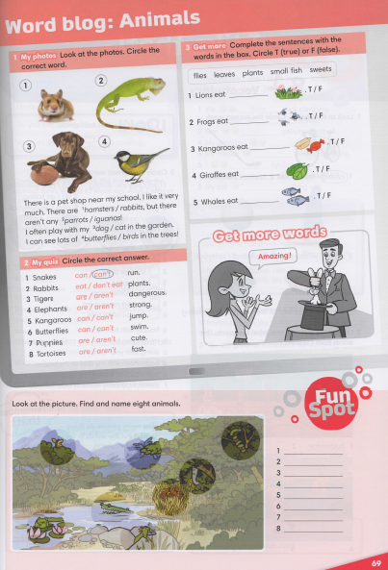


IrinaPapakhinac

