Slide 1
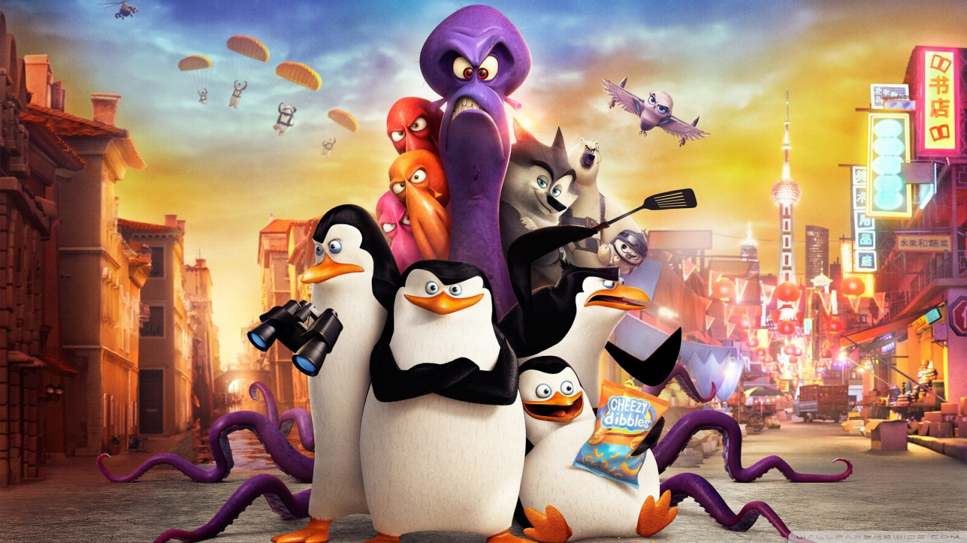



IrinaPapakhinac

Slide 2

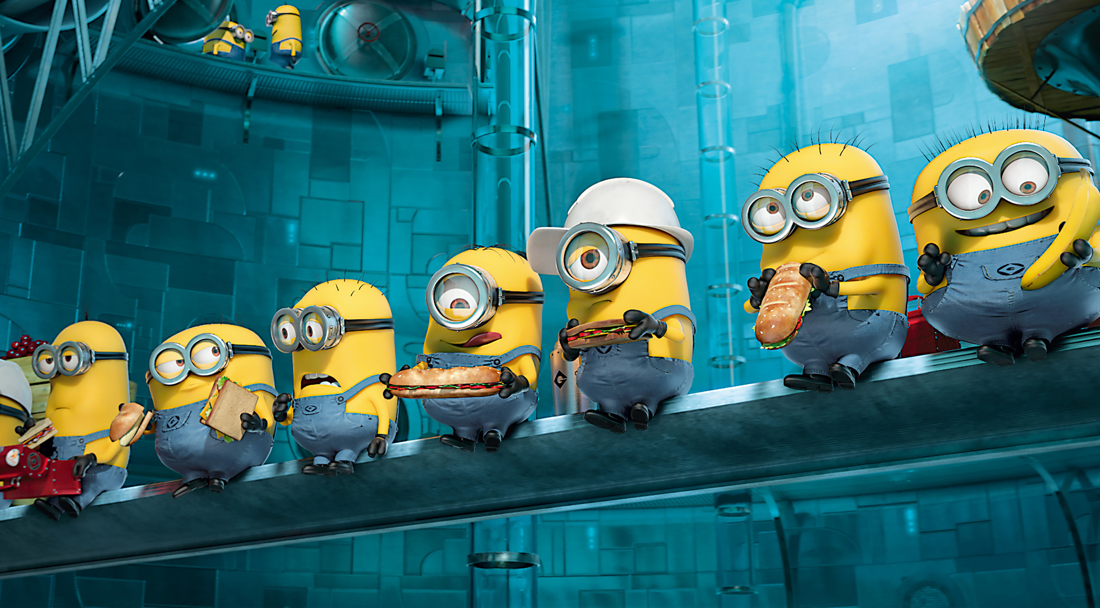

1. Do you like watching cartoons?
2. Who is your favourite cartoon character?
3. Is he/she funny / friendly / helpful / clever?
IrinaPapakhinac

Slide 3

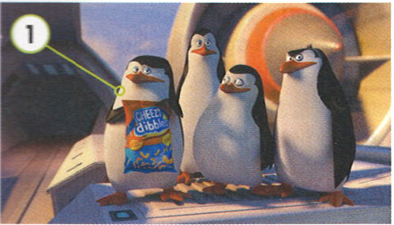
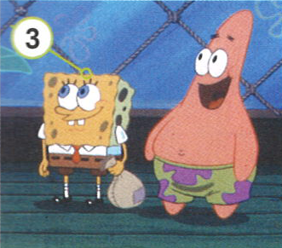
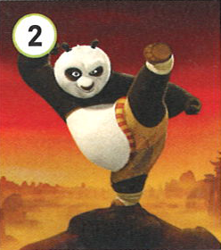
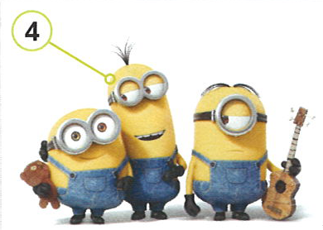
Do you know these cartoons characters?
Penguins of Madagascar
Skipper, Kowalski, Private, Rico
The Spongebob Movie
Spongebob Squarepants,
Patrick Star
Kung Fu Panda 3
Po
Minions
Bob, Kevin, Stuart
IrinaPapakhinac

Slide 4

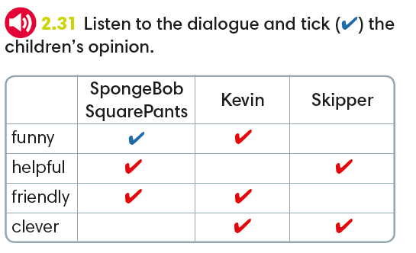
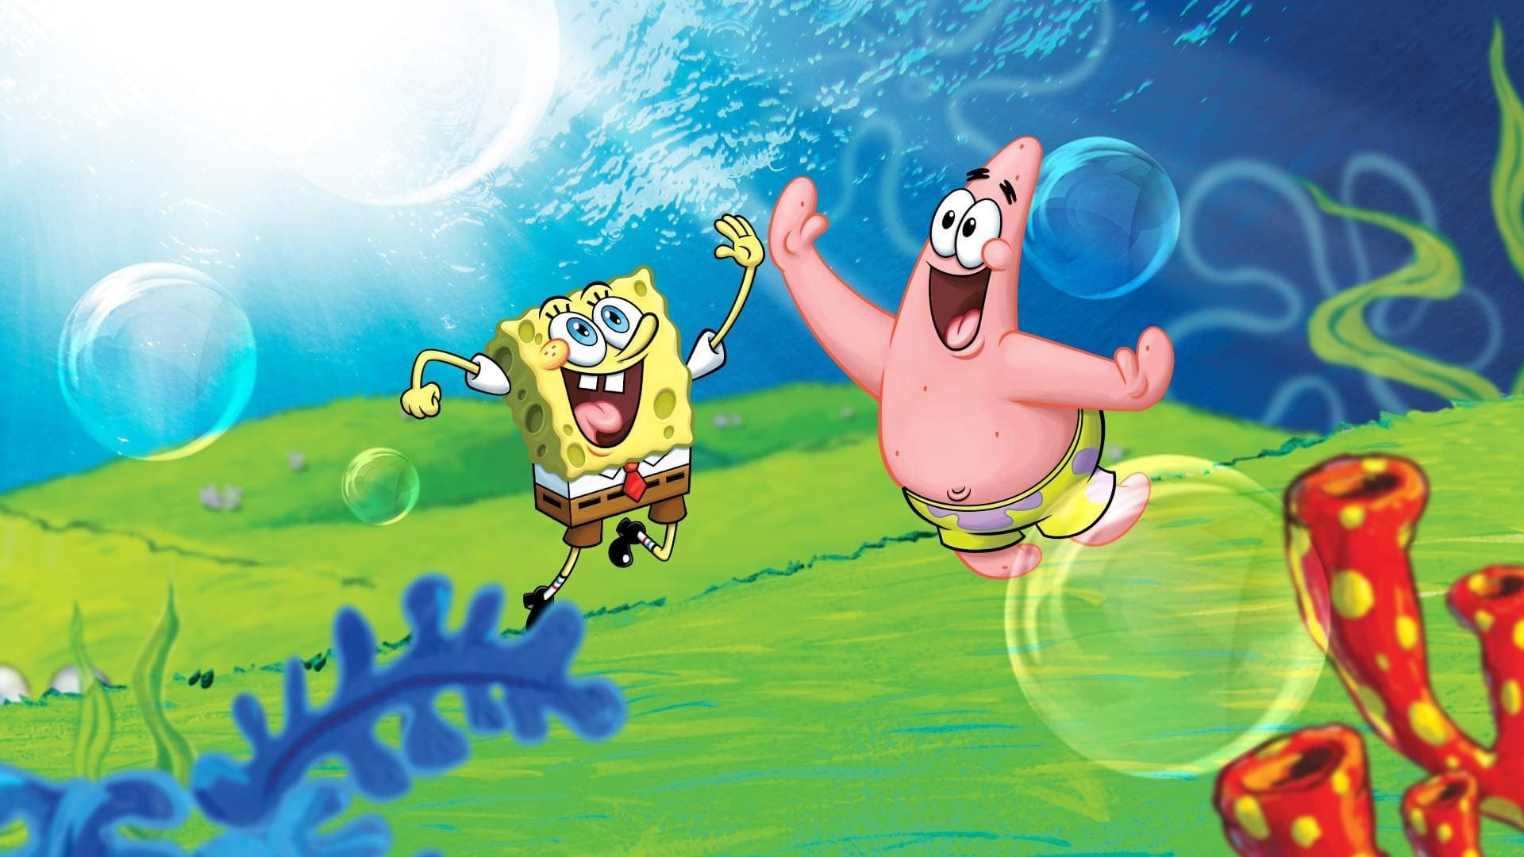
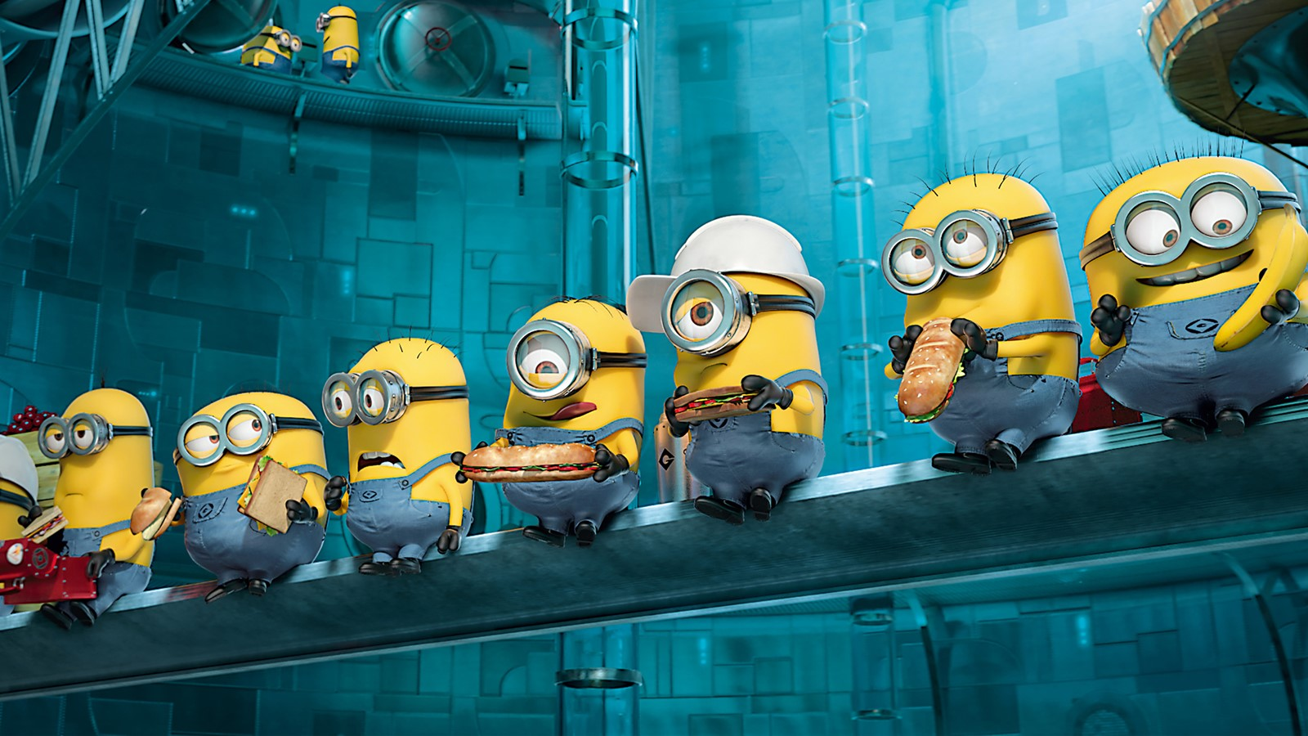
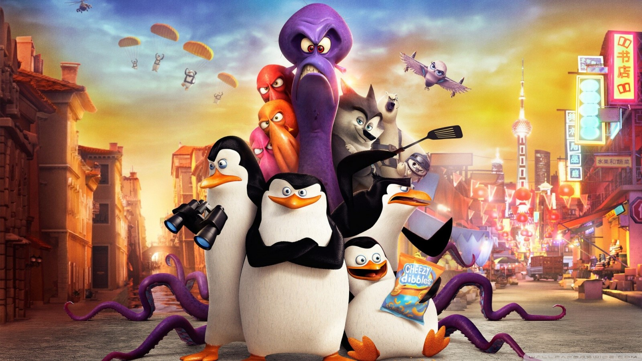
Skipper, Kowalski, Private, Rico
Po
Spongebob Squarepants,
Patrick Star
Bob, Kevin, Stuart
IrinaPapakhinac

Slide 5
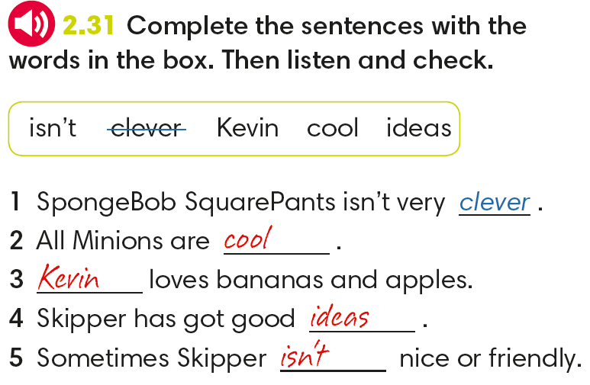
IrinaPapakhinac

Slide 6
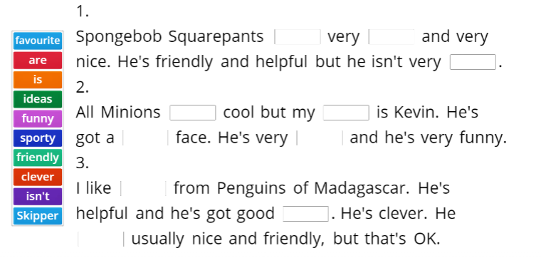
IrinaPapakhinac

Slide 7
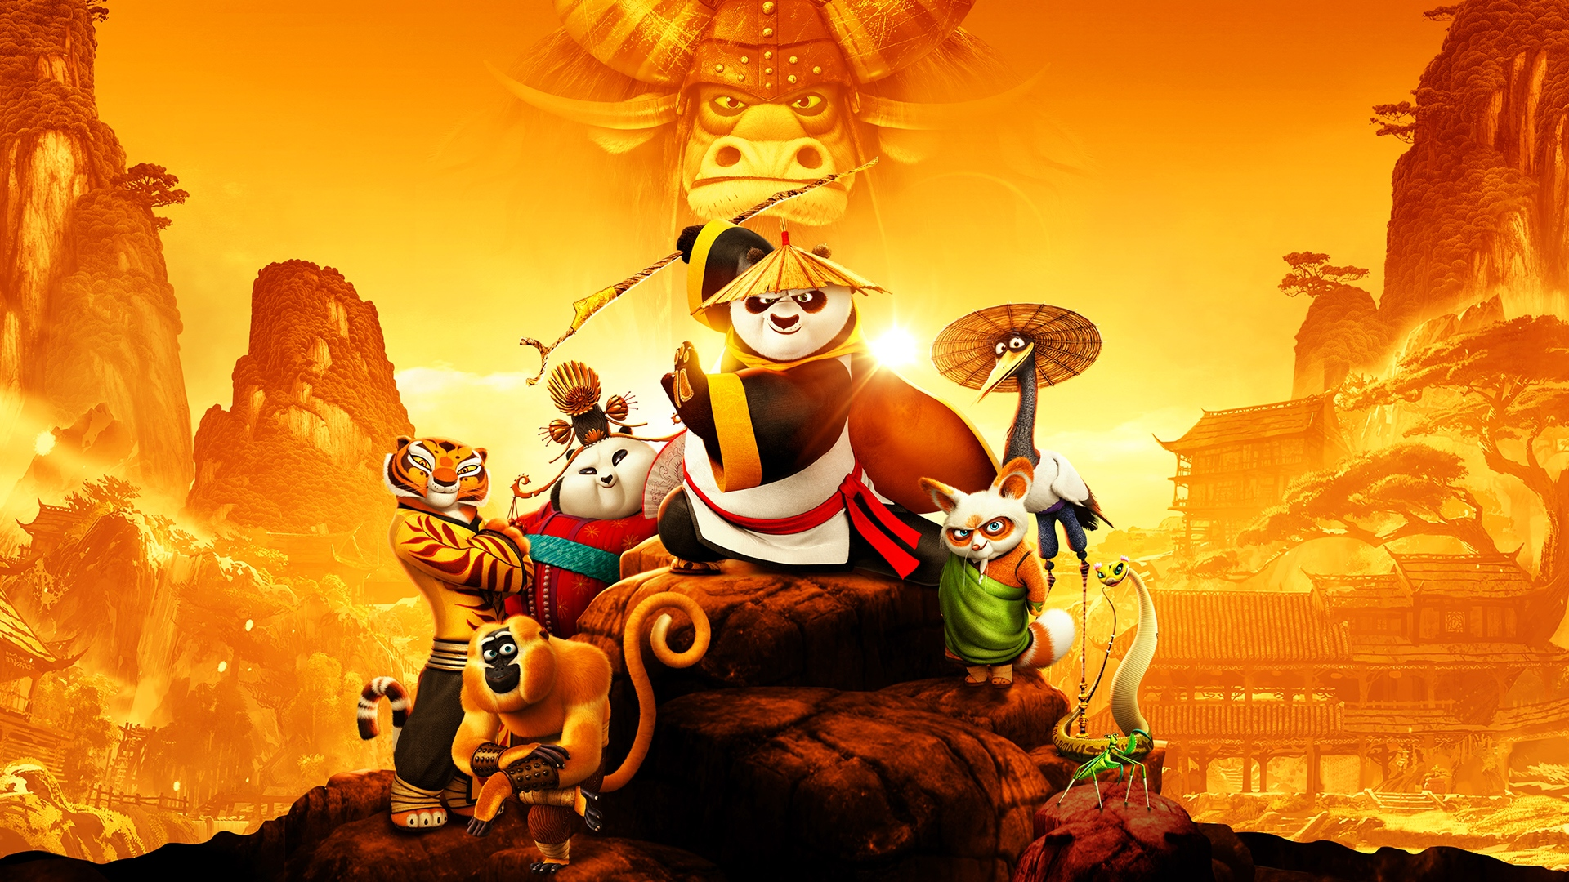
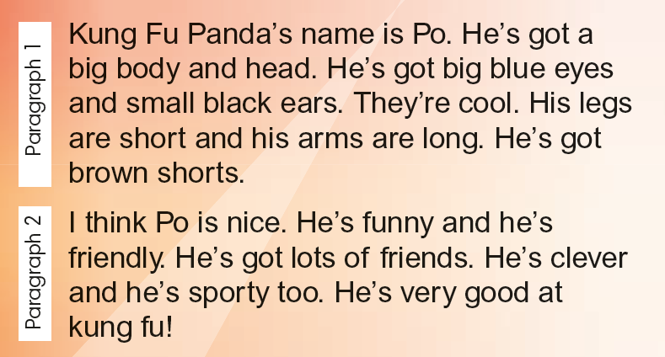

Read Lian’s web text about her favourite cartoon character.
Can you guess this character?
IrinaPapakhinac

Slide 8
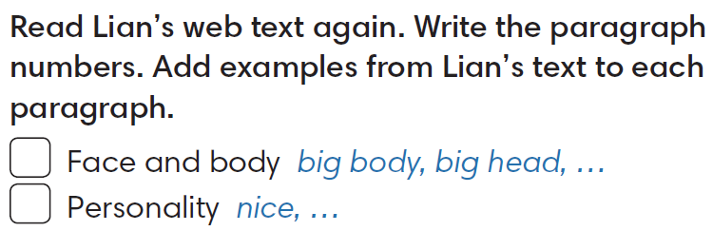
1
2
IrinaPapakhinac

Slide 9

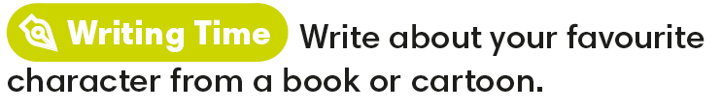
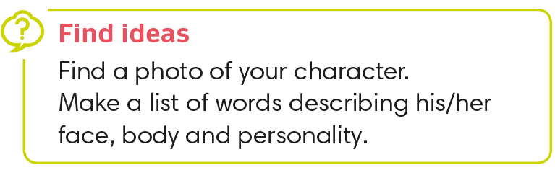
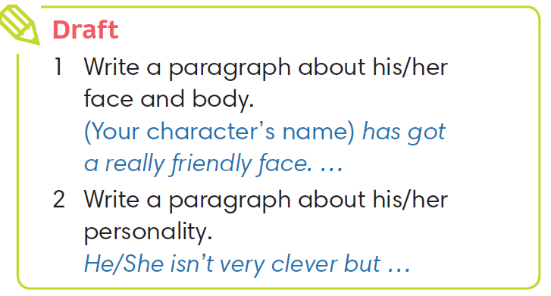

Slide 10
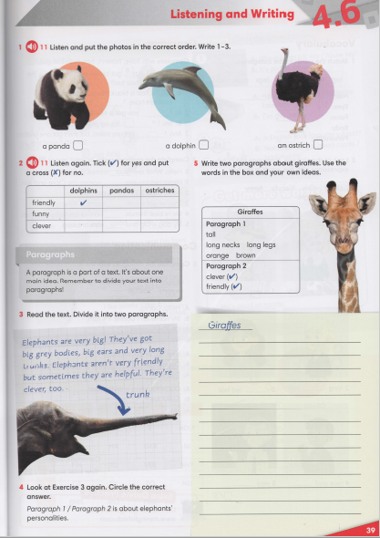

Slide 11
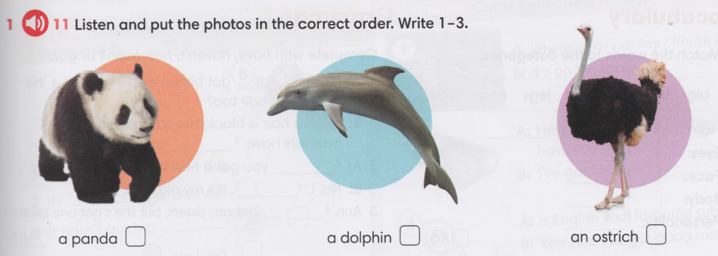
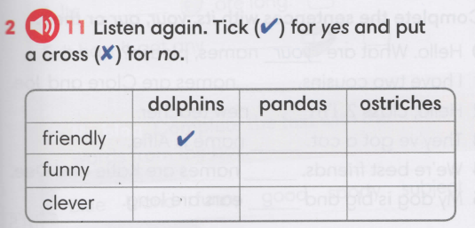


2
1
3

Slide 12
