Slide 1
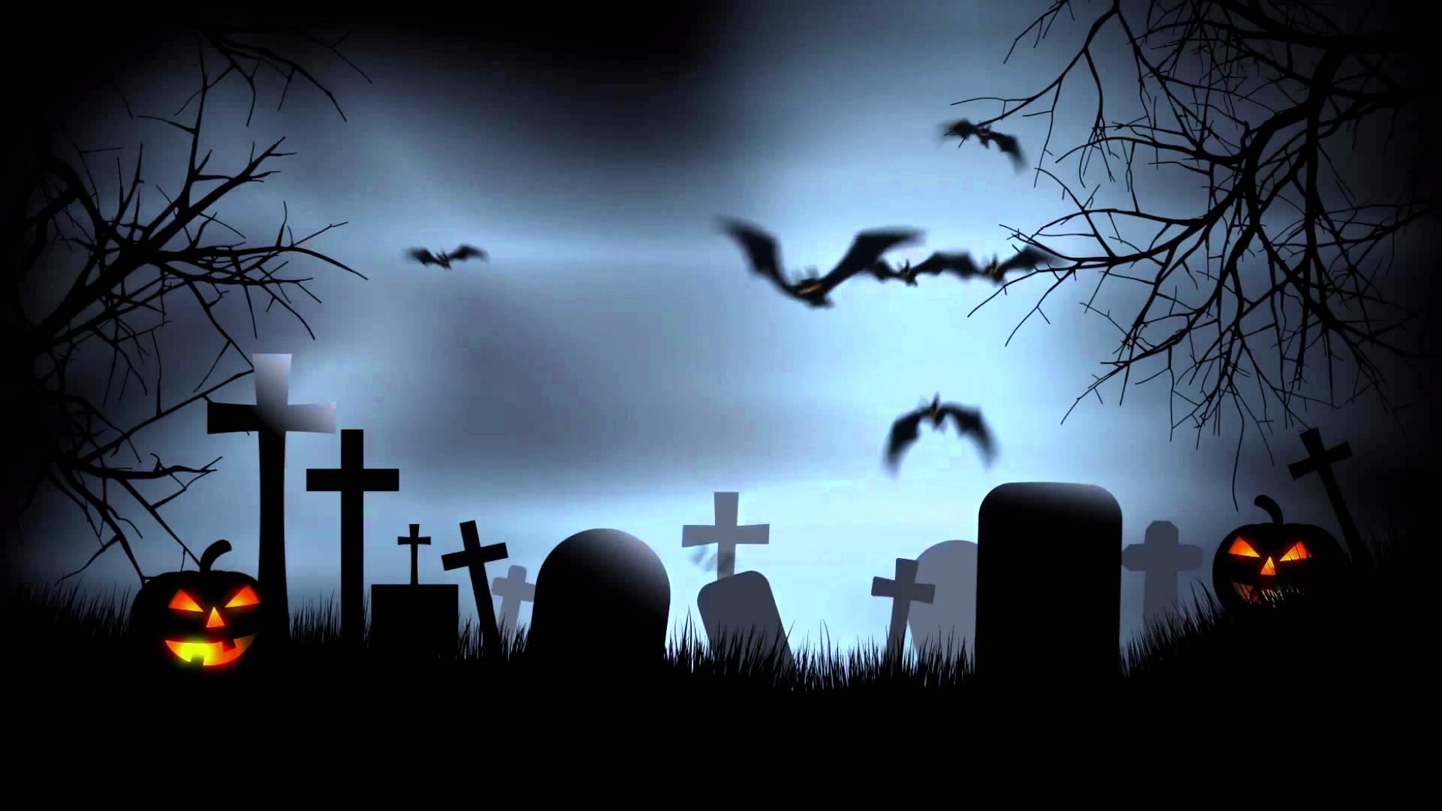




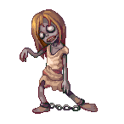
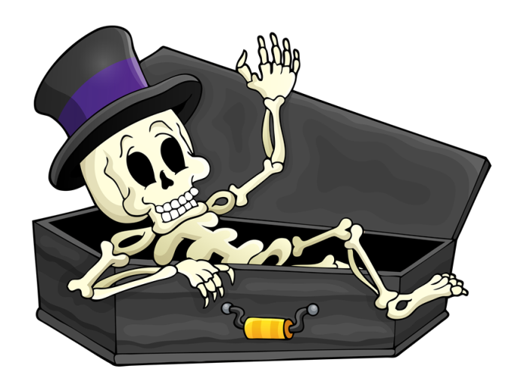

Determiners and personal pronouns

Slide 2
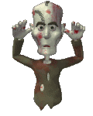








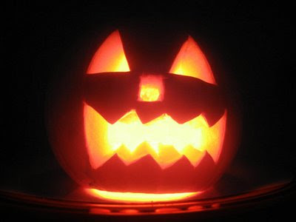

Luke and I are wearing the same costume.
____ are vampires.
We
us
we
our
next
Click on the right zombie
1/10

Slide 3

him
Joe was at the party but I couldn’t find ____.
he
him
his
next
Click on the right zombie
2/10

Slide 4
I
Paul and ____ always go trick or treating together.
me
I
my
next
Click on the right zombie
3/10

Slide 5
me
He told ____ that he was in danger.
I
me
my
next
Click on the right zombie
4/10

Slide 6
Nancy has made his brother jump. ____ is crying.
He
him
he
his
next
Click on the right zombie
5/10

Slide 7
us
My dad gave ____ a torch.
we
us
our
next
Click on the right zombie
6/10

Slide 8
their
These are _______ Jack o’lanterns.
they
them
their
next
Click on the right zombie
7/10

Slide 9
my
Wait a moment! I’m looking for ____ mask.
I
me
my
next
Click on the right zombie
8/10

Slide 10
our
Greg and I are brothers. That is _____sister.
we
our
us
next
Click on the right zombie
9/10

Slide 11
Brian was really successful. Look at ____ candies!
his
he
him
his
exit
Click on the right zombie
10/10

