Slide 1
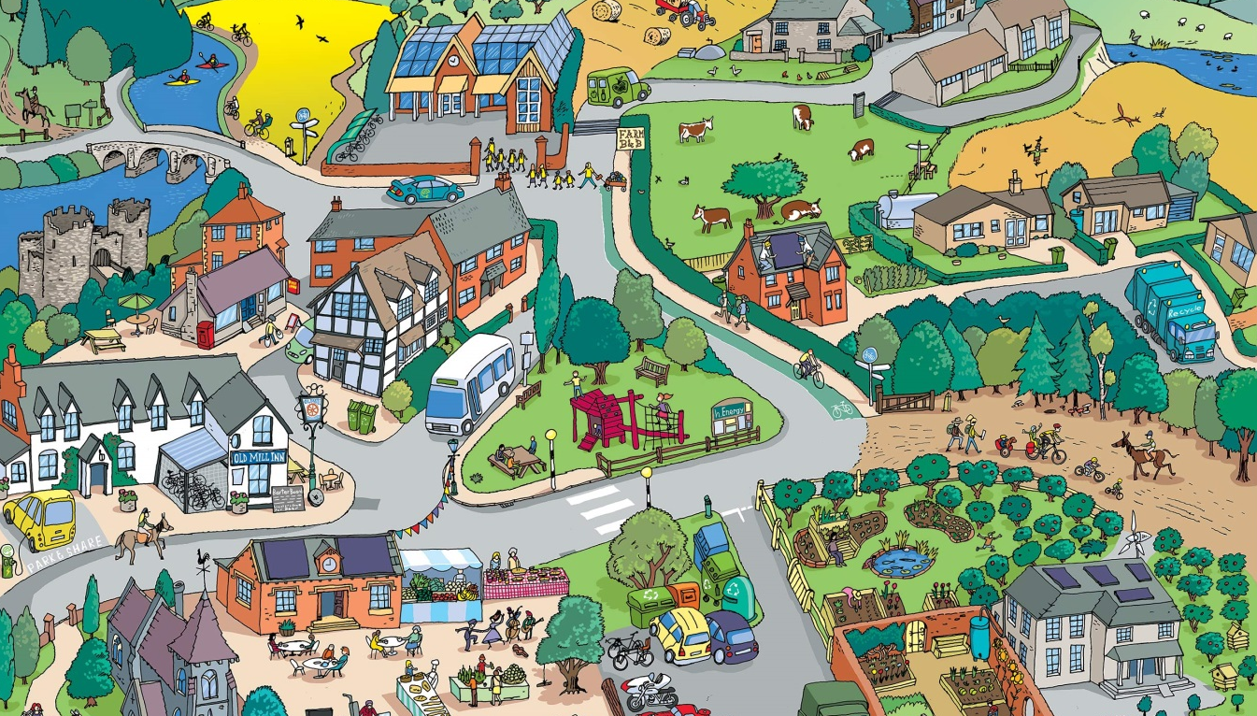





IrinaPapakhina

Slide 2

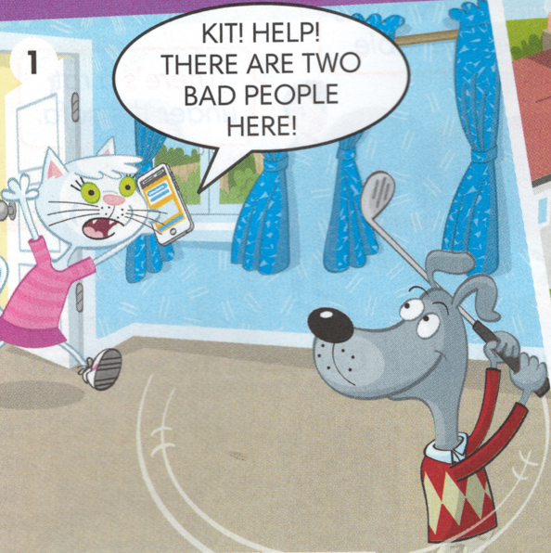
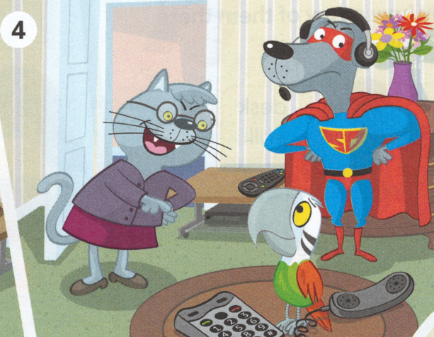
5. Who can you see in photo 4?
6. What is Dug wearing?
7. What is Granny wearing?
8. What colour is the parrot?
9. What is there in the room?
1. Who can you see in photo 1?
2. Do you remember their names?
3. Where are they?
4. How many windows are there?
Kit
Dug
IrinaPapakhina

Slide 3
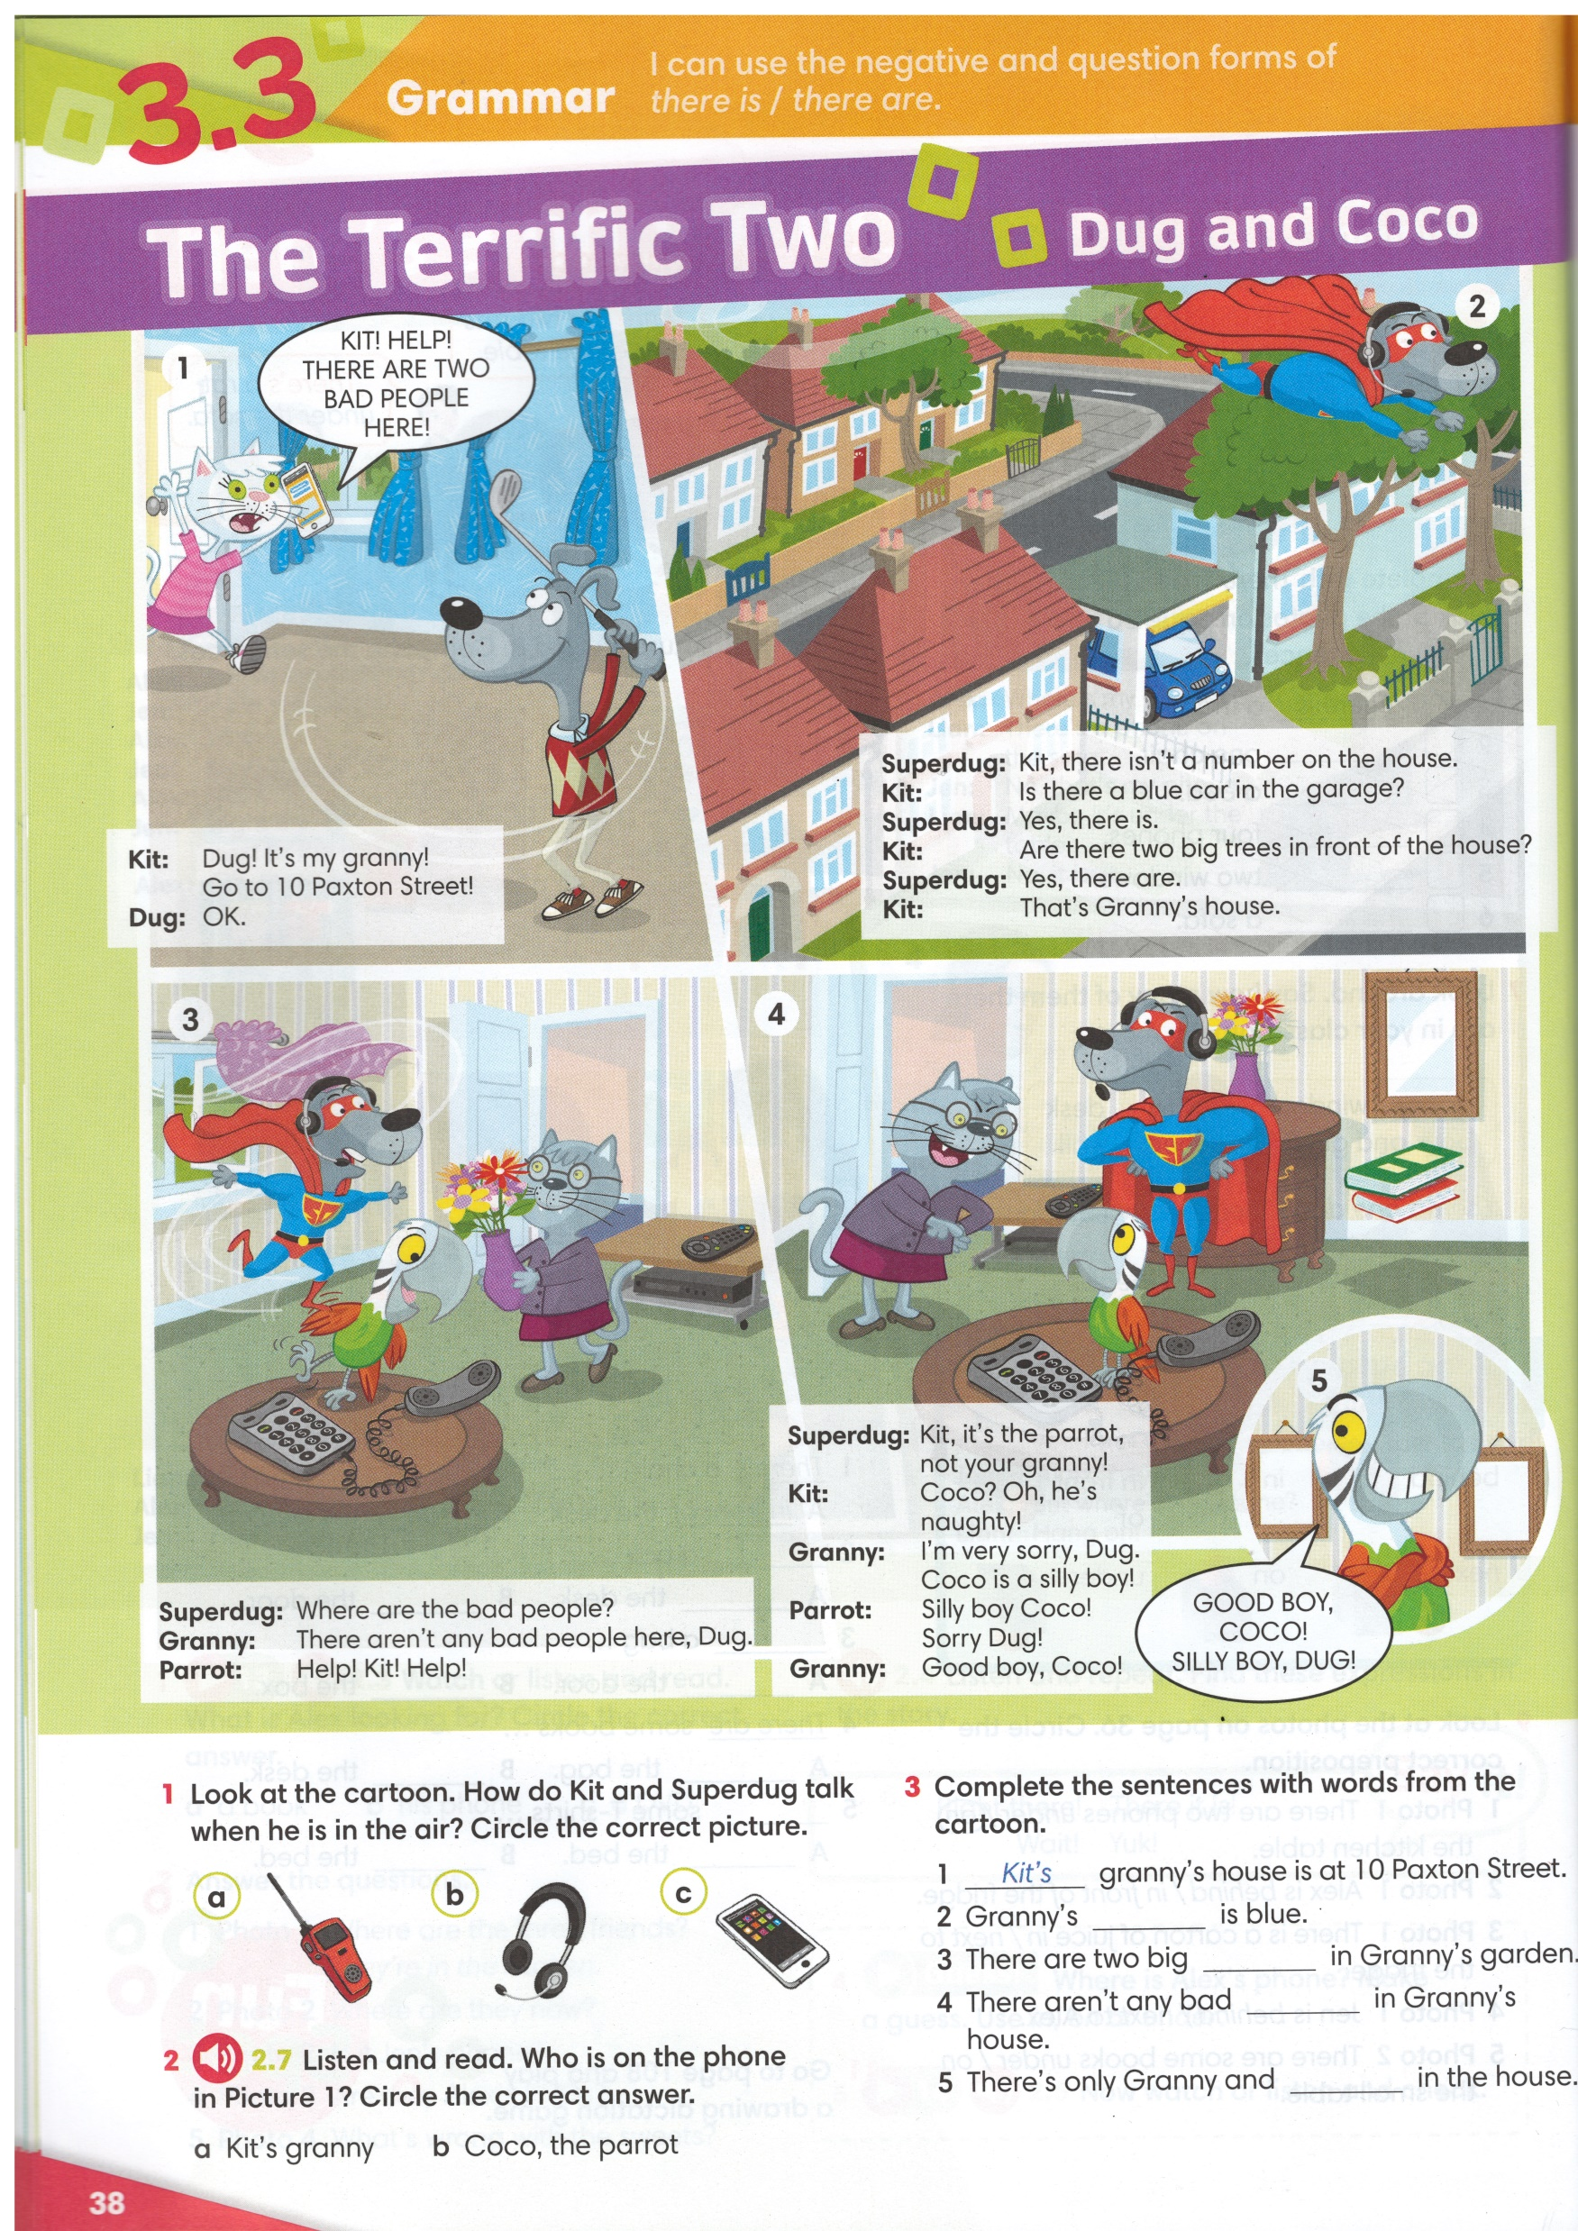

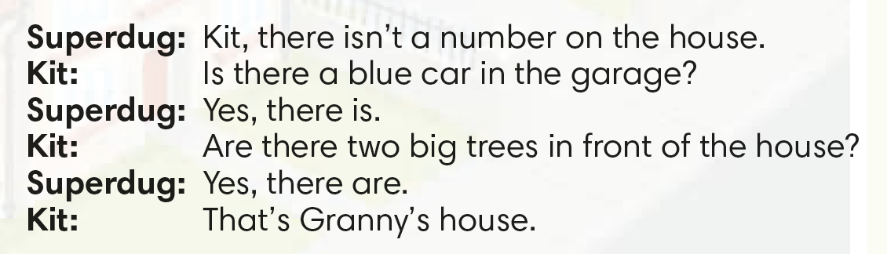
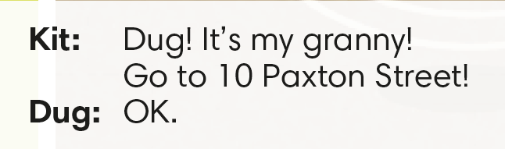
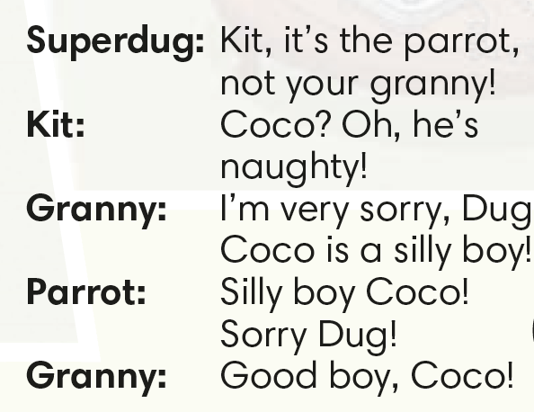
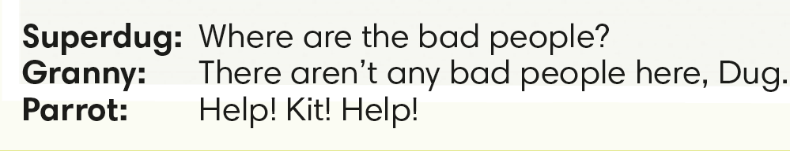
Read the dialogue and say
what the parrot’s name is.
Coco
IrinaPapakhina

Slide 4
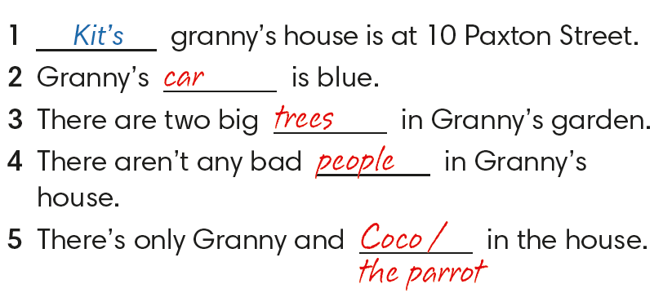
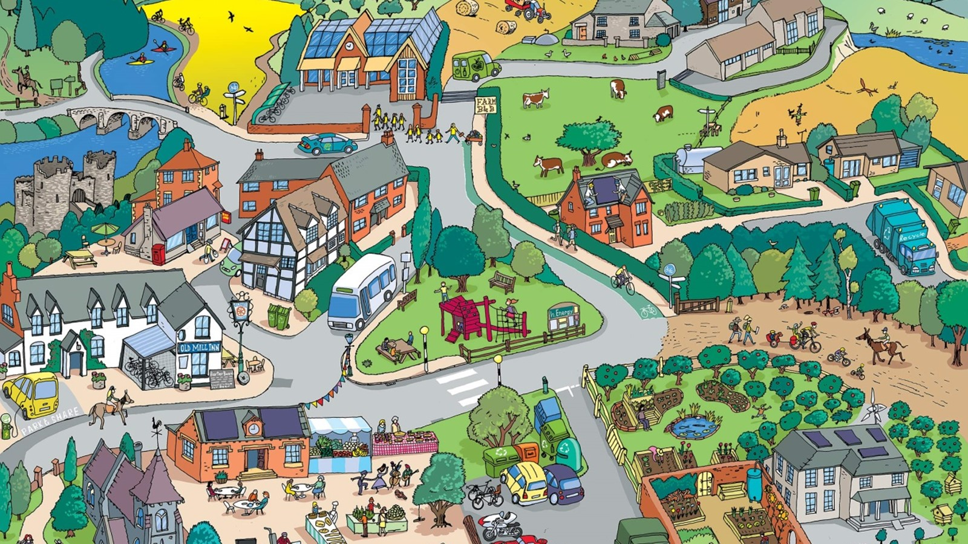
Complete the sentences
with the words from the cartoon.
IrinaPapakhina

Slide 5
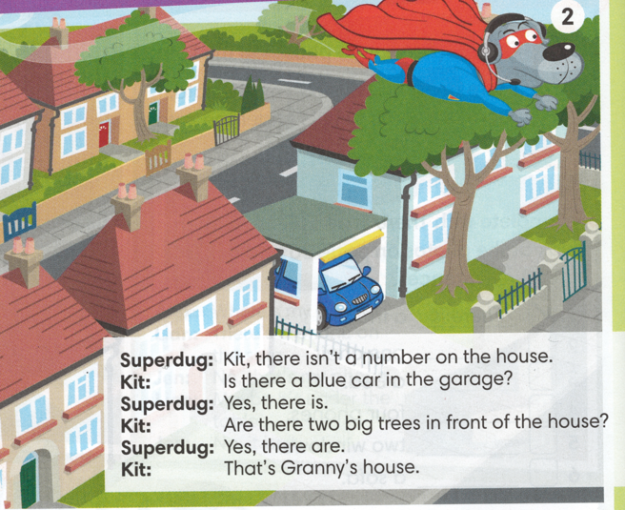
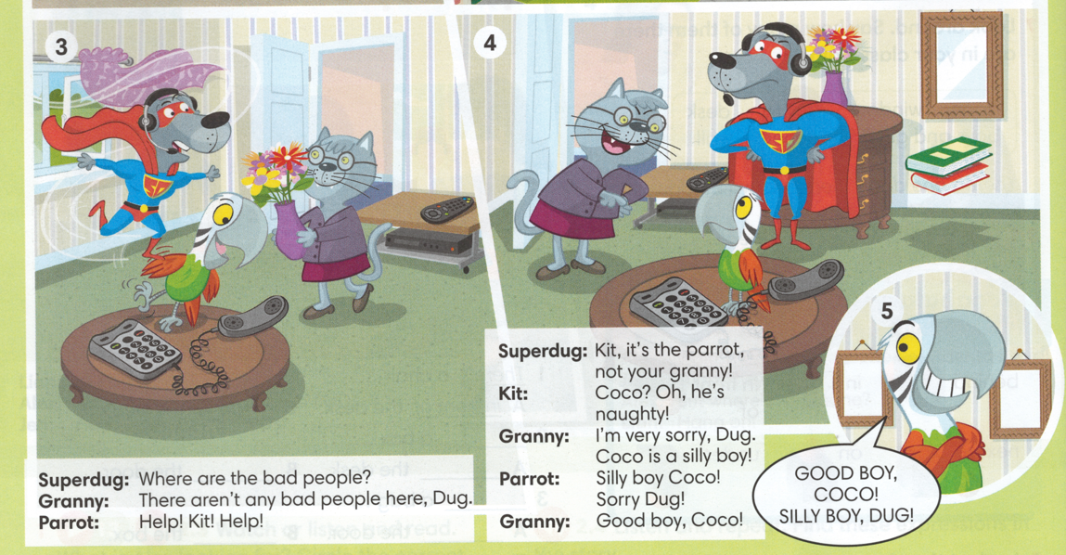
Complete the sentences.
there isn’t
Kit, _____________ a number on the house.
____________ a blue car in the garage?
____________ two big trees in front of the house?
____________ any bad people here, Dug.
Is there
Are there
There aren’t
IrinaPapakhina

Slide 6
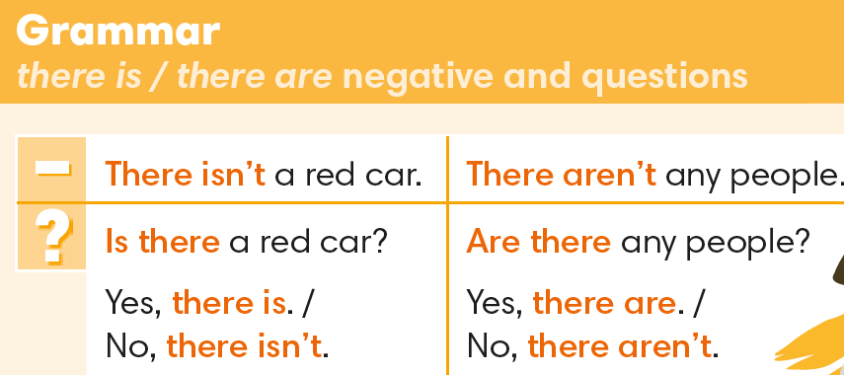
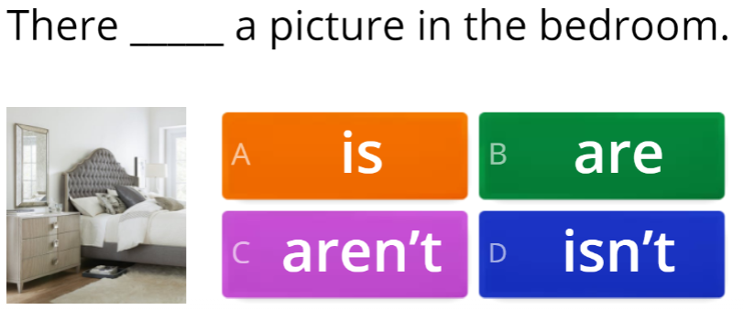
IrinaPapakhina

Slide 7
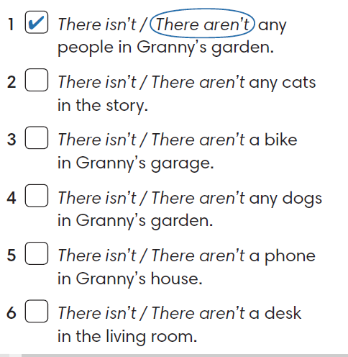


Circle the correct answer.
Look at the cartoon. Tick (V) the true sentences
and cross (X) the false sentences.
3. Correct the false sentences.
IrinaPapakhina

Slide 8
Complete the sentences.
a
Kit, there isn’t _____ number on the house.
There aren’t _____ bad people here, Dug.
any
IrinaPapakhina

Slide 9



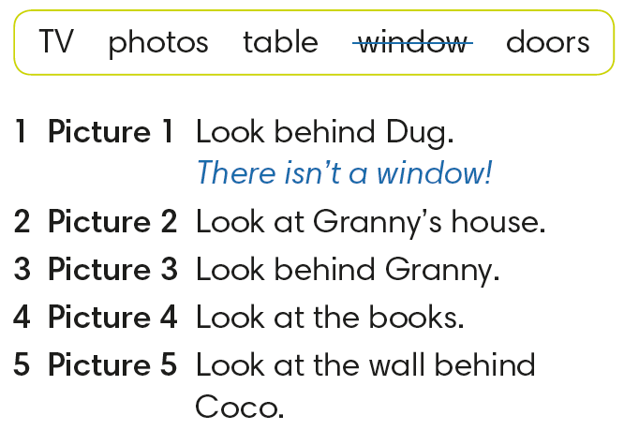



IrinaPapakhina

Slide 10
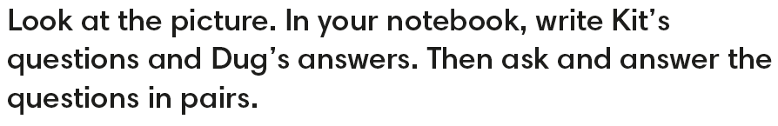
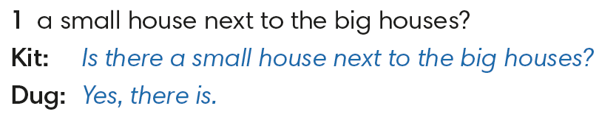
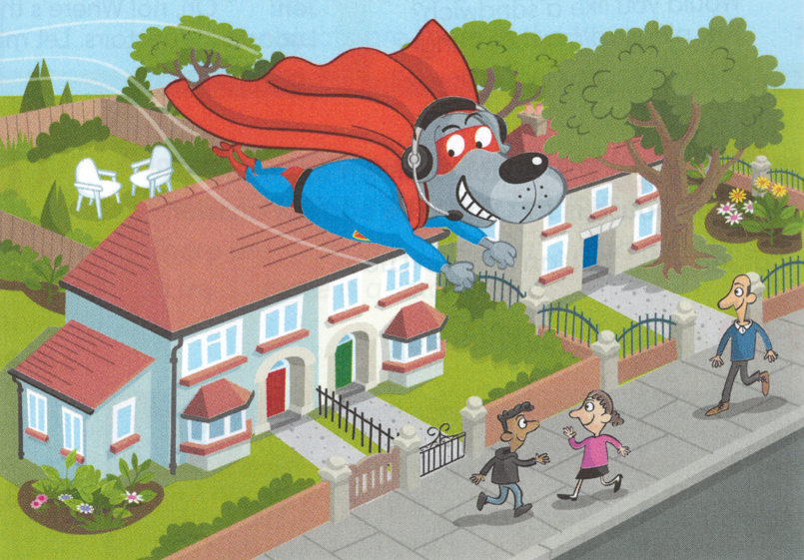
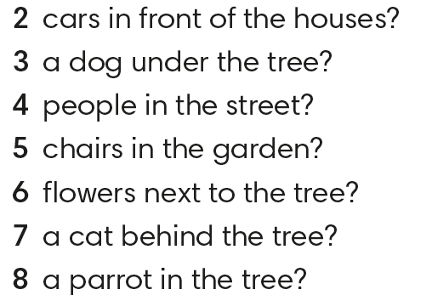
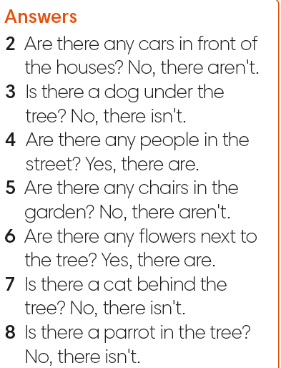
IrinaPapakhina

Slide 11
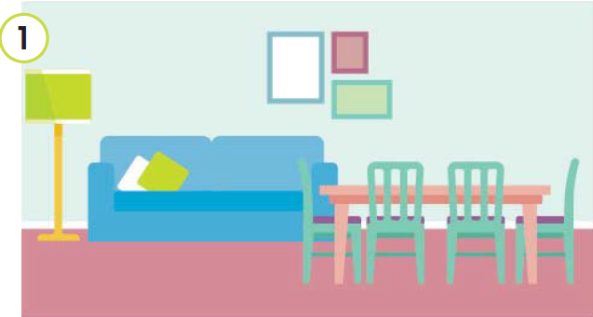
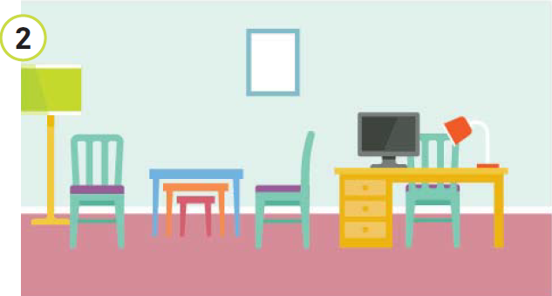
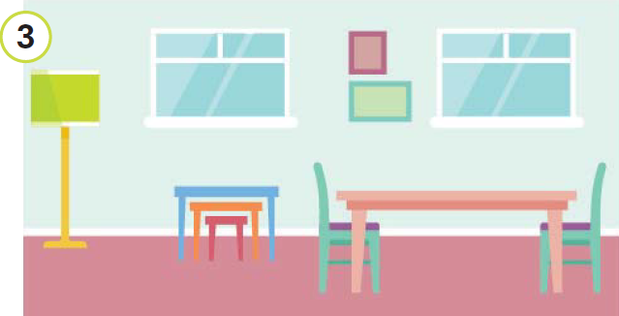
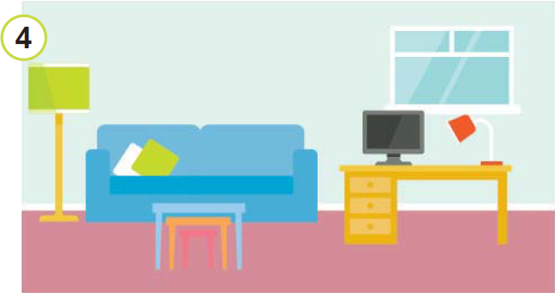
There isn’t a computer.
There aren’t any windows.
IrinaPapakhina

Slide 12
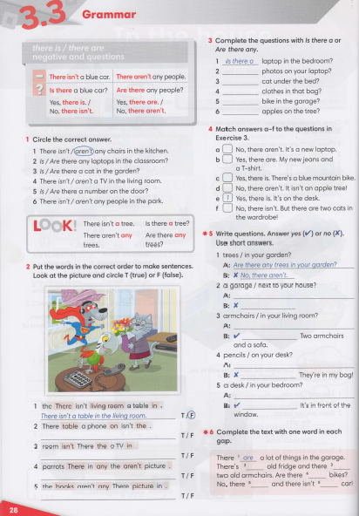


IrinaPapakhina

Slide 13
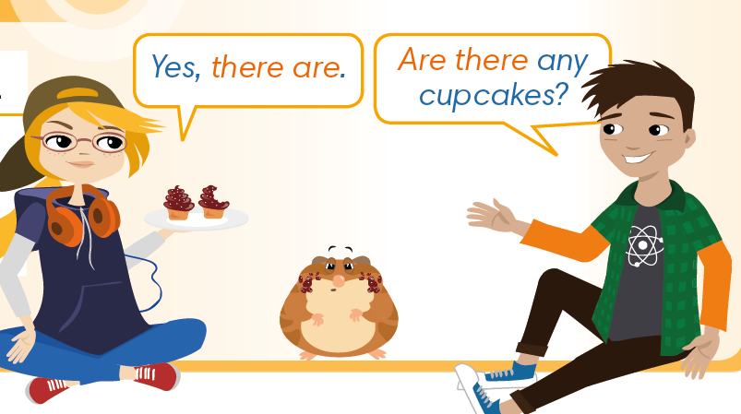
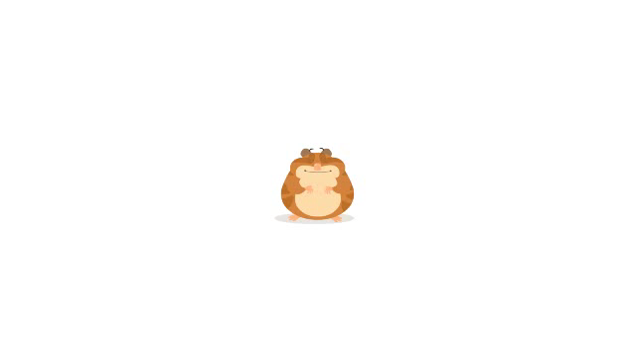
1. What is Anna’s answer?
2. Watch the video and check.
IrinaPapakhina

Slide 14
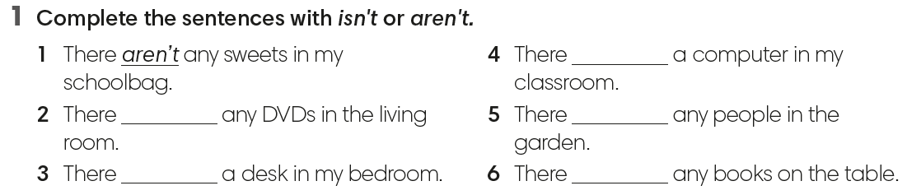
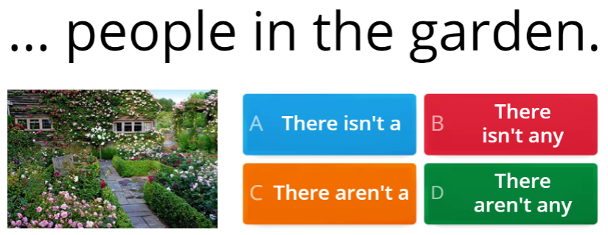
IrinaPapakhina

Slide 15
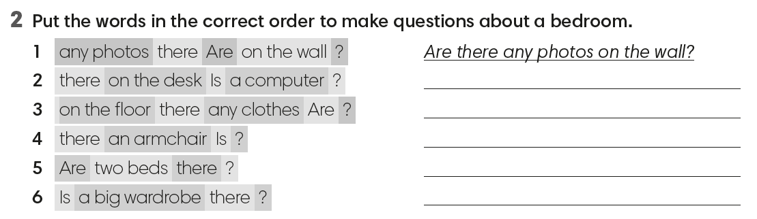
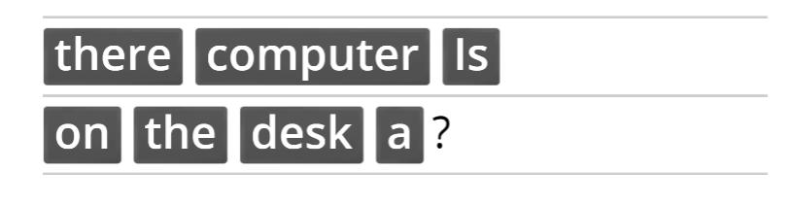
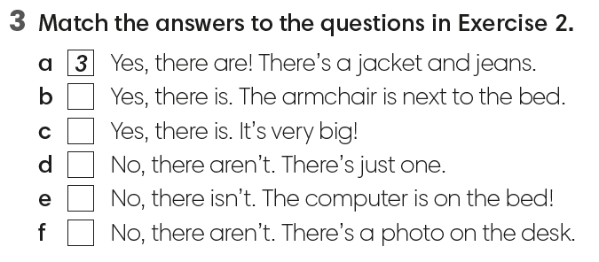
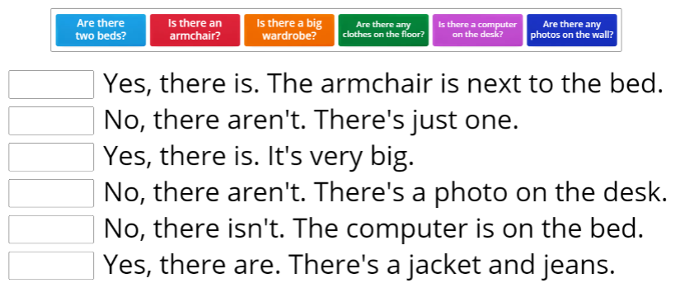
IrinaPapakhina

Slide 16
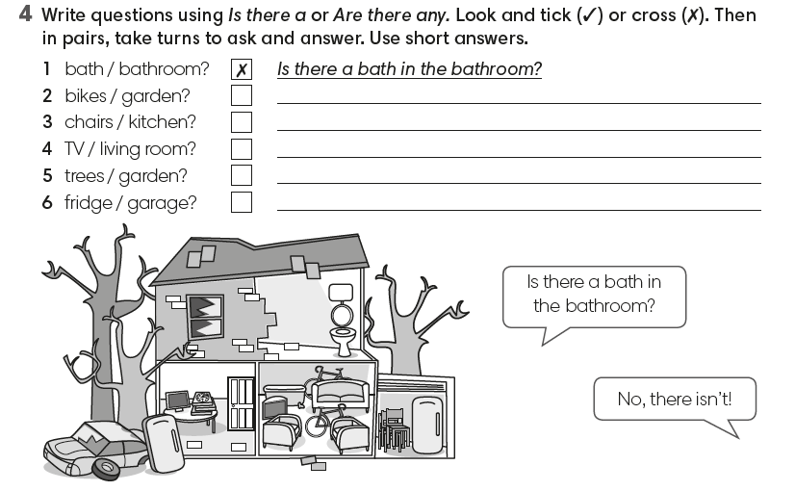
Are there any bikes in the garden?
- No, there aren’t.
Are there any chairs in the kitchen?
- No, there aren’t.
Is there a TV in the living room?
- Yes, there is.
Are there any trees in the garden?
- Yes, there are.
Is there a fridge in the garage?
- Yes, there is.
IrinaPapakhina

