Slide 1

Introduction to Biology: Understanding Life
Notes:
Created from: https://app.briskteaching.com/onboarding_try_video

Slide 2

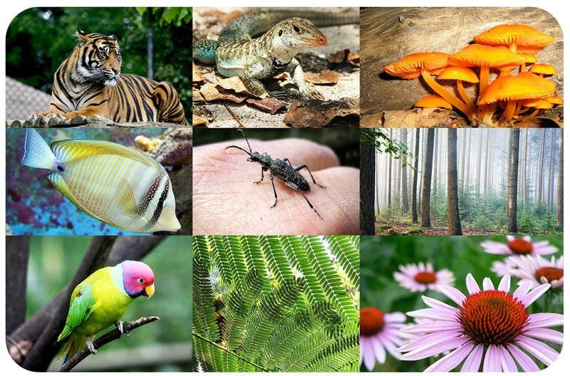
What is Life?
Life began around 4 billion years ago.
Biology is the study of life in all its forms and processes.
Life is diverse: from tiny bacteria to massive whales.
Why study biology? To develop medicines, understand ecosystems, and more.

Slide 3

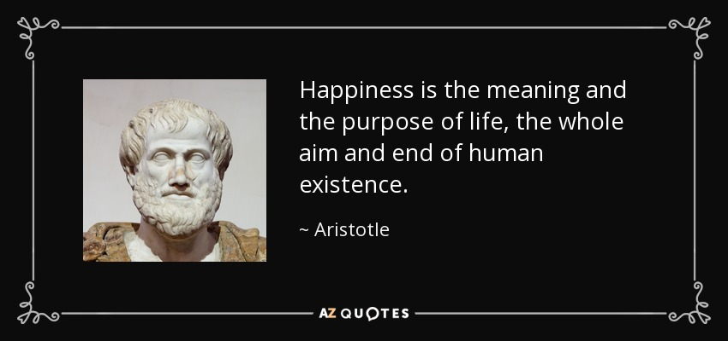
Defining Life
Aristotle's early definition: growth, reproduction, and reaction to forces.
Modern definition: self-sustaining chemical systems capable of evolution.
NASA's definition for extraterrestrial life: "A self-sustaining chemical system capable of evolution."

Slide 4

Characteristics of Life
Regulation: Maintaining internal stability.
Response to environment: Reacting to external stimuli.
Reproduction: Passing genetic information to offspring.
Growth and development: Following genetic instructions.

Slide 5

More Characteristics of Life
Energy processing: Using energy to perform activities.
Organization: Structured from cells to tissues to organs.
Adaptations: Traits shaped by evolution to survive and reproduce.

Slide 6
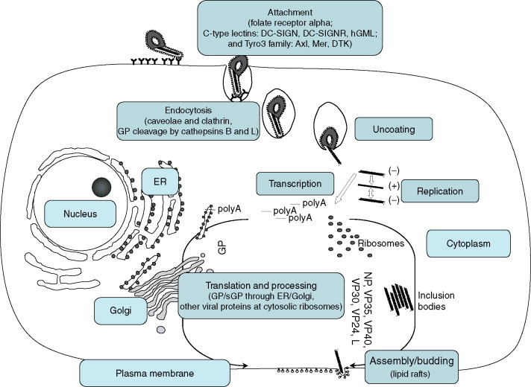
Gray Areas: Viruses
Viruses: Tiny bundles of genes in protein jackets.
Not alive on their own: Can't reproduce or process energy without a host.
Seem alive when infecting a host: Replicate and evolve.
Most biologists consider viruses not alive.

Slide 7
Astrobiology: Life Beyond Earth
Astrobiology: Study of potential extraterrestrial life.
Examines extreme life forms on Earth for clues.
Future discoveries may change our definition of life.

