Slide 1

Understanding French Music and Culture
Notes:
Created from: https://www.youtube.com/watch?v=V1bFr2SWP1I&list=RDV1bFr2SWP1I&start_radio=1

Slide 2

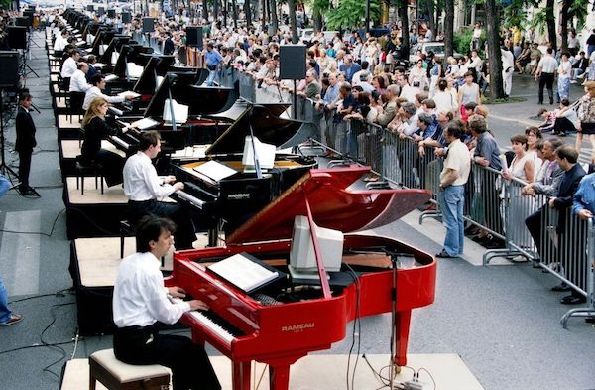
Introduction to French Music
French music is diverse and rich in history.
It includes various genres such as classical, pop, and traditional.
This presentation will explore the cultural significance of French music.

Slide 3

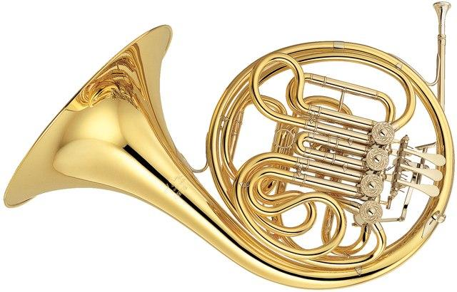
Genres of French Music
Classical: Influential composers like Debussy and Ravel.
Pop: Modern artists like Stromae and Christine and the Queens.
Traditional: Folk music from different regions of France.

Slide 4

Influence of French Music Globally
French music has influenced global music trends.
French artists often collaborate with international musicians.
French music festivals attract global audiences.

Slide 5
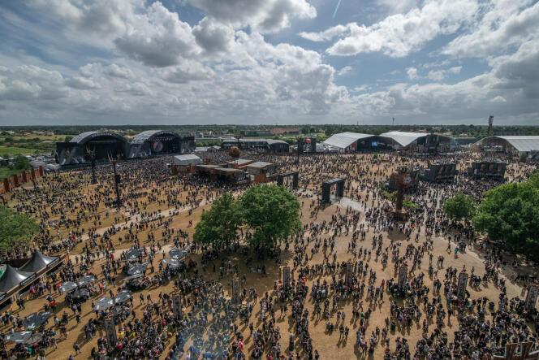
Key French Music Festivals
Cannes Film Festival: Includes music performances.
Fête de la Musique: Celebrated worldwide.
Les Vieilles Charrues: One of the largest music festivals in France.

Slide 6
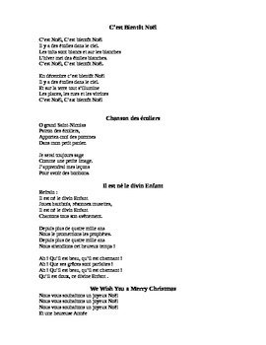
Understanding French Lyrics
Lyrics often reflect French culture and societal issues.
Common themes include love, politics, and daily life.
Learning French through music can be an engaging way to understand the language.

Slide 7
Popular French Songs
"La Vie en Rose" by Édith Piaf: A classic love song.
"Alors on Danse" by Stromae: A modern hit.
"Je te promets" by Johnny Hallyday: A romantic ballad.

Slide 8
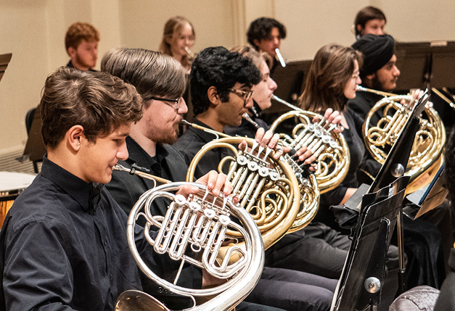
Impact of French Music on Youth
French music often addresses issues relevant to young people.
It can influence fashion, language, and attitudes.
Music is a way for youth to express their identity.

Slide 9

Learning French Through Music
Listening to French songs can improve language skills.
It helps with pronunciation and vocabulary.
Music makes learning more enjoyable and memorable.

Slide 10
Discussion: Your Favorite French Song
What is your favorite French song and why?
How does it make you feel?
What have you learned from its lyrics?

Slide 11
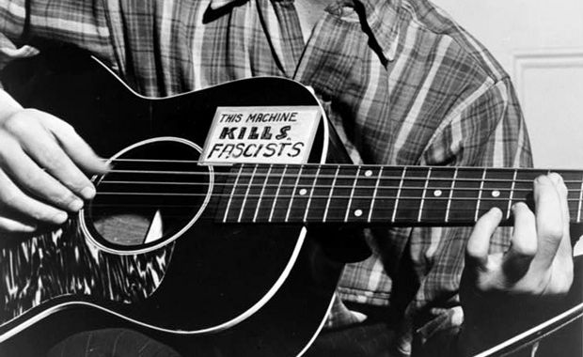
Conclusion: The Power of Music
French music is a powerful cultural tool.
It connects people and transcends language barriers.
Explore more French music to deepen your understanding of the culture.

